Slide 1

Recognition Methods for
Open-Universe Datasets
Lana Lazebnik

Slide 2
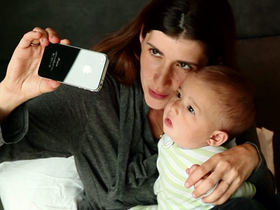
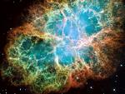

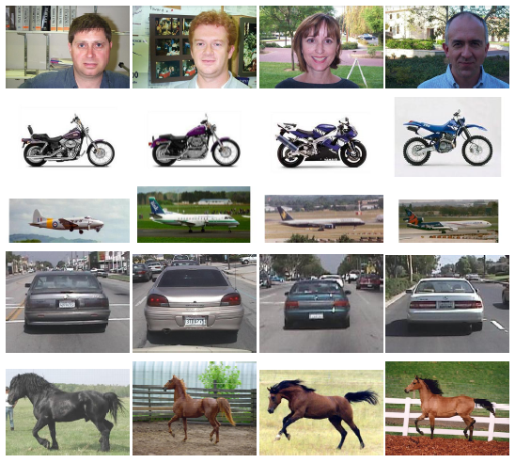


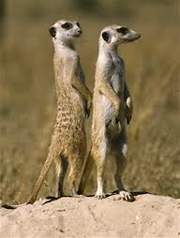

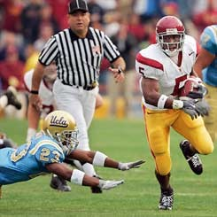
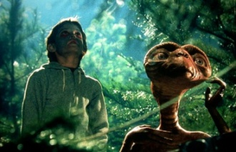






Closed-universe datasets
Open-universe datasets
  Small amount of data
  Static datasets
  Limited variation
  Full annotation
  Large amount of data
  Evolving datasets
  Wide variation
  Incomplete annotation

Slide 3
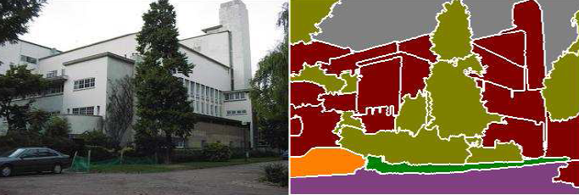




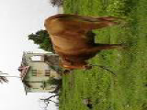

Closed-universe recognition
Fixed, pre-defined set of classes
Test image
Fixed, static training set
Models
Learning
Inference
(offline)
Output
Notes:
In a closed-universe setting, we would begin by making a short list of all the possible classes we can expect to see at test time, and learn a separate model for each class. [Explain about possible types of models] If we wanted to add new classes or new examples for existing classes to the database, we would have to re-train all the models from scratch. So, the challenge is to have an approach that can very easily accommodate evolving datasets and annotations.

Slide 4
Closed-universe datasets
Open-universe datasets
  Small amount of data
  Static datasets
  Limited variation
  Full annotation
  Large amount of data
  Evolving datasets
  Wide variation
  Incomplete annotation

Slide 5
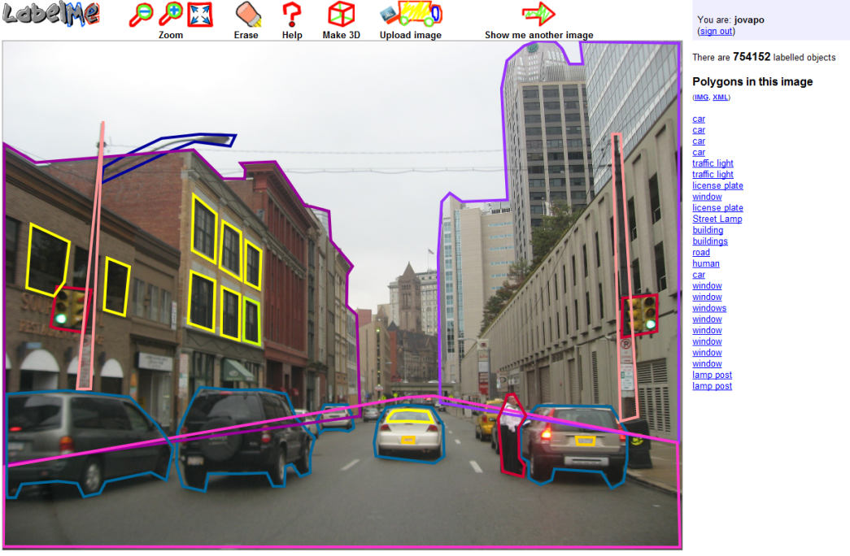
Open-universe recognition
Evolving training set
http://labelme.csail.mit.edu/

Slide 6
Open-universe recognition
Very large/open-ended set of classes
…

Slide 7
Open-universe recognition
Very large/open-ended set of classes
…
Unbalanced data distribution

Slide 8
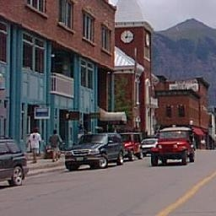
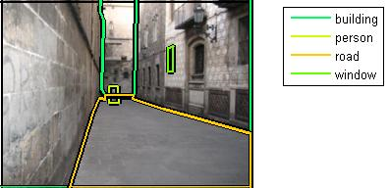
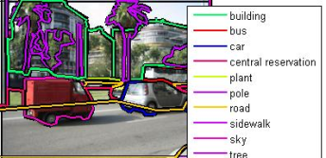
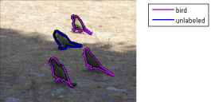
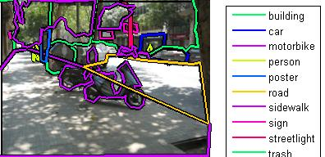
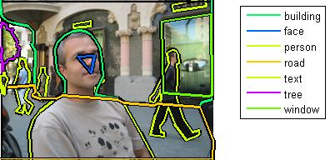
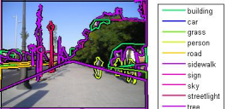
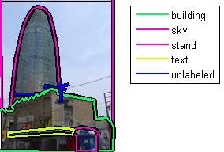
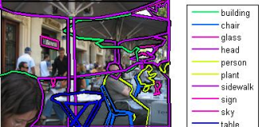
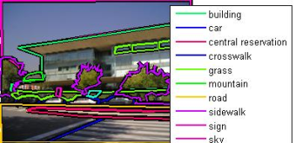
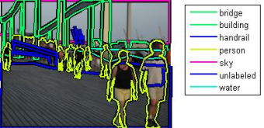
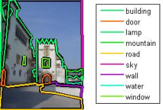
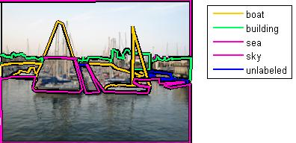
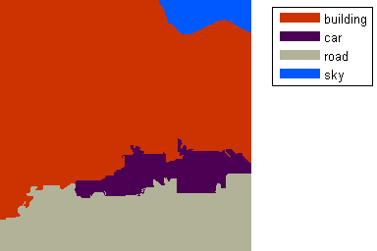
Potential solution: Lazy learning
Test image
On-the-fly inference
sky
building
Training set
car
road

Slide 9
Our approach
Lazy learning: do (almost) nothing at training time
At test time:
  Find a retrieval set of similar images for each query image
  Transfer labels from the retrieval set by matching segmentation regions (superpixels)
Related work: SIFT Flow
  C. Liu, J. Yuen, and A. Torralba, “Nonparametric Scene Parsing via Label Transfer,” PAMI 2011

Slide 10
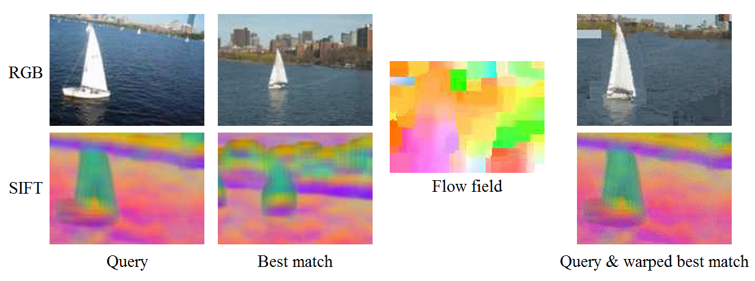
Dense Scene Alignment by SIFT Flow
Warped best match
  C. Liu, J. Yuen, and A. Torralba, “Nonparametric Scene Parsing via Label Transfer,” PAMI 2011

Slide 11
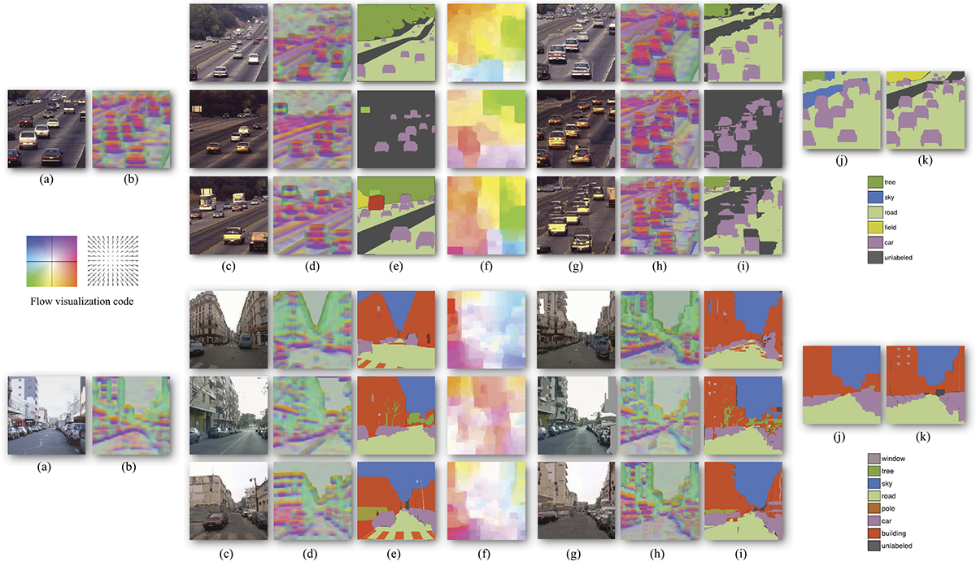
Dense Scene Alignment by SIFT Flow
Top scene matches
Labels
SIFT Flow
Warped matches and labels
Final labels
Ground truth
Test image (SIFT)
  C. Liu, J. Yuen, and A. Torralba, “Nonparametric Scene Parsing via Label Transfer,” PAMI 2011

Slide 12
Dense Scene Alignment by SIFT Flow
Top scene matches
Labels
SIFT Flow
Warped matches and labels
Final labels
Ground truth
Test image (SIFT)
  C. Liu, J. Yuen, and A. Torralba, “Nonparametric Scene Parsing via Label Transfer,” PAMI 2011

Slide 13
SIFT Flow: Pros and cons
Advantages
  Nonparametric method, can work with any number of labels, evolving training set
  Initial global scene matching step improves efficiency, provides scene-level context
Disadvantages
  Computing SIFT flow is very computationally intensive
  Warping model is not necessarily the most natural one for describing object-level correspondence

Slide 14


Large-Scale Nonparametric Image Parsing
Joseph Tighe and Svetlana Lazebnik
ECCV 2010, new stuff in preparation
sky
building
car
road

Slide 15
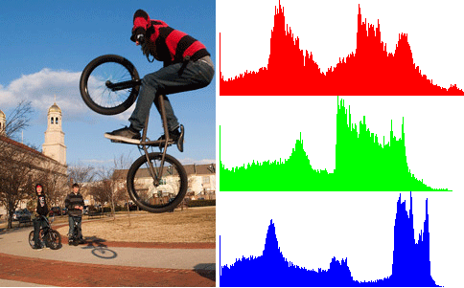
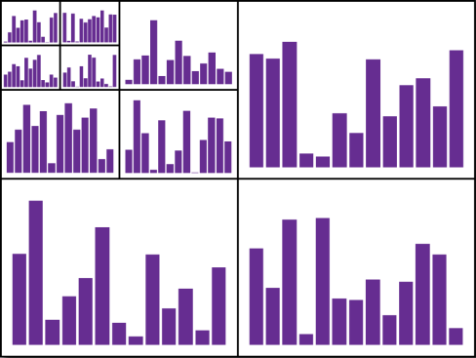
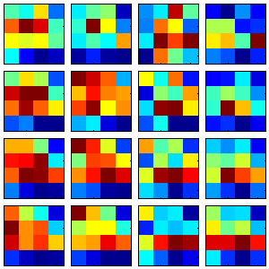
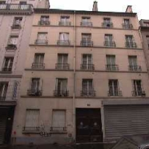
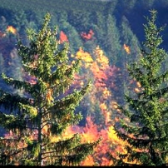
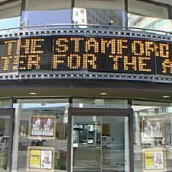

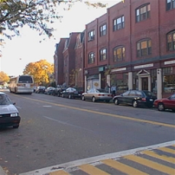
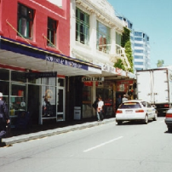
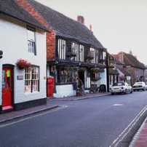
Step 1: Scene-level matching
Color Histogram
Spatial Pyramid
(Lazebnik et al., 2006)
Gist
(Oliva & Torralba, 2001)
Notes:
Retrieval set:
Source of possible labels
Source of region-level matches

Slide 16
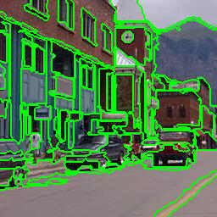
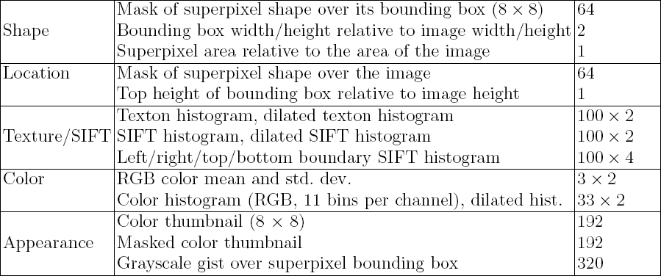
Step 2: Region-level matching
Superpixel features
Superpixels
(Felzenszwalb & Huttenlocher, 2004)

Slide 17



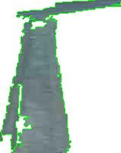





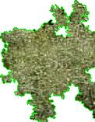

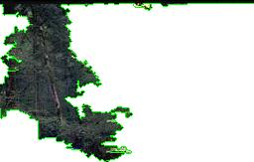
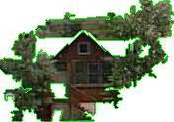

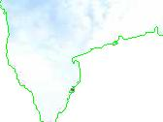
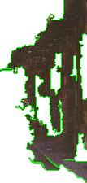

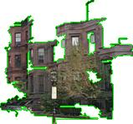
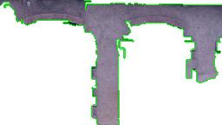

Step 2: Region-level matching
Road
Tree
Pixel Area (size)
Sky
Building
Snow

Slide 18

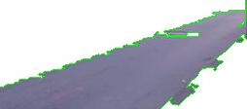














Step 2: Region-level matching
Road
Absolute mask
(location)
Sidewalk

Slide 19

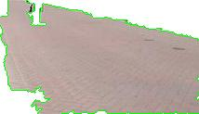
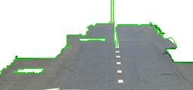


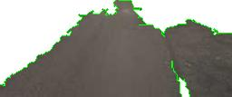
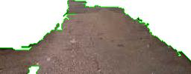

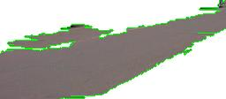







Step 2: Region-level matching
Road
Texture
Sidewalk
Snow
Sky

Slide 20






Step 2: Region-level matching
Road
Sidewalk
Color histogram
Building

Slide 21
Region-level likelihoods
Nonparametric estimate of class-conditional densities for each class c and feature type k:
Per-feature likelihoods combined via Naïve Bayes:
Features of class c within some radius of r_{i}
Total features of class c in the dataset
kth feature type
of ith region

Slide 22







Region-level likelihoods
Building
Car
Crosswalk
Road
Window
Sky

Slide 23

Step 3: Global image labeling
Compute a global image labeling by optimizing a Markov random field (MRF) energy function:
Vector of region labels
Regions
Likelihood score for
region r_{i} and label c_{i}
Neighboring regions
Smoothing penalty
Co-occurrence penalty
Efficient approximate minimization using α-expansion (Boykov et al., 2002)
r_{i}
r_{j}

Slide 24
Step 3: Global image labeling
Compute a global image labeling by optimizing a Markov random field (MRF) energy function:
Vector of region labels
Regions
Likelihood score for
region r_{i} and label c_{i}
Neighboring regions
Smoothing penalty
Co-occurrence penalty

Slide 25



Step 3: Global image labeling
Compute a global image labeling by optimizing a Markov random field (MRF) energy function:
Vector of region labels
Regions
Likelihood score for
region r_{i} and label c_{i}
Neighboring regions
Smoothing penalty
Co-occurrence penalty
Maximum likelihood labeling
Edge penalties
Final labeling
Final edge penalties
sky
sky
building
building
window
car
car
road
road

Slide 26




Step 3: Global image labeling
Compute a global image labeling by optimizing a Markov random field (MRF) energy function:
Vector of region labels
Regions
Likelihood score for
region r_{i} and label c_{i}
Neighboring regions
Smoothing penalty
Co-occurrence penalty
Maximum likelihood labeling
Original image
Edge penalties
MRF labeling
sky
sky
road
tree
sea
sea
road
sand
sand

Slide 27
Datasets
 | Training images | Test images | Labels
SIFT Flow (Liu et al., 2009) | 2,488 | 200 | 33
Barcelona | 14,871 | 279 | 170
LabelMe+SUN | 50,424 | 300 | 232
Notes:
I constructed the LM+SUN dataset by taking the data from the Sun dataset and all the available data from LabelMe. I then did manual synonym correction on both datasets to make 232 unique labels that both datasets share. I then added any image that had at least 10% of the pixels labeled. Finally I removed approximately 15k images of video surveillance sequences from the LabelMe image set that were very repetitive and not very interesting (mostly just people walking on the street).
The LM+SUN dataset is approximately 1/3 indoor 2/3 outdoor. The test set is 84 indoor images and 216 outdoor images. The test set is taken at random from all the images that have at least 90% of their pixels labeled.

Slide 28

Overall performance

Slide 29
Overall performance
 | SIFT Flow |  | Barcelona |  | LabelMe + SUN
 | Semantic | Geom. | Semantic | Geom. | Semantic | Geom.
Base | 73.2 (29.1) | 89.8 | 62.5 (8.0) | 89.9 | 46.8 (10.7) | 81.5
MRF | 76.3 (28.8) | 89.9 | 66.6 (7.6) | 90.2 | 50.0 (9.1) | 81.0
MRF + Joint | 76.9 (29.4) | 90.8 | 66.9 (7.6) | 90.7 | 50.2 (10.5) | 82.2
*SIFT Flow: 74.75
 | LabelMe + SUN Indoor |  | LabelMe + SUN Outdoor
 | Semantic | Geom. | Semantic | Geom.
Base | 22.4 (9.5) | 76.1 | 53.8 (11.0) | 83.1
MRF | 27.5 (6.5) | 76.4 | 56.4 (8.6) | 82.3
MRF + Joint | 27.8 (9.0) | 78.2 | 56.6 (10.8) | 84.1
Notes:
The average class rate is higher on LM+Sun because there is a larger diversity of test images. There are 169 of the 232 unique labels present in the test images whereas there are only 83 of the 170 in Barcelona. This happened because while there are indoor and nature scenes in the Barcelona training set there aren't any in the test set. So in some ways Barcelona is harder because it has a greater number of rare classes in the testset because the test set is only street scenes. LM+Sun has a range of indoor and even some object images as well as street, highway, and nature outdoor scenes. That gives is a greater number of 'easy' classes.

Slide 30
Per-class classification rates

Slide 31

Effect of spatial support

Slide 32


Results on SIFT Flow dataset

Slide 33

Results on LM+SUN dataset

Slide 34

Running times
Barcelona dataset
SIFT Flow

Slide 35
Summary so far
A lazy learning method for image parsing:
  Global scene matching
  Superpixel-level matching
  MRF optimization
Challenges
  Indoor images are hard!
  We do well on “stuff” but not on “things”

Slide 36


We get the “stuff” but not the “things”
sky
building
ceiling
boat
statue
sea
sand

Slide 37

To get the “things” use detectors
Ladicky et al. used detector output coupled with bounding box based foreground/background segmentation to improve performance on things
Result without detections
Set of detections
Final Result
Ľubor Ladický, Paul Sturgess, Karteek Alahari, Chris Russell, Philip H.S. Torr
What, Where & How Many? Combining Object Detectors and CRFs, ECCV 2010

Slide 38






Problems with this approach
The mask for bounding boxes is obtained by an automatic segmentation, which can fail
The models must be pre-trained and cannot adapt to new data easily
There is little flexibility for objects that take many forms

Slide 39

Per-exemplar detectors
For each instance of a class: train SVM based on HOG features
Negative examples are taken from all images that do not contain the class
Tomasz Malisiewicz, Abhinav Gupta, Alexei A. Efros. Ensemble of Exemplar-SVMs for Object Detection and Beyond. In ICCV, 2011

Slide 40

Tomasz Malisiewicz, Abhinav Gupta, Alexei A. Efros. Ensemble of Exemplar-SVMs for Object Detection and Beyond . In ICCV, 2011

Slide 41
Per-exemplar detectors for parsing
Retrieve a set of similar images using global image descriptors
Train per-exemplar detectors for “things” in retrieval set
Run trained detectors on query and transfer weighted masked for all positive detections

Slide 42

Retrieval set for

Slide 43
Retrieval set for

Slide 44
Per-exemplar detectors for parsing
Retrieve a set of similar images using global image descriptors
Train per-exemplar detectors for each object in retrieval set
Run trained detectors on query and transfer weighted masked for all positive detections

Slide 45
Per-exemplar detectors for parsing

Slide 46


Per-exemplar detectors for parsing

Slide 47


Slide 48


Slide 49
Per-exemplar detectors for parsing
Retrieve a set of similar images using global image descriptors
Train per-exemplar detectors for “things” in retrieval set
Run trained detectors on query and transfer weighted masks for all positive detections

Slide 50

Per-exemplar detectors for parsing

Slide 51



Superparsing Result
Detector-based Parsing Result
Sign
Some bus
Building
Bus
Car
Wheel
55% (23%)
45% (26%)

Slide 52

Superparsing Result
Detector Based Parsing Result
55% (23%)
45% (26%)
Sign
Bus
Wheel
61% (31%)

Slide 53


Superparsing Result
Detector Based Parsing Result
Building
Church
Boat
Ceiling
Statue
Boat
52% (31%)
19% (25%)

Slide 54

Superparsing Result
Detector Based Parsing Result
52% (31%)
19% (25%)
Sky
Boat
Sea
62% (46%)

Slide 55




Superparsing Result
Detector Based Parsing Result
Ceiling
Window
Building
Wall
Washing Machine
Cupboard
12% (7%)
20% (9%)
Dishwasher

Slide 56

Superparsing Result
Detector Based Parsing Result
Ceiling
Window
Building
Wall
Washing Machine
Cupboard
12% (7%)
20% (9%)
Dish Washer
24% (10%)

Slide 57
Timing
10-15 seconds to train each exemplar
2-4k exemplars per query
5-17 hours per query training time
That’s too slow!
.1 seconds to run trained detector
200-400 seconds per query

Slide 58
Next Steps
Determine which detectors to run
  Manually select the “thing” classes
  Use context from parsing
Find better methods for integrating image parsing and detectors

Slide 59
Review so far
Image parsing with superpixels
  Scene-level matching
  Superpixel-level matching
  MRF optimization
Getting “things” with detectors
  Use per-exemplar detectors of Malisiewicz et al.

Slide 60



Joint geometric/semantic labeling
Semantic labels: road, grass, building, car, etc.
Geometric labels: sky, vertical, horizontal
  Gould et al. (ICCV 2009)
Original image
Semantic labeling
Geometric labeling
sky
sky
tree
vertical
car
road
horizontal

Slide 61
Recall: Global image labeling
Compute a global image labeling by optimizing a Markov random field (MRF) energy function:
Vector of region labels
Regions
Likelihood score for
region r_{i} and label c_{i}
Neighboring regions
Smoothing penalty
Co-occurrence penalty
Efficient approximate minimization using α-expansion (Boykov et al., 2002)
r_{i}
r_{j}

Slide 62
Joint geometric/semantic labeling
Objective function for joint labeling:
Semantic labels
Geometric labels
Cost of semantic labeling
Cost of geometric labeling
Geometric/semantic
consistency penalty
Original image
Semantic labeling
Geometric labeling
sky
sky
tree
vertical
car
road
horizontal

Slide 63

Example of joint labeling

Slide 64

Understanding scenes on many levels
Tighe and Lazebnik, ICCV 2011

Slide 65


Understanding scenes on many levels
Region labelings for every level
Likelihood score
for level l, region r_{i}
and label c_{i}
Single-level MRF
Consistency penalty for labels of region i on levels l and m
Consistency penalty
for neighbors on
the same level
Level l
r_{j}
r_{i}
…
Level m

Slide 66

Understanding scenes on many levels

Slide 67
Review
Nonparametric image parsing
Beyond superpixels
Beyond unique labels

Slide 68
Review so far
Image parsing with superpixels
  Scene-level matching
  Superpixel-level matching
  MRF optimization
Getting “things” with detectors
  Use per-exemplar detectors of Malisiewicz et al.
Better scene understanding with multi-level labelings

Slide 69
Beyond labels: Attributes

