Slide 1
Tracking Objects with Dynamics
04/17/12
Computer Vision
CS 543 / ECE 549
University of Illinois
Amin Sadeghi
some slides from Lana Lazebnik, Kristen Grauman, Deva Ramanan, Derek Hoiem

Slide 2
Today: Tracking Objects
Goal: Locating a moving object/part across video frames
This Class:
Examples and Applications
Overview of probabilistic tracking
Kalman Filter
Particle Filter

Slide 3
Tracking Examples
Traffic: http://www.youtube.com/watch?v=dlZEakHcD_o
Soccer: http://www.youtube.com/watch?v=ZqQIItFAnxg
Face: http://www.youtube.com/watch?v=i_bZNVmhJ2o
Body: http://www.youtube.com/watch?v=gRyo-DM2F6E
Eye: http://www.youtube.com/watch?v=NCtYdUEMotg
Gaze: http://www.youtube.com/watch?v=-G6Rw5cU-1c

Slide 4
Further applications
Motion capture
Augmented Reality
Action Recognition
Security, traffic monitoring
Video Compression
Video Summarization
Medical Screening

Slide 5
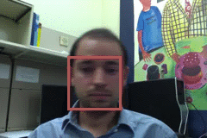
Things that make visual tracking difficult
Small, few visual features
Erratic movements, Moving very quickly
Occlusions, leaving and coming back
Surrounding similar-looking objects

Slide 6
Strategies for tracking
Tracking by repeated detection
Works well if object is easily detectable (e.g., face or colored glove) and there is only one
Need some way to link up detections
Best you can do, if you can’t predict motion

Slide 7
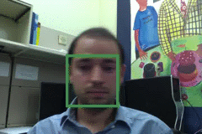
Tracking with dynamics
Key idea: Based on a model of expected motion, predict where objects will occur in next frame, before even seeing the image
Restrict search for the object
measurement noise is reduced by trajectory smoothness
Robustness to missing or weak observations

Slide 8
Strategies for tracking
Tracking with motion prediction
Predict the object’s state in the next frame
Kalman filtering: next state can be linearly predicted from current state (Gaussian)
Particle filtering: sample multiple possible states of the object (non-parametric, good for clutter)

Slide 9
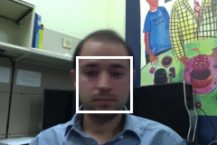
General model for tracking
state X: The actual state of the moving object that we want to estimate
State could be any combination of position, pose, viewpoint, velocity, acceleration, etc.
observations Y: Our actual measurement or observation of state X. Observation can be very noisy
At each time t, the state changes to X_{t} and we get a new observation Y_{t}

Slide 10
Steps of tracking
Prediction: What is the next state of the object given past measurements?

Slide 11
Steps of tracking
Prediction: What is the next state of the object given past measurements?
Correction: Compute an updated estimate of the state from prediction and measurements

Slide 12
Simplifying assumptions
Only the immediate past matters
dynamics model

Slide 13
Simplifying assumptions
Only the immediate past matters
Measurements depend only on the current state
dynamics model
observation model

Slide 14
Simplifying assumptions
Only the immediate past matters
Measurements depend only on the current state
dynamics model
observation model
…
X₀
X₁
X₂
X_{t-1}
X_{t}
Y₀
Y₁
Y₂
Y_{t-1}
Y_{t}

Slide 15
Problem statement
We have models for
Likelihood of next state given current state:
Likelihood of observation given the state:
We want to recover, for each t:

Slide 16
Tracking as induction
Base case:
Start with initial prior that predicts state in absence of any evidence: P(X₀)
For the first frame, correct this given the first measurement: Y₀=y₀

Slide 17
Tracking as induction
Base case:
Start with initial prior that predicts state in absence of any evidence: P(X₀)
For the first frame, correct this given the first measurement: Y₀=y₀

Slide 18
Tracking as induction
Base case:
Start with initial prior that predicts state in absence of any evidence: P(X₀)
For the first frame, correct this given the first measurement: Y₀=y₀
Given corrected estimate for frame t-1:
Predict for frame t ➔
Observe y_{t}; Correct for frame t ➔
predict
correct

Slide 19
Prediction
Prediction involves representing given
Law of total probability

Slide 20
Prediction
Prediction involves representing given
Conditioning on X_{t–1}

Slide 21
Prediction
Prediction involves representing given
Independence assumption

Slide 22
Prediction
Prediction involves representing given
dynamics model
corrected estimate from previous step

Slide 23
Correction
Correction involves computing given predicted value

Slide 24
Correction
Correction involves computing given predicted value
Bayes’ Rule

Slide 25
Correction
Correction involves computing given predicted value
Independence assumption (observation y_{t} directly depends only on state X_{t})

Slide 26
Correction
Correction involves computing given predicted value
Conditioning on X_{t}

Slide 27
Correction
Correction involves computing given predicted value
observation model
predicted estimate
normalization factor

Slide 28
Summary: Prediction and correction
Prediction:
Correction:
dynamics model
corrected estimate from previous step
observation model
predicted estimate

Slide 29
The Kalman filter
Linear dynamics model: state undergoes linear transformation plus Gaussian noise
Observation model: measurement is linearly transformed state plus Gaussian noise
The predicted/corrected state distributions are Gaussian
You only need to maintain the mean and covariance
The calculations are easy (all the integrals can be done in closed form)

Slide 30
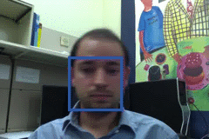
Example: Kalman Filter
Ground Truth
Observation
Correction
Next Frame
Update Location, Velocity, etc.
Prediction

Slide 31
Comparison
Ground Truth
Observation
Correction

Slide 32
Propagation of Gaussian densities
Current state
Expected change
Decent model if there is just one object, but localization is imprecise
Uncertainty
Observation and Correction

Slide 33
Particle filtering
Represent the state distribution non-parametrically
Prediction: Sample possible values X_{t-1} for the previous state
Correction: Compute likelihood of X_{t} based on weighted samples and P(y_{t}|X_{t})
M. Isard and A. Blake, CONDENSATION -- conditional density propagation for visual tracking, IJCV 29(1):5-28, 1998

Slide 34
Particle filtering
Start with weighted samples from previous time step
Sample and shift according to dynamics model
Spread due to randomness; this is predicted density P(X_{t}|Y_{t-1})
Weight the samples
according to observation density
Arrive at corrected density estimate P(X_{t}|Y_{t})
M. Isard and A. Blake, CONDENSATION -- conditional density propagation for visual tracking, IJCV 29(1):5-28, 1998

Slide 35
Propagation of non-parametric densities
Current state
Expected change
Good if there are multiple, confusable objects (or clutter) in the scene
Uncertainty
Observation and Correction

Slide 36
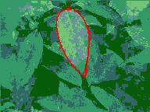
Particle filtering results
People: http://www.youtube.com/watch?v=wCMk-pHzScE
Hand: http://www.youtube.com/watch?v=tIjufInUqZM

Slide 37
Tracking issues
Initialization
Manual
Background subtraction
Detection

Slide 38
Tracking issues
Initialization
Getting observation and dynamics models
Observation model: match a template or use a trained detector
Dynamics model: usually specify using domain knowledge

Slide 39
Tracking issues
Initialization
Obtaining observation and dynamics model
Uncertainty of prediction vs. correction
If the dynamics model is too strong, will end up ignoring the data
If the observation model is too strong, tracking is reduced to repeated detection
Too strong dynamics model
Too strong observation model

Slide 40
Tracking issues
Initialization
Getting observation and dynamics models
Prediction vs. correction
Data association
When tracking multiple objects, need to assign right objects to right tracks (particle filters good for this)

Slide 41
Tracking issues
Initialization
Getting observation and dynamics models
Prediction vs. correction
Data association
Drift
Errors can accumulate over time

Slide 42
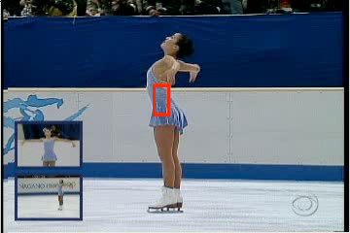
Drift
D. Ramanan, D. Forsyth, and A. Zisserman. Tracking People by Learning their Appearance. PAMI 2007.

Slide 43
Things to remember
Tracking objects = detection + prediction
Probabilistic framework
Predict next state
Update current state based on observation
Two simple but effective methods
Kalman filters: Gaussian distribution
Particle filters: multimodal distribution

Slide 44
Next class: action recognition
Action recognition
What is an “action”?
How can we represent movement?
How do we incorporate motion, pose, and nearby objects?

