Slide 1
Object Category Detection: Sliding Windows
04/10/12
Computer Vision
CS 543 / ECE 549
University of Illinois
Derek Hoiem

Slide 2
Today’s class: Object Category Detection
Overview of object category detection
Statistical template matching with sliding window detector
Dalal-Triggs pedestrian detector
Viola-Jones face detector

Slide 3
Object Category Detection
Focus on object search: “Where is it?”
Build templates that quickly differentiate object patch from background patch
Dog Model
…
Object or
Non-Object?

Slide 4
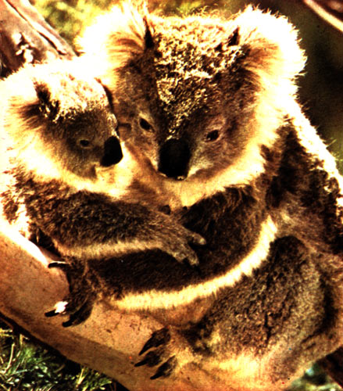
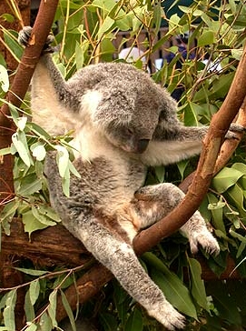
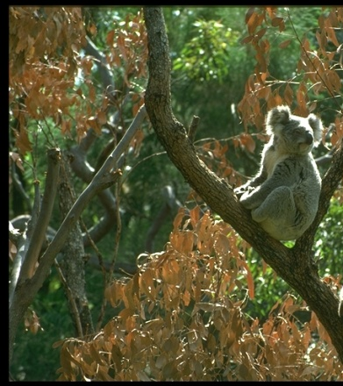
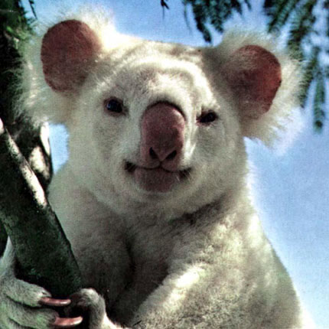
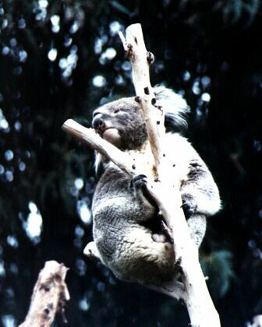
Challenges in modeling the object class
Illumination
Object pose
Clutter
Occlusions
Intra-class appearance
Viewpoint
Slide from K. Grauman, B. Leibe

Slide 5
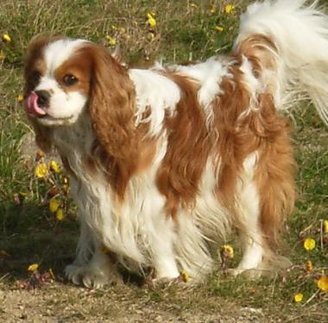
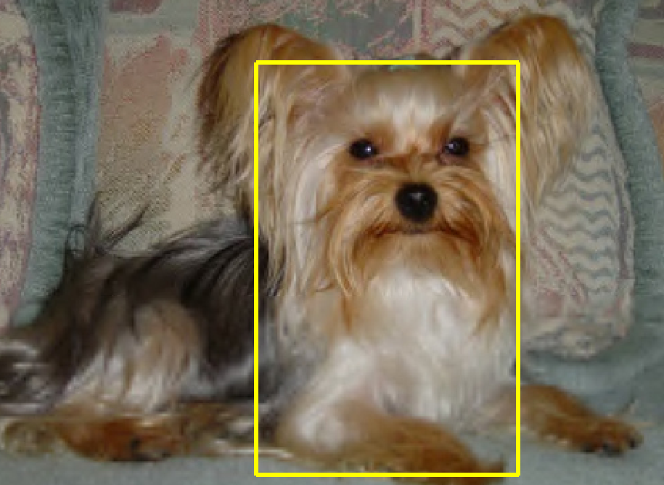
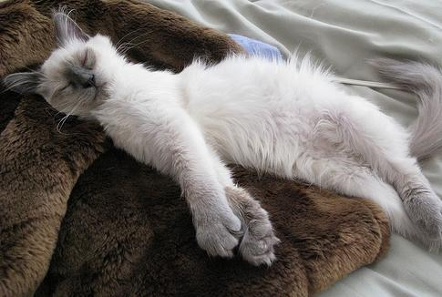
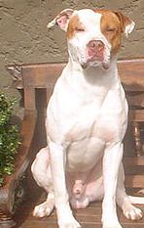
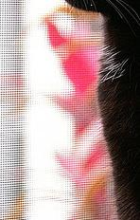
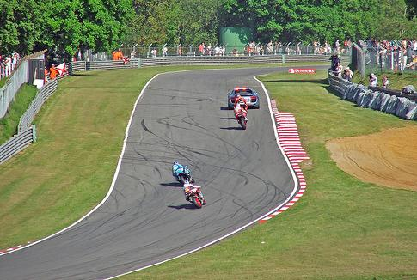
Challenges in modeling the non-object class
True Detections
Bad Localization
Confused with Similar Object
Confused with Dissimilar Objects
Misc. Background

Slide 6
General Process of Object Recognition
Specify Object Model
What are the object parameters?
Generate Hypotheses
Score Hypotheses
Resolve Detections

Slide 7
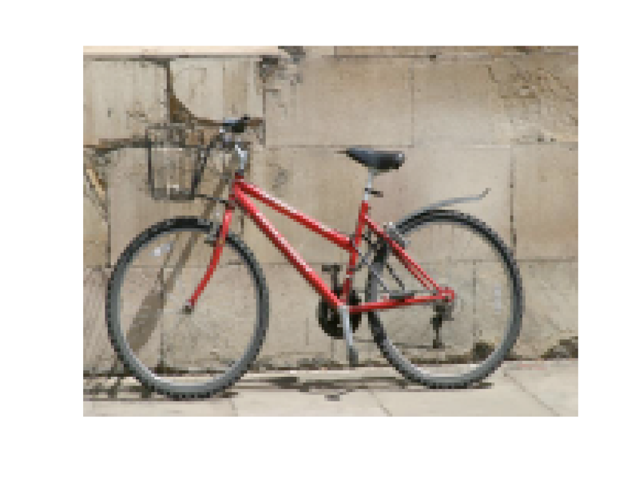
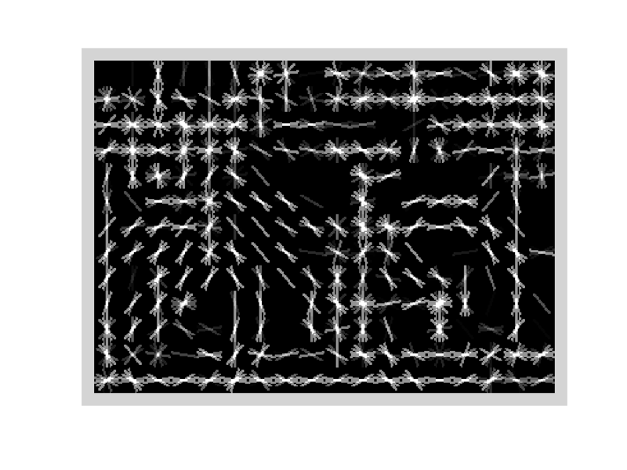
Specifying an object model
Statistical Template in Bounding Box
Object is some (x,y,w,h) in image
Features defined wrt bounding box coordinates
Image
Template Visualization
Images from Felzenszwalb

Slide 8
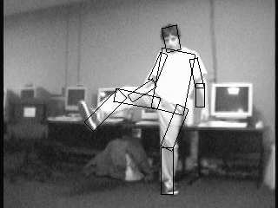
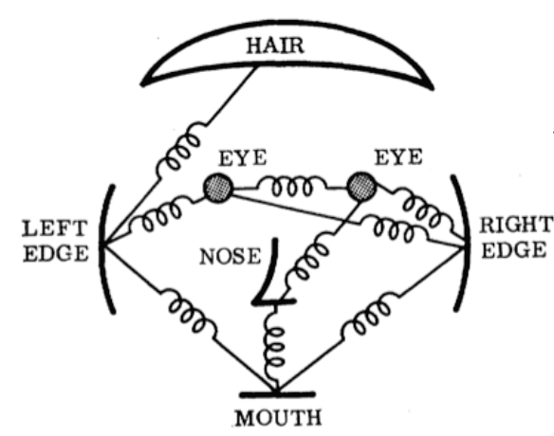
Specifying an object model
2. Articulated parts model
Object is configuration of parts
Each part is detectable
Images from Felzenszwalb

Slide 9
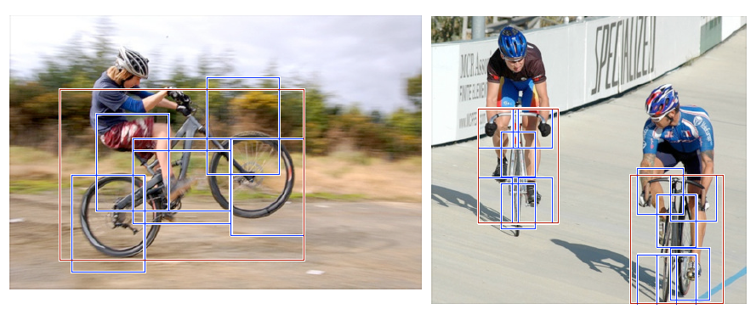
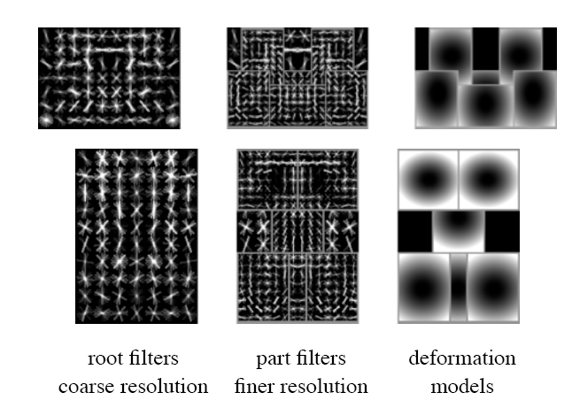
Specifying an object model
3. Hybrid template/parts model
Detections
Template Visualization
Felzenszwalb et al. 2008

Slide 10
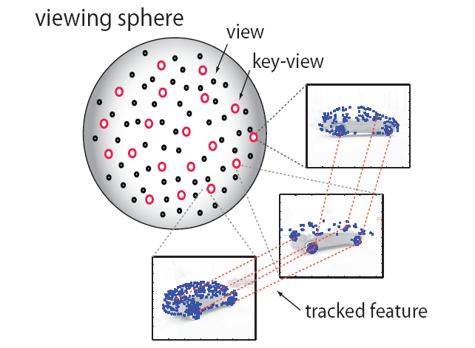
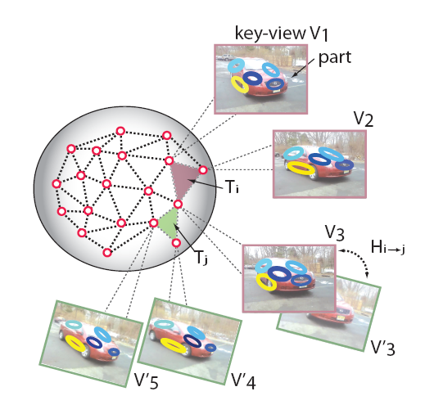
Specifying an object model
3D-ish model
Object is collection of 3D planar patches under affine transformation

Slide 11
General Process of Object Recognition
Specify Object Model
Generate Hypotheses
Propose an alignment of the model to the image
Score Hypotheses
Resolve Detections

Slide 12
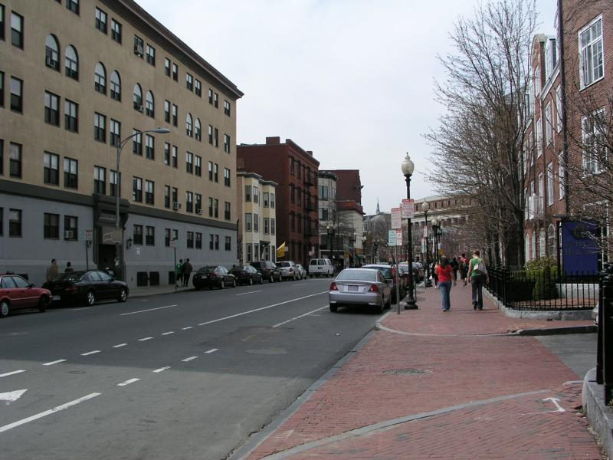
Generating hypotheses
Sliding window
Test patch at each location and scale

Slide 13
Generating hypotheses
Sliding window
Test patch at each location and scale

Slide 14
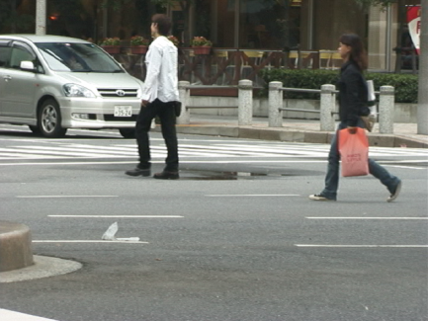
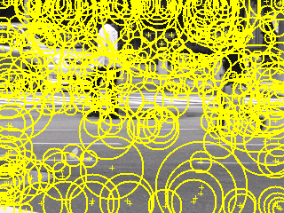
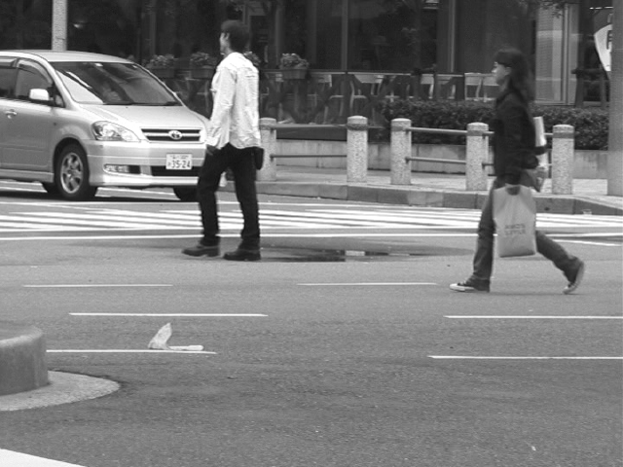
Generating hypotheses
2. Voting from patches/keypoints
Matched Codebook Entries
Probabilistic Voting
Interest Points
y
s
3D Voting Space (continuous)
x
ISM model by Leibe et al.

Slide 15
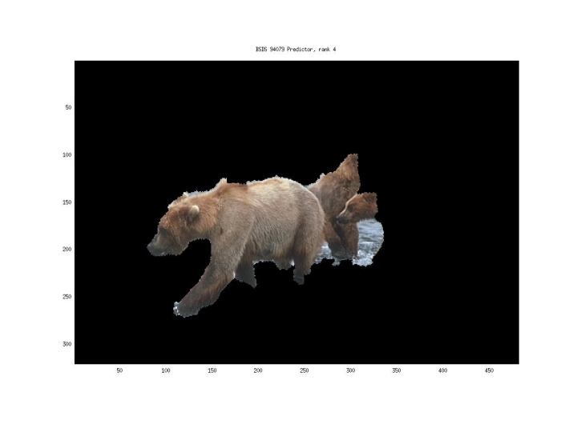
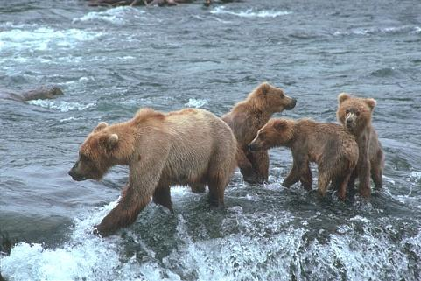
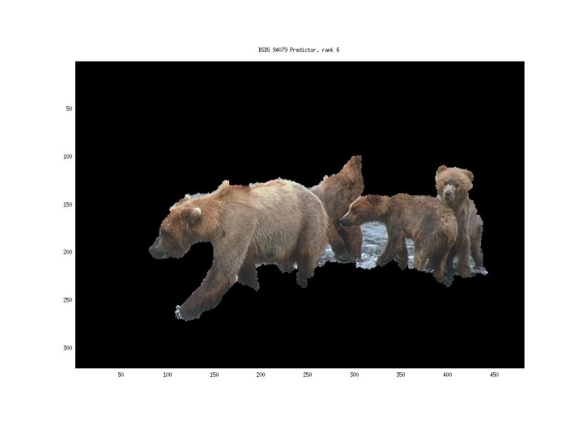
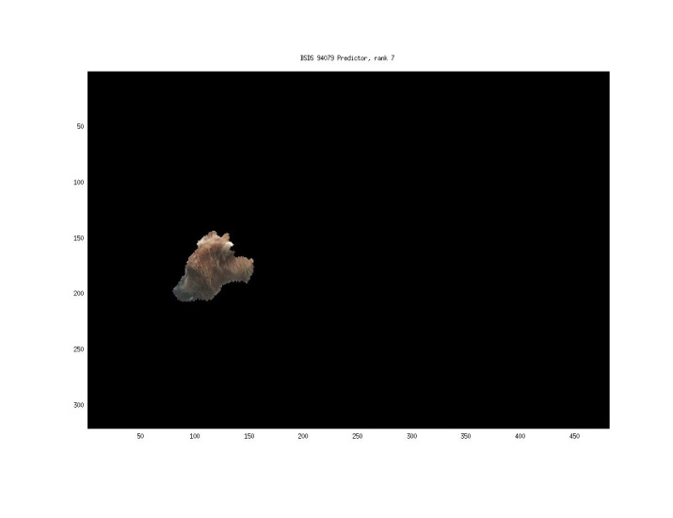
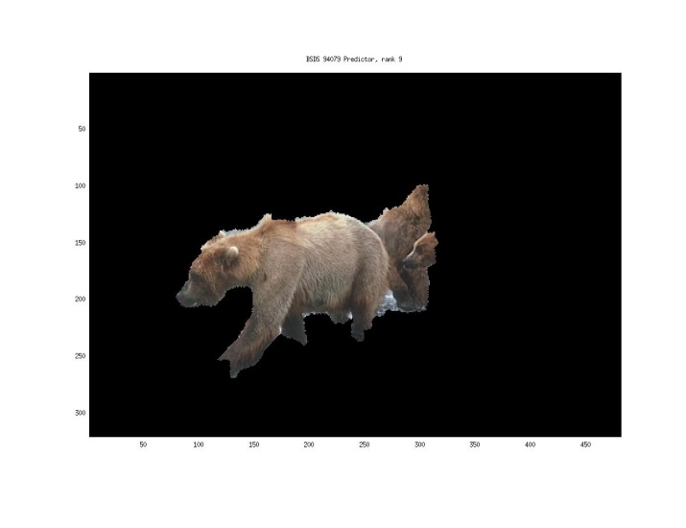
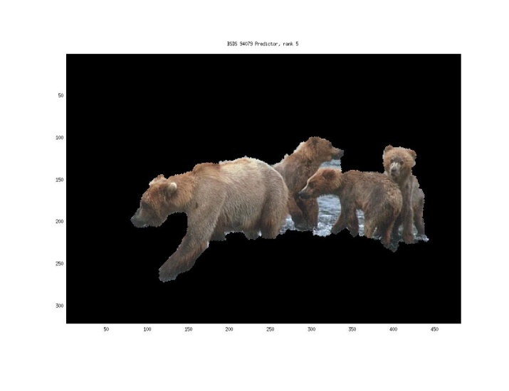
Generating hypotheses
3. Region-based proposal
Endres Hoiem 2010

Slide 16
General Process of Object Recognition
Specify Object Model
Generate Hypotheses
Mainly-gradient based features, usually based on summary representation, many classifiers
Score Hypotheses
Resolve Detections

Slide 17
General Process of Object Recognition
Specify Object Model
Generate Hypotheses
Score Hypotheses
Resolve Detections
Rescore each proposed object based on whole set

Slide 18
Resolving detection scores
Non-max suppression
Score = 0.8
Score = 0.8
Score = 0.1

Slide 19
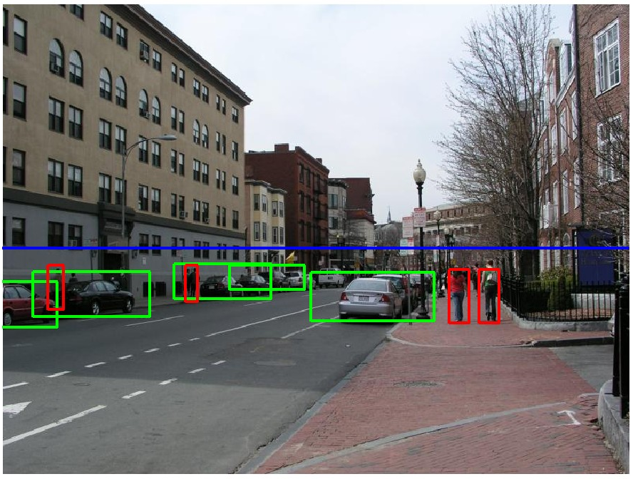
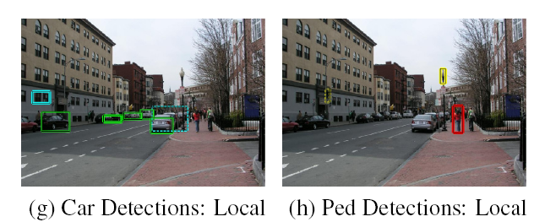
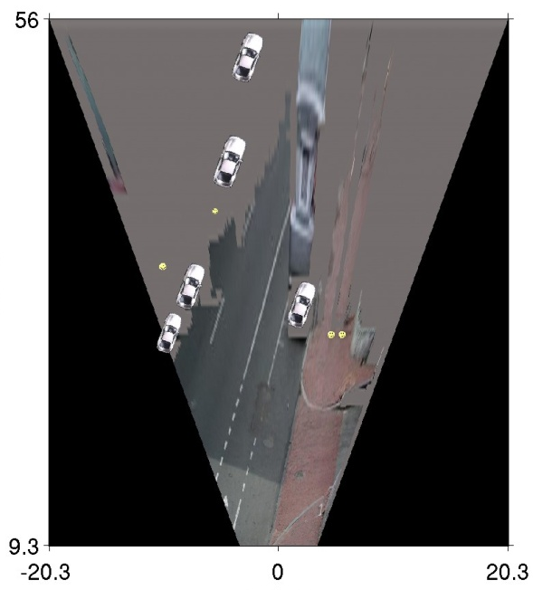
Resolving detection scores
2. Context/reasoning
meters
Hoiem et al. 2006
meters

Slide 20
Object category detection in computer vision
Goal: detect all pedestrians, cars, monkeys, etc in image

Slide 21
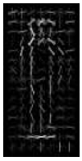
Basic Steps of Category Detection
Align
E.g., choose position, scale orientation
How to make this tractable?
Compare
Compute similarity to an example object or to a summary representation
Which differences in appearance are important?
Aligned
Possible Objects
Exemplar
Summary

Slide 22
Sliding window: a simple alignment solution
…
…

Slide 23
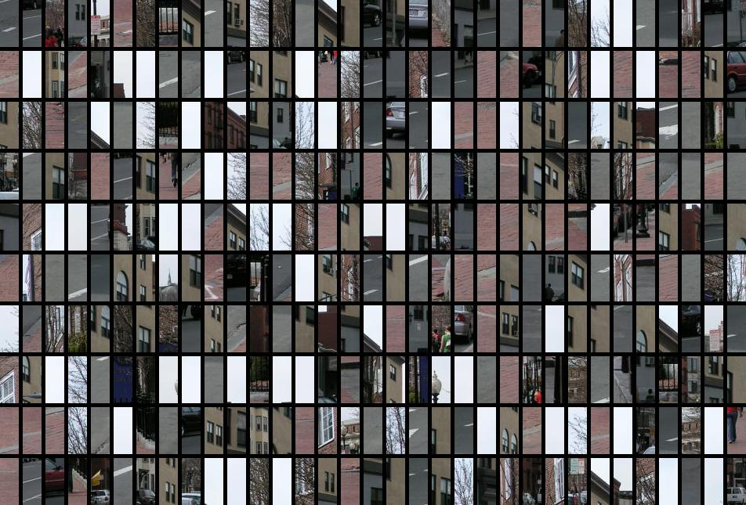
Each window is separately classified

Slide 24
Statistical Template
Object model = sum of scores of features at fixed positions
?
+3
+2
-2
-1
-2.5
= -0.5
> 7.5
Non-object
?
+4
+1
+0.5
+3
+0.5
= 10.5
> 7.5
Object

Slide 25
Design challenges
How to efficiently search for likely objects
Even simple models require searching hundreds of thousands of positions and scales
Feature design and scoring
How should appearance be modeled? What features correspond to the object?
How to deal with different viewpoints?
Often train different models for a few different viewpoints
Implementation details
Window size
Aspect ratio
Translation/scale step size
Non-maxima suppression

Slide 26
Example: Dalal-Triggs pedestrian detector
Extract fixed-sized (64x128 pixel) window at each position and scale
Compute HOG (histogram of gradient) features within each window
Score the window with a linear SVM classifier
Perform non-maxima suppression to remove overlapping detections with lower scores
Navneet Dalal and Bill Triggs, Histograms of Oriented Gradients for Human Detection, CVPR05

Slide 27
Slides by Pete Barnum
Navneet Dalal and Bill Triggs, Histograms of Oriented Gradients for Human Detection, CVPR05

Slide 28
Tested with
RGB
LAB
Grayscale
Gamma Normalization and Compression
Square root
Log
Slightly better performance vs. grayscale
Very slightly better performance vs. no adjustment

Slide 29
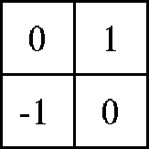
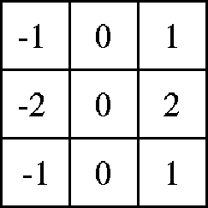
Outperforms
centered
diagonal
uncentered
cubic-corrected
Sobel
Slides by Pete Barnum
Navneet Dalal and Bill Triggs, Histograms of Oriented Gradients for Human Detection, CVPR05

Slide 30
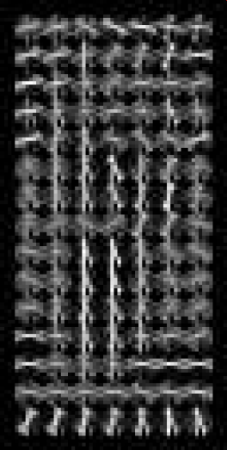
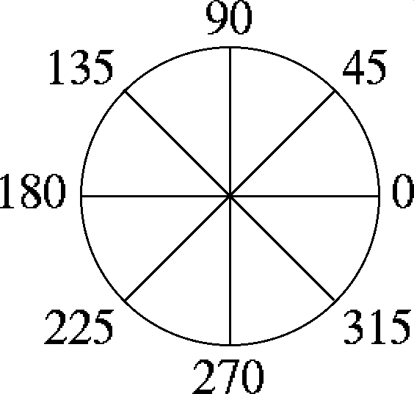
Histogram of gradient orientations
Votes weighted by magnitude
Bilinear interpolation between cells
Orientation: 9 bins (for unsigned angles)
Histograms in 8x8 pixel cells
Slides by Pete Barnum
Navneet Dalal and Bill Triggs, Histograms of Oriented Gradients for Human Detection, CVPR05

Slide 31
Normalize with respect to surrounding cells
Slides by Pete Barnum
Navneet Dalal and Bill Triggs, Histograms of Oriented Gradients for Human Detection, CVPR05

Slide 32
# orientations
# features = 15 x 7 x 9 x 4 = 3780
X=
# cells
# normalizations by neighboring cells
Slides by Pete Barnum
Navneet Dalal and Bill Triggs, Histograms of Oriented Gradients for Human Detection, CVPR05

Slide 33
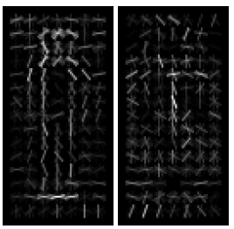
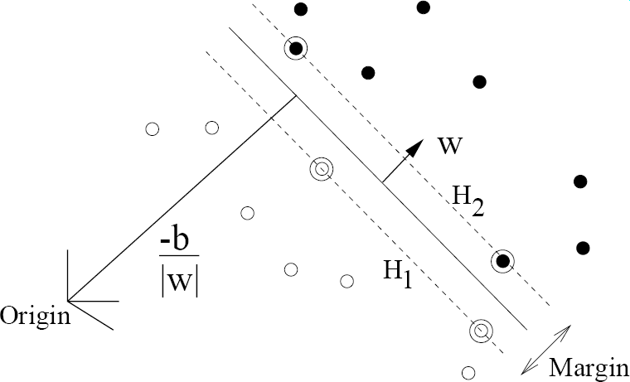
pos w
neg w
Slides by Pete Barnum
Navneet Dalal and Bill Triggs, Histograms of Oriented Gradients for Human Detection, CVPR05

Slide 34
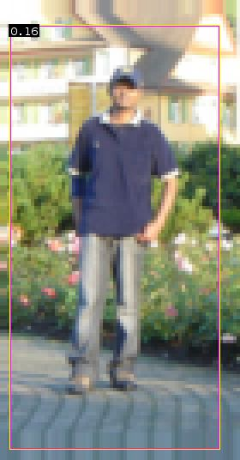
pedestrian
Slides by Pete Barnum
Navneet Dalal and Bill Triggs, Histograms of Oriented Gradients for Human Detection, CVPR05

Slide 35
Detection examples

Slide 36
2 minute break
Something to think about…
Sliding window detectors work
very well for faces
fairly well for cars and pedestrians
badly for cats and dogs
Why are some classes easier than others?

Slide 37
Viola-Jones sliding window detector
Fast detection through two mechanisms
Quickly eliminate unlikely windows
Use features that are fast to compute
Viola and Jones. Rapid Object Detection using a Boosted Cascade of Simple Features (2001).

Slide 38
Cascade for Fast Detection
Choose threshold for low false negative rate
Fast classifiers early in cascade
Slow classifiers later, but most examples don’t get there
Stage 1
H₁(x) > t₁?
Yes
Stage 2
H₂(x) > t₂?
Stage N
H_{N}(x) > t_{N}?
Yes
…
Pass
No
No
No
Examples
Reject
Reject
Reject

Slide 39
Features that are fast to compute
“Haar-like features”
Differences of sums of intensity
Thousands, computed at various positions and scales within detection window
-1
+1
Two-rectangle features
Three-rectangle features
Etc.

Slide 40
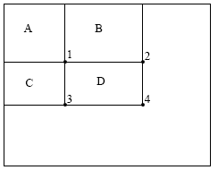
Integral Images
ii = cumsum(cumsum(im, 1), 2)
x, y
ii(x,y) = Sum of the values in the grey region
How to compute B-A?
How to compute A+D-B-C?

Slide 41
Feature selection with Adaboost
Create a large pool of features (180K)
Select features that are discriminative and work well together
“Weak learner” = feature + threshold + parity
Choose weak learner that minimizes error on the weighted training set
Reweight

Slide 42
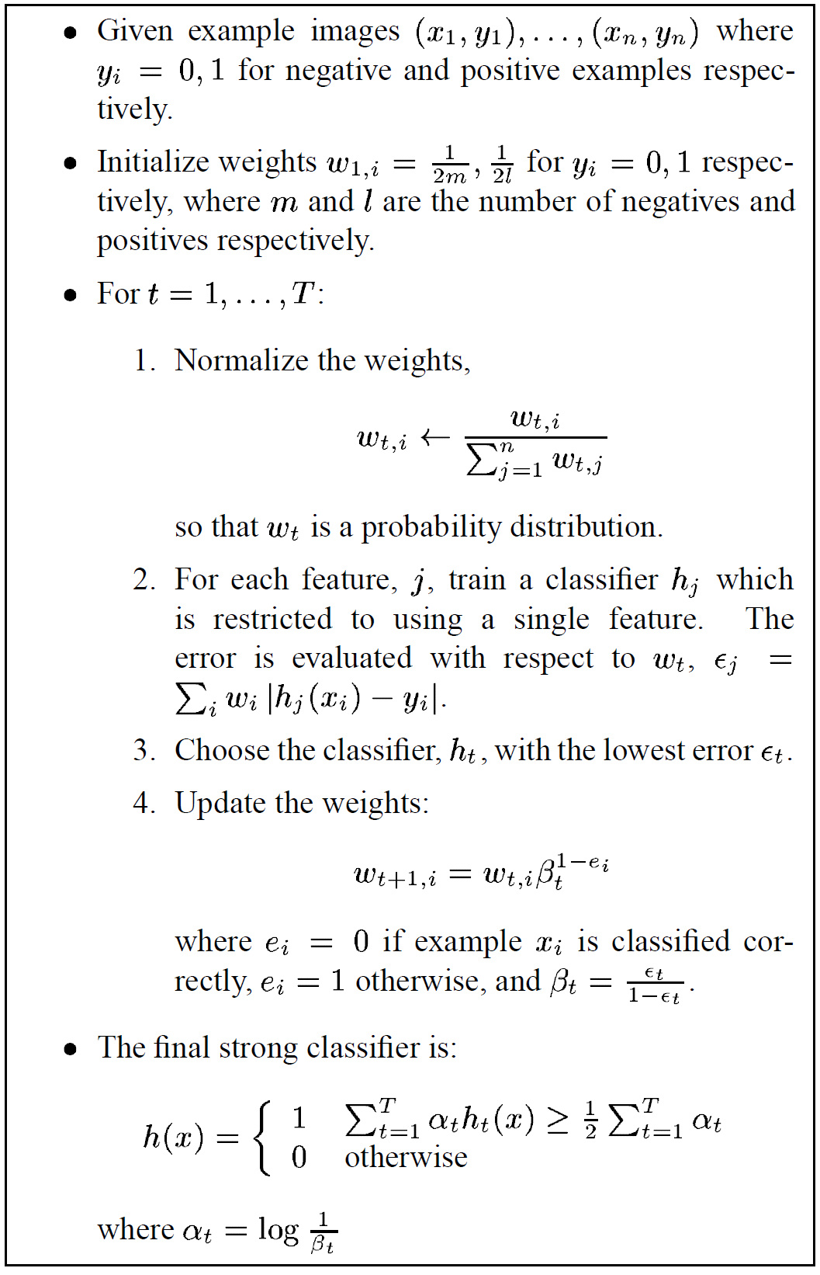
Adaboost

Slide 43
Adaboost: Immune to Overfitting?
Test error
Train error

Slide 44
Adaboost: Margin Maximizer
Test error
Train error
margin

Slide 45
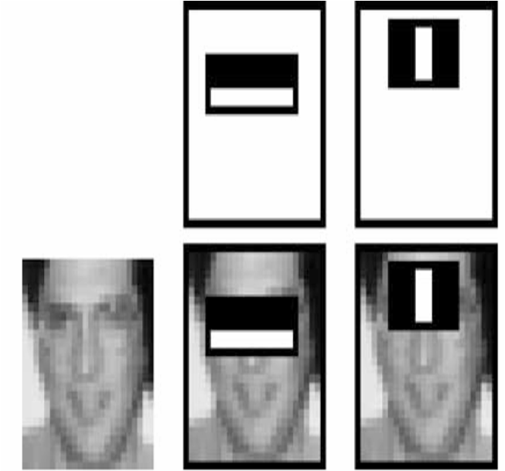
Top 2 selected features

Slide 46
Viola-Jones details
38 stages with 1, 10, 25, 50 … features
6061 total used out of 180K candidates
10 features evaluated on average
Training Examples
4916 positive examples
10000 negative examples collected after each stage
Scanning
Scale detector rather than image
Scale steps = 1.25 (factor between two consecutive scales)
Translation 1*scale (# pixels between two consecutive windows)
Non-max suppression: average coordinates of overlapping boxes
Train 3 classifiers and take vote

Slide 47
Viola Jones Results
Speed = 15 FPS (in 2001)
MIT + CMU face dataset

Slide 48
Strengths and Weaknesses of Statistical Template Approach
Strengths
Works very well for non-deformable objects: faces, cars, upright pedestrians
Fast detection
Weaknesses
Not so well for highly deformable objects
Not robust to occlusion
Requires lots of training data

Slide 49
Tricks of the trade
Details in feature computation really matter
E.g., normalization in Dalal-Triggs improves detection rate by 27% at fixed false positive rate
Template size
Typical choice is size of smallest detectable object
“Jittering” to create synthetic positive examples
Create slightly rotated, translated, scaled, mirrored versions as extra positive examples
Bootstrapping to get hard negative examples
Randomly sample negative examples
Train detector
Sample negative examples that score > -1
Repeat until all high-scoring negative examples fit in memory

Slide 50
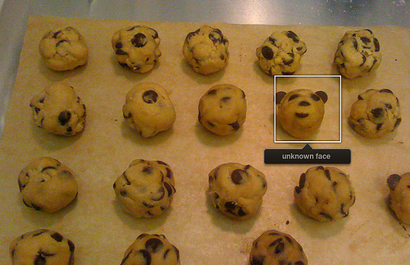
Consumer application: iPhoto 2009
Things iPhoto thinks are faces

Slide 51
Influential Works in Detection
Sung-Poggio (1994, 1998) : ~1750 citations
Basic idea of statistical template detection (I think), bootstrapping to get “face-like” negative examples, multiple whole-face prototypes (in 1994)
Rowley-Baluja-Kanade (1996-1998) : ~3400
“Parts” at fixed position, non-maxima suppression, simple cascade, rotation, pretty good accuracy, fast
Schneiderman-Kanade (1998-2000,2004) : ~1700
Careful feature engineering, excellent results, cascade
Viola-Jones (2001, 2004) : ~11,000
Haar-like features, Adaboost as feature selection, hyper-cascade, very fast, easy to implement
Dalal-Triggs (2005) : ~3250
Careful feature engineering, excellent results, HOG feature, online code
Felzenszwalb-Huttenlocher (2000): ~1000
Efficient way to solve part-based detectors
Felzenszwalb-McAllester-Ramanan (2008)? ~800
Excellent template/parts-based blend

Slide 52
Things to remember
Sliding window for search
Features based on differences of intensity (gradient, wavelet, etc.)
Excellent results require careful feature design
Boosting for feature selection
Integral images, cascade for speed
Bootstrapping to deal with many, many negative examples
Stage 1
H₁(x) > t₁?
Yes
Stage 2
H₂(x) > t₂?
…
Stage N
H_{N}(x) > t_{N}?
Yes
Pass
Examples
No
No
No
Reject
Reject
Reject

Slide 53
Next class
Deformable parts models and the distance transform

