Slide 1
MRFs and Segmentation with Graph Cuts
03/27/12
Computer Vision
CS 543 / ECE 549
University of Illinois
Derek Hoiem

Slide 2
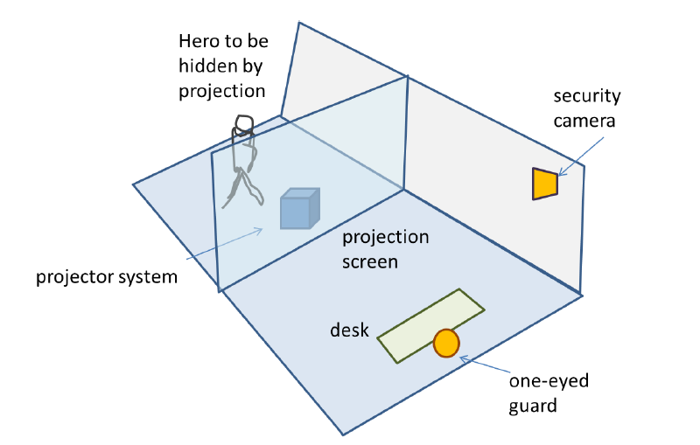
HW 3
Mean 92
Median 98
Common mistakes
Mission Possible: don’t need camera rotation matrix
Epipolar geometry: general problems with RANSAC and/or estimating F

Slide 3
Final projects
Make appointments to see Ruiqi or me
https://docs.google.com/spreadsheet/ccc?key=0AiuVuPXkVyqmdF9LZWNVbVFtYXRmTldWcjFhWWpZLWc&hl=en_US#gid=0
No late penalty for not meeting us this week, but must get proposal submitted by Thursday
If you’re not sure, make your best guess; can change later

Slide 4
Today’s class
Review of EM
MRFs
Segmentation with Graph Cuts
i
w_{ij}
j

Slide 5
EM Algorithm: Recap
E-step: compute
M-step: solve
Determines hidden variable assignments and parameters that maximize likelihood of observed data
Improves likelihood at each step (reaches local maximum)
Derivation is tricky but implementation is easy

Slide 6
EM: Mixture of Gaussians
Initialize parameters
Compute likelihood of hidden variables for current parameters
Estimate new parameters for each component, weighted by likelihood
Given by normal distribution

Slide 7
Gaussian Mixture Models: Practical Tips
Design decisions
Number of components
Select by hand based on knowledge of problem
Select using cross-validation or sample data
Usually, not too sensitive and safer to use more components
Variance
“Spherical covariance”: dimensions within each component are independent with equal variance (1 parameter but usually too restrictive)
“Diagonal covariance”: dimensions within each component are not independent with difference variances (N parameters for N-D data)
“Full covariance”: no assumptions (N*(N+1)/2 parameters); for high N might be expensive to do EM, to evaluate, and may overfit
Typically use “Full” if lots of data, few dimensions; Use “Diagonal” otherwise
Can get stuck in local minima
Use multiple restarts
Choose solution with greatest data likelihood

Slide 8
EM Demo
GMM with images demos

Slide 9
What’s wrong with this prediction?
P(foreground | image)

Slide 10
Solution
P(foreground | image)
Encode dependencies between pixels
Normalizing constant called “partition function”
Labels to be predicted
Individual predictions
Pairwise predictions

Slide 11
Writing Likelihood as an “Energy”
-log(.)
Cost of assignment y_{i}
Cost of pairwise assignment y_{i ,}y_{j}

Slide 12
Notes on energy-based formulation
Primarily used when you only care about the most likely solution (not the confidences)
Can think of it as a general cost function
Can have larger “cliques” than 2
Clique is the set of variables that go into a potential function

Slide 13
Markov Random Fields
Node y_{i}: pixel label
Edge: constrained pairs
Cost to assign a label to each pixel
Cost to assign a pair of labels to connected pixels

Slide 14
Markov Random Fields
Unary potential
Example: “label smoothing” grid
0: -logP(y_{i} = 0 | data)
1: -logP(y_{i} = 1 | data)
Pairwise Potential
0 1
0 0 K
1 K 0
K>0

Slide 15
Solving MRFs with graph cuts
Source (Label 0)
Cost to assign to 1
Cost to split nodes
Cost to assign to 0
Sink (Label 1)

Slide 16
Solving MRFs with graph cuts
Source (Label 0)
Cost to assign to 1
Cost to split nodes
Cost to assign to 0
Sink (Label 1)

Slide 17
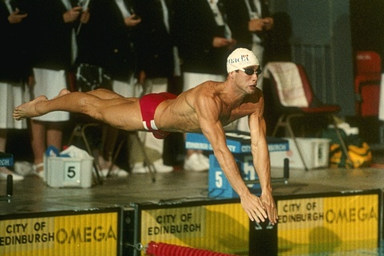
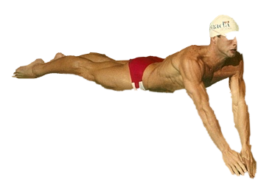
GrabCut segmentation
User provides rough indication of foreground region.
Goal: Automatically provide a pixel-level segmentation.

Slide 18
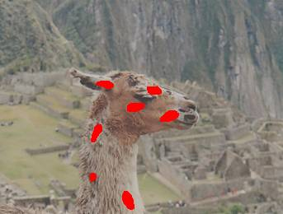
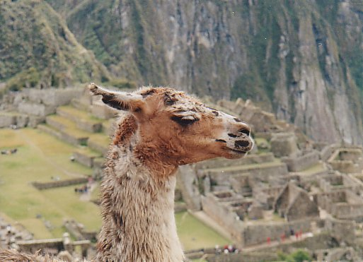
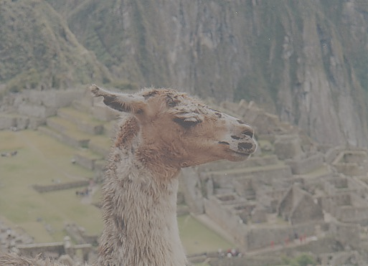
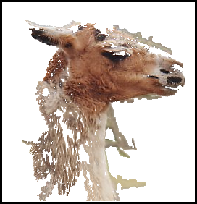
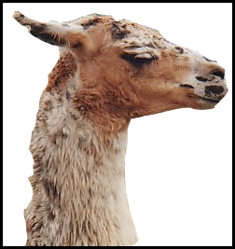
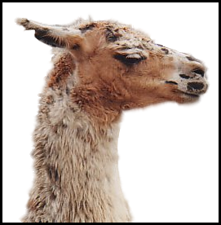
Grab cuts and graph cuts
Magic Wand (198?)
Intelligent Scissors Mortensen and Barrett (1995)
GrabCut
User Input
Result
Regions
Boundary
Regions & Boundary
Source: Rother
Notes:
Basic idea is to combine the information which was used in the 2 well known tools: MW and IS.
MS select a region of similar colour according to your input. Fat pen and the boundary snapps to high contrast edges.
Grabcut combines it. And this allows us to simplify the user interface considerably by …

Slide 19
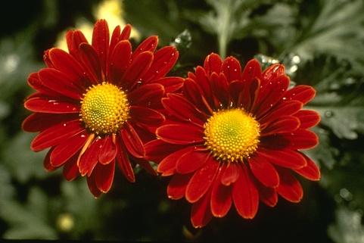
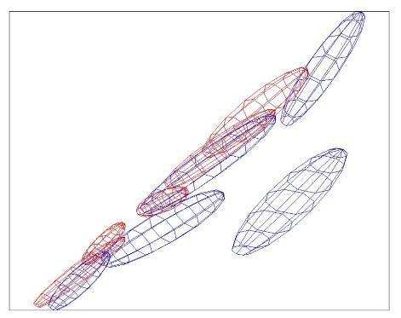
Colour Model
R
Foreground & Background
Background
G
Gaussian Mixture Model (typically 5-8 components)
Source: Rother
Notes:
Color enbergy.
Iterations have the effect of pulling them away;
D is – log likelyhood of the GMM.

Slide 20
Graph cuts Boykov and Jolly (2001)
Foreground (source)
Image
Min Cut
Background (sink)
Cut: separating source and sink; Energy: collection of edges
Min Cut: Global minimal enegry in polynomial time
Source: Rother
Notes:
Optimization engine we use Graph Cuts. By now everybody should know what graph cut is. IN case you missed it here is a very brief introduction.
To image. 3D view. First task to construct a graph.
All pixels on a certain scanline. Just a few of them.
Next step introduce artificial nodes. fgd and background.
Edges – contrast. Boundary is quite likely between black and white.
Min Cut - Minimum edge strength.

Slide 21
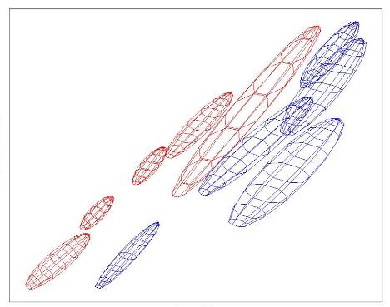
Colour Model
R
R
Foreground & Background
Iterated graph cut
Foreground
Background
G
Background
G
Gaussian Mixture Model (typically 5-8 components)
Source: Rother
Notes:
Color enbergy.
Iterations have the effect of pulling them away;
D is – log likelyhood of the GMM.

Slide 22
GrabCut segmentation
Define graph
usually 4-connected or 8-connected
Divide diagonal potentials by sqrt(2)
Define unary potentials
Color histogram or mixture of Gaussians for background and foreground
Define pairwise potentials
Apply graph cuts
Return to 2, using current labels to compute foreground, background models

Slide 23
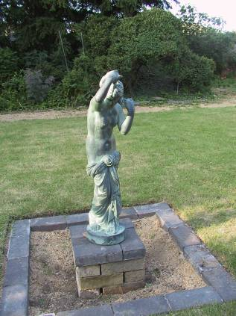
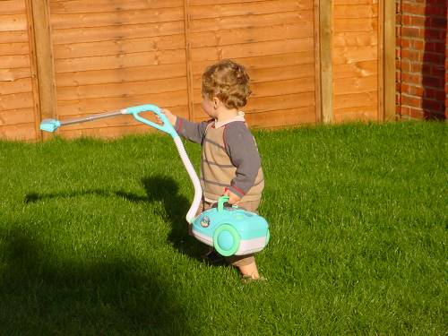
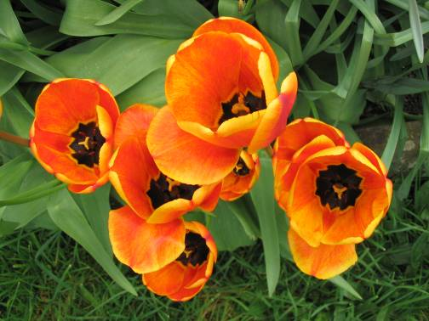
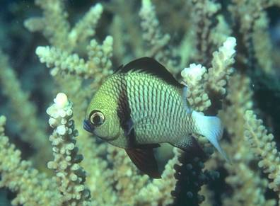
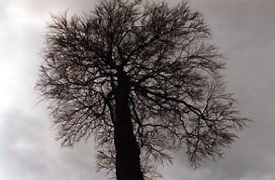
What is easy or hard about these cases for graphcut-based segmentation?

Slide 24
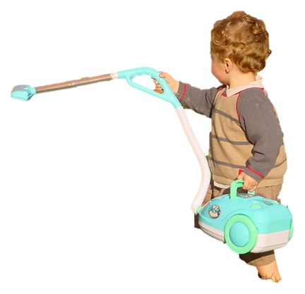
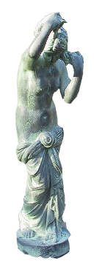
Easier examples
GrabCut – Interactive Foreground Extraction 10
Notes:
Moderately straightforward examples- after the user input automnatically

Slide 25
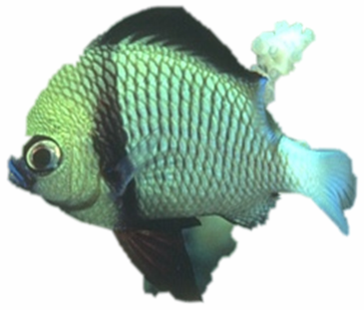
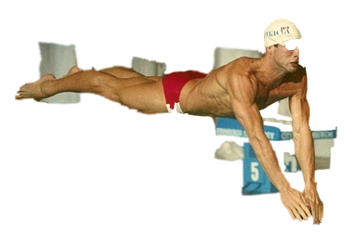
More difficult Examples
Camouflage &
Low Contrast
Fine structure
Harder Case
Initial Rectangle
Initial Result
GrabCut – Interactive Foreground Extraction 11
Notes:
You might wonder when does it fail. 4 cases. Low contrats – an edge not good visible

Slide 26
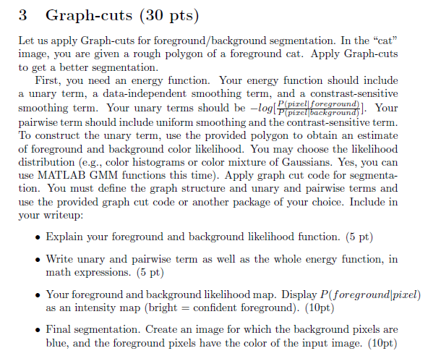
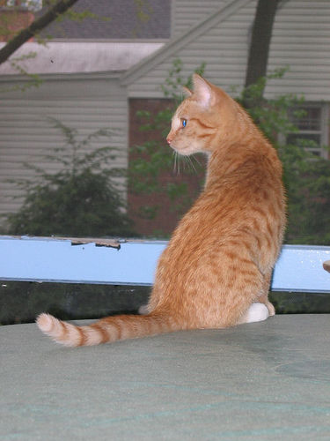
Notes
look at GraphCut.m in provided code (skip README) – if you have trouble using package get help from Ruiqi
Use poly2mask to convert the polygon to a foreground mask

Slide 27
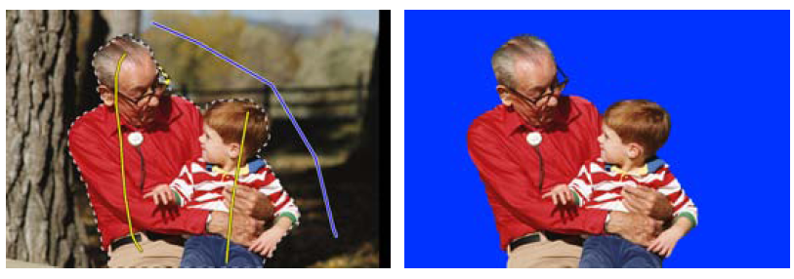
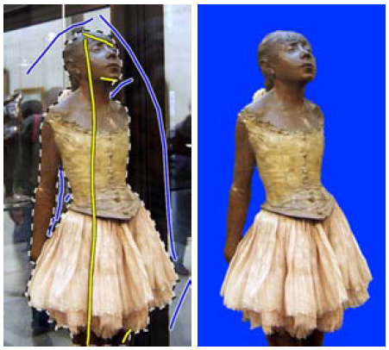
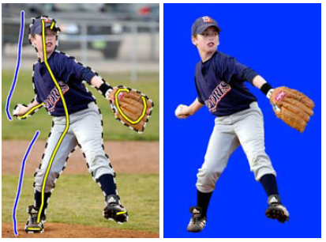
Lazy Snapping (Li et al. SG 2004)

Slide 28
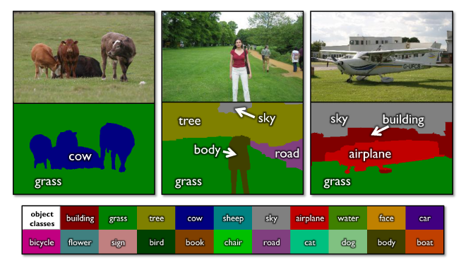
Using graph cuts for recognition
TextonBoost (Shotton et al. 2009 IJCV)

Slide 29
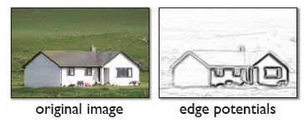
Using graph cuts for recognition
Unary Potentials
Alpha Expansion Graph Cuts
TextonBoost (Shotton et al. 2009 IJCV)

Slide 30
Graph cuts with multiple labels
Alpha expansion
Repeat until no change
For $α=1..M$
Assign each pixel to current label or $α$ (2-class graphcut)
Achieves “strong” local minimum
Alpha-beta swap
Repeat until no change
For $α=1..M, β=1..M$
Re-assign all pixels currently labeled as $α$or $β$ to one of those two labels while keeping all other pixels fixed

Slide 31
Limitations of graph cuts
Associative: edge potentials penalize different labels
If not associative, can sometimes clip potentials
Graph cut algorithm applies to only 2-label problems
Multi-label extensions are not globally optimal (but still usually provide very good solutions)
Must satisfy

Slide 32
Graph cuts: Pros and Cons
Pros
Very fast inference
Can incorporate data likelihoods and priors
Applies to a wide range of problems (stereo, image labeling, recognition)
Cons
Not always applicable (associative only)
Need unary terms (not used for bottom-up segmentation, for example)
Use whenever applicable

Slide 33
More about MRFs/CRFs
Other common uses
Graph structure on regions
Encoding relations between multiple scene elements
Inference methods
Loopy BP or BP-TRW
Exact for tree-shaped structures
Approximate solutions for general graphs
More widely applicable and can produce marginals but often slower

Slide 34
Further reading and resources
Graph cuts
http://www.cs.cornell.edu/~rdz/graphcuts.html
Classic paper: What Energy Functions can be Minimized via Graph Cuts? (Kolmogorov and Zabih, ECCV '02/PAMI '04)
Belief propagation
Yedidia, J.S.; Freeman, W.T.; Weiss, Y., "Understanding Belief Propagation and Its Generalizations”, Technical Report, 2001: http://www.merl.com/publications/TR2001-022/

Slide 35
Next section: Object Recognition
Face recognition
Image categorization and general classification methods
Object detection
Statistical templates
Parts-based methods
Tracking objects

