Slide 1
Clustering with Application to Fast Object Search
03/08/12
Computer Vision
CS 543 / ECE 549
University of Illinois
Derek Hoiem

Slide 2
This section
Clustering: grouping together similar points, images, feature vectors, etc.
Segmentation: dividing the image into meaningful regions
Segmentation by clustering: K-means and mean-shift
Graph approaches to segmentation: graph cuts and normalized cuts
Segmentation from boundaries: watershed
EM: soft clustering, or parameter estimation with hidden data

Slide 3
Today’s class
Clustering algorithms
K-means
Application to fast object search
Hierarchical clustering
Spectral clustering

Slide 4
Clustering: group together similar points and represent them with a single token
Key Challenges:
1) What makes two points/images/patches similar?
2) How do we compute an overall grouping from pairwise similarities?

Slide 5
Why do we cluster?
Summarizing data
Look at large amounts of data
Patch-based compression or denoising
Represent a large continuous vector with the cluster number
Counting
Histograms of texture, color, SIFT vectors
Segmentation
Separate the image into different regions
Prediction
Images in the same cluster may have the same labels

Slide 6
How do we cluster?
K-means
Iteratively re-assign points to the nearest cluster center
Agglomerative clustering
Start with each point as its own cluster and iteratively merge the closest clusters
Spectral clustering
Split the nodes in a graph based on assigned links with similarity weights

Slide 7
Clustering for Summarization
Goal: cluster to minimize variance in data given clusters
Preserve information
Cluster center
Data
Whether x_{j} is assigned to c_{i}

Slide 8
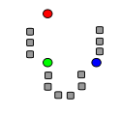
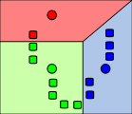
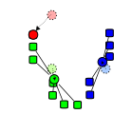
K-means algorithm
1. Randomly select K centers
2. Assign each point to nearest center
3. Compute new center (mean) for each cluster
Illustration: http://en.wikipedia.org/wiki/K-means_clustering

Slide 9
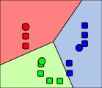
K-means algorithm
1. Randomly select K centers
2. Assign each point to nearest center
Back to 2
3. Compute new center (mean) for each cluster
Illustration: http://en.wikipedia.org/wiki/K-means_clustering

Slide 10
K-means demos
General
http://home.dei.polimi.it/matteucc/Clustering/tutorial_html/AppletKM.html
http://www.cs.washington.edu/research/imagedatabase/demo/kmcluster/
Color clustering

Slide 11
K-means
Initialize cluster centers: c⁰ ; t=0
Assign each point to the closest center
Update cluster centers as the mean of the points
Repeat 2-3 until no points are re-assigned (t=t+1)

Slide 12
Kmeans: Matlab code
function C = kmeans(X, K)
% Initialize cluster centers to be randomly sampled points
[N, d] = size(X);
rp = randperm(N);
C = X(rp(1:K), :);
lastAssignment = zeros(N, 1);
while true
% Assign each point to nearest cluster center
bestAssignment = zeros(N, 1);
mindist = Inf*ones(N, 1);
for k = 1:K
for n = 1:N
dist = sum((X(n, :)-C(k, :)).^2);
if dist < mindist(n)
mindist(n) = dist;
bestAssignment(n) = k;
end
end
end
% break if assignment is unchanged
if all(bestAssignment==lastAssignment), break; end;
% Assign each cluster center to mean of points within it
for k = 1:K
C(k, :) = mean(X(bestAssignment==k, :));
end
end

Slide 13
K-means: design choices
Initialization
Randomly select K points as initial cluster center
Or greedily choose K points to minimize residual
Distance measures
Traditionally Euclidean, could be others
Optimization
Will converge to a local minimum
May want to perform multiple restarts

Slide 14
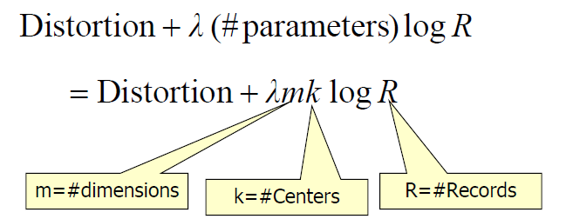
How to choose the number of clusters?
Minimum Description Length (MDL) principal for model comparison
Minimize Schwarz Criterion
also called Bayes Information Criteria (BIC)
sum squared error

Slide 15
How to choose the number of clusters?
Validation set
Try different numbers of clusters and look at performance
When building dictionaries (discussed later), more clusters typically work better

Slide 16
How to evaluate clusters?
Generative
How well are points reconstructed from the clusters?
Discriminative
How well do the clusters correspond to labels?
Purity
Note: unsupervised clustering does not aim to be discriminative

Slide 17
Common similarity/distance measures
P-norms
City Block (L1)
Euclidean (L2)
L-infinity
Mahalanobis
Scaled Euclidean
Cosine distance
Here x_{i} is the distance between two points

Slide 18
Conclusions: K-means
Good
Finds cluster centers that minimize conditional variance (good representation of data)
Simple to implement, widespread application
Bad
Prone to local minima
Need to choose K
All clusters have the same parameters (e.g., distance measure is non-adaptive)
Can be slow: each iteration is O(KNd) for N d-dimensional points

Slide 19
K-medoids
Just like K-means except
Represent the cluster with one of its members, rather than the mean of its members
Choose the member (data point) that minimizes cluster dissimilarity
Applicable when a mean is not meaningful
E.g., clustering values of hue or using L-infinity similarity

Slide 20
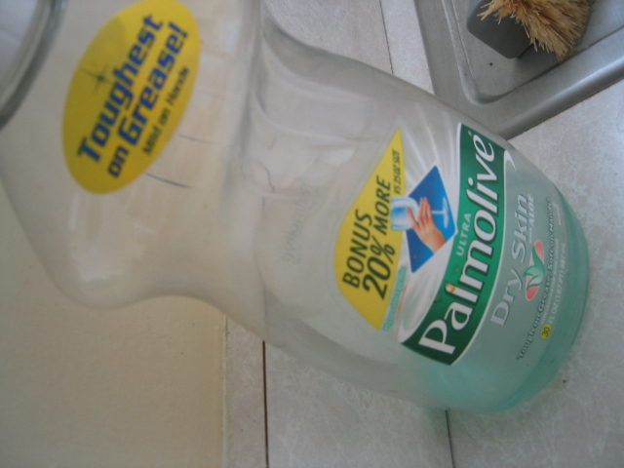
Building Visual Dictionaries
Sample patches from a database
E.g., 128 dimensional SIFT vectors
Cluster the patches
Cluster centers are the dictionary
Assign a codeword (number) to each new patch, according to the nearest cluster

Slide 21
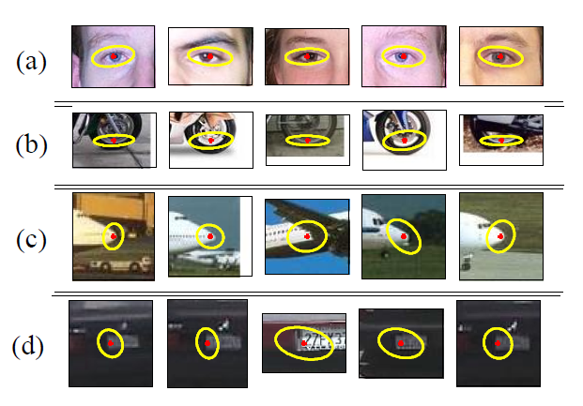
Examples of learned codewords
Most likely codewords for 4 learned “topics”
EM with multinomial (problem 3) to get topics
http://www.robots.ox.ac.uk/~vgg/publications/papers/sivic05b.pdf
Sivic et al. ICCV 2005

Slide 22
Application of Clustering
How to quickly find images in a large database that match a given image region?

Slide 23
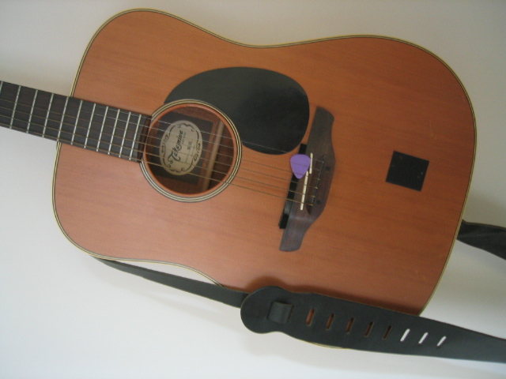
Simple idea
See how many SIFT keypoints are close to SIFT keypoints in each other image
Lots of Matches
Few or No Matches
But this will be really, really slow!

Slide 24
Key idea 1: “Visual Words”
Cluster the keypoint descriptors
Assign each descriptor to a cluster number
What does this buy us?
Each descriptor was 128 dimensional floating point, now is 1 integer (easy to match!)
Is there a catch?
Need a lot of clusters (e.g., 1 million) if we want points in the same cluster to be very similar
Points that really are similar might end up in different clusters

Slide 25
Key idea 1: “Visual Words”
Cluster the keypoint descriptors
Assign each descriptor to a cluster number
Represent an image region with a count of these “visual words”

Slide 26
Key idea 1: “Visual Words”
Cluster the keypoint descriptors
Assign each descriptor to a cluster number
Represent an image region with a count of these “visual words”
An image is a good match if it has a lot of the same visual words as the query region

Slide 27
Naïve matching is still too slow
Imagine matching 1,000,000 images, each with 1,000 keypoints

Slide 28
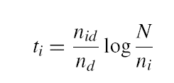
Key Idea 2: Inverse document file
Like a book index: keep a list of all the words (keypoints) and all the pages (images) that contain them.
Rank database images based on tf-idf measure.
tf-idf: Term Frequency – Inverse Document Frequency
# documents
# times word appears in document
# documents that contain the word
# words in document

Slide 29
Fast visual search
“Video Google”, Sivic and Zisserman, ICCV 2003
“Scalable Recognition with a Vocabulary Tree”, Nister and Stewenius, CVPR 2006.

Slide 30
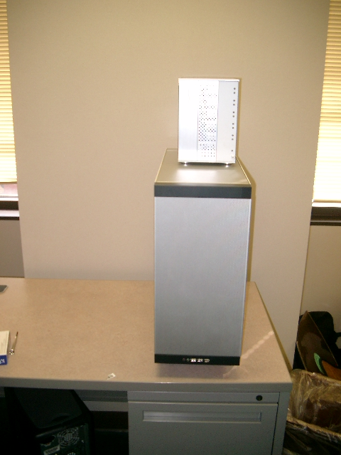
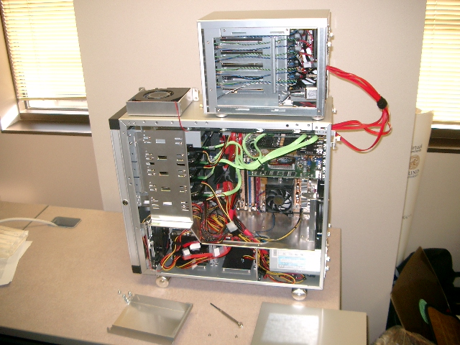
110,000,000 Images in 5.8 Seconds
Slide
This slide and following by David Nister
Notes:
Very recently, we have scaled the system even further.
The system we just demo’d searches a 50 thousand image index in the RAM of this laptop at real-time rates.
We have built and programmed a desktop system at home in which we currently have 12 hard drives. We bypass the operating system and
read and write the disk surfaces directly.
Last week this system clocked in on 110 Million images in 5.8 seconds, so roughly 20Million images per second and machine.
The images consist of around 10 days of four TV channels, so more than a month of TV.
Soon we don’t have to watch TV, because we’ll have machines doing it for us.

Slide 31
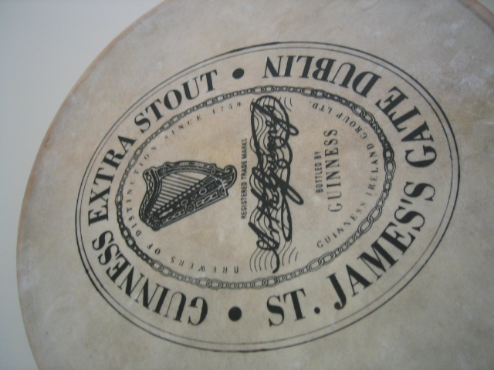
Notes:
I will now try to describe the approach with an animation.
The first, offline phase, is to train the vocabulary tree.
We use Maximally Stable Extremal Regions by Matas et al. and then we extract SIFT descriptors from the MSER regions.
Regarding the feature extraction, we are not really claiming anything other than down-in-the-trenches nose-to-the-grindstone hard work to get good implementations of the state-of-the-art, and since we are all obsessed with novelty I will not spend any time talking about the feature extraction.
We believe that the vocabulary tree approach will work well on any of your favorite descriptors.

Slide 32
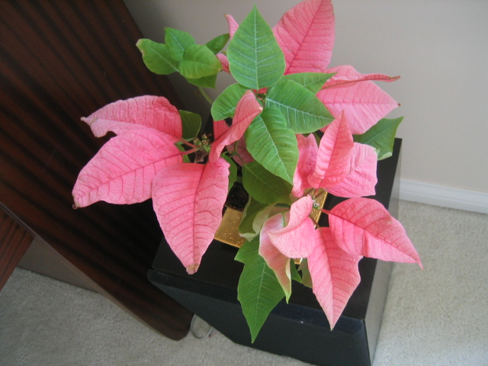
Notes:
All the descriptor vectors are thrown into a common space.
This is done for many images, the goal being to acquire enough statistics on how natural images distribute points in the descriptor space.

Slide 34
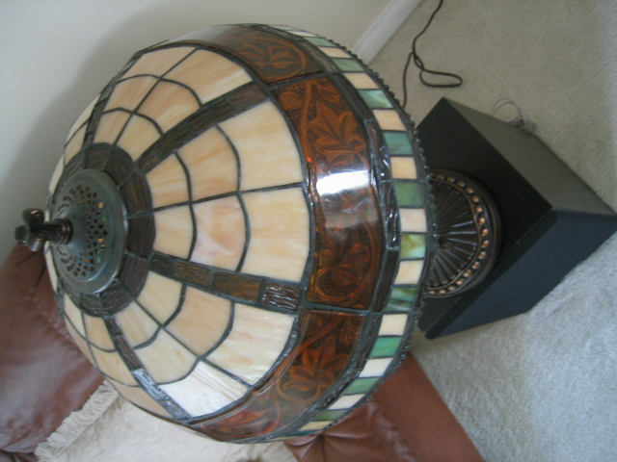

Slide 36
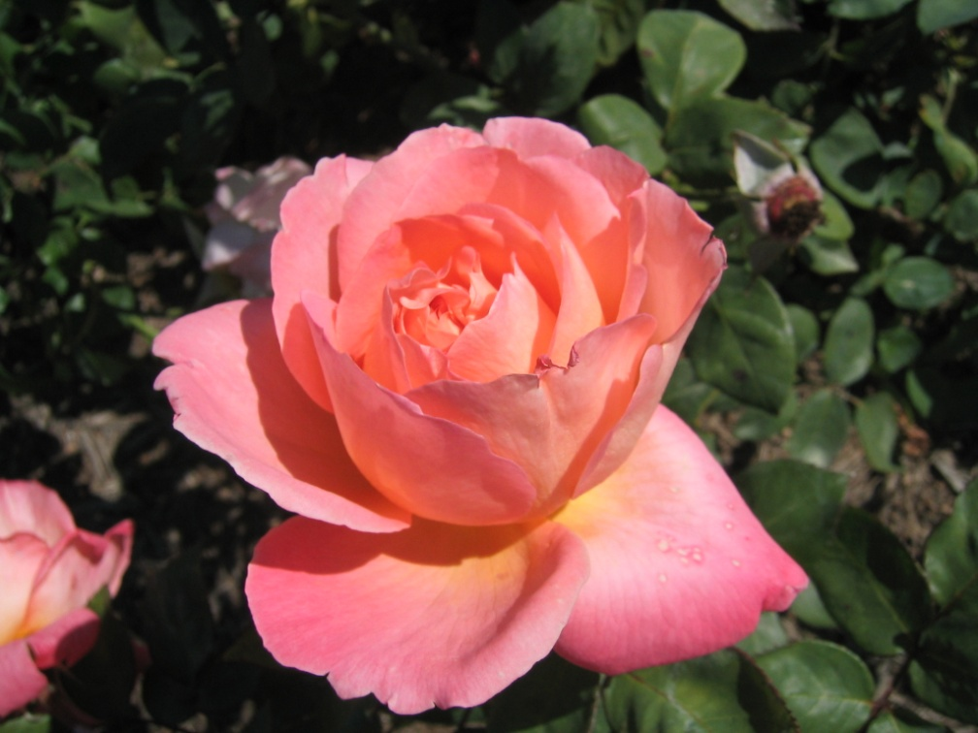

Slide 38
Notes:
We then run k-means on the descriptor space. In this setting, k defines what we call the branch-factor of the tree, which indicates how fast the tree branches.
In this illustration, k is three. We then run k-means again, recursively on each of the resulting quantization cells.
This defines the vocabulary tree, which is essentially a hierarchical set of cluster centers and their corresponding Voronoi regions.
We typically use a branch-factor of 10 and six levels, resulting in a million leaf nodes. We lovingly call this the Mega-Voc.

Slide 48
Notes:
We now have the vocabulary tree, and the online phase can begin.
In order to add an image to the database, we perform feature extraction. Each descriptor vector is now dropped down from the root of the tree and quantized very efficiently into a path down the tree, encoded by a single integer.
Each node in the vocabulary tree has an associated inverted file index.
Indecies back to the new image are then added to the relevant inverted files.
This is a very efficient operation that is carried out whenever we want to add an image.

Slide 49
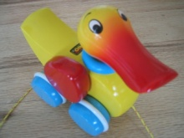

Slide 50
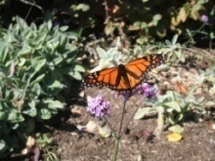

Slide 51
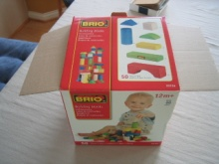

Slide 53
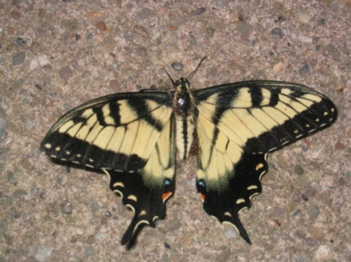
Notes:
When we then wish to query on an input image, we quantize the descriptor vectors of the input image in a similar way, and accumulate scores for the images in the database with so called term frequency inverse document frequency (tf-idf). This is effectively an entropy weighting of the information. The winner is the image in the database with the most common information with the input image.

Slide 54
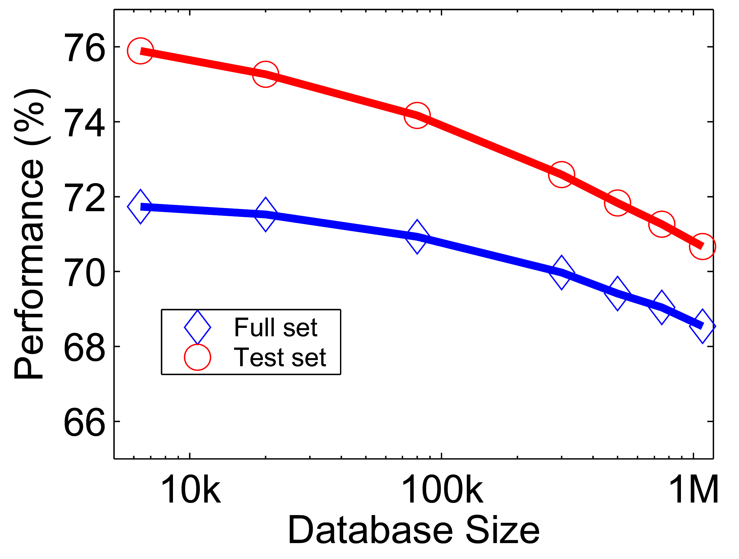
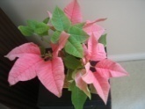
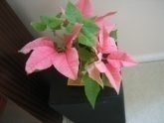
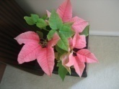
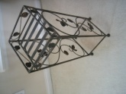
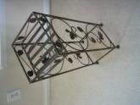
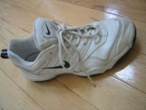
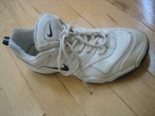
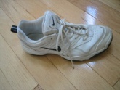
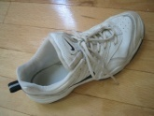
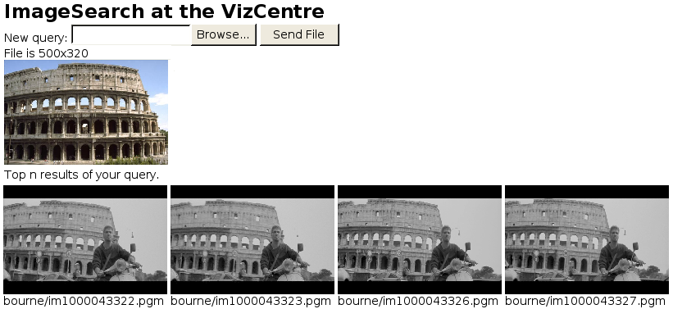
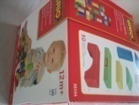
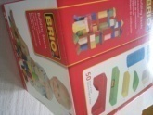
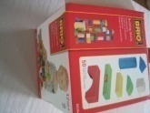
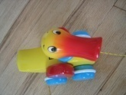
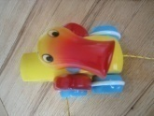
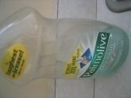
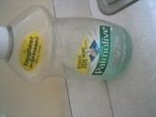
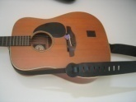
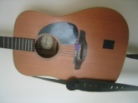
Performance
Notes:
One of the reasons we managed to take the system this far is that we have worked with rigorous performance testing against a database with ground truth.
We now have a benchmark database with over 10000 images grouped in sets of four images of the same object. We query on one of the images in the group and see how many of the other images in the group make it to the top of the query.
In the paper, we have tested this up to a million images, by embedding the ground truth database into a database encompassing all the frames of 10 feature length movies.

Slide 55
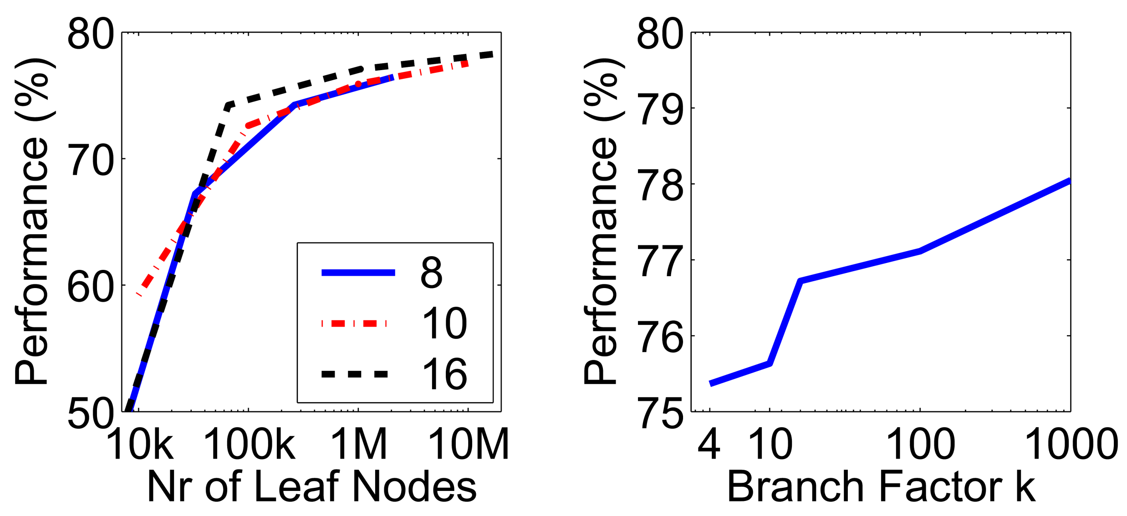
More words is better
Improves
Retrieval
Improves
Speed
Branch factor
Notes:
We have used the performance testing to explore various settings for the algorithm.
The most important finding is that the number of leaf nodes in the vocabulary tree is very important.
In principle, there is a trade-off, because we wish to have discriminative quantizations, which implies many leaf-nodes, while we also wish to have repeatable quantizations, which implies few leaf nodes.
However, it seems that in a large practical range, the bigger the better when it comes to the vocabulary. This probably depends on the descriptors used, but is not entirely surprising, since we are trying to divide up a 128-dimensional space in discriminative bins.
This is a very useful finding, because it means that we are in a win-win situation:
a larger vocabulary improves retrieval performance. It turns out that it also improves the retrieval speed, because our inverted file index becomes much sparser, so we exploit the true power of inverted files better with a larger vocabulary.
We also use a hierarchical scoring scheme, which has the nice property that the performance will only level out, not actually go down.

Slide 56
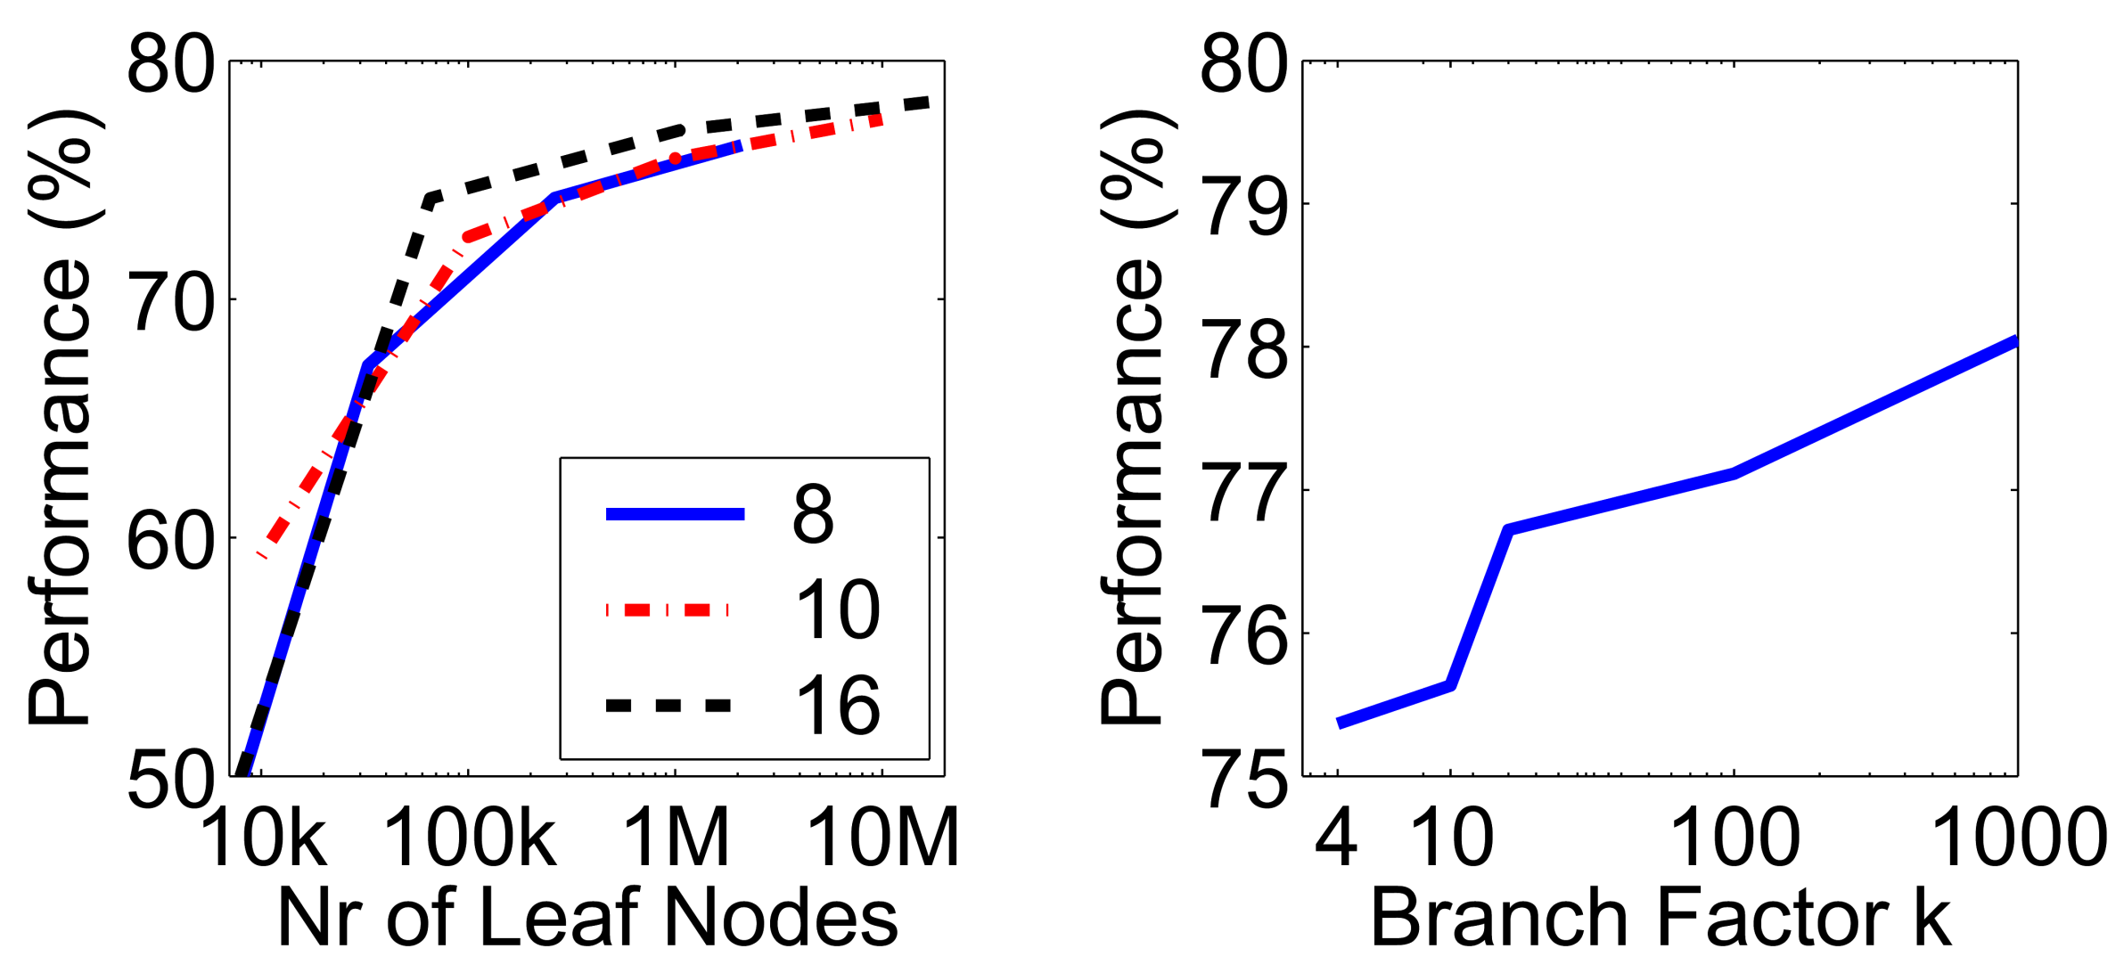
Higher branch factor works better (but slower)
Notes:
We also find that performance improves with the branch factor.
This improvement is not dramatic, but it is interesting to note that very low branch factors are somewhat weak, and a branch factor of two results in partitioning the space with planes.

Slide 57
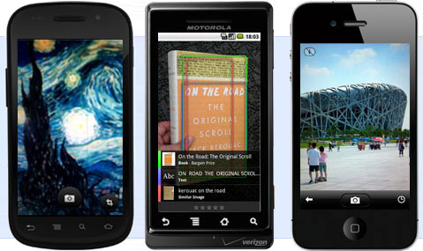
Application: Google Goggles
http://www.google.com/mobile/goggles/#text

Slide 58
Sampling strategies
Sparse, at interest points
Dense, uniformly
Randomly
To find specific, textured objects, sparse sampling from interest points often more reliable.
Multiple complementary interest operators offer more image coverage.
For object categorization, dense sampling offers better coverage.
[See Nowak, Jurie & Triggs, ECCV 2006]
Multiple interest operators
Image credits: F-F. Li, E. Nowak, J. Sivic

Slide 59
Can we be more accurate?
So far, we treat each image as containing a “bag of words”, with no spatial information
Which matches better?
e
h
a
f
e
e
z
a
f
e
h
a
f
e
e

Slide 60
Can we be more accurate?
So far, we treat each image as containing a “bag of words”, with no spatial information
Real objects have consistent geometry

Slide 61
Final key idea: geometric verification
RANSAC for affine transform
Repeat N times:
e
z
e
z
a
a
Randomly choose 3 matching pairs
f
f
e
e
Estimate transformation
Affine Transform
e
z
e
Predict remaining points and count “inliers”
z
a
a
f
f
e
e

Slide 62
Application: Large-Scale Retrieval
Query
Results on 5K (demo available for 100K)
[Philbin CVPR’07]

Slide 63
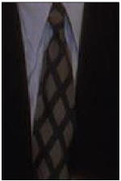
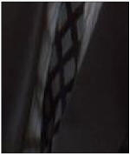
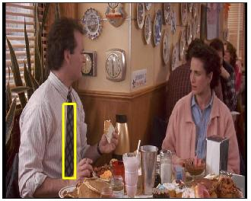
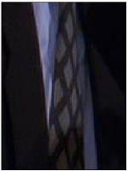
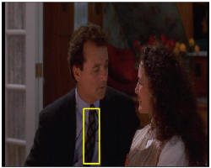
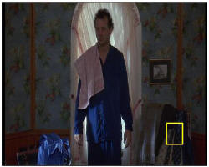
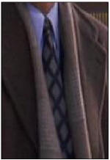
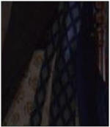
Video Google System
Query region
Collect all words within query region
Inverted file index to find relevant frames
Compare word counts
Spatial verification
Sivic & Zisserman, ICCV 2003
Demo online at : http://www.robots.ox.ac.uk/~vgg/research/vgoogle/index.html
Retrieved frames

Slide 64
Building Visual Dictionaries
Sample patches from a database
E.g., 128 dimensional SIFT vectors
Cluster the patches
Cluster centers are the dictionary
Assign a codeword (number) to each new patch, according to the nearest cluster

Slide 65
Examples of learned codewords
Most likely codewords for 4 learned “topics”
EM with multinomial (problem 3) to get topics
http://www.robots.ox.ac.uk/~vgg/publications/papers/sivic05b.pdf
Sivic et al. ICCV 2005

Slide 66
Learning Visual Dictionaries
Inpainting Application

Slide 67
Agglomerative clustering

Slide 68
Agglomerative clustering

Slide 69
Agglomerative clustering

Slide 70
Agglomerative clustering

Slide 71
Agglomerative clustering

Slide 72
Agglomerative clustering
How to define cluster similarity?
Average distance between points, maximum distance, minimum distance
Distance between means or medoids
How many clusters?
Clustering creates a dendrogram (a tree)
Threshold based on max number of clusters or based on distance between merges
distance

Slide 73
Agglomerative clustering demo
http://home.dei.polimi.it/matteucc/Clustering/tutorial_html/AppletH.html

Slide 74
Conclusions: Agglomerative Clustering
Good
Simple to implement, widespread application
Clusters have adaptive shapes
Provides a hierarchy of clusters
Bad
May have imbalanced clusters
Still have to choose number of clusters or threshold
Need to use an “ultrametric” to get a meaningful hierarchy

Slide 75
Spectral clustering
Group points based on links in a graph
B
A

Slide 76
Cuts in a graph
B
A
Normalized Cut
the raw cut cost encouraging splitting out just one node
fix by normalizing for size of segments
volume(A) = sum of costs of all edges that touch A
Source: Seitz

Slide 77
Normalized cuts for segmentation

Slide 78
Visual PageRank
Determining importance by random walk
What’s the probability that you will randomly walk to a given node?
Create adjacency matrix based on visual similarity
Edge weights determine probability of transition
Jing Baluja 2008
Notes:
Gives a way to select representative samples

Slide 79
Which algorithm to use?
Quantization/Summarization: K-means
Aims to preserve variance of original data
Can easily assign new point to a cluster
Summary of 20,000 photos of Rome using “greedy k-means”
http://grail.cs.washington.edu/projects/canonview/
Quantization for computing histograms

Slide 80
Which algorithm to use?
Image segmentation: agglomerative clustering
More flexible with distance measures (e.g., can be based on boundary prediction)
Adapts better to specific data
Hierarchy can be useful
http://www.cs.berkeley.edu/~arbelaez/UCM.html

Slide 81
Which algorithm to use?
Image segmentation: spectral clustering
Can provide more regular regions
Spectral methods also used to propagate global cues (e.g., Global pB)

Slide 82
Things to remember
K-means useful for summarization, building dictionaries of patches, general clustering
Fast object retrieval using visual words and inverse index table
Agglomerative clustering useful for segmentation, general clustering
Spectral clustering useful for determining relevance, summarization, segmentation

Slide 83
Next class
Gestalt grouping
Image segmentation
Mean-shift segmentation
Watershed segmentation

