Slide 1
Alignment and Object Instance Recognition
02/16/12
Computer Vision
CS 543 / ECE 549
University of Illinois
Derek Hoiem

Slide 2
Today’s class
Alignment (continued)
Object instance recognition
Example of alignment-based category recognition

Slide 3
Line Fitting Demo

Slide 4
Alignment
Alignment: find parameters of model that maps one set of points to another
Typically want to solve for a global transformation that accounts for *most* true correspondences
Difficulties
Noise (typically 1-3 pixels)
Outliers (often 50%)
Many-to-one matches or multiple objects

Slide 5
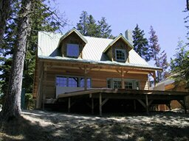
Parametric (global) warping
T
p = (x,y)
p’ = (x’,y’)
Transformation T is a coordinate-changing machine:
p’ = T(p)
What does it mean that T is global?
Is the same for any point p
can be described by just a few numbers (parameters)
For linear transformations, we can represent T as a matrix
p’ = Tp

Slide 6
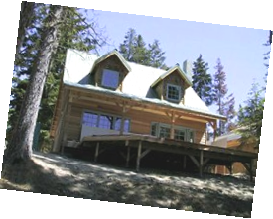
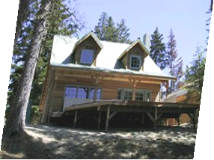
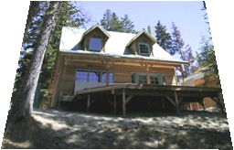
Common transformations
original
Transformed
translation
rotation
aspect
affine
perspective
Slide credit (next few slides): A. Efros and/or S. Seitz

Slide 7
Scaling
Scaling a coordinate means multiplying each of its components by a scalar
Uniform scaling means this scalar is the same for all components:
× 2

Slide 8
Scaling
Non-uniform scaling: different scalars per component:
X × 2, Y × 0.5

Slide 9
Scaling
Scaling operation:
Or, in matrix form:
scaling matrix S

Slide 10
2-D Rotation
(x’, y’)
(x, y)
x’ = x cos(θ) - y sin(θ)
y’ = x sin(θ) + y cos(θ)
θ

Slide 11
2-D Rotation
Polar coordinates…
x = r cos (φ)
y = r sin (φ)
x’ = r cos (φ + θ)
y’ = r sin (φ + θ)
Trig Identity…
x’ = r cos(φ) cos(θ) – r sin(φ) sin(θ)
y’ = r sin(φ) cos(θ) + r cos(φ) sin(θ)
Substitute…
x’ = x cos(θ) - y sin(θ)
y’ = x sin(θ) + y cos(θ)
(x’, y’)
(x, y)
θ
φ

Slide 12
2-D Rotation
This is easy to capture in matrix form:
Even though sin(θ) and cos(θ) are nonlinear functions of θ,
x’ is a linear combination of x and y
y’ is a linear combination of x and y
What is the inverse transformation?
Rotation by –θ
For rotation matrices
R

Slide 13
Basic 2D transformations
Scale
Shear
Rotate
Translate
Affine is any combination of translation, scale, rotation, shear
Affine

Slide 14
Affine Transformations
Affine transformations are combinations of
Linear transformations, and
Translations
Properties of affine transformations:
Lines map to lines
Parallel lines remain parallel
Ratios are preserved
Closed under composition
or

Slide 15
Projective Transformations
Projective transformations are combos of
Affine transformations, and
Projective warps
Properties of projective transformations:
Lines map to lines
Parallel lines do not necessarily remain parallel
Ratios are not preserved
Closed under composition
Models change of basis
Projective matrix is defined up to a scale (8 DOF)

Slide 16
2D image transformations (reference table)

Slide 17
Example: solving for translation
A₁
A₂
A₃
B₁
B₂
B₃
Given matched points in {A} and {B}, estimate the translation of the object

Slide 18
Example: solving for translation
A₁
A₂
A₃
(t_{x}, t_{y})
B₁
B₂
B₃
Least squares solution
Write down objective function
Derived solution
Compute derivative
Compute solution
Computational solution
Write in form Ax=b
Solve using pseudo-inverse or eigenvalue decomposition

Slide 19
Example: solving for translation
A₁
A₅
B₄
A₂
A₃
(t_{x}, t_{y})
B₁
A₄
B₂
B₃
B₅
Problem: outliers
RANSAC solution
Sample a set of matching points (1 pair)
Solve for transformation parameters
Score parameters with number of inliers
Repeat steps 1-3 N times

Slide 20
Example: solving for translation
B₄
A₁
B₅
B₆
A₂
A₃
(t_{x}, t_{y})
B₁
A₄
B₂
B₃
A₅
A₆
Problem: outliers, multiple objects, and/or many-to-one matches
Hough transform solution
Initialize a grid of parameter values
Each matched pair casts a vote for consistent values
Find the parameters with the most votes
Solve using least squares with inliers

Slide 21
Example: solving for translation
(t_{x}, t_{y})
Problem: no initial guesses for correspondence

Slide 22
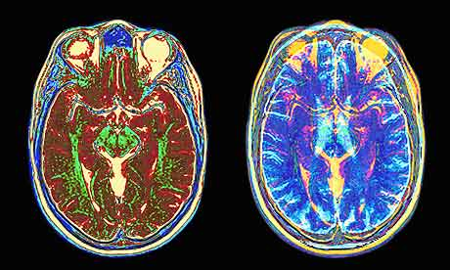
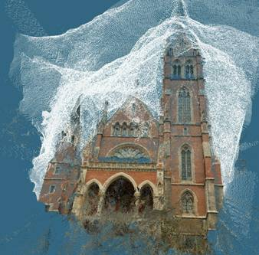
What if you want to align but have no prior matched pairs?
Hough transform and RANSAC not applicable
Important applications
Medical imaging: match brain scans or contours
Robotics: match point clouds

Slide 23
Iterative Closest Points (ICP) Algorithm
Goal: estimate transform between two dense sets of points
Initialize transformation (e.g., compute difference in means and scale)
Assign each point in {Set 1} to its nearest neighbor in {Set 2}
Estimate transformation parameters
e.g., least squares or robust least squares
Transform the points in {Set 1} using estimated parameters
Repeat steps 2-4 until change is very small

Slide 24
Example: solving for translation
(t_{x}, t_{y})
Problem: no initial guesses for correspondence
ICP solution
Find nearest neighbors for each point
Compute transform using matches
Move points using transform
Repeat steps 1-3 until convergence

Slide 25
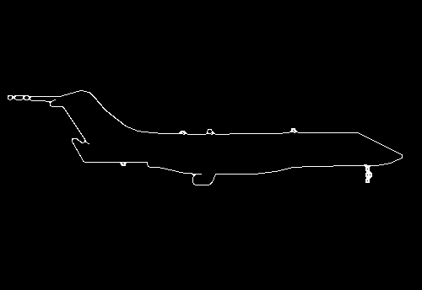
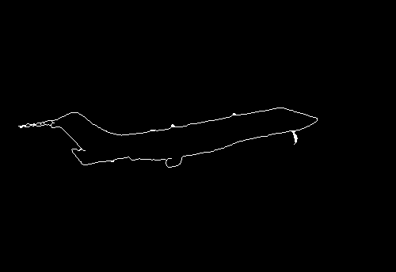
Example: aligning boundaries
Extract edge pixels $p1..pn$ and $q1..qm$
Compute initial transformation (e.g., compute translation and scaling by center of mass, variance within each image)
Get nearest neighbors: for each point $pi$ find corresponding $match(i)=\underset{j}{argmin}{dist(pi,qj)}$
Compute transformation T based on matches
Warp points p according to T
Repeat 3-5 until convergence
p
q

Slide 26
Algorithm Summary
Least Squares Fit
closed form solution
robust to noise
not robust to outliers
Robust Least Squares
improves robustness to noise
requires iterative optimization
Hough transform
robust to noise and outliers
can fit multiple models
only works for a few parameters (1-4 typically)
RANSAC
robust to noise and outliers
works with a moderate number of parameters (e.g, 1-8)
Iterative Closest Point (ICP)
For local alignment only: does not require initial correspondences

Slide 27
Object Instance Recognition
Match keypoints to object model
Solve for affine transformation parameters
Score by inliers and choose solutions with score above threshold
A₁
B₃
A₃
A₂
Matched keypoints
B₁
B₂
Affine Parameters
This Class
# Inliers
Choose hypothesis with max score above threshold

Slide 28
Overview of Keypoint Matching
1. Find a set of distinctive key- points
A₁
B₃
2. Define a region around each keypoint
A₂
A₃
B₁
B₂
3. Extract and normalize the region content
4. Compute a local descriptor from the normalized region
N pixels
e.g. color
e.g. color
N pixels
5. Match local descriptors

Slide 29
Keypoint-based instance recognition
Given two images and their keypoints (position, scale, orientation, descriptor)
Goal: Verify if they belong to a consistent configuration
Local Features, e.g. SIFT
Slide credit: David Lowe

Slide 30
Finding the objects (overview)
Input Image
Stored Image
Match interest points from input image to database image
Matched points vote for rough position/orientation/scale of object
Find position/orientation/scales that have at least three votes
Compute affine registration and matches using iterative least squares with outlier check
Report object if there are at least T matched points

Slide 31
Matching Keypoints
Want to match keypoints between:
Query image
Stored image containing the object
Given descriptor x₀, find two nearest neighbors x₁, x₂ with distances d₁, d₂
x₁ matches x₀ if d₁/d₂ < 0.8
This gets rid of 90% false matches, 5% of true matches in Lowe’s study

Slide 32
Affine Object Model
Accounts for 3D rotation of a surface under orthographic projection

Slide 33
Affine Object Model
Accounts for 3D rotation of a surface under orthographic projection
What is the minimum number of matched points that we need?

Slide 34
Finding the objects (in detail)
Match interest points from input image to database image
Get location/scale/orientation using Hough voting
In training, each point has known position/scale/orientation wrt whole object
Matched points vote for the position, scale, and orientation of the entire object
Bins for x, y, scale, orientation
Wide bins (0.25 object length in position, 2x scale, 30 degrees orientation)
Vote for two closest bin centers in each direction (16 votes total)
Geometric verification
For each bin with at least 3 keypoints
Iterate between least squares fit and checking for inliers and outliers
Report object if > T inliers (T is typically 3, can be computed to match some probabilistic threshold)

Slide 35
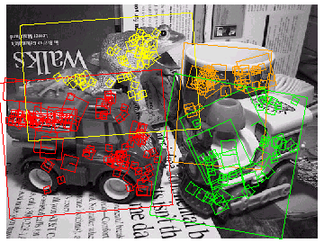
Examples of recognized objects

Slide 36
View interpolation
Training
Given images of different viewpoints
Cluster similar viewpoints using feature matches
Link features in adjacent views
Recognition
Feature matches may be spread over several training viewpoints
⇒ Use the known links to “transfer votes” to other viewpoints
[Lowe01]
Slide credit: David Lowe

Slide 37
Applications
Sony Aibo (Evolution Robotics)
SIFT usage
Recognize docking station
Communicate with visual cards
Other uses
Place recognition
Loop closure in SLAM
Slide credit: David Lowe

Slide 38
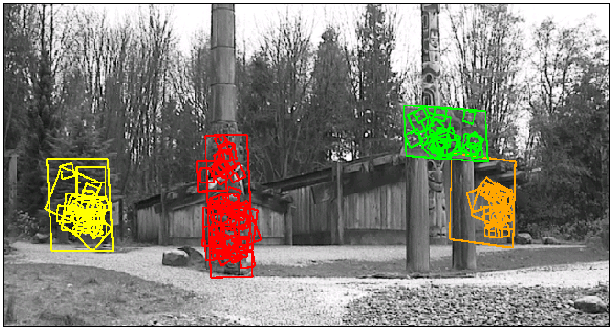
Location Recognition
Training
[Lowe04]
Slide credit: David Lowe

Slide 39
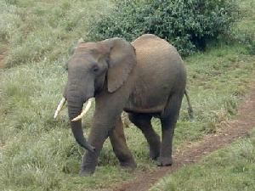
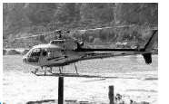
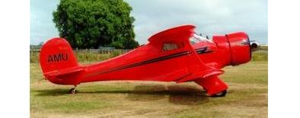
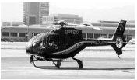
Another application: category recognition
Goal: identify what type of object is in the image
Approach: align to known objects and choose category with best match
?
“Shape matching and object recognition using low distortion correspondence”, Berg et al., CVPR 2005: http://www.cnbc.cmu.edu/cns/papers/berg-cvpr05.pdf

Slide 40
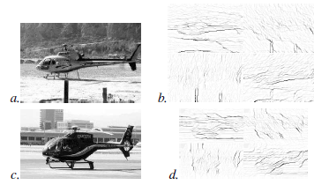
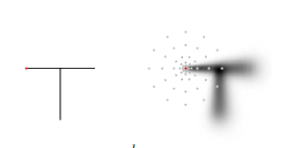
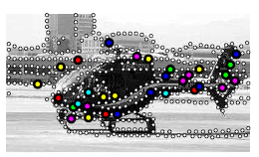
Summary of algorithm
Input: query q and exemplar e
For each: sample edge points and create “geometric blur” descriptor
Compute match cost c to match points in q to each point in e
Compute deformation cost H that penalizes change in orientation and scale for pairs of matched points
Solve a binary quadratic program to get correspondence that minimizes c and H, using thin-plate spline deformation
Record total cost for e, repeat for all exemplars, choose exemplar with minimum cost
Input, Edge Maps
Geometric Blur
Feature Points
Correspondences

Slide 41
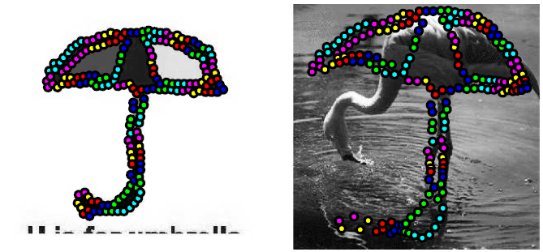
Examples of Matches

Slide 42
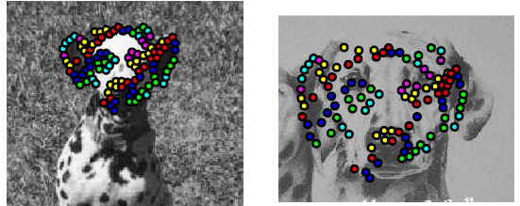
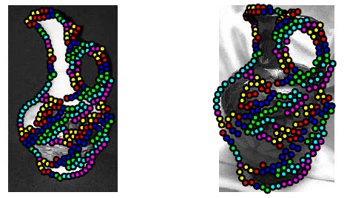
Examples of Matches

Slide 43
Other ideas worth being aware of
Thin-plate splines: combines global affine warp with smooth local deformation
Robust non-rigid point matching: http://noodle.med.yale.edu/~chui/tps-rpm.html (includes code, demo, paper)

Slide 44
Think about your final projects
Strongly encouraged to work in groups of 2-4 (but if you have a good reason to work by self, could be ok)
Projects don’t need to be of publishable originality but should evince independent effort to learn about a new topic, try something new, or apply to an application of interest
Project ideas from Cinda Hereen
Classroom attendance: I teach in Siebel 1404, and I'd like to be able to track attendance by taking photos of the room (students who opt out can just put their heads down). Extra facts in the problem: a) I have photo rosters; b) i'm willing to use a tagging system wherein students can verify our assertions; c) the results don't have to be exact.
Medication tracking: I would like for a person to be able to chart his/her medicine consumption by taking a photo of the med bottles. Extra facts: a. it has to work on a mobile device (limited computation), b. it could be a matching problem--could photograph known meds and use the photos as the labels.
Thermometer reading: In a related problem, i'd like to be able to take a picture of a thermometer (digital or analogue) and record it's reading.

Slide 45
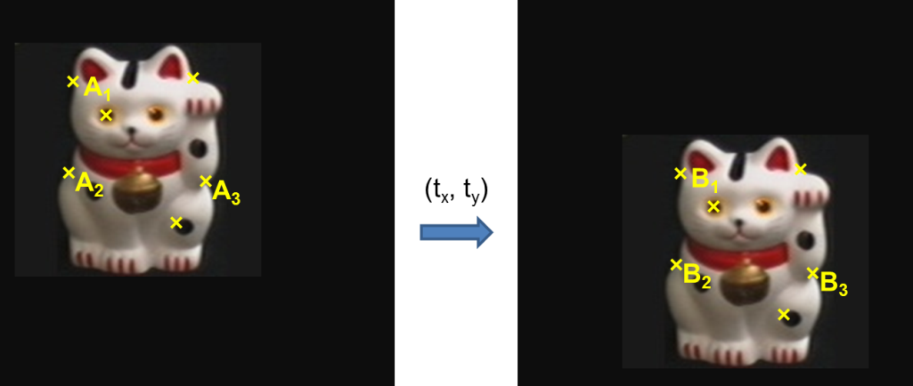
Key concepts
Alignment
Hough transform
RANSAC
ICP
Object instance recognition
Find keypoints, compute descriptors
Match descriptors
Vote for / fit affine parameters
Return object if # inliers > T

