Slide 1
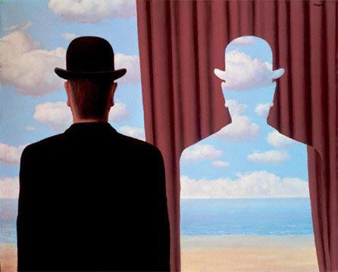
Edge Detection
02/02/12
Magritte, “Decalcomania”
Computer Vision (CS 543 / ECE 549)
University of Illinois
Derek Hoiem
Many slides from Lana Lazebnik, Steve Seitz, David Forsyth, David Lowe, Fei-Fei Li

Slide 2
Last class
How to use filters for
  Matching
  Compression
Image representation with pyramids
Texture and filter banks

Slide 3
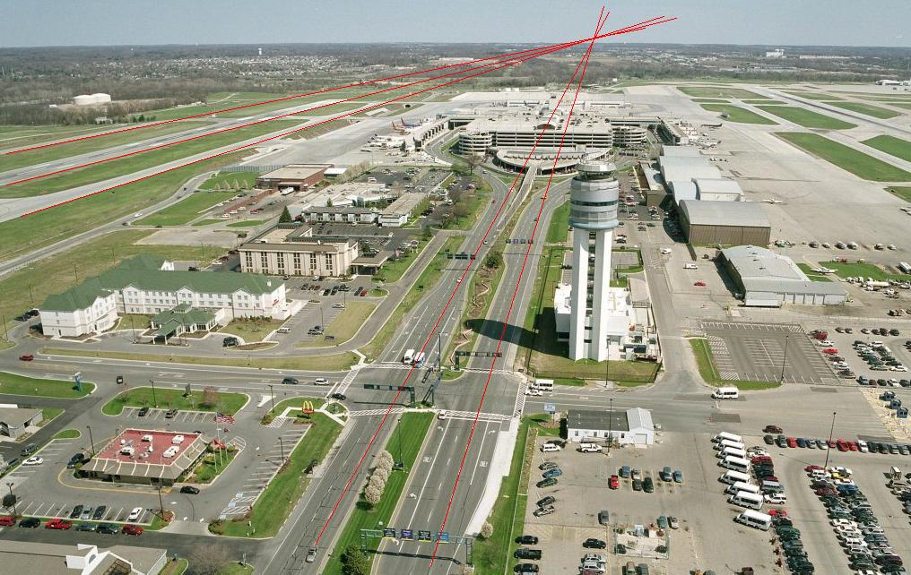
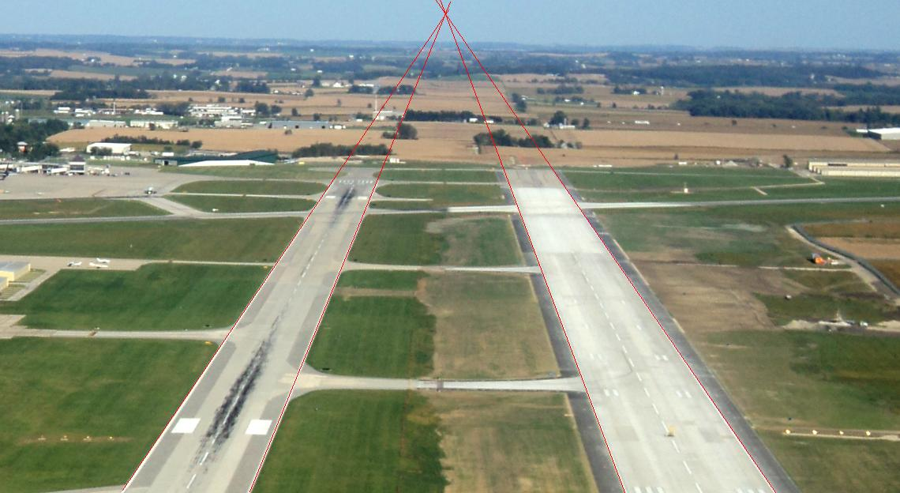
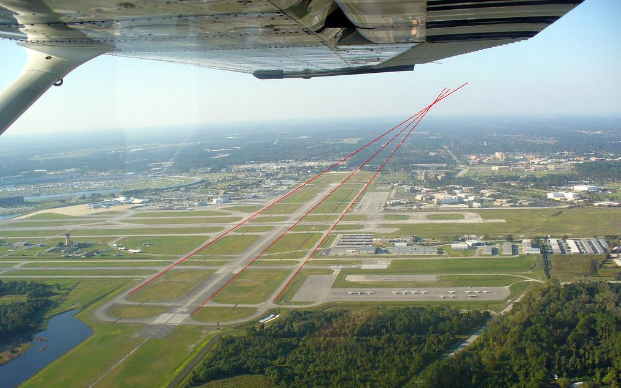
A couple remaining questions from earlier
Does the curvature of the earth change the horizon location?
Illustrations from Amin Sadeghi

Slide 4
A couple remaining questions from earlier
Computational complexity of coarse-to-fine search?
Image 1 Pyramid
Image 2 Pyramid
Size M
Size N
Repeated Local Neighborhood Search O(M)
Downsampling: O(N+M)
Low Resolution Search O(N/M)
Overall complexity: O(N+M)
Original high-resolution full search: O(NM) or O(N logN)

Slide 5
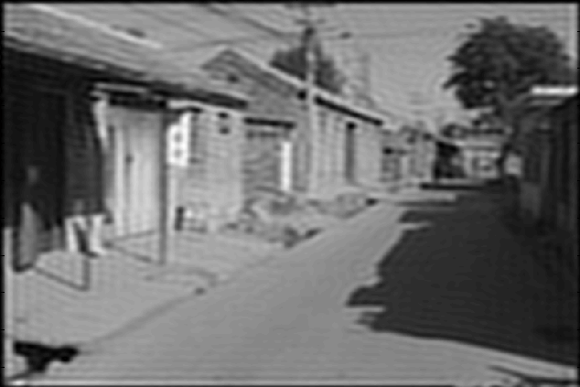
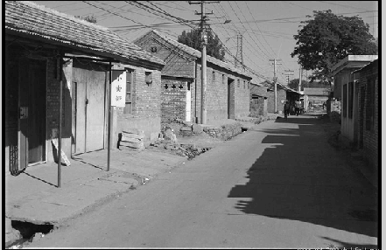
Issue from Tuesday
Why not use an ideal filter?
Answer: has infinite spatial extent, clipping results in ringing
Attempt to apply ideal filter in frequency domain

Slide 6

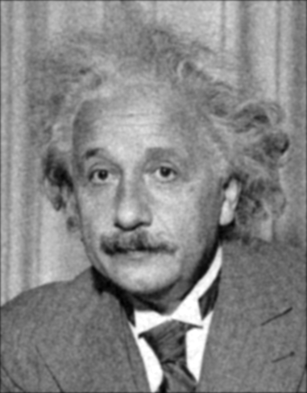
Denoising
Gaussian Filter
Additive Gaussian Noise

Slide 7
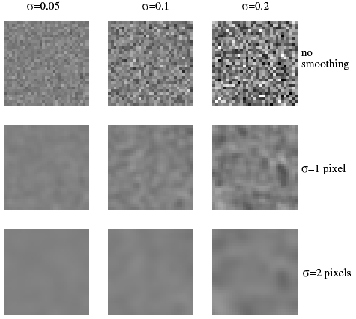
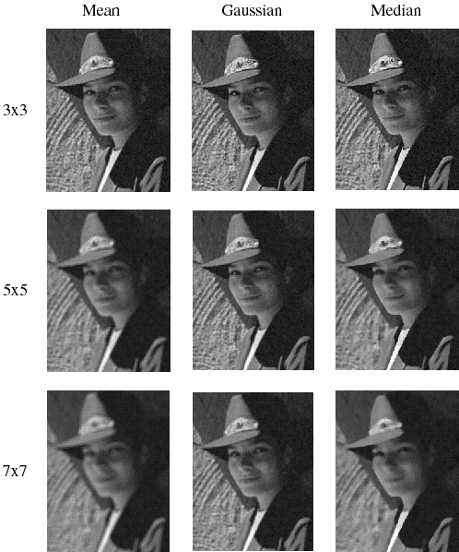
Reducing Gaussian noise
Smoothing with larger standard deviations suppresses noise, but also blurs the image
Source: S. Lazebnik

Slide 8
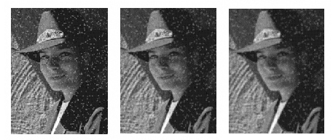
Reducing salt-and-pepper noise by Gaussian smoothing
3x3
5x5
7x7
Notes:
What’s wrong with these results?

Slide 9
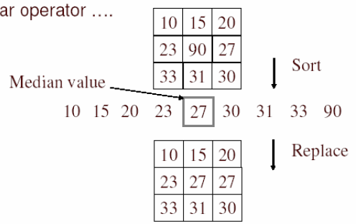
Alternative idea: Median filtering
A median filter operates over a window by selecting the median intensity in the window
Is median filtering linear?
Source: K. Grauman
Notes:
Better at salt’n’pepper noise
Not convolution: try a region with 1’s and a 2, and then 1’s and a 3

Slide 10
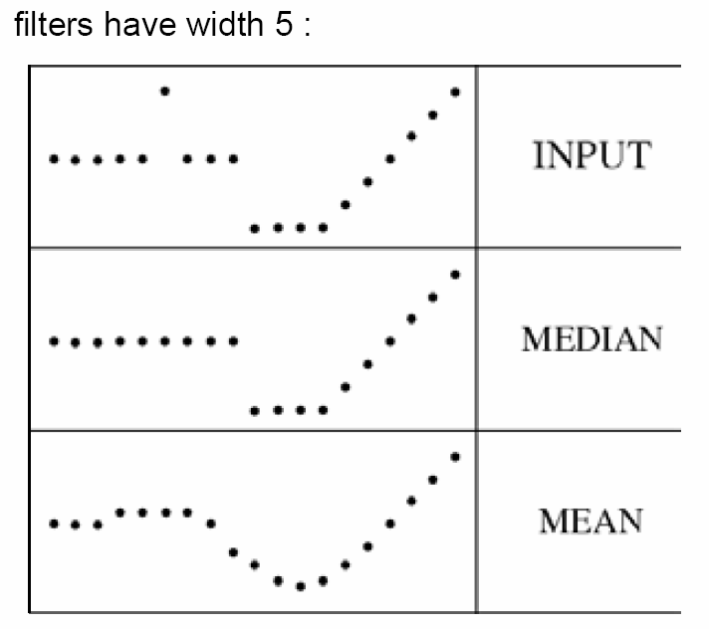
Median filter
What advantage does median filtering have over Gaussian filtering?
  Robustness to outliers, preserves edges
Source: K. Grauman

Slide 11
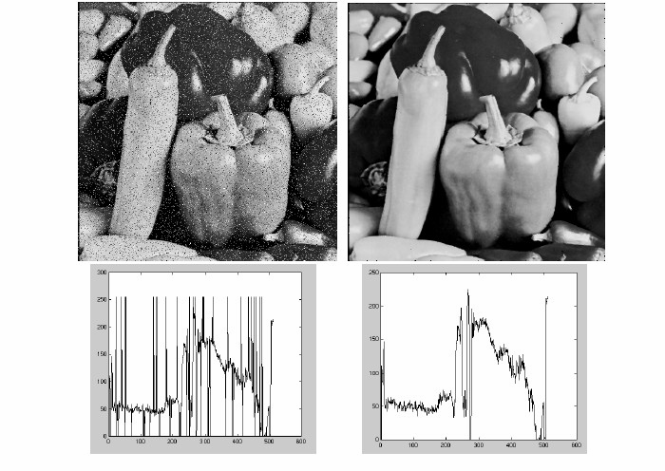
Median filter
Salt-and-pepper noise
Median filtered
MATLAB: medfilt2(image, [h w])
Source: M. Hebert

Slide 12
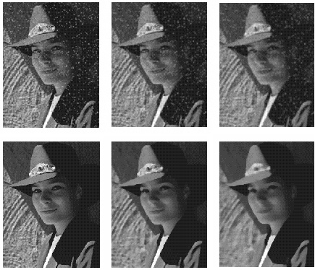
Median vs. Gaussian filtering
3x3
5x5
7x7
Gaussian
Median

Slide 13
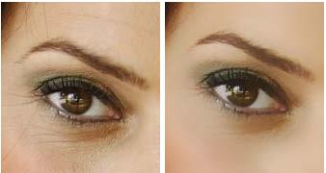
Other non-linear filters
Weighted median (pixels further from center count less)
Clipped mean (average, ignoring few brightest and darkest pixels)
Max or min filter (ordfilt2)
Bilateral filtering (weight by spatial distance and intensity difference)
Bilateral filtering
Image:
http://vision.ai.uiuc.edu/?p=1455

Slide 14
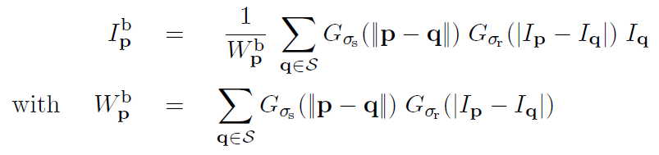
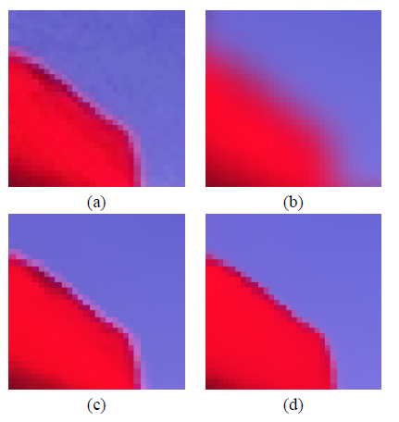
Bilateral filters
Edge preserving: weights similar pixels more
spatial
similarity (e.g., intensity)
Original
Gaussian
Bilateral
Carlo Tomasi, Roberto Manduchi, Bilateral Filtering for Gray and Color Images, ICCV, 1998.

Slide 15
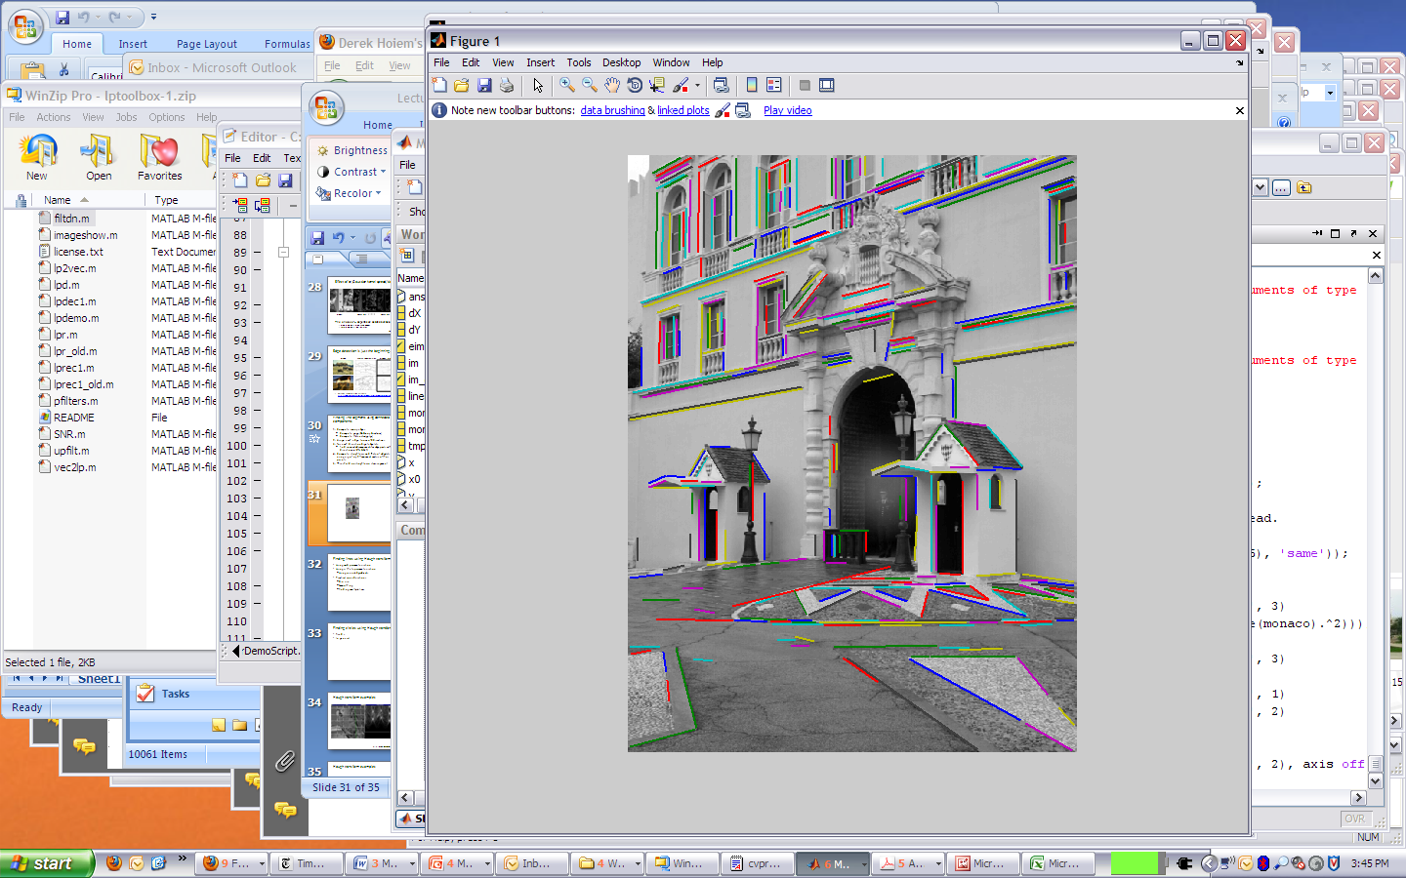

Today’s class
Detecting edges
Finding straight lines

Slide 16

Why do we care about edges?
Extract information, recognize objects
Recover geometry and viewpoint
Vertical vanishing
point
(at infinity)
Vanishing
line
Vanishing
point
Vanishing
point

Slide 17

Origin of Edges
surface normal discontinuity
depth discontinuity
surface color discontinuity
illumination discontinuity
Edges are caused by a variety of factors
Source: Steve Seitz

Slide 18
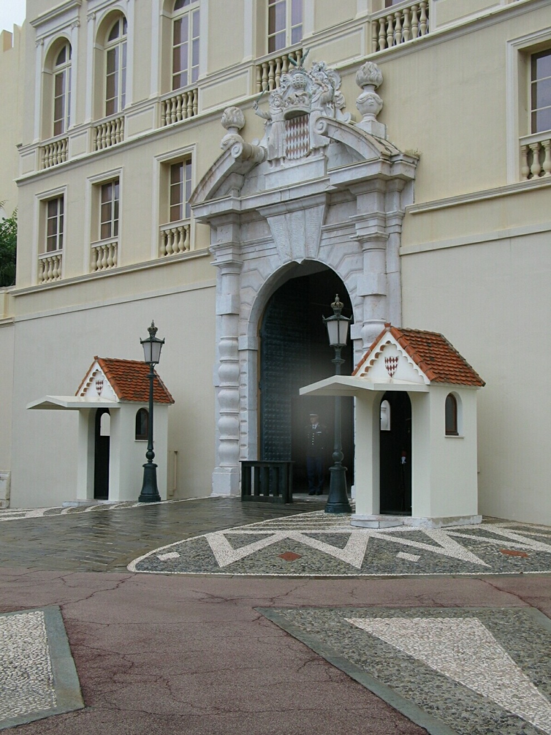
Closeup of edges

Slide 19
Closeup of edges

Slide 20
Closeup of edges

Slide 21
Closeup of edges

Slide 22

Characterizing edges
An edge is a place of rapid change in the image intensity function
intensity function
(along horizontal scanline)
image
first derivative
edges correspond to
extrema of derivative

Slide 23
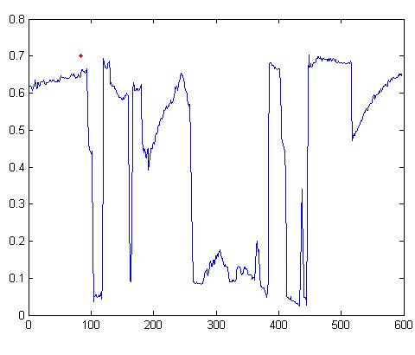

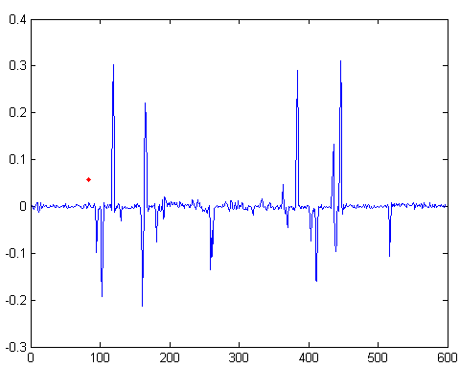
Intensity profile
Intensity
Gradient

Slide 24
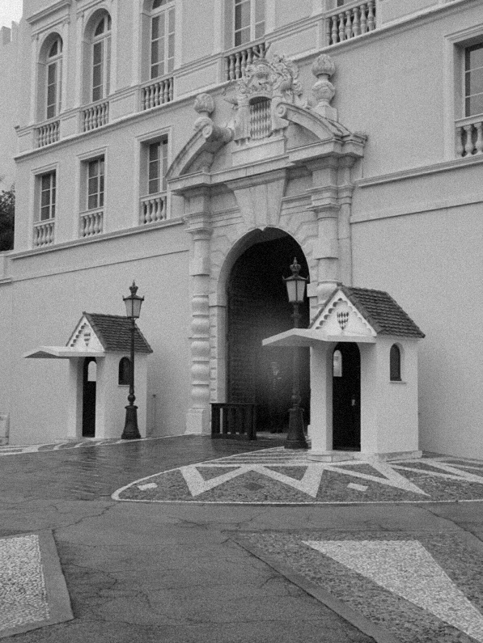
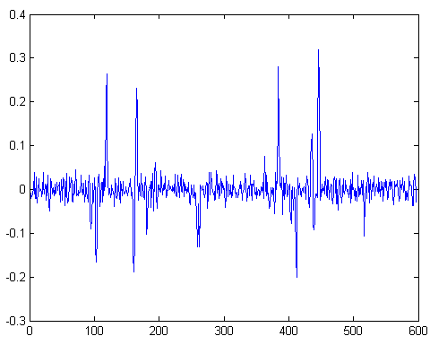
With a little Gaussian noise
Gradient

Slide 25




Effects of noise
Consider a single row or column of the image
  Plotting intensity as a function of position gives a signal
Where is the edge?
Source: S. Seitz
Notes:
How to fix?

Slide 26
Effects of noise
Difference filters respond strongly to noise
  Image noise results in pixels that look very different from their neighbors
  Generally, the larger the noise the stronger the response
What can we do about it?
Source: D. Forsyth

Slide 27
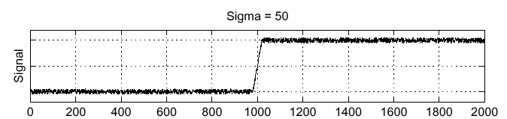
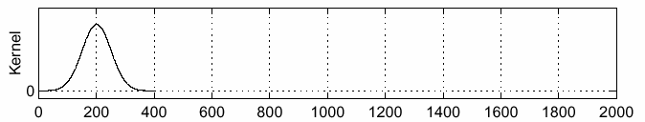
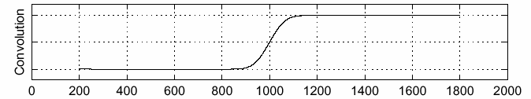
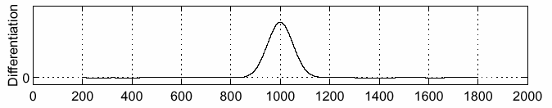
Solution: smooth first
f
g
f * g
To find edges, look for peaks in
Source: S. Seitz

Slide 28

Derivative theorem of convolution
Differentiation is convolution, and convolution is associative:
This saves us one operation:
f
Source: S. Seitz

Slide 29


Derivative of Gaussian filter
* [1 0 -1] =
Is this filter separable?

Slide 30
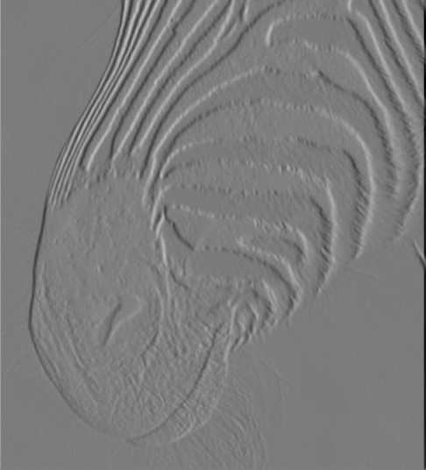
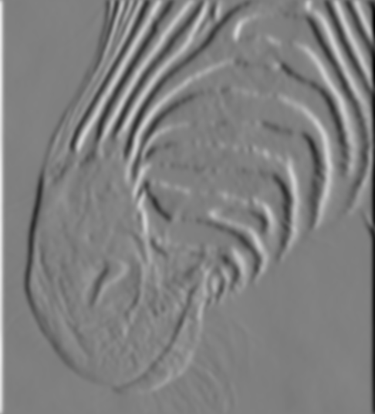
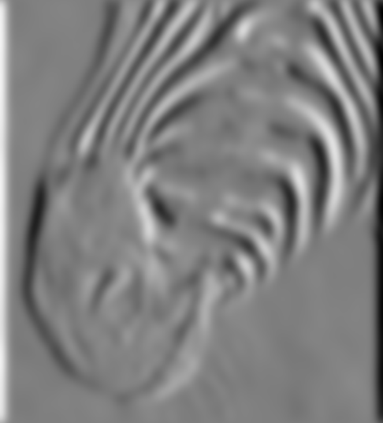
Tradeoff between smoothing and localization
1 pixel
3 pixels
7 pixels
Smoothed derivative removes noise, but blurs edge. Also finds edges at different “scales”.
Source: D. Forsyth

Slide 31
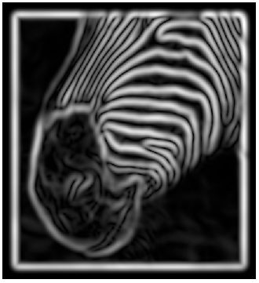
Implementation issues
The gradient magnitude is large along a thick “trail” or “ridge,” so how do we identify the actual edge points?
How do we link the edge points to form curves?
Source: D. Forsyth
Notes:
Figures show gradient magnitude of zebra at two different scales

Slide 32
Designing an edge detector
Criteria for a good edge detector:
  Good detection: the optimal detector should find all real edges, ignoring noise or other artifacts
  Good localization
    the edges detected must be as close as possible to the true edges
    the detector must return one point only for each true edge point
Cues of edge detection
  Differences in color, intensity, or texture across the boundary
  Continuity and closure
  High-level knowledge
Source: L. Fei-Fei

Slide 33
Canny edge detector
This is probably the most widely used edge detector in computer vision
Theoretical model: step-edges corrupted by additive Gaussian noise
Canny has shown that the first derivative of the Gaussian closely approximates the operator that optimizes the product of signal-to-noise ratio and localization
J. Canny, A Computational Approach To Edge Detection, IEEE Trans. Pattern Analysis and Machine Intelligence, 8:679-714, 1986.
Source: L. Fei-Fei

Slide 34

Example
input image (“Lena”)

Slide 35


Derivative of Gaussian filter
x-direction
y-direction

Slide 36
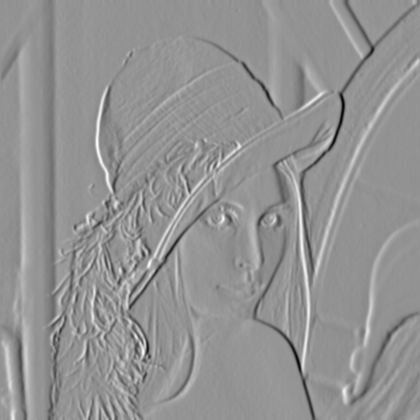
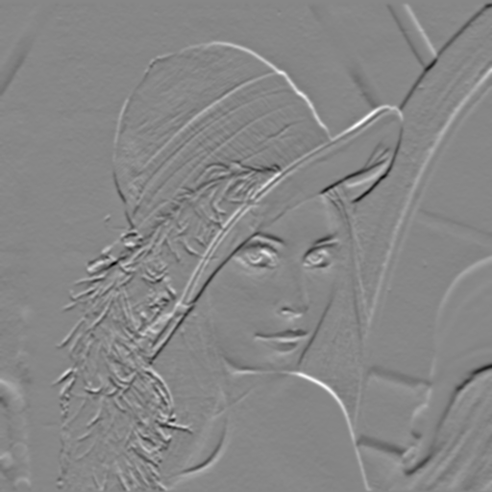
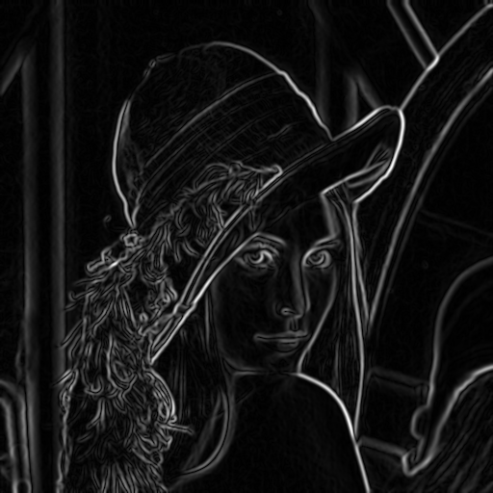
Compute Gradients (DoG)
X-Derivative of Gaussian
Y-Derivative of Gaussian
Gradient Magnitude

Slide 37
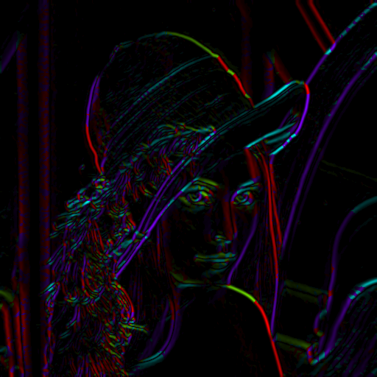
Get Orientation at Each Pixel
Threshold at minimum level
Get orientation
theta = atan2(-gy, gx)
Notes:
-gy because y=2 is below y=1, and we typically want 90 degrees to point up

Slide 38


Non-maximum suppression for each orientation
At q, we have a maximum if the value is larger than those at both p and at r. Interpolate to get these values.
Source: D. Forsyth

Slide 39

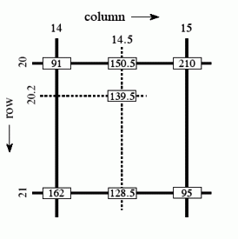
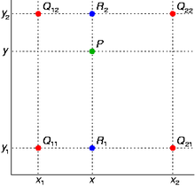
Bilinear Interpolation
http://en.wikipedia.org/wiki/Bilinear_interpolation

Slide 40
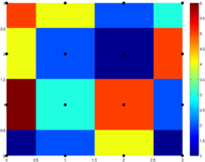
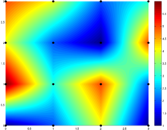
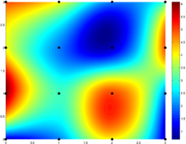
Sidebar: Interpolation options
imx2 = imresize(im, 2, interpolation_type)
‘nearest’
  Copy value from nearest known
  Very fast but creates blocky edges
‘bilinear’
  Weighted average from four nearest known pixels
  Fast and reasonable results
‘bicubic’ (default)
  Non-linear smoothing over larger area
  Slower, visually appealing, may create negative pixel values
Examples from http://en.wikipedia.org/wiki/Bicubic_interpolation

Slide 41
Before Non-max Suppression

Slide 42
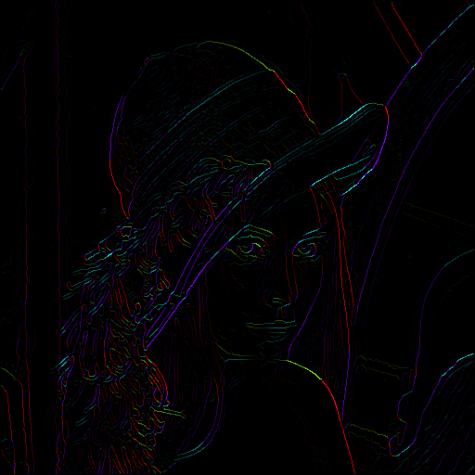
After non-max suppression

Slide 43
Before Non-max Suppression

Slide 44
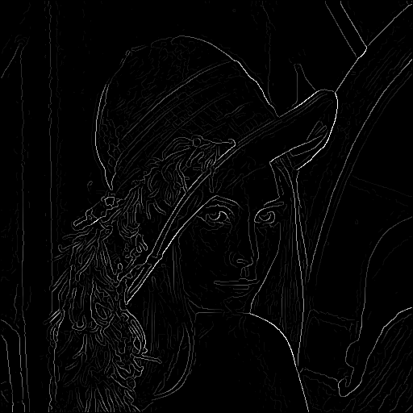
After non-max suppression

Slide 45
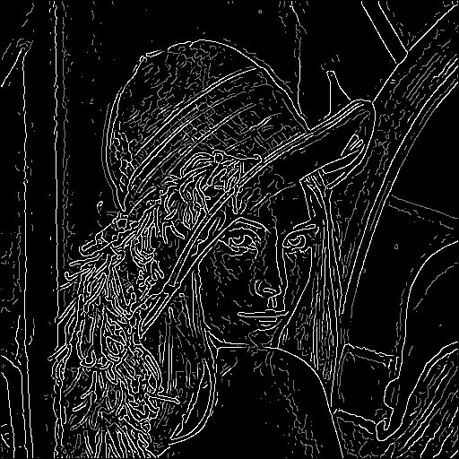
Hysteresis thresholding
Threshold at low/high levels to get weak/strong edge pixels
Do connected components, starting from strong edge pixels

Slide 46
Hysteresis thresholding
Check that maximum value of gradient value is sufficiently large
  drop-outs? use hysteresis
    use a high threshold to start edge curves and a low threshold to continue them.
Source: S. Seitz

Slide 47
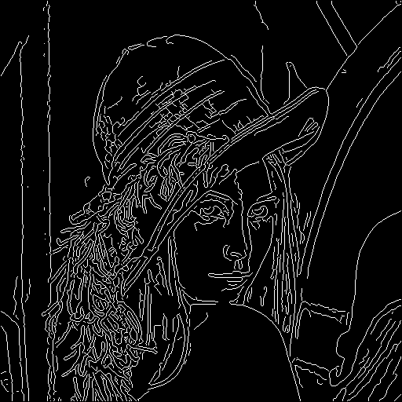
Final Canny Edges

Slide 48
Canny edge detector
Filter image with x, y derivatives of Gaussian
Find magnitude and orientation of gradient
Non-maximum suppression:
  Thin multi-pixel wide “ridges” down to single pixel width
Thresholding and linking (hysteresis):
  Define two thresholds: low and high
  Use the high threshold to start edge curves and the low threshold to continue them
MATLAB: edge(image, ‘canny’)
Source: D. Lowe, L. Fei-Fei

Slide 49





Effect of σ (Gaussian kernel spread/size)
original
Canny with
Canny with
The choice of σ depends on desired behavior
  large σ detects large scale edges
  small σ detects fine features
Source: S. Seitz

Slide 50






Learning to detect boundaries
image
human segmentation
gradient magnitude
Berkeley segmentation database:
http://www.eecs.berkeley.edu/Research/Projects/CS/vision/grouping/segbench/

Slide 51
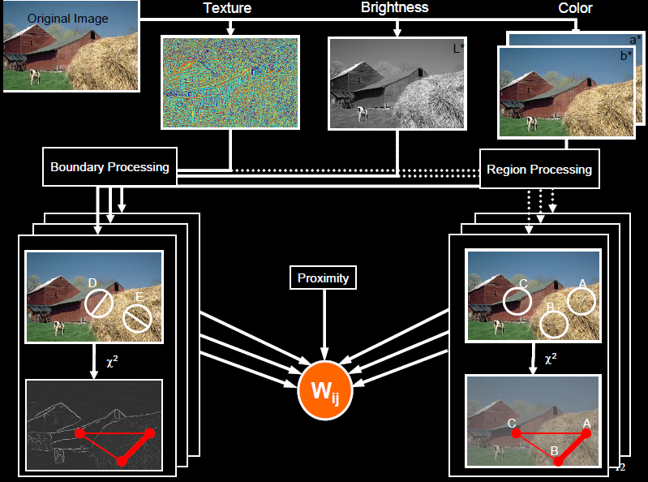
pB boundary detector
Martin, Fowlkes, Malik 2004: Learning to Detection Natural Boundaries…
http://www.eecs.berkeley.edu/Research/Projects/CS/vision/grouping/papers/mfm-pami-boundary.pdf
Figure from Fowlkes

Slide 52
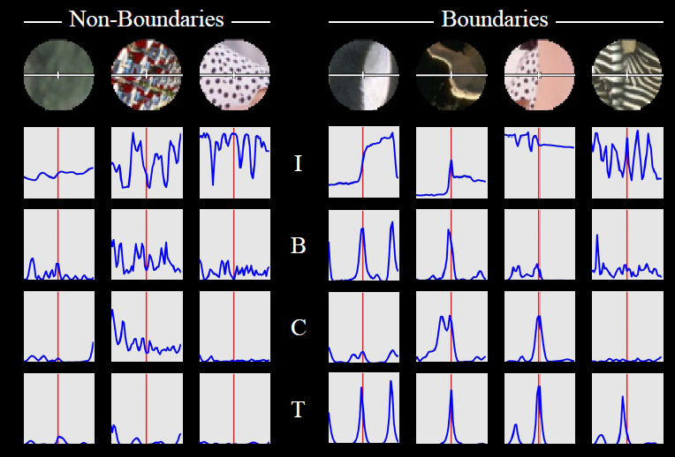
pB Boundary Detector
Figure from Fowlkes

Slide 53
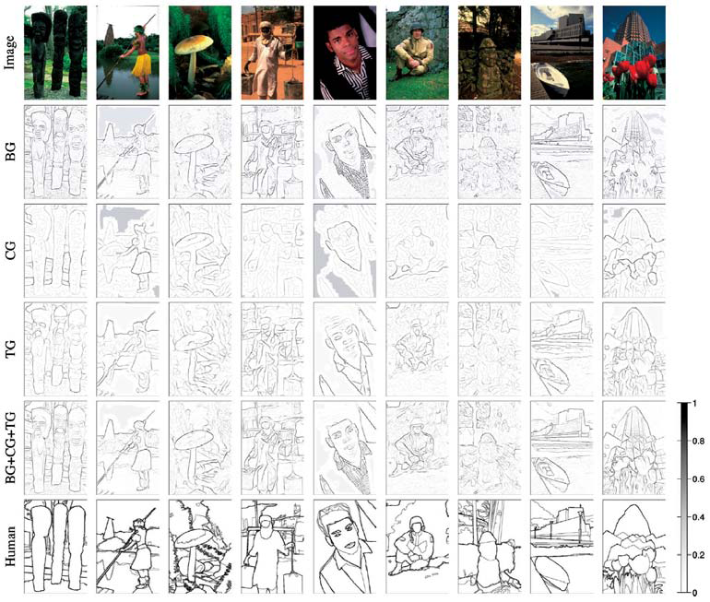
Brightness
Color
Texture
Combined
Human

Slide 54
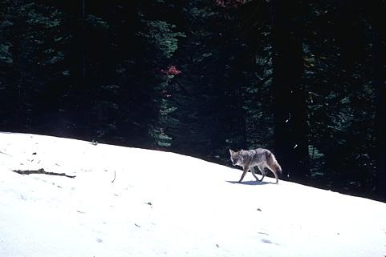
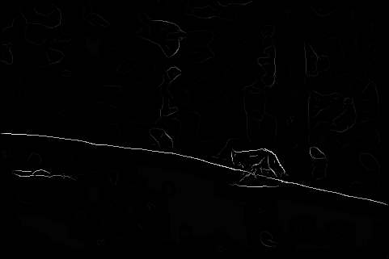
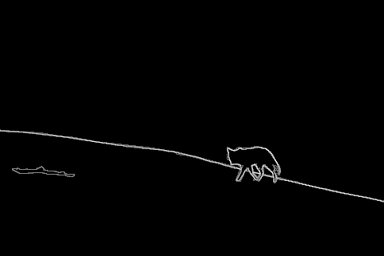
Results
Pb (0.88)
Human (0.95)

Slide 55



Results
Pb
Pb (0.88)
Global Pb
Human
Human (0.96)

Slide 56



Pb (0.63)
Human (0.95)

Slide 57



Pb (0.35)
Human (0.90)
For more: http://www.eecs.berkeley.edu/Research/Projects/CS/vision/bsds/bench/html/108082-color.html

Slide 58

Global pB boundary detector
Figure from Fowlkes

Slide 59
State of edge detection
Local edge detection is mostly solved
  Intensity gradient, color, texture
Some methods to take into account longer contours, but could probably do better
Poor use of object and high-level information

Slide 60
Finding straight lines
Another solution: get connected components of pixels and check for straightness

Slide 61

Finding straight lines

Slide 62
Finding line segments using connected components
Compute canny edges
  Compute: gx, gy (DoG in x,y directions)
  Compute: theta = atan(gy / gx)
Assign each edge to one of 8 directions
For each direction d, get edgelets:
  find connected components for edge pixels with directions in {d-1, d, d+1}
Compute straightness and theta of edgelets using eig of x,y 2nd moment matrix of their points
Threshold on straightness, store segment
Larger eigenvector

Slide 63
2. Canny lines → … →straight edges

Slide 64
Homework 1
Due Feb 14, but try to finish by Tues (HW 2 will take quite a bit more time)
http://www.cs.illinois.edu/class/sp12/cs543/hw/CV_Spring12_HW1.pdf

Slide 65
Things to remember
Canny edge detector = smooth → derivative → thin → threshold → link
Pb: learns weighting of gradient, color, texture differences
Straight line detector = canny + gradient orientations → orientation binning → linking → check for straightness

Slide 66
Next classes: Correspondence and Alignment
Detecting interest points
Tracking points
Object/image alignment and registration
  Aligning 3D or edge points
  Object instance recognition
  Image stitching

Slide 67
Finding straight lines
One solution: try many possible lines and see how many points each line passes through
Hough transform provides a fast way to do this

Slide 68
Outline of Hough Transform
Create a grid of parameter values
Each point votes for a set of parameters, incrementing those values in grid
Find maximum or local maxima in grid

Slide 69
Finding lines using Hough transform
Using m,b parameterization
Using r, theta parameterization
  Using oriented gradients
Practical considerations
  Bin size
  Smoothing
  Finding multiple lines
  Finding line segments

Slide 70
1. Image → Canny

Slide 71

2. Canny → Hough votes

Slide 72

3. Hough votes → Edges
Find peaks and post-process

Slide 73

Hough transform example
http://ostatic.com/files/images/ss_hough.jpg

Slide 74


Hough transform examples
OpenCV: probabilistic hough transform

Slide 75
Finding circles using Hough transform
Fixed r
Variable r

Slide 76
Comparison
Hough Transform Method
Connected Components Method

