Slide 1
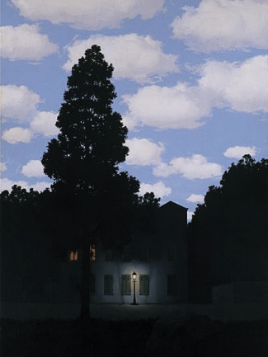
Light and Shading
01/19/12
Computer Vision
Derek Hoiem, University of Illinois
“Empire of Light”, Magritte

Slide 2
Outline
Light and wavelengths
The eye
  Physiology (rods and cones)
  Receptivity, non-linear response
  Trichromacity
The camera and display
  Bayer filter revisited
  RGB display
Physics of light and reflection
  Direct light: spectrum of wavelengths
  Reflection: influence of albedo, orientation, reflectivity, BRDF
  Inter-reflection: light may be influenced by multiple surfaces
  Illusions, ambiguity of albedo and illumination color, color constancy
  Light sources and shadows
Color spaces
  RGB, HSV, YCrCb, XYZ, Lab

Slide 3
Outline
How observed intensity of one pixel depends on geometry, material, lighting, and viewpoint
  Basic pinhole model
  Diffuse reflectance, specular reflectance
  Lambertian surfaces, Lambert’s law of cosines
  Effects due to surroundings: interreflections, shadows
  Color: wavelengths, Bayer filter
  What does the pixel intensity tell us? Not much
How can we infer scene properties from a set of pixels
  Local analysis (next class)
  Look at differences in intensity
  Lighting normalization
  Photometric stereo

Slide 4
Today’s class
What determines a pixel’s brightness?
  How is light reflected?
  How is light measured?
What can be inferred about the world from those brightness values?

Slide 5
Administrative stuff
Some people waiting to get in
Tentative office hours
  Derek: Wed 4pm, 8pm (skype only)
  Ruiqi: Mon 7pm, Thurs 4pm
Homework 1 released soon
Any questions?

Slide 6

How light is recorded

Slide 7

Digital camera
A digital camera replaces film with a sensor array
Each cell in the array is light-sensitive diode that converts photons to electrons
Two common types: Charge Coupled Device (CCD) and CMOS
http://electronics.howstuffworks.com/digital-camera.htm
Slide by Steve Seitz

Slide 8
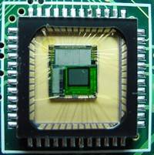

Sensor Array
CMOS sensor
Each sensor cell records amount of light coming in at a small range of orientations

Slide 9
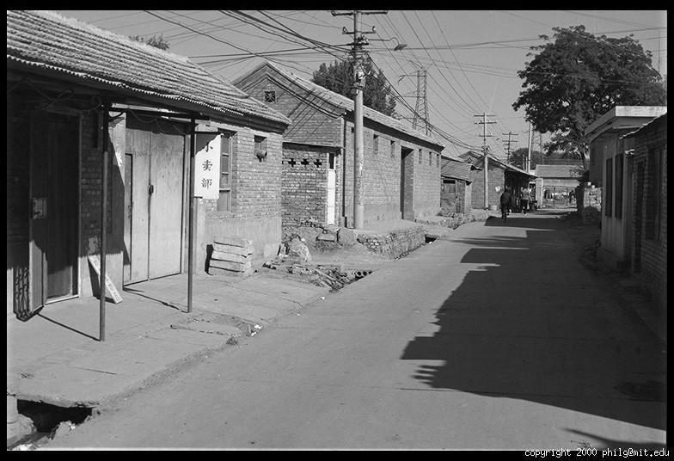
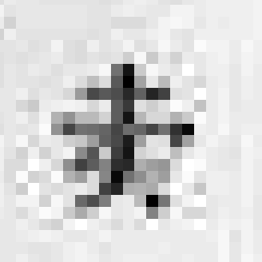
The raster image (pixel matrix)

Slide 10
The raster image (pixel matrix)
0.92 | 0.93 | 0.94 | 0.97 | 0.62 | 0.37 | 0.85 | 0.97 | 0.93 | 0.92 | 0.99
0.95 | 0.89 | 0.82 | 0.89 | 0.56 | 0.31 | 0.75 | 0.92 | 0.81 | 0.95 | 0.91
0.89 | 0.72 | 0.51 | 0.55 | 0.51 | 0.42 | 0.57 | 0.41 | 0.49 | 0.91 | 0.92
0.96 | 0.95 | 0.88 | 0.94 | 0.56 | 0.46 | 0.91 | 0.87 | 0.90 | 0.97 | 0.95
0.71 | 0.81 | 0.81 | 0.87 | 0.57 | 0.37 | 0.80 | 0.88 | 0.89 | 0.79 | 0.85
0.49 | 0.62 | 0.60 | 0.58 | 0.50 | 0.60 | 0.58 | 0.50 | 0.61 | 0.45 | 0.33
0.86 | 0.84 | 0.74 | 0.58 | 0.51 | 0.39 | 0.73 | 0.92 | 0.91 | 0.49 | 0.74
0.96 | 0.67 | 0.54 | 0.85 | 0.48 | 0.37 | 0.88 | 0.90 | 0.94 | 0.82 | 0.93
0.69 | 0.49 | 0.56 | 0.66 | 0.43 | 0.42 | 0.77 | 0.73 | 0.71 | 0.90 | 0.99
0.79 | 0.73 | 0.90 | 0.67 | 0.33 | 0.61 | 0.69 | 0.79 | 0.73 | 0.93 | 0.97
0.91 | 0.94 | 0.89 | 0.49 | 0.41 | 0.78 | 0.78 | 0.77 | 0.89 | 0.99 | 0.93

Slide 11
Today’s class: Light and Shading
What determines a pixel’s intensity?
What can we infer about the scene from pixel intensities?

Slide 12
How does a pixel get its value?
Light emitted
Fraction of light reflects into camera
Lens
Sensor

Slide 13
How does a pixel get its value?
Major factors
  Illumination strength and direction
  Surface geometry
  Surface material
  Nearby surfaces
  Camera gain/exposure
Light emitted
Light reflected to camera
Sensor

Slide 14


Basic models of reflection
Specular: light bounces off at the incident angle
  E.g., mirror
Diffuse: light scatters in all directions
  E.g., brick, cloth, rough wood
specular reflection
incoming light
$$Θ$$
$$Θ$$
diffuse reflection
incoming light

Slide 15



Lambertian reflectance model
Some light is absorbed (function of albedo$ρ$)
Remaining light is scattered (diffuse reflection)
Examples: soft cloth, concrete, matte paints
light source
light source
diffuse reflection
$$ρ$$
absorption
$$(1−ρ)$$
Notes:
albedo is the fraction of light reflected

Slide 16
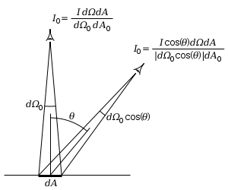
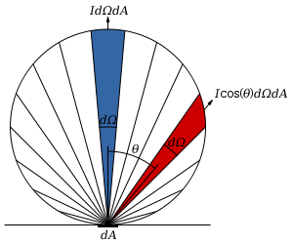

Diffuse reflection: Lambert’s cosine law
Intensity does not depend on viewer angle.
  Amount of reflected light proportional to $cos⁡(θ)$
  Visible solid angle also proportional to $cos⁡(θ)$
http://en.wikipedia.org/wiki/Lambert%27s_cosine_law

Slide 17

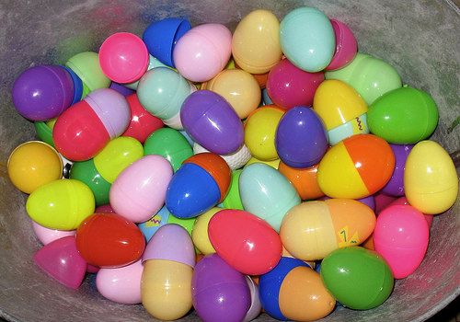


Specular Reflection
Reflected direction depends on light orientation and surface normal
  E.g., mirrors are fully specular
  Most surfaces can be modeled with a mixture of diffuse and specular components
Flickr, by suzysputnik
light source
specular reflection
$$Θ$$
$$Θ$$
Flickr, by piratejohnny

Slide 18
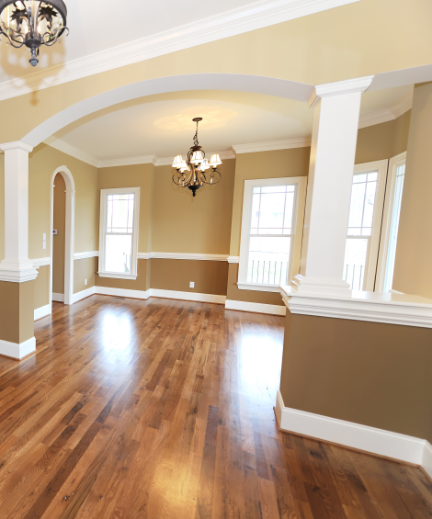
Most surfaces have both specular and diffuse components
Specularity = spot where specular reflection dominates (typically reflects light source)
Typically, specular component is small
Photo: northcountryhardwoodfloors.com

Slide 19
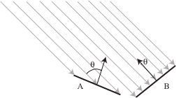
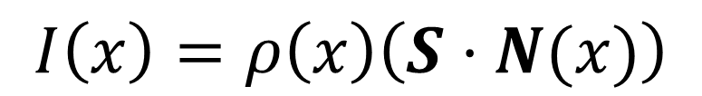

Intensity and Surface Orientation
Intensity depends on illumination angle because less light comes in at oblique angles.
$ρ=$albedo
$S=$ directional source
$N=$ surface normal
$I=$ reflected intensity
$$I\left(x\right)=ρ\left(x\right)\left(S⋅N(x)\right)$$
Slide: Forsyth

Slide 20
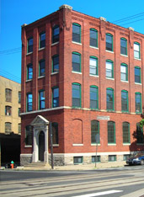
1
2

Slide 21

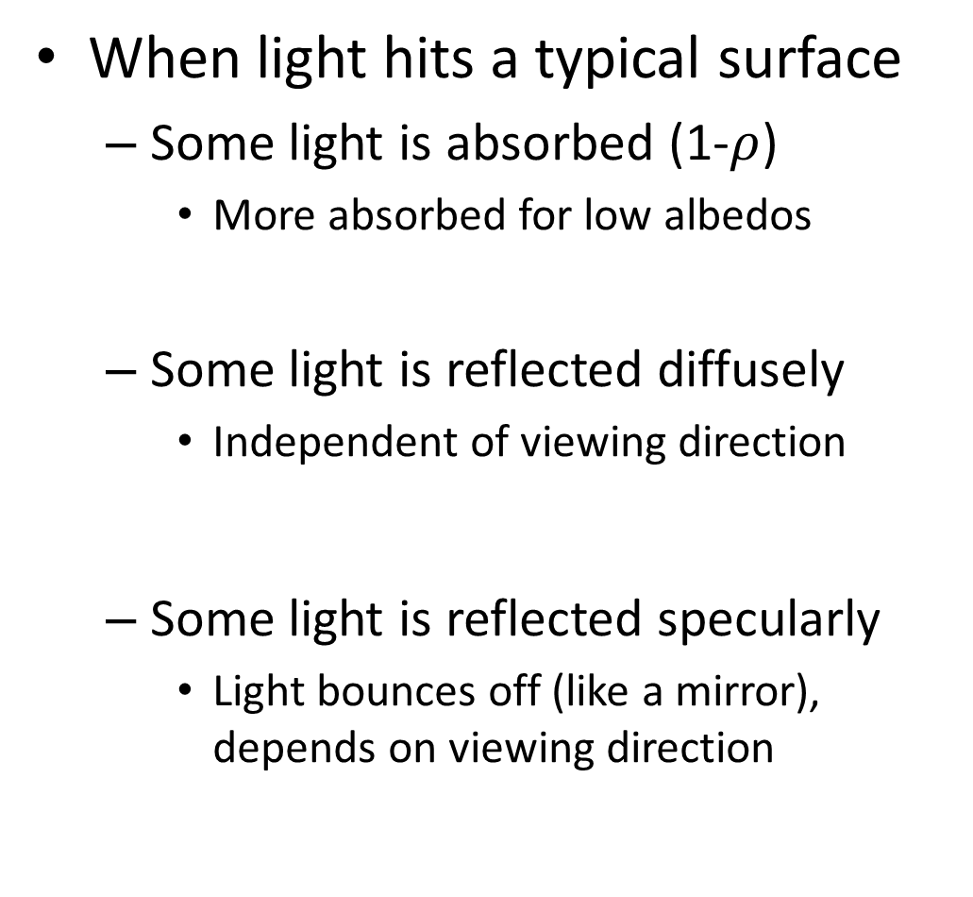

Recap
When light hits a typical surface
  Some light is absorbed (1-$ρ$)
    More absorbed for low albedos
  Some light is reflected diffusely
    Independent of viewing direction
  Some light is reflected specularly
    Light bounces off (like a mirror), depends on viewing direction
absorption
diffuse reflection
specular reflection
$$Θ$$
$$Θ$$

Slide 22
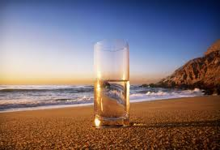
Other possible effects
transparency
light source
light source
refraction

Slide 23
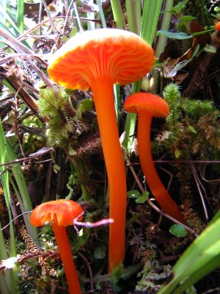
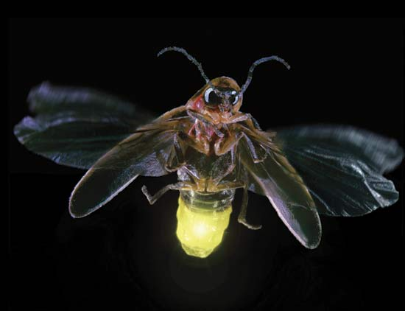
light source
light source
fluorescence
phosphorescence
λ₁
t=1
λ₂
t>1

Slide 24
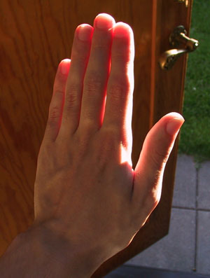
light source
subsurface scattering
λ

Slide 25
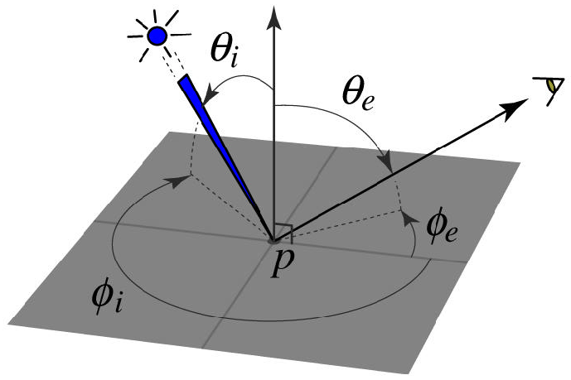
BRDF: Bidirectional Reflectance Distribution Function
Model of local reflection that tells how bright a surface appears when viewed from one direction when light falls on it from another
surface normal
Slide credit: S. Savarese

Slide 26

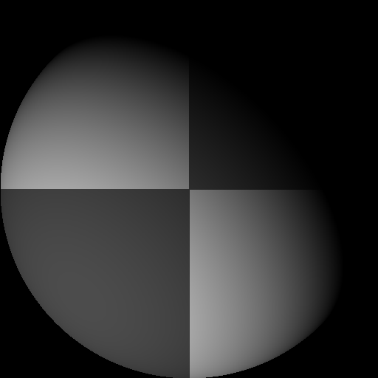



Application: photometric stereo
Assume:
  a set of point sources that are infinitely distant
  a set of pictures of an object, obtained in exactly the same camera/object configuration but using different sources
  A Lambertian object (or the specular component has been identified and removed)
Photometric stereo slides by Forsyth

Slide 27



Each image is:
$$I_{i}\left(x\right)=S_{i} ⋅(p\left(x\right)N\left(x\right))$$
So if we have enough images with known sources, we can solve for
albedo times 3D normal
$$B\left(x\right)= p\left(x\right)N\left(x\right)$$

Slide 28


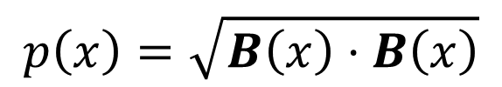
$$B\left(x\right)= p\left(x\right)N\left(x\right)$$
And the albedo (shown here) is given by:
$$p\left(x\right)=\sqrt{B\left(x\right)⋅B\left(x\right)}$$
(the normal is a unit vector)

Slide 29
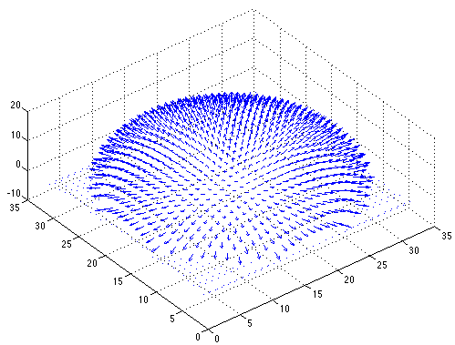

Slide 30
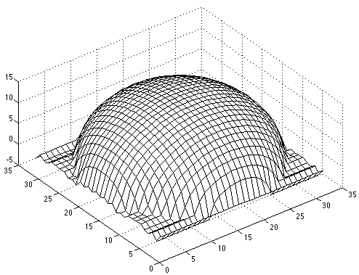

Slide 31
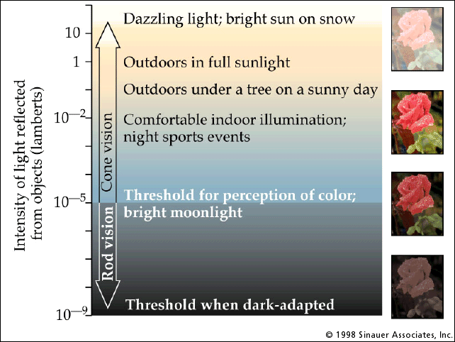
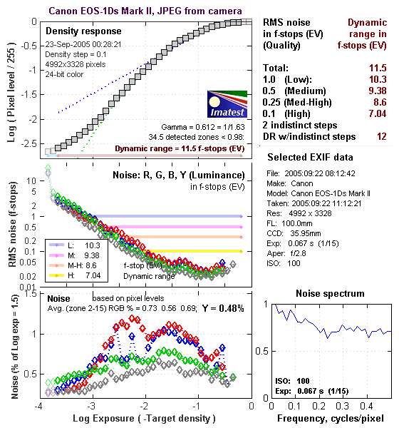
Dynamic range and camera response
Typical scenes have a huge dynamic range
Camera response is roughly linear in the mid range (15 to 240) but non-linear at the extremes
  called saturation or undersaturation

Slide 32
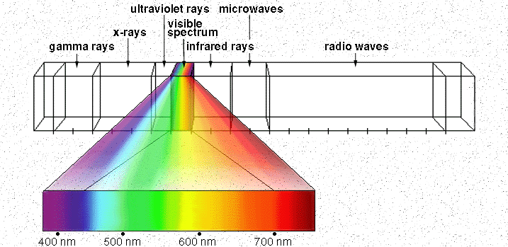

Color
Light is composed of a spectrum of wavelengths
Human Luminance Sensitivity Function
Slide Credit: Efros
http://www.yorku.ca/eye/photopik.htm

Slide 33
Some examples of the spectra of light sources
© Stephen E. Palmer, 2002

Slide 34
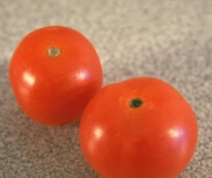
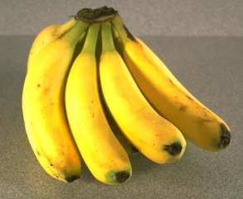
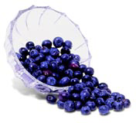
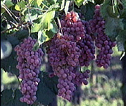
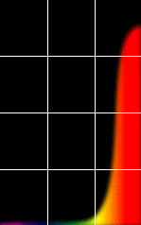
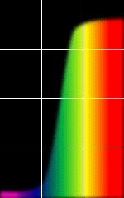
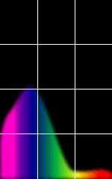
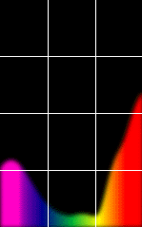
Some examples of the reflectance spectra of surfaces
Red
Yellow
Blue
Purple
% Photons Reflected
400 700
400 700
400 700
400 700
Wavelength (nm)
© Stephen E. Palmer, 2002

Slide 35
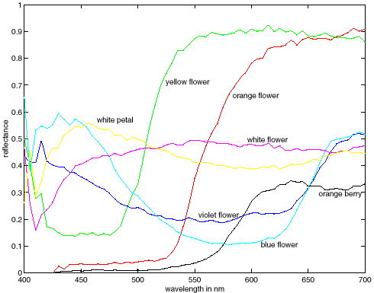
More spectra
metamers

Slide 36
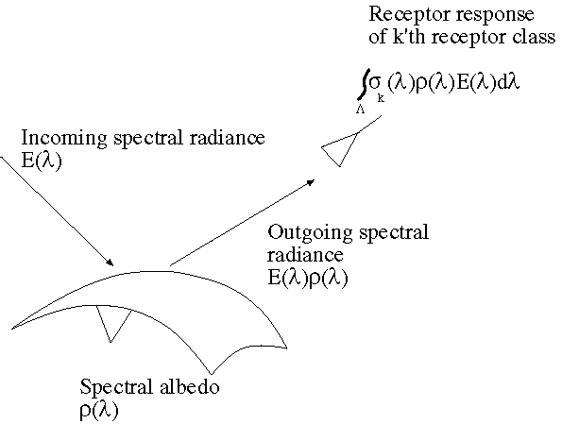
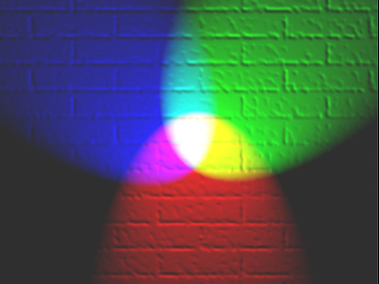
The color of objects
Colored light arriving at the camera involves two effects
  The color of the light source (illumination + inter-reflections)
  The color of the surface
Slide: Forsyth

Slide 37


Color Sensing: Bayer Grid
Estimate RGB at each cell from neighboring values
http://en.wikipedia.org/wiki/Bayer_filter
Slide by Steve Seitz

Slide 38
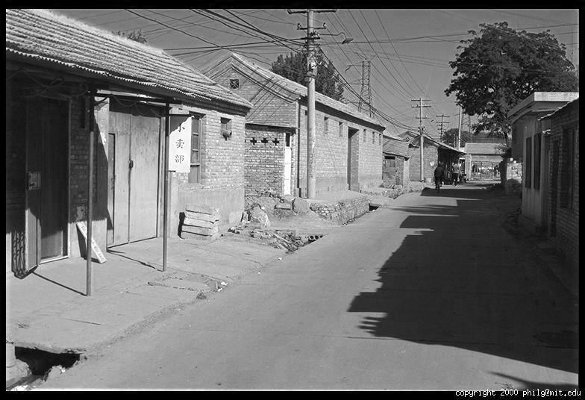
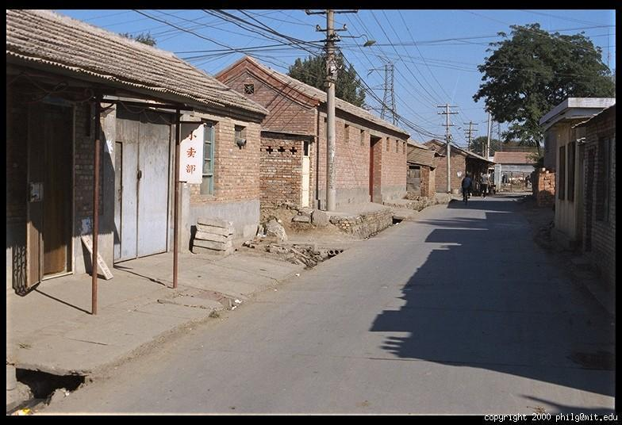
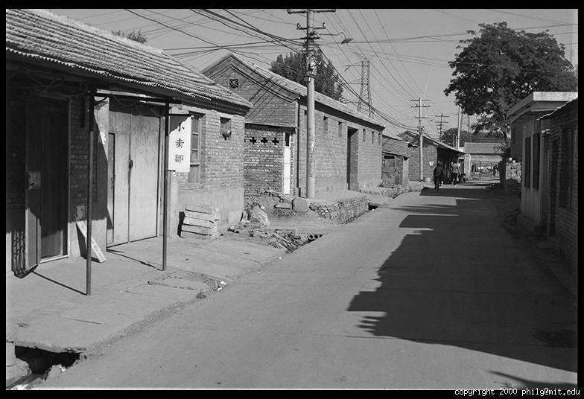
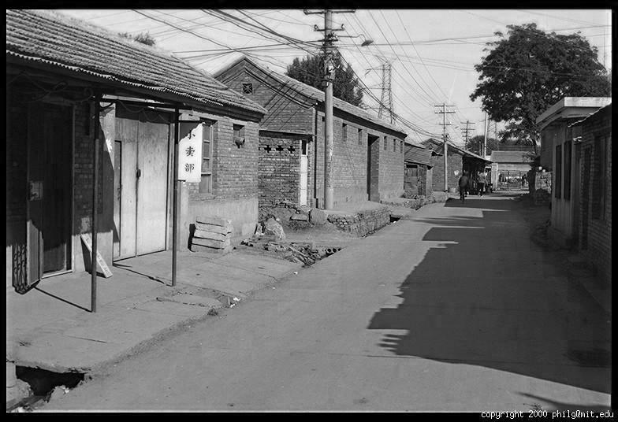
Color Image
R
G
B

Slide 39
Why RGB?
If light is a spectrum, why are images RGB?

Slide 40
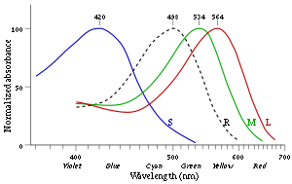
Human color receptors
Long (red), Medium (green), and Short (blue) cones, plus intensity rods
Fun facts
  “M” and “L” on the X-chromosome
    That’s why men are more likely to be color blind (see what it’s like: http://www.vischeck.com/vischeck/vischeckURL.php)
  “L” has high variation, so some women are tetrachromatic
  Some animals have 1 (night animals), 2 (e.g., dogs), 4 (fish, birds), 5 (pigeons, some reptiles/amphibians), or even 12 (mantis shrimp) types of cones
http://en.wikipedia.org/wiki/Color_vision

Slide 41
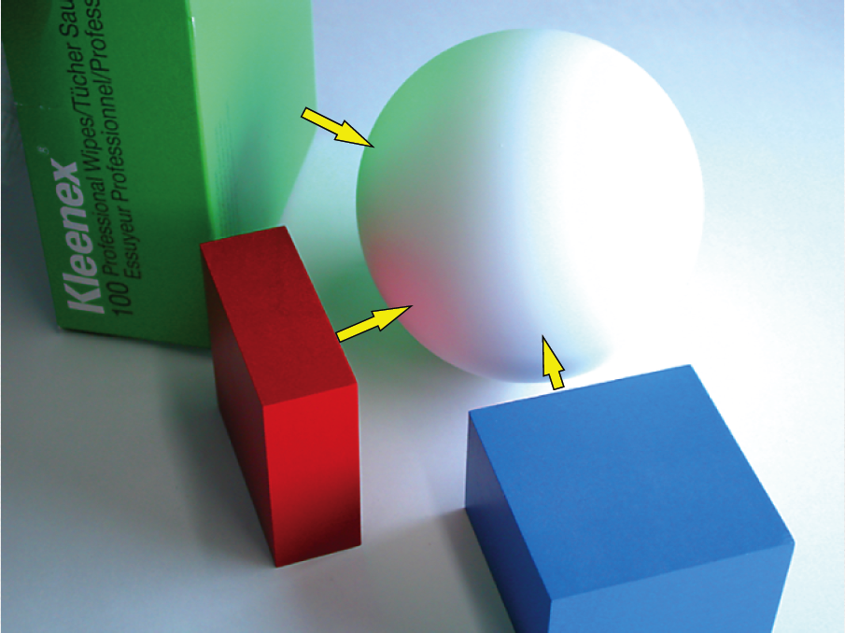
So far: light→surface→camera
Called a local illumination model
But much light comes from surrounding surfaces
From Koenderink slides on image texture and the flow of light

Slide 42
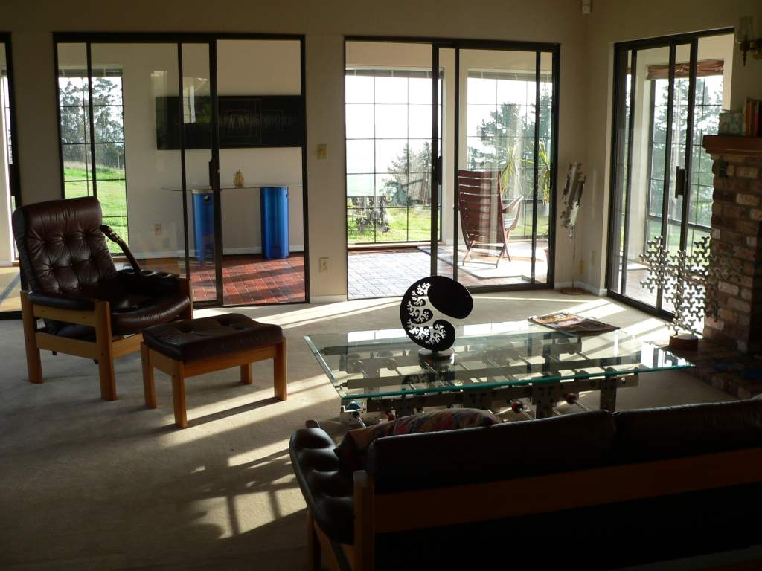
Inter-reflection is a major source of light

Slide 43
Inter-reflection affects the apparent color of objects
From Koenderink slides on image texture and the flow of light

Slide 44
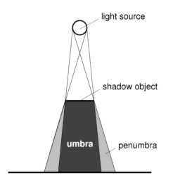
Scene surfaces also cause shadows
Shadow: reduction in intensity due to a blocked source

Slide 45
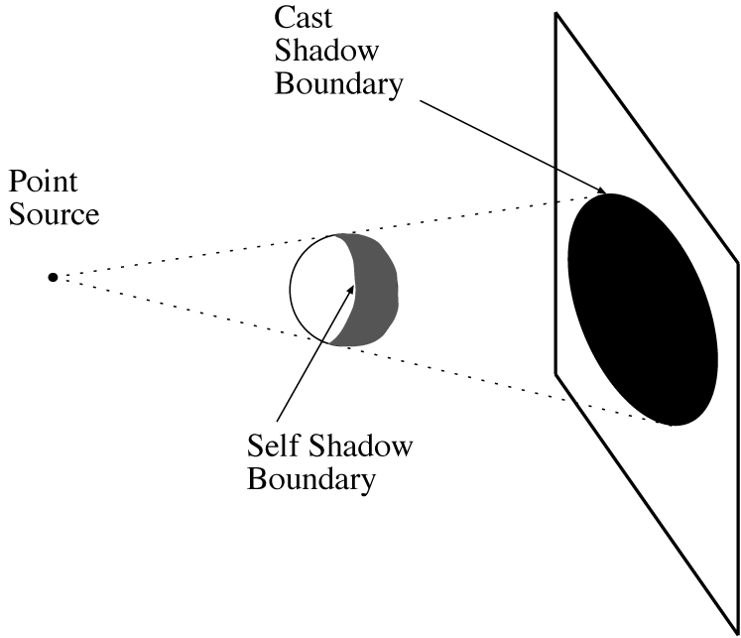
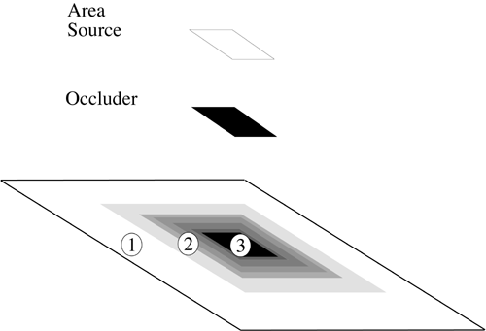
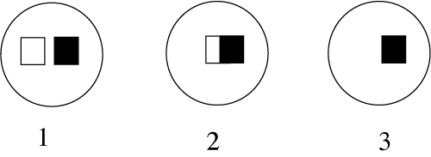
Shadows

Slide 46
Models of light sources
Distant point source
  One illumination direction
  E.g., sun
Area source
  E.g., white walls, diffuser lamps, sky
Ambient light
  Substitute for dealing with interreflections
Global illumination model
  Account for interreflections in modeled scene

Slide 47
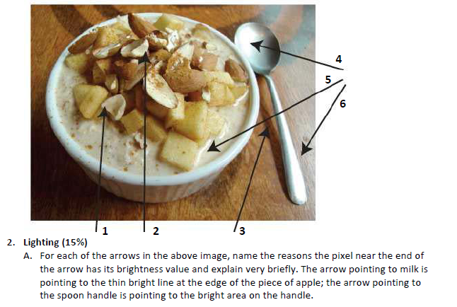
Recap
Possible factors: albedo, shadows, texture, specularities, curvature, lighting direction

Slide 48

Area sources
A point receives light as the summation of contributions of small elements over the whole source
Slide: Forsyth

Slide 49
What does the intensity of a pixel tell us?
im(234, 452) = 0.58
0.92 | 0.93 | 0.94 | 0.97 | 0.62 | 0.37 | 0.85 | 0.97 | 0.93 | 0.92 | 0.99
0.95 | 0.89 | 0.82 | 0.89 | 0.56 | 0.31 | 0.75 | 0.92 | 0.81 | 0.95 | 0.91
0.89 | 0.72 | 0.51 | 0.55 | 0.51 | 0.42 | 0.57 | 0.41 | 0.49 | 0.91 | 0.92
0.96 | 0.95 | 0.88 | 0.94 | 0.56 | 0.46 | 0.91 | 0.87 | 0.90 | 0.97 | 0.95
0.71 | 0.81 | 0.81 | 0.87 | 0.57 | 0.37 | 0.80 | 0.88 | 0.89 | 0.79 | 0.85
0.49 | 0.62 | 0.60 | 0.58 | 0.50 | 0.60 | 0.58 | 0.50 | 0.61 | 0.45 | 0.33
0.86 | 0.84 | 0.74 | 0.58 | 0.51 | 0.39 | 0.73 | 0.92 | 0.91 | 0.49 | 0.74
0.96 | 0.67 | 0.54 | 0.85 | 0.48 | 0.37 | 0.88 | 0.90 | 0.94 | 0.82 | 0.93
0.69 | 0.49 | 0.56 | 0.66 | 0.43 | 0.42 | 0.77 | 0.73 | 0.71 | 0.90 | 0.99
0.79 | 0.73 | 0.90 | 0.67 | 0.33 | 0.61 | 0.69 | 0.79 | 0.73 | 0.93 | 0.97
0.91 | 0.94 | 0.89 | 0.49 | 0.41 | 0.78 | 0.78 | 0.77 | 0.89 | 0.99 | 0.93

Slide 50
The plight of the poor pixel
A pixel’s brightness is determined by
  Light source (strength, direction, color)
  Surface orientation
  Surface material and albedo
  Reflected light and shadows from surrounding surfaces
  Gain on the sensor
A pixel’s brightness tells us nothing by itself

Slide 51


Slide 52

Photo by nickwheeleroz, Flickr
Slide: Forsyth

Slide 53
And yet we can interpret images…
Key idea: for nearby scene points, most factors do not change much
The information is mainly contained in local differences of brightness

Slide 54

Darkness = Large Difference in Neighboring Pixels

Slide 55

What is this?

Slide 56


Slide 57


What differences in intensity tell us about shape
Changes in surface normal
Texture
Proximity
Indents and bumps
Grooves and creases
Photos Koenderink slides on image texture and the flow of light
Notes:
So far, most people have gotten away with just knowing that differences are important and designing features that measure differences.

Slide 58

Shadows as cues
From Koenderink slides on image texture and the flow of light
Slide: Forsyth

Slide 59
Color constancy
Interpret surface in terms of albedo or “true color”, rather than observed intensity
  Humans are good at it
  Computers are not nearly as good

Slide 60

One source of constancy: local comparisons

Slide 61

http://www.echalk.co.uk/amusements/OpticalIllusions/colourPerception/colourPerception.html

Slide 62

Perception of Intensity
from Ted Adelson

Slide 63
Perception of Intensity
from Ted Adelson

Slide 64

Color Correction
Simple idea: multiply R, G, and B values by separate constants
$\left[\begin{matrix}\tilde{r} \\ \tilde{g} \\ \tilde{b}\end{matrix}\right]$=$\left[\begin{matrix}αr & 0 & 0 \\ 0 & αg & 0 \\ 0 & 0 & αb\end{matrix}\right]\left[\begin{matrix}r \\ g \\ b\end{matrix}\right]$
How to choose the constants?
  “White world” assumption: brightest pixel is white
    Divide by largest value
  “Gray world” assumption: average value should be gray
    E.g., multiply r channel by avg(r) /avg((r+g+b)/3)
  White balancing: choose a reference as the white or gray color

Slide 65

HW 1, Problem 1a

Slide 66

HW 1, Problem 1b

Slide 67


Things to remember
Important terms: diffuse/specular reflectance, albedo, umbra/penumbra
Observed intensity depends on light sources, geometry/material of reflecting surface, surrounding objects, camera settings
Objects cast light and shadows on each other
Differences in intensity are primary cues for shape

Slide 68
Thank you
Next class: Image Filters

