Slide 1
Scaling Distributed Machine Learning with the
Based on the Paper and presentation:
Scaling Distributed Machine Learning with the Parameter Server – Google, Baidu, Carnegie Mellon University
Included in the Proceedings at OSDI 14
Presentation by: Sanchit Gupta

Slide 6
Data is Large and Increasing!

Slide 8
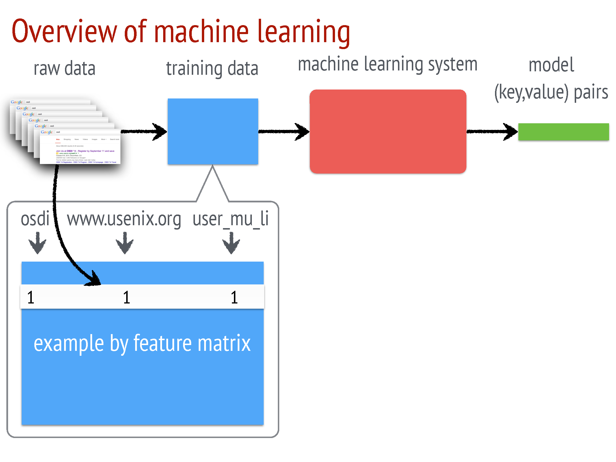

Slide 9
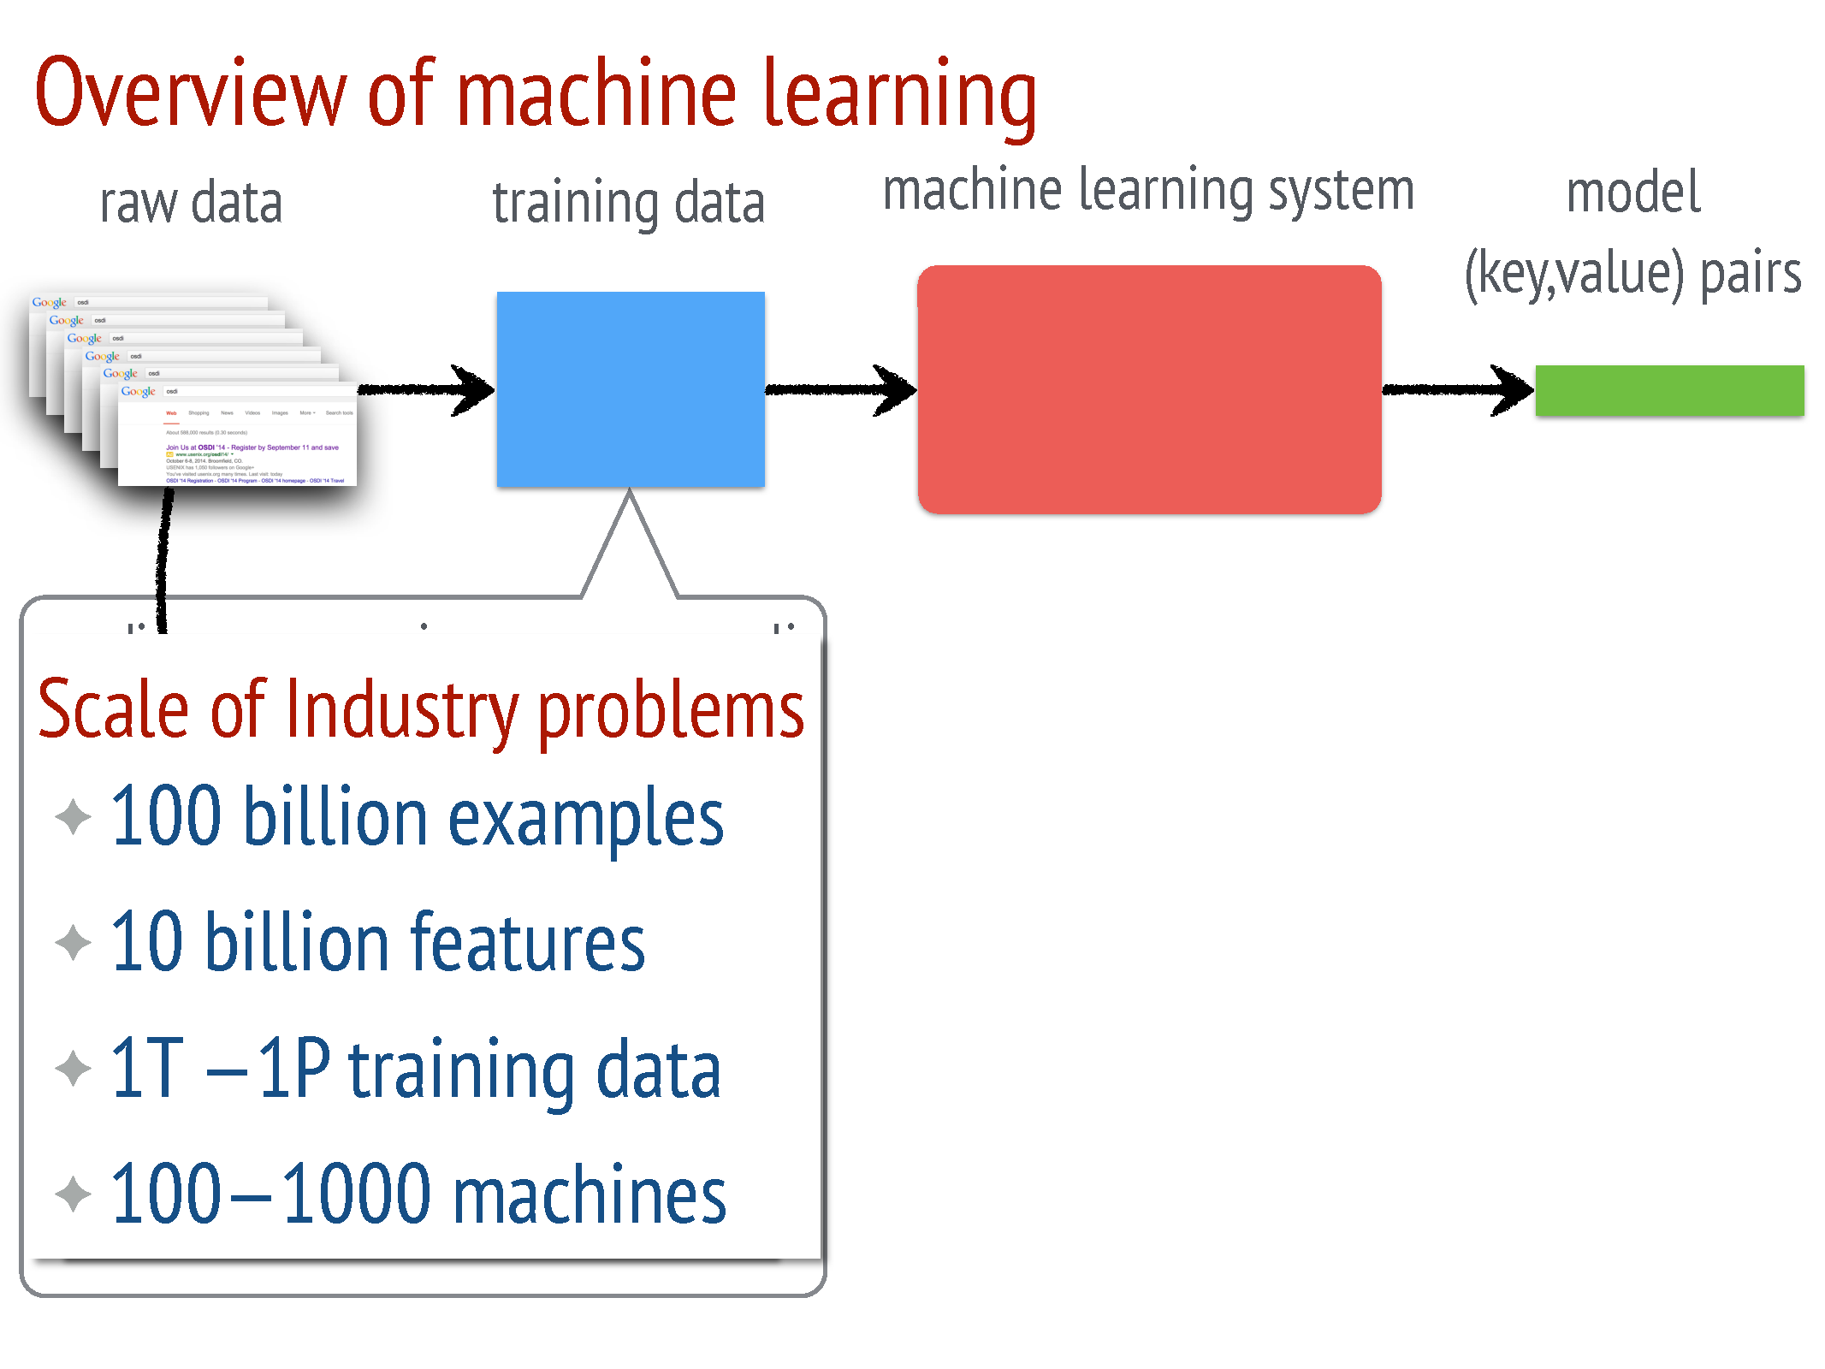

Slide 10
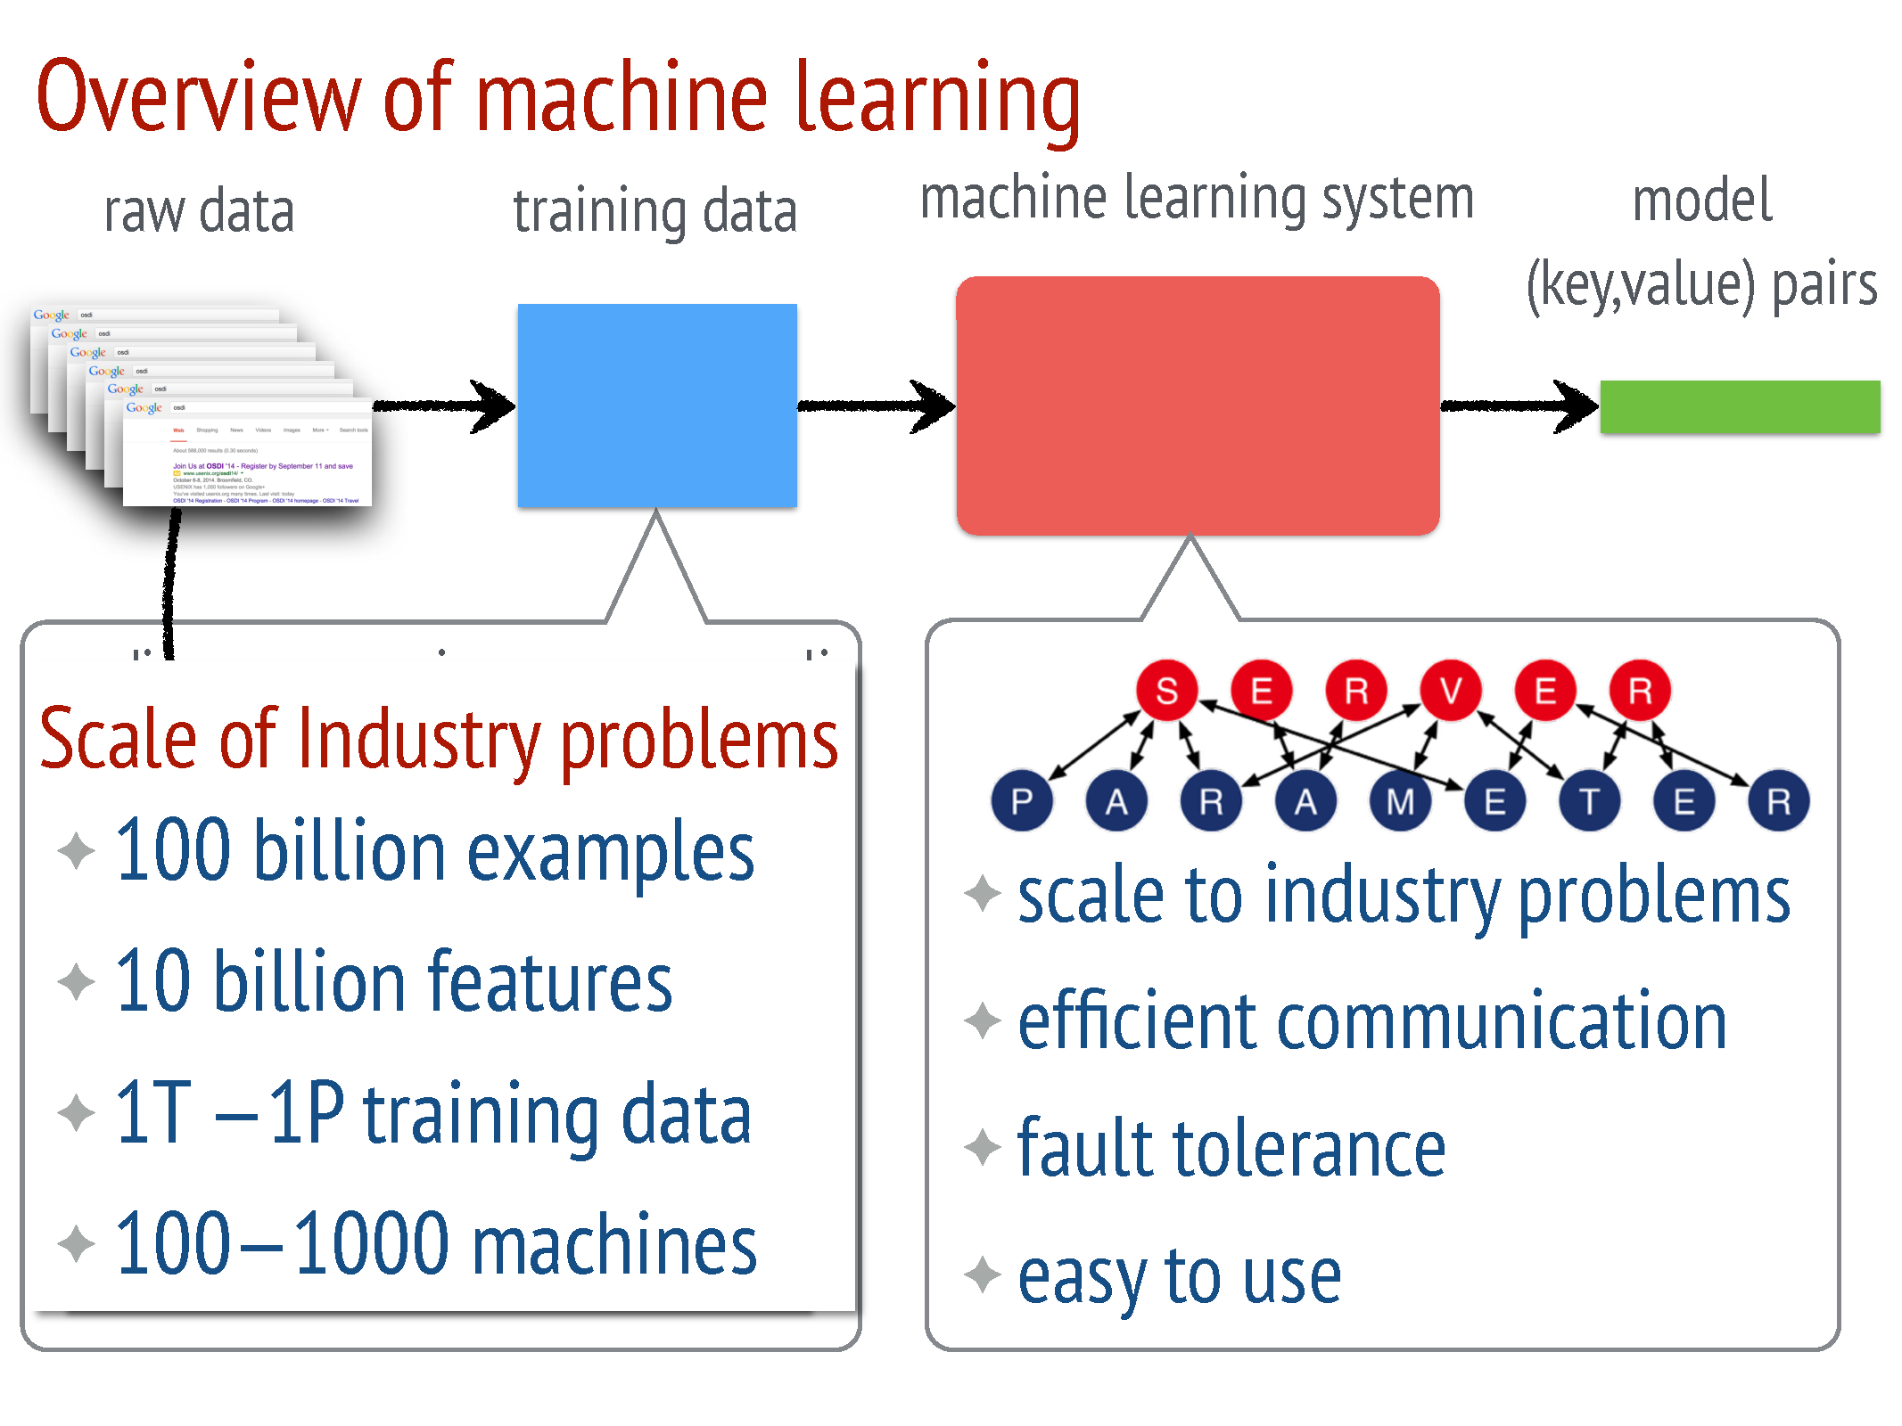

Slide 11
Characteristics & Challenges of ML jobs
Training Data is Large – 1TB to 1PB
Complex Models with Billions and Trillions of Parameters
Parameters are shared globally among worker nodes:
Accessing them incurs large Network costs
Sequential ML jobs require barriers and hurt performance by blocking
At scale, Fault Tolerance is required as these jobs run in a cloud environment where machines are unreliable and jobs can be preempted

Slide 12
Key Goals and Features of Design
Efficient Communication: asynchronous communication model (does not block computation)
Flexible Consistency Models: Algorithm designer can balance algorithmic convergence and system efficiency
Elastic Scalability : New nodes can be added without restarting framework
Fault Tolerance and Durability: Recovery from and repair in 1 sec.
Ease of Use: easy for users to write programs

Slide 13
Architecture & Design Details

Slide 14
Architecture: Data and Model
Training Data
Model
Server Manager
Server Machines
Resource Manager
Work
Push
Pull
Task Scheduler
Work
Worker Machines

Slide 15
Example: Distributed gradient Descent
Work
Server Machines
Worker
Worker
Workers get the Assigned training data
Workers Pull the Working set of Model
Iterate until Stop:
Workers Compute Gradients
Workers Push Gradients
Servers Aggregate into current model
Workers Pull updated model
Work
Training Data

Slide 16
Architecture: Parameter Key-Value
Model Parameters are represented as Key – Value pairs
Parameter Server approach models the Key-Value pairs as sparse Linear Algebra Objects.
Batch several key-value pairs required to compute a vector/matrix instead of sending them one by one
Easy to Program! – Lets us treat the parameters as key-values while endowing them with matrix semantics

Slide 20
Architecture: Range Push and Pull
Data is sent between Workers and Servers using PUSH and PUSH operations.
Parameter Server optimizes updates communication by using RANGE based PUSH and PULL.
Example: Let w denote parameters of some model
w.push(Range, dest)
w.pull(Range, dest)
These methods will send/receive all existing entries of w with keys in Range

Slide 21
Architecture: Asynchronous tasks and Dependency
Challenges for Data Synchronization:
There is a MASSIVE communication traffic due to frequent access of Shared Model
Global barriers between iterations – leads to:
idle workers waiting for other computation to finish
High total finish time

Slide 27
Architecture: Flexible Consistency
Can change the consistency model for the system, as per the requirements of the job
Up to the algorithm designer to choose the flexible consistency model
Trade-off between Algorithm Efficiency and System Performance

Slide 33
Architecture: User Defined Filters
Selectively Synchronize (key, value) pairs.
Filters can be placed at either or both the Server machines and Worker machines.
Allows for fine-grained consistency control within a task
Example: Significantly modified filter: Only pushes entries that have changed for more than an amount.

Slide 34
Implementation: Vector Clocks & Messaging
Vector Clocks are attached for each (Key, value) pairs for several purposes:
Tracking Aggregation Status
Rejecting doubly sent data
Recovery from Failure
As many (key, value) pairs get updated at the same time during one iteration, they can share the same clock stamps. This reduces the space requirements.
Messages are sent in Ranges for efficient lookup and transfers.
Messages are compressed using Google’s Snappy compression library.

Slide 35
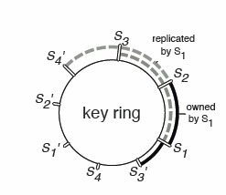
Implementation: Consistent Hashing & Replication
The parameter server partitions the keys on to the Servers using Ranged Partitioning.
The Servers are themselves hashed to a virtual ring similar to Chord.
Server nodes store a replica of (Key, value) pairs in k nodes counter clockwise to it.

Slide 48
Evaluation

Slide 49
Evaluation: Sparse Logistic Regression
One of the most popular large scale Risk Minimization algorithm.
For example in the case of ads prediction, we want to predict the revenue an ad will generate.
It can be done by running a logistic regression on the available data for ads which are ‘close to’ the ad we want to post.
The experiment was run with:
170 billion examples
65 billion unique features
636 TB of data in total
1000 machines: 800 workers & 200 servers
Machines: 16 cores, 192 GB DRAM, and 10 Gb Ethernet links

Slide 50
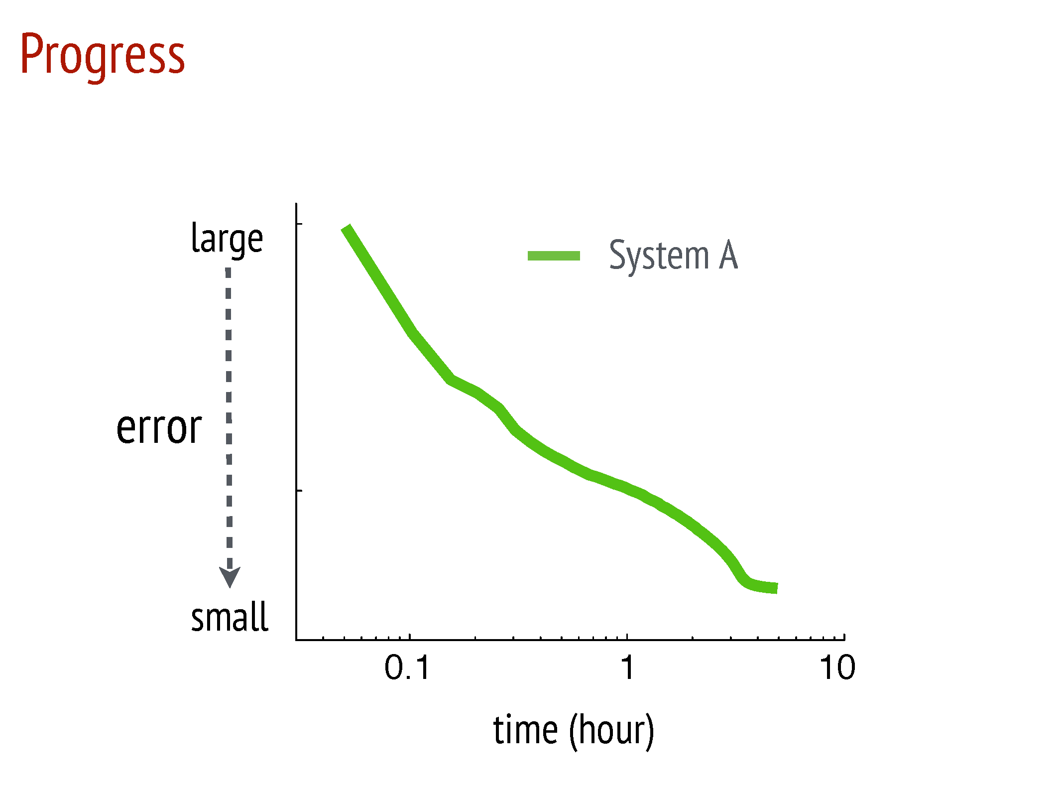

Slide 51
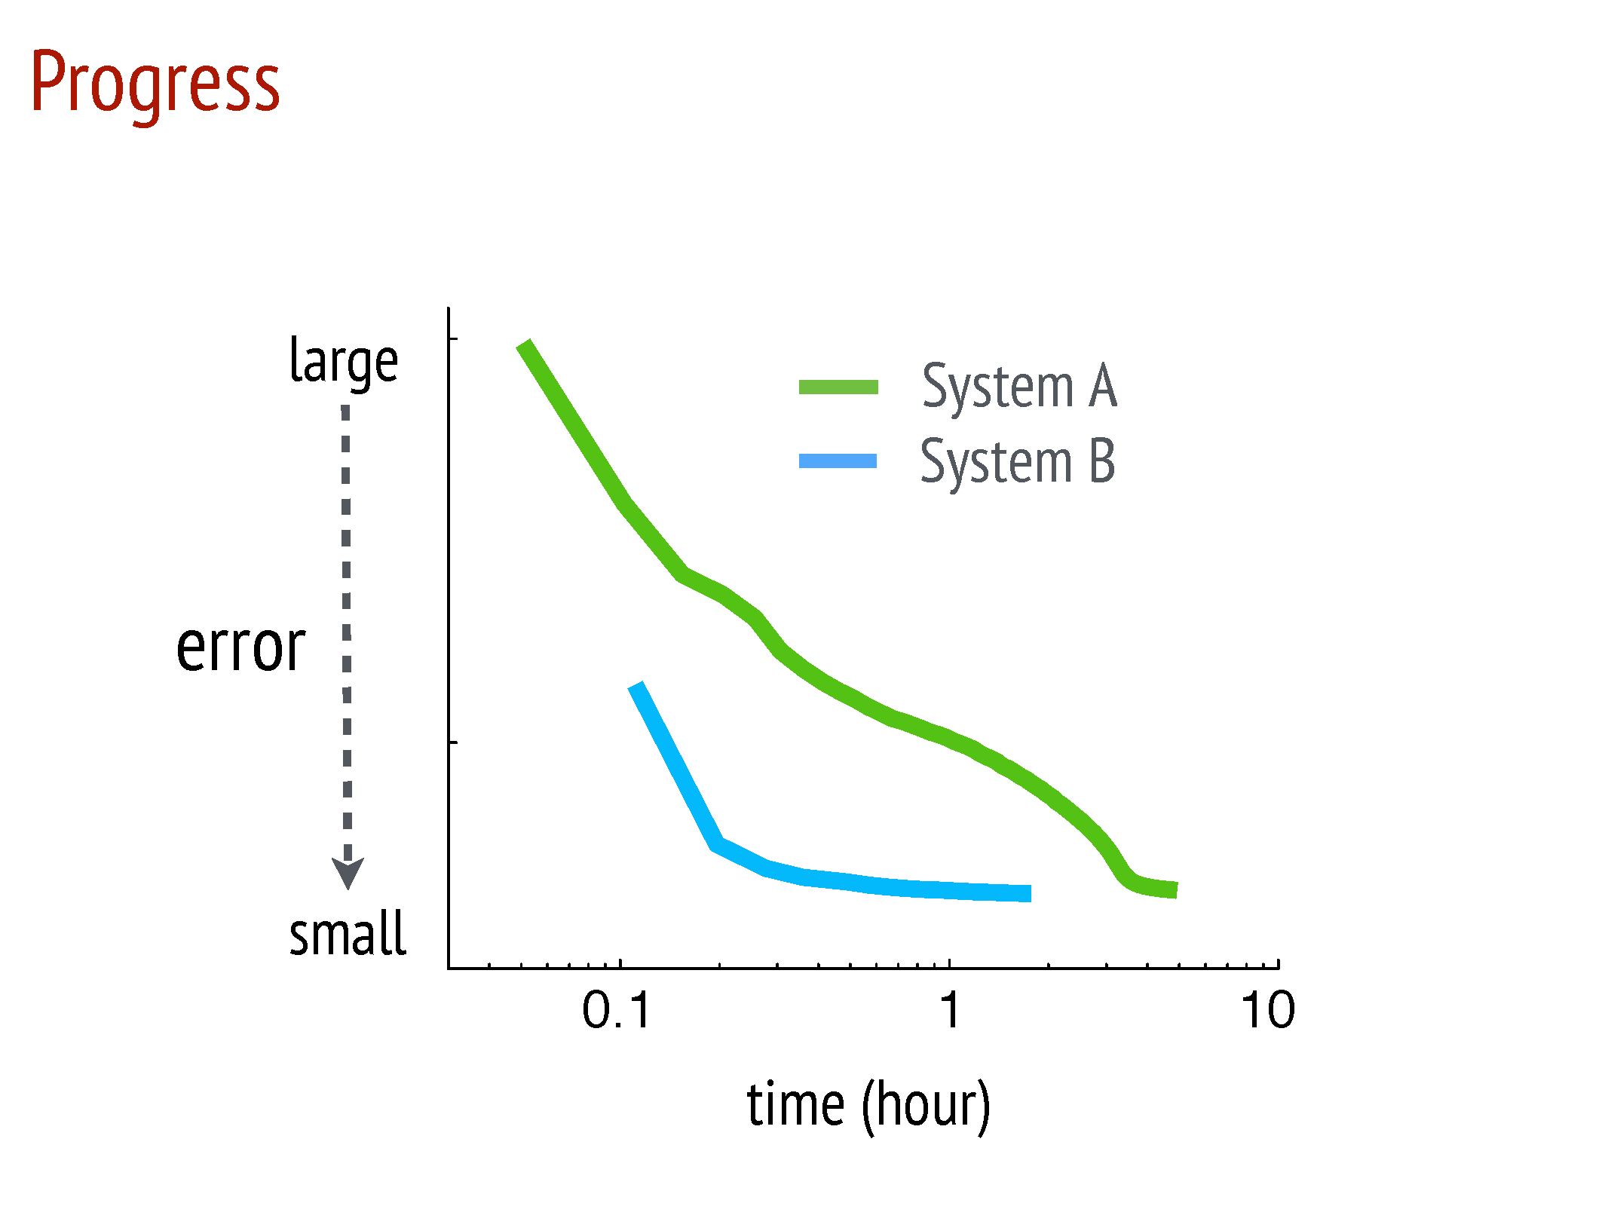

Slide 52
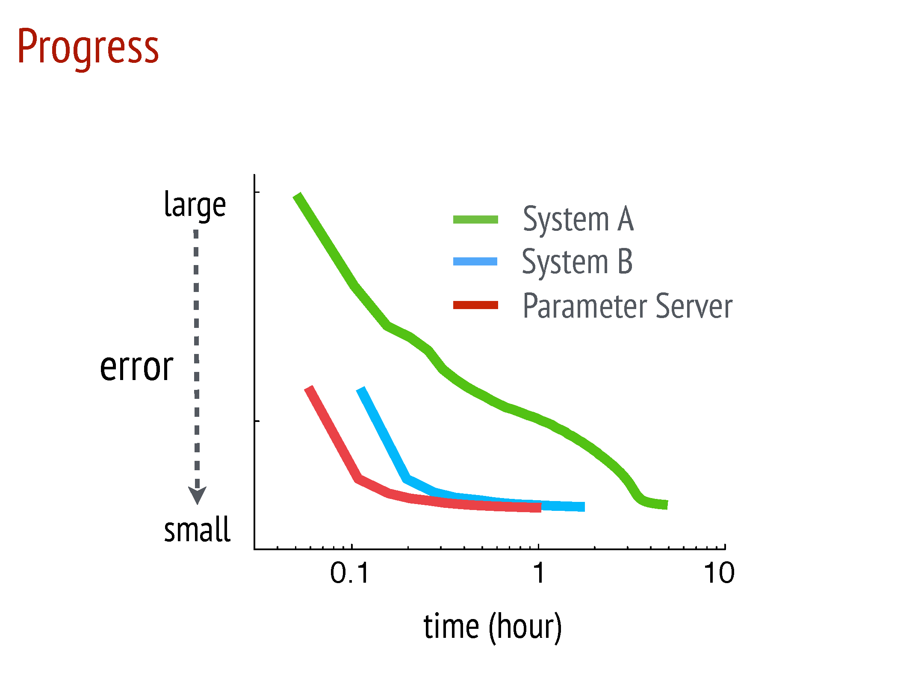

Slide 53
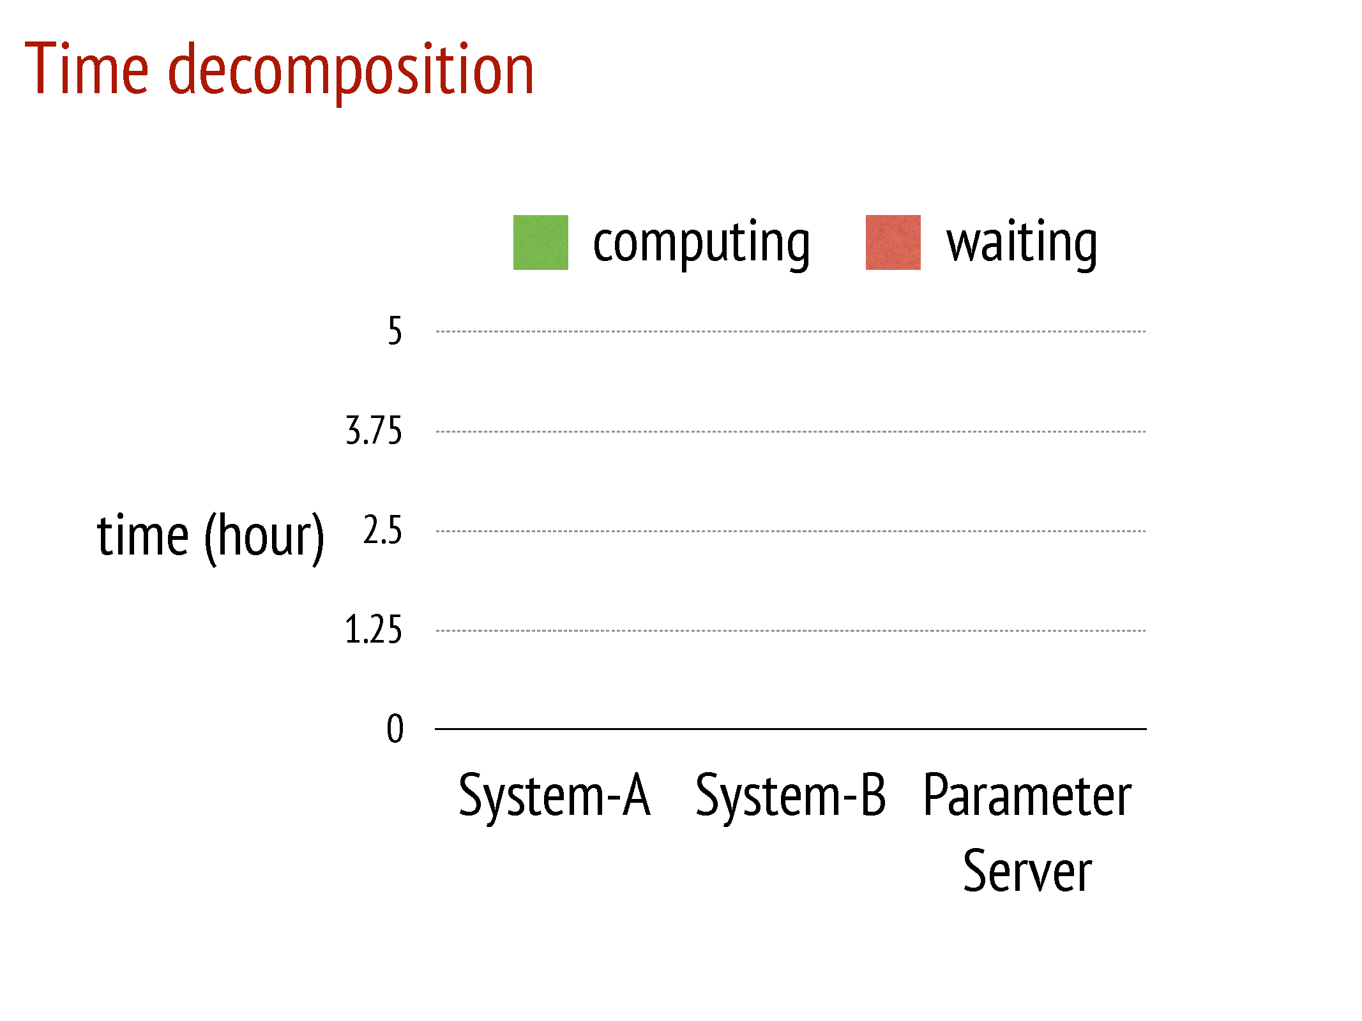

Slide 54
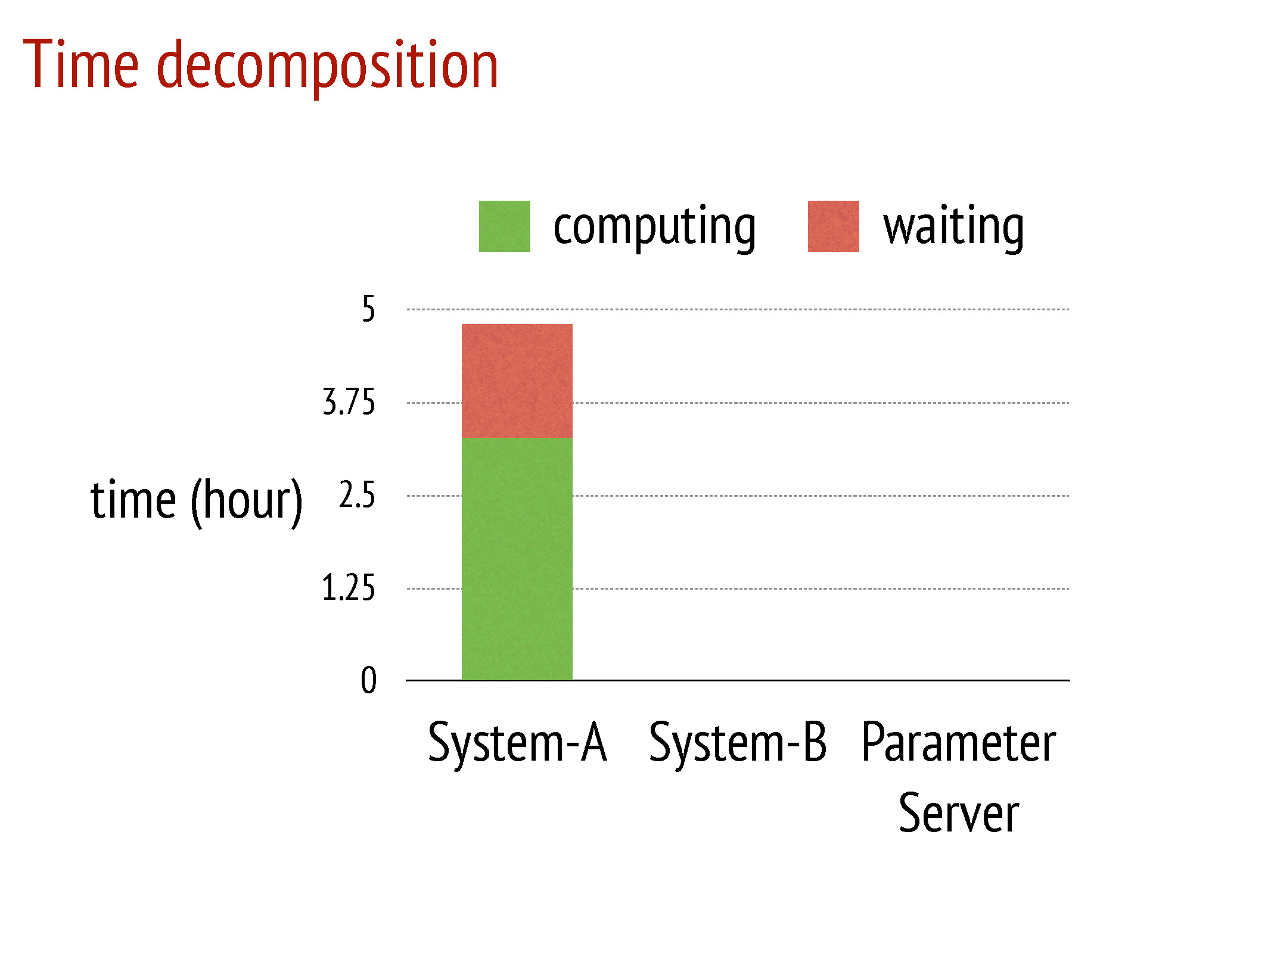

Slide 55
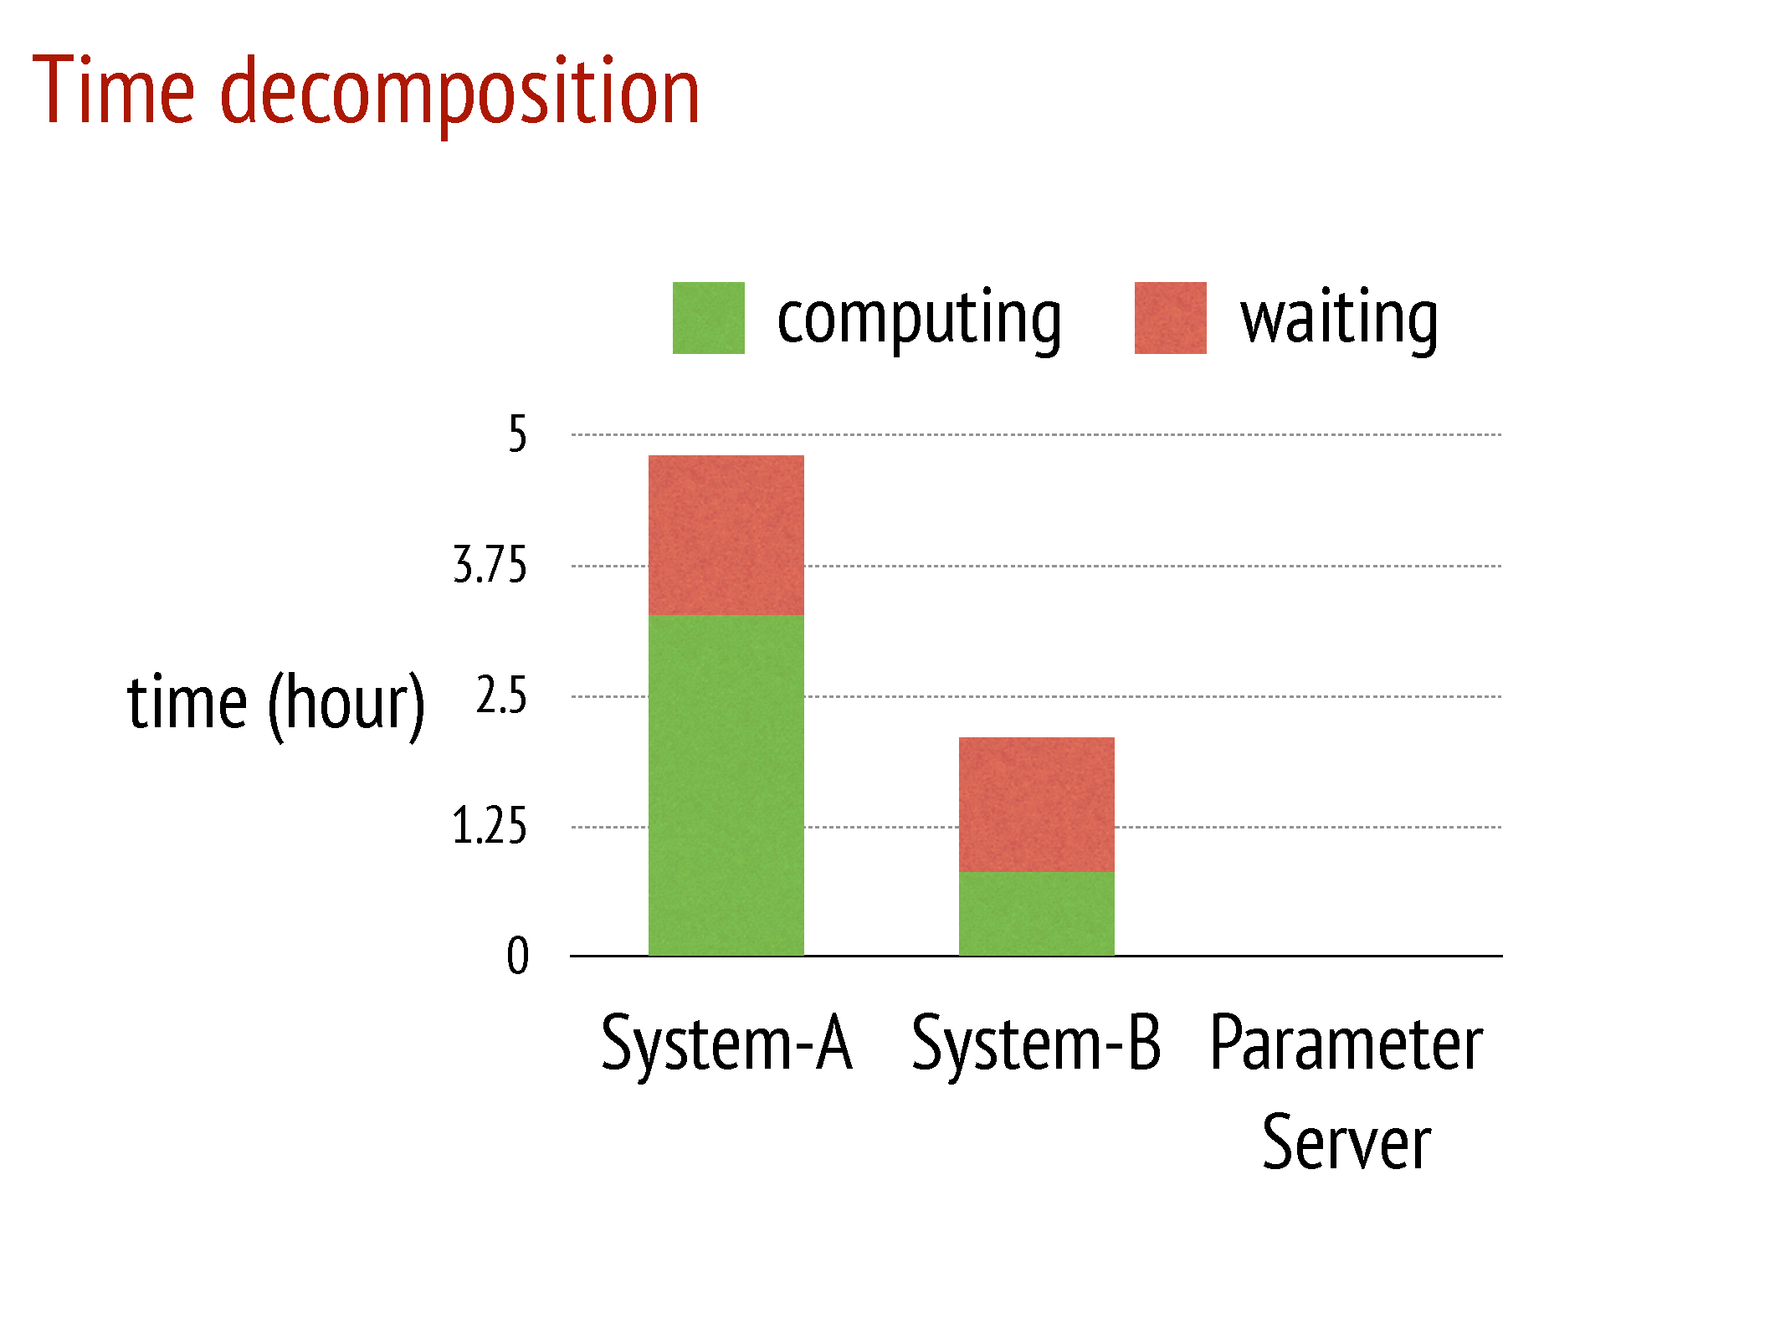

Slide 56
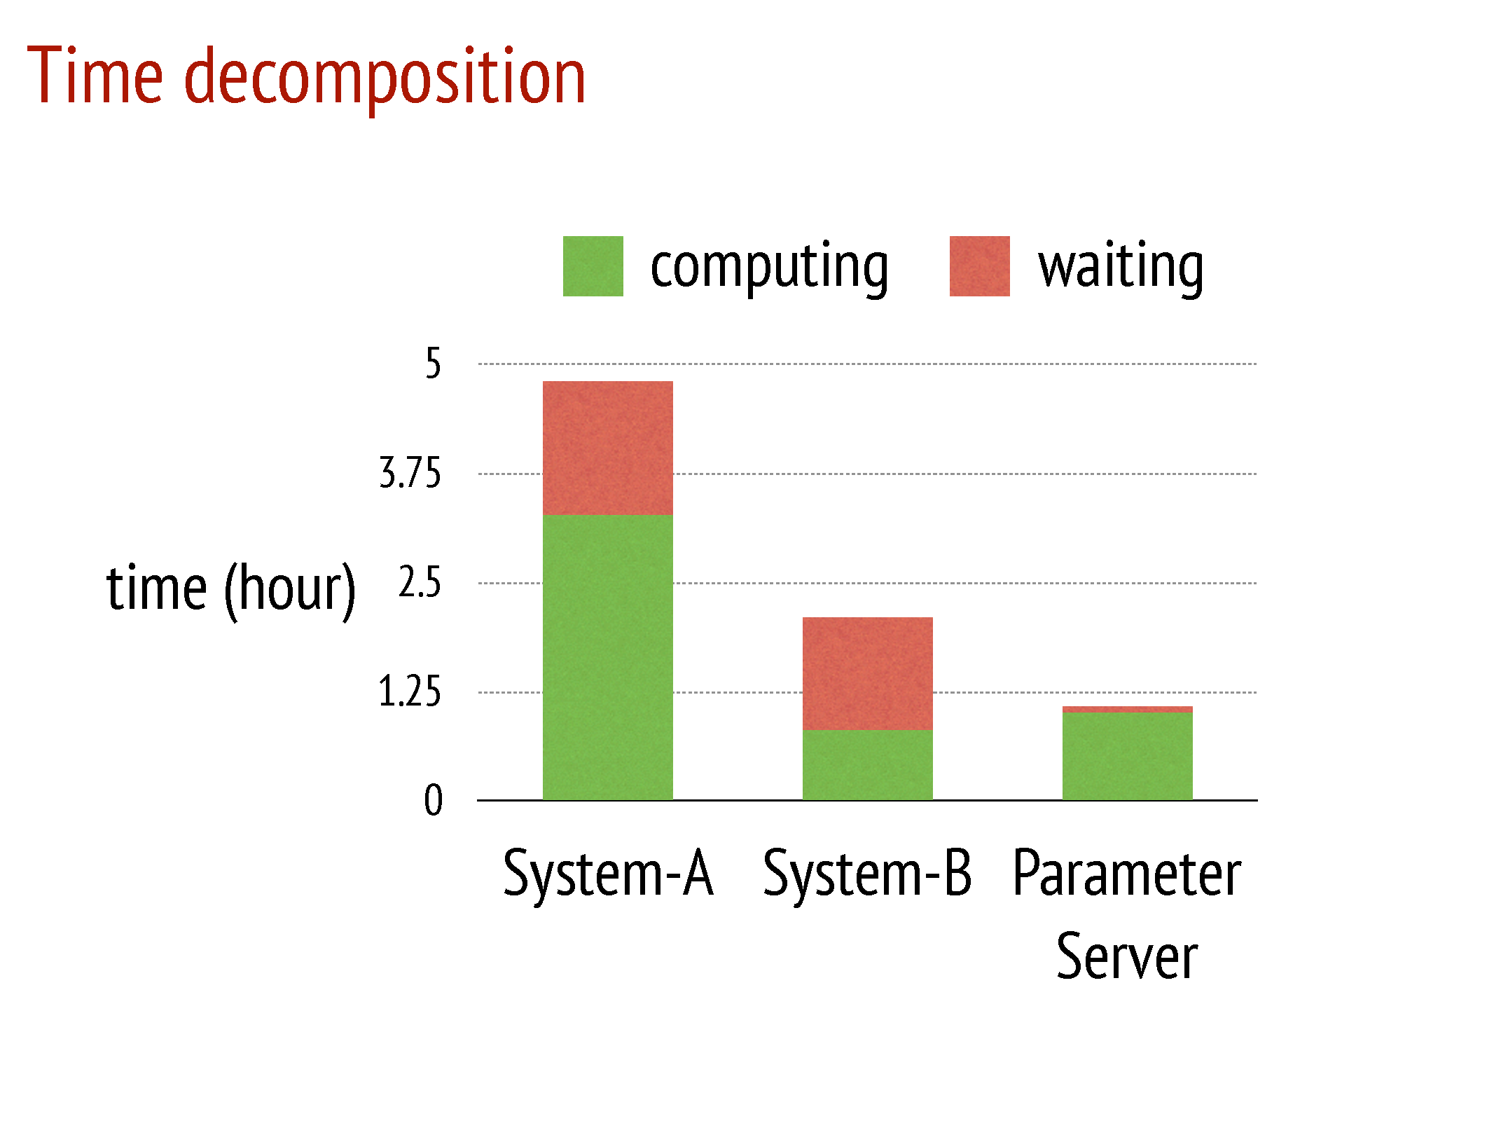

Slide 57
Summary and Discussion

Slide 58
Summary: Pros
Efficient Communication:
Batching (key,value) pairs in Linear Algebra objects
Filters to reduce unnecessary communication & message compression
Caching keys at worker and server nodes for local access
Flexible Consistency Models:
Can choose between Sequential, Eventual, and Bounded delay consistency models
Allows for tradeoffs between System Performance and Algorithmic Convergence
Fault Tolerance and Durability:
Replication of data in Servers
Failed workers can restart at the point of failure by using vector clocks
Ease of Use:
Linear Algebra objects allow for intuitive implementation of tasks

Slide 59
Summary: Cons & Further Discussion
What are System A and System B? No insight into design differences.
Server Manager Failures and Task Scheduler failures are not discussed.
No experiments on the other two systems with Bounded delay model. System B’s waiting time may reduce if implemented with a Bounded Delay model.

