Slide 1
LFGraph: Simple and Fast Distributed Graph Analytics
Presented by : Chaitanya Datye
Hoque, Imranul, Vmware Inc. and Gupta, Indranil, University of Illinois at Urbana-Champaign – TRIOS ‘13

Slide 2
Why Distributed Graph Processing ??
Graphs are everywhere!! – Social Networks, Finance, Stocks, Transportation Networks, Search engines, etc
Well, These graphs are HUGE !!! – Millions and billions of vertices and edges

Slide 3
Distributed Graph Analytics Engine – Key Aspects
Computations – Low and Load balanced
Communications – Low and Load balanced
Low Preprocessing Cost
Smaller Memory Footprint
System should be Scalable
Notes:
Here are some of the essential aspects that a distributed graph analytics engine should pay attention to -
Computations – should be low and should be load balanced across the servers. This determines per-iteration time and thus total job completion time. It is affected by the number and distribution of vertices and edges across servers.
Communications – should be low and should be load balanced across servers. This also determines per-iteration time and thus total job completion time. Affected by quantity and distribution of data exchanged among vertices across servers.
Pre-Processing – prior to the first iteration, the graph needs to be partitioned across different servers. This partitioning time should be low since it represents upfront cost and is included in job completion time.
Memory – The memory footprint per server must be low. Only then it ensures that fewer servers can be used for processing large graphs.
Scalability – Smaller clusters must be able to load and process large graphs. As cluster size increases, computation and communication must become cheaper leading to the entire job running faster.
Given this, a lot of existing graph processing systems try to cater to these requirements but fall short in atleast one of the above categories. We will look into some of them before we go to LFGraph.

Slide 4
Pregel
Server 1
Server 2
B
D
A
C
E
Notes:
Google came up with the first ever vertex centric distributed graph processing framework called Pregel. Basically, Think like a vertex.
A vertex program in Pregel first reads all the in-neighbor values, computes the new value for that particular vertex and then sends this new value to all the out-neighbors of that vertex.
Let’s consider the example here. For A, first, A’s vertex program will read values from B and C since they are the in-neighbors for A. Then, A will compute its new value and at the end of the iteration A will send its new value to D and E.
A point to note here is that the new value of A is sent to server S2 twice. Once for D and once for E even if D and E are on the same server. Pregel allows programmers to write combiners which can combine these outgoing messages but that requires an additional pass over the outgoing message list and also increases the cost of computation.

Slide 5
Is there any better option?
Goal | Pregel
Computation | 2 passes, Combiners
Communication | ∝ #Edge-cuts
Pre-Processing | Cheap(Hash)
Memory | High(store out-edges + buffered messages)
Scalability | Good but needs a min #servers
Notes:
We can see here that Pregel has a communication overhead proportional to the number of edge cuts which is basically the number of edges crossing servers.

Slide 6
GraphLab
Server 1
Server 2
B
D
D
A
A
C
E
E
Notes:
Next, came GraphLab. GraphLab first assigns each vertex to one server. Then, for a particular vertex’s in- and out- neighbors not on that server, it creates ghost vertices on the other servers. Here, we can see that for A, since D and E are its out neighbors and are not on the same server, A is ghosted on S2. Similarly, D and E are ghosted on S1 since their in-neighbor A is on S1. This avoids the edge communication from crossing network but, at the end of each iteration the new value at a particular vertex has to be sent to all its ghosts. And, the number of ghosts can be large. So, the communication overhead is basically equal to the number of ghosts.
Also, in GraphLab, in every iteration, a vertex reads in-neighbor values, computes its new value and then if this value is updated, it activates all the out-neighbors of that vertex. So, two passes are required. One for update of the value and the other pass over the list of out-neighbors to activate them.

Slide 7
Can we do better ?
Goal | GraphLab
Computation | 2 passes
Communication | ∝ #vertex ghosts
Pre-Processing | Cheap(Hash)
Memory | High(store in- and out-edges + ghost values)
Scalability | Good but needs a min #servers
Notes:
GraphLab is better than Pregel with regards to communication overhead since the communication overhead is just equal to the number of ghosts and not the number of edges crossing server boundaries. However, the memory footprint is large for GraphLab than Pregel. GraphLab has to store in- and out- edges as well as ghost values which adds to the memory footprint. Is there something better?

Slide 8
PowerGraph
Server 1
Server 2
B
D
A1
A2
C
E
Notes:
PowerGraph places each edge on one server. Creates mirrors on different servers for a particular vertex. The mirrors avoid edge communication from crossing the network however, the mirrors need to be synced during each iteration. A master mirror is chosen. All other mirrors send their values during an iteration to this master mirror, the master aggregates these values and sends them back. So, the communication overhead is actually twice the number of mirrors. The number of mirrors can be very large.

Slide 9
Can we still do better ?
Goal | PowerGraph
Computation | 2 passes
Communication | ∝ #vertex mirrors
Pre-Processing | Expensive (Intelligent)
Memory | High(store in- and out-edges + mirror values)
Scalability | Good but needs a min #servers
Notes:
Also better than Pregel in terms of communication overhead. However, memory footprint is large. This is however computation balanced. Since it uses very intelligent partitioning strategies, it ensures that the computations are load balanced across servers. But, the cost of preprocessing in powergraph is very high.

Slide 10
LFGraph – YES, We Can !!!
Cheap Hash based partitioning
Decoupling Computation and Communication
Publish – Subscribe Mechanism
Single – Pass Computations
No Locking
In – Neighbor Storage
Notes:
Uses cheap hash based partitioning which incurs very less cost when it comes to preprocessing, unlike PowerGraph where preprocessing takes up around 80-90% of the total job runtime. We will see in the experiments section why cheap partitioning works and why there is no need for intelligent expensive partitioning strategies for real world graphs.
Computations and Communications are decoupled making the code more modular and allowing optimizations to both these phases separately independent of each other.
A server only maintains publish list of servers per vertex which has the out-neighbors of that particular vertex. The updated values are sent to those servers that belong to the publish list of the vertex. This ensures the fetch-once mechanism at the receiving end.
LFGraph just makes one pass over the in-neighbor list. It trades off computation for reduced storage. No mechanism for activation/deactivation that can enable/disable execution of neighboring vetrices.
The vertex reads and writes are decoupled and hence, no locking is required. Two copies are maintained to ensure consistency.
Only stores in-neighbor lists. Thus reducing the memory footprint.

Slide 11
Publish Subscribe Mechanism
Subscribe Lists
Created during preprocessing and are short lived
Per remote server
List contains vertices to be fetched from that server.
Garbage collected after preprocessing iteration
Publish Lists
Created based on the Subscribe lists.
Each server maintains a Publish list for each remote server consisting of the vertices it needs to send to that server.

Slide 12
Publish Subscribe Mechanism
Allows for Fetch-Once behavior since values are fetched only once
Server 1
Server 2
B
D
A
C
Publish List at S1 for S2 : {A}
E
Subscribe to {A}
Notes:
During preprocessing, S2 knows that it will require the value of A in order to calculate the values of D and E. Hence, S2’s subscribe list for S1 contains {A}. Based on this list of S2, S1 knows that it will have to send the value of A after each iteration to S2. Hence, it creates a publish list for S2 containing {A} since A’s out neighbors are on S2. Makes sure that each external vertex data is fetched exactly once.

Slide 13
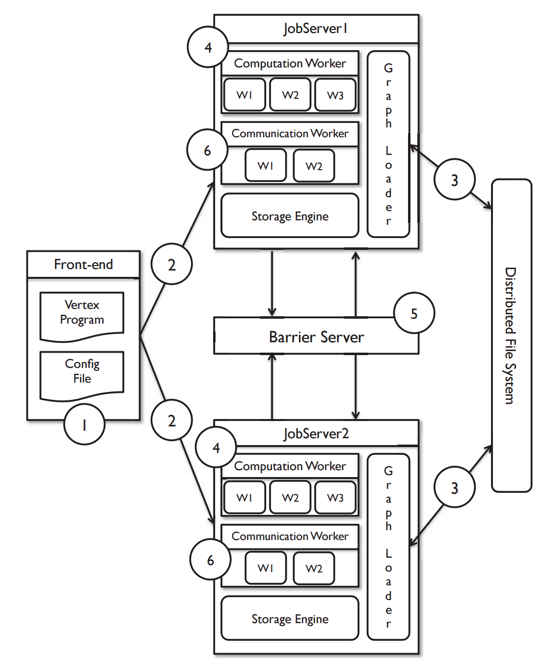
LFGraph System Design
Notes:
The Front-end stores the vertex program and the configuration file consisting of all the information like graph data location, IP addresses of Job Servers, IP address of the Barrier server, number of computation workers per job server, number of communication workers per job server, etc.
The Front-end sends the vertex program and configuration file to all the job servers.
The Graph Loaders, collectively load the graph data using the location specified in the cofig file and they split them across storage engines.
When the barrier server signals back that the barrier is completed, the job servers kickstart the computation workers and sends them sub shards of vertex values.
When all computation workers finish, they signal either next or halt to the barrier server. Halt is signaled only when the termination condition for the algorithm is met. The Barrier server terminates the job only if all job servers signal halt.
If any of the job servers has signaled next, the barrier server signals back when the barrier is reached, this marks the start of the communication phase. Jobservers kickstart the communication worker threads which send vertex values to remote job servers. Then the job server signals next to the barrier server to start the next iteration.
Steps 4 to 6 repeat.

Slide 14
Local and Remote Value Stores
Local Value Store
Real Version (Reads), Shadow Version (Writes)
Decoupled reads and writes – No Locking required
Shared across the computation workers in a Job Server
Flag set whenever shadow value written - used by communication workers to send values
Remote Value Store
Stores values for each in-neighbor of a vertex at a Job Server.
Uses a flag – set only if updated value is received – Allows to skip vertices which aren’t updated in that iteration.
Notes:
For each vertex, the local value store maintains two versions of that vertex values. Real version which is used for reads and a shadow version which is used for writes. At the end of each iteration, the real version value is set to the shadow version value and the shadow version value is cleared. We require two versions because computation workers at a Job Server share the local value store.
A communication worker runs in three stages reading the local/remote value stores. In the first stage, it clears all the remote value flags for the vertices. Now, it looks at the publish lists, sends only those values which have been updated.

Slide 15
Example : SSSP using LFGraph
ITERATION – 0
Server 1
Server 2
B
0
D
∞
A
∞
C
∞
E
∞

Slide 16
Example : SSSP using LFGraph
ITERATION – 1
Server 1
Server 2
B
0
D
∞
Read : 0
A
1
Update value Shadow
C
∞
E
∞
Read : ∞
Publish Value of {A}

Slide 17
Example : SSSP using LFGraph
ITERATION – 2
Server 1
Server 2
B
0
D
2
Locally Read A’s value received in previous iteration and use that
A
1
C
∞
E
2

Slide 18
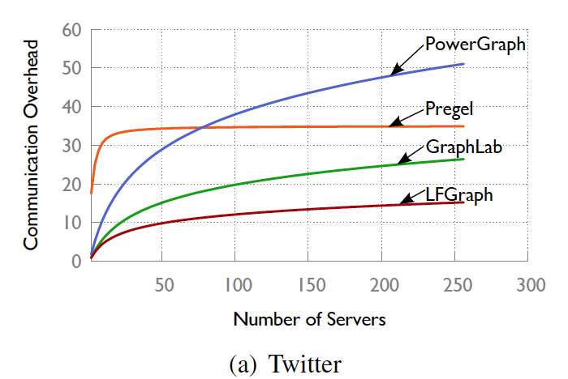
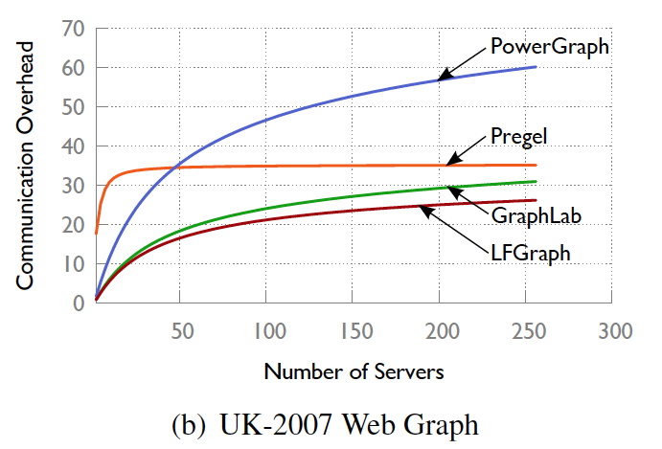
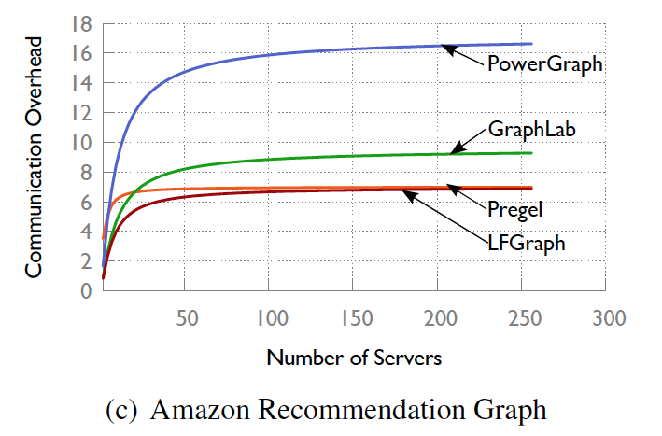
Communication Overhead analysis
Notes:
The mathematical equations that were derived to calculate the expected communication overhead were used on real world graphs and here is what we obtain. In all cases we see that LFGraph performs better as expected than the other graph processing systems.
The first graph is for Twitter data, the second one is for websites in UK and the third one is for recommendation system of Amazon online bookstore.
This is primarily because, LFGraphs cheap partitioning strategy consumes less amount of time leading to faster preprocessing and also the fetch once mechanism is faster than the other approaches and achieves a lower communication overhead.

Slide 19
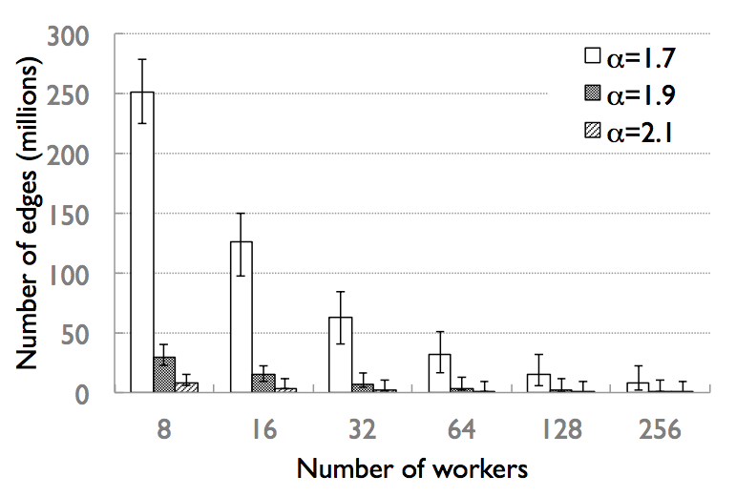
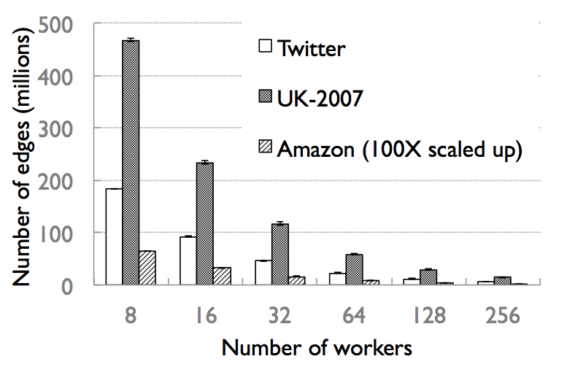
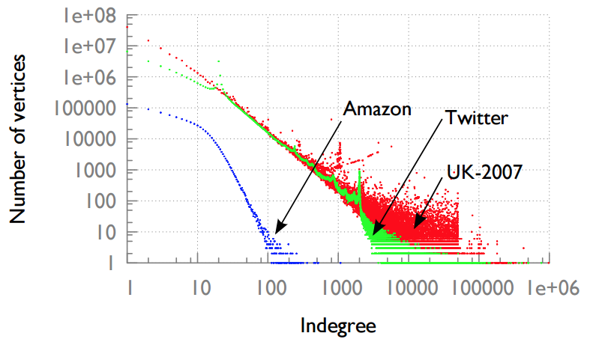
Computation Balance analysis – Real World vs Ideal Power Law graphs
Cheap partitioning strategy suffices for real world graphs

Slide 20
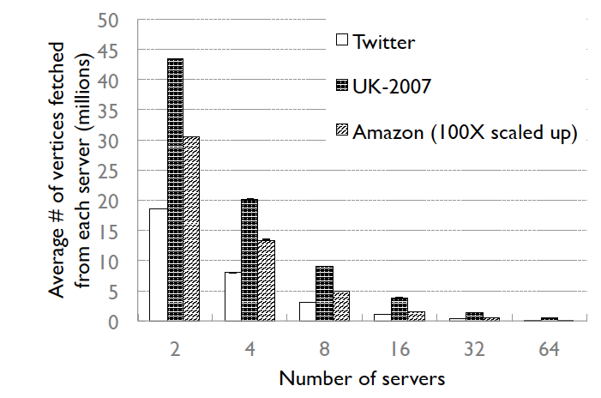
Communication Balance analysis
Communication imbalance → more processing time
If data sent by server S1 is more than that of S2, overall transfer time increases
LFGraph balances communication load very well since error bars are small

Slide 21
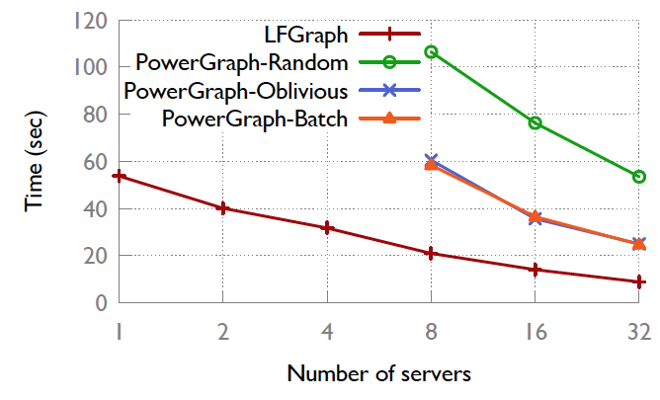
PageRank runtime ignoring partition time
PowerGraph couldn’t load graph at small cluster sizes
LFGraph wins over the best PowerGraph version by a factor of 2x

Slide 22
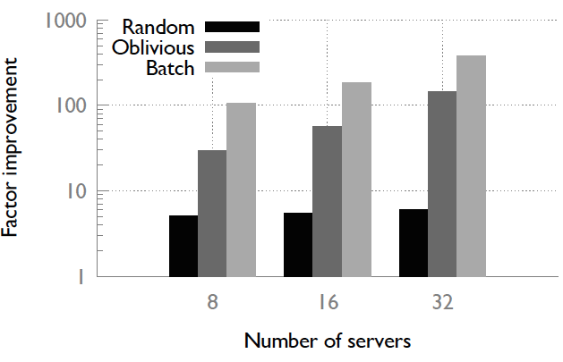
PageRank runtime including partition time
Improvement is most over the intelligent partitioning schemes of PowerGraph
8 servers – 4x to 100x improvement, 32 servers – 5x to 380x improvement
Intelligent partitioning strategies have little effect

Slide 23
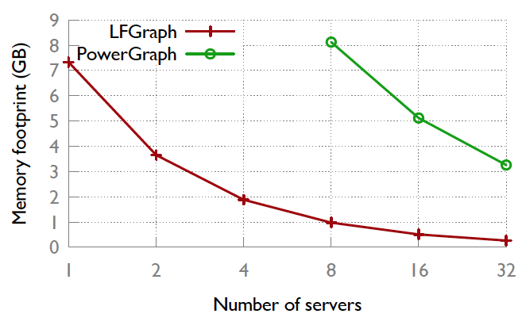
Memory Footprint – LFGraph vs PowerGraph
LFGraph stores only in-links and publish lists unlike PowerGraph.
Memory footprint is 8x to 12x lesser than PowerGraph

Slide 24
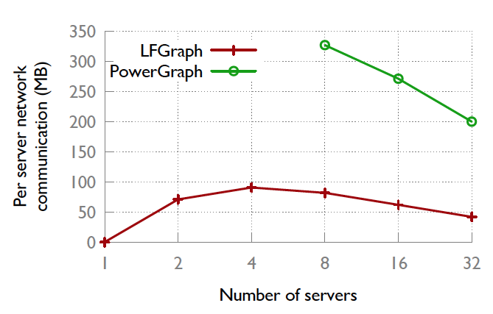
Network Communication – LFGraph vs PowerGraph
There is first a quick rise in the total communication overhead
But, as the total communication overhead plateaus out, the cluster size increase takes over dropping the per server overhead
LFGraph transfers about 4x less data per server than PowerGraph

Slide 25
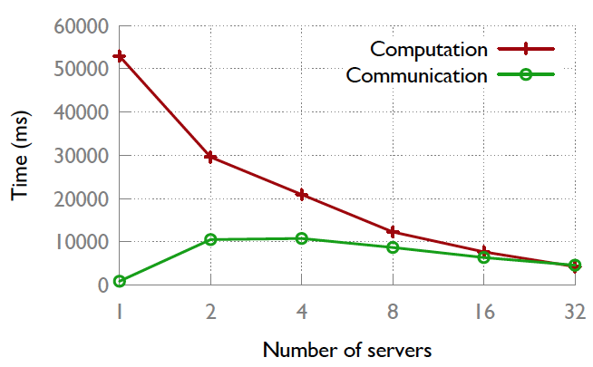
Computation vs Communication
Computation time decreases with increasing number of servers
Communication time curve mirrors the per-server network overhead
Compute dominates communicate in small clusters
After 16 servers, LFGraph achieves a balance

Slide 26
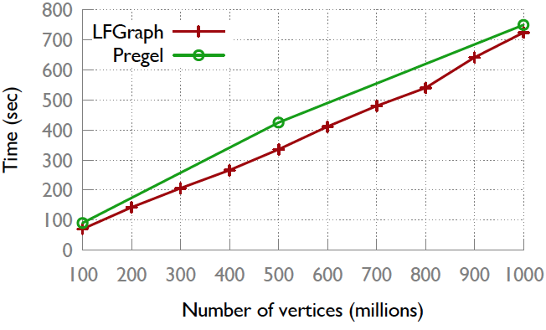
Scaling to Larger Graphs
Pregel – 300 servers, 800 workers
LFGraph – 12 servers, 96 workers
Runs SSSP benchmark
Uses 10x less compute power still gives better performance. LFGraph scales well

Slide 27
Pros
Low computation and communication overheads ☺
Low memory footprint ☺
Highly Scalable ☺
Computations and Communications are balanced ☺
Cheap partitioning strategy suffices ☺

Slide 28
Cons/Comments/Discussion
In case of failures, LFGraph restarts computation. More efficient mechanisms for fault tolerance?
Barrier Server – SPOF!!
LFGraph requires that sufficient memory is available in the cluster to store the graph and the associated values. What if graph size is large? Or such a cluster is unavailable?
No techniques to give out partial results in case of LFGraph. Every computation runs to completion. What if there is a deadline?

Slide 29
Questions ?

