Slide 1
Tag: a tiny aggregation service for ad-hoc sensor networks
Samuel Madden, Michael J. Franklin, Joseph Hellerstein, and Wei Hong
Presented by – Mahanth Gowda
(Some pictures are adopted from paper)

Slide 2
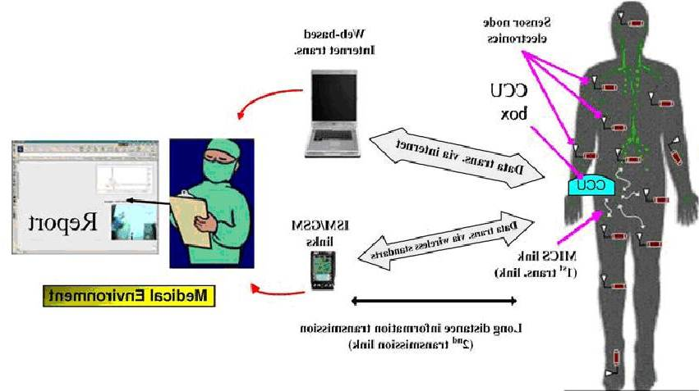
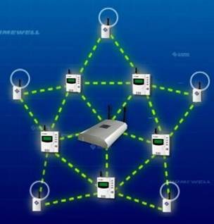
Wireless Sensor Networks (WSN)
Wireless sensor networks consists of nodes having the ability to
sense the environment
compute
communicate
Applications include
Military, surveillance, temperature, monitoring, medical health monitoring

Slide 3
Energy Efficiency
Sensor nodes are battery operated, hence conserving power becomes a very important problem

Slide 4
Opportunity - Computation Communication Tradeoff
Communicating 1 bit of data is equivalent to executing 800 instructions
Computation is always preferable over communication

Slide 5
TAG principle
Process data inside the network, instead of communicating all the way to the base-station and then processing it
The process of compressing the data by processing it in-network is called aggregation
This reduces communication overhead dramatically at the cost of computation, which is relatively cheaper

Slide 6
Outline
Query Model
Aggregation Process
Aggregate structures
Optimizations and Performance results
Conclusion

Slide 7
QUERY MODEL

Slide 8
Query Model
SQL style query model
Single table called sensors over a distributed database formed by motes
Eases programming, users need not worry about low level details → Think about what to do, not how to do
Amenable to incorporation of optimization techniques from parallel/distributed databases
Sensors
 | Temperature | Location | Sound Volume
20 deg C
Room 1
80 db
35 deg C
Room 2
20 db
25 deg C
Room 3
40 db

Slide 9
Query example
Monitor occupancy of rooms in 6th floor of building :-
SELECT AVG(volume), room FROM sensors
WHERE floor = 6
GROUP BY room
HAVING AVG(VOLUME) > threshold
EPOCH DURATION 30s

Slide 10
Epoch
Observe that the query contains an Epoch parameter.
It specifies the periodicity with which sensor updates need to come to the root
Epochs form the main difference between TAG query and SQL query
A lower bound exists on the epoch duration because of sensing and communication limitations

Slide 11
NETWORK AGGREGATION

Slide 12
Tree Based Routing
Nodes organize themselves into different levels of a tree
Data is routed to the root by following a path of parents
A
A
B
C
B
C
D
D
E
E
F
F
Network
Tree Structure

Slide 13
Example: CENTRALIZED
Queries are issued to the nodes:- SELECT MIN TEMP from SENSORS
In-network processing to collect aggregate values
MIN TEMP?
8
MIN?
4
3
MIN?
MIN?
9
1
MIN?
5
2
MIN?
MIN?
MIN<4,9,5,1,2,3,8> = 1
8
Number of Messages = 12
<4,9>
4
3
<5,1,2,3>
<9>
9
1
<5,1,2>
5
2
<2>
<5>

Slide 14
Example: AGGREGATION
Distribution phase :- SELECT MIN TEMP from SENSORS
Collection Phase :-
MIN TEMP?
8
MIN?
4
3
MIN?
MIN?
9
1
MIN?
5
2
MIN?
MIN?
MIN<4,1,8> = 1
8
Number of Messages = 6
MIN<4,9>=4
4
3
MIN<1,3>=1
<9>
9
1
MIN<5,1,2> = 1
5
2
<2>
<5>

Slide 15
Other Routing Algorithms
TAG operates on the top of routing layer
Requirements of a routing algorithm are :-
Ability to delivery query requests to all nodes in a network
Ability to route from any node to the root

Slide 16
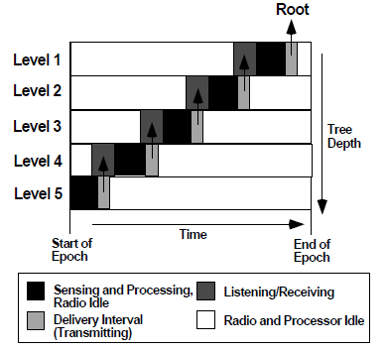
Flow of partial state
Partial Aggregates flow up the tree during an Epoch
A node transitions through following states
Receive partial records from children
Process aggregates by combining own information
Deliver updated partial record to the parent
Synchronization schemes help nodes be idle for rest of the time, thereby saving energy

Slide 17
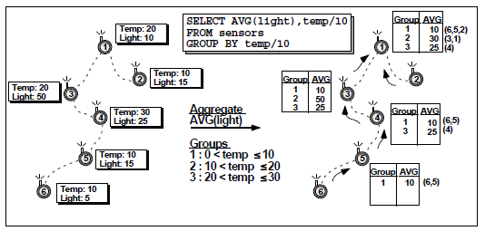
Grouping
Grouping introduces storage problems when number of groups exceed available storage
Group eviction schemes introduced to manage storage
Base-station combines partial groups to form accurate aggregate value

Slide 18
AGGREGATE STRUCTURE

Slide 19
Aggregate Structure
SQL supports “basic 5”
MIN, MAX, SUM, AVERAGE, and COUNT
TAG facilitates any function that can be expressed using
Initializer:- Initializes a state from single sensor value
Merging function :- Combines partial states
Evaluator :- Evaluates aggregate from states

Slide 20
Aggregation Example
Averaging ..
Initializer: i(x) = <x,1> (state = <sum, count>)
Evaluator: e(<S,C>) = S/C
Merging Function: f(<S1,C1>,<S2,C2>) = <S1+S2,C1+C2>
Other aggregate functions like MEDIAN, HISTOGRAM, UNIQUE also supported

Slide 21
Classification of Aggregates
Duplicate Sensitive:- Duplicates will affect aggregates
Exemplary/Summary:- MAX is Exemplary, AVG is summary
Monotonic :- The evaluation function increases/decreases monotonically over the levels of the tree
Partial States :-
Distributive aggregates – size of partial records same as aggregate
Algebraic Aggregates – size of partial records is a constant
Holistic aggregates – size of partial record is proportional to size of the data (unlikely to benefit from aggregation)
Unique aggregates – state is proportional (unique updates)
Context sensitive

Slide 22
Classes of aggregates

Slide 23
PERFORMANCE RESULTS AND OPTIMIZATIONS

Slide 24
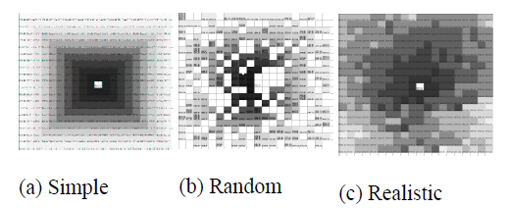
Evaluation
Simulation setup
Environment set up in Java
Time is divided into epochs and nodes can send/receive messages during an epoch
Connectivity based on geographic distances
Grid Topology
Three Communication models
The Darker, the closer to the root in terms of radio hops

Slide 25
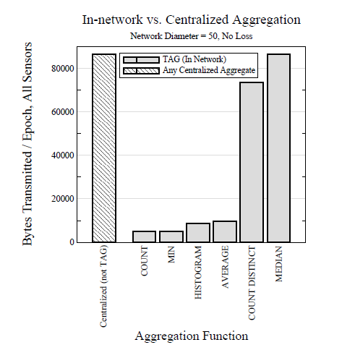
Performance of TAG
Orders of magnitude improvement
Count and MIN perform best because only one integer is communicated (distributive)
AVERAGE needs two integers, slightly more expensive (algebraic)
MEDIAN does not benefit from aggregation (holistic)

Slide 26
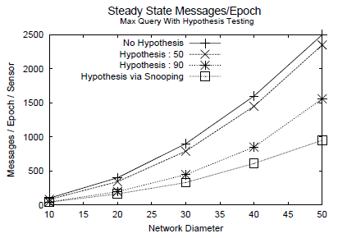
Optimizations
Snooping
Take advantage of broadcast channel
Don’t send if a sensor value doesn’t affect the aggregate result
Example: For MAX If sensor value < Overheard value, suppress sending
Hypothesis testing
Ex. For exemplary aggregates like MAX, compute MAX of top k levels and use it to suppress values from other nodes
Substantial Difference

Slide 27
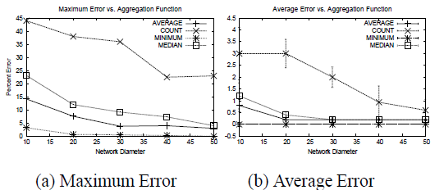
Loss Tolerance
Reselect parents based on dynamically changing link qualities
A new parent is chosen when a link to the parent is broken. Reselection happens after timeout
A parent may end up choosing its own child as a parent, in which case the child will select a new parent
Percentage error decreases with network diameter because more errors will occur near the leaves of the network

Slide 28
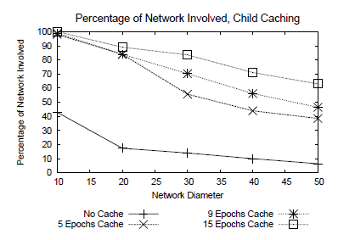
Caching results
Caching is used to improve quality of aggregates
Old partial records from clients are reported, in case of message failures
As the network size increases, since probability of error compounds with number of hops, errors will increase

Slide 29
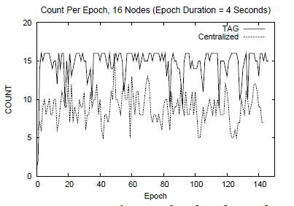
Prototype on mica motes
16 motes arranged in a depth-4 tree
Does not include optimizations
Quality of count is better for TAG
Number of messages is half of centralized

Slide 30
Related Work
Centralized query processing
In-efficient, results in large data communication
Directed Diffusion
Puts aggregation APIs in routing layer, users need to think about how to move the data
Synopsis diffusion
Tree based routing is not robust, but avoids double counting. Proposes energy efficient multipath aggregation that is both robust and prevents double counting
Data Cubes
Provides formulations for properties of aggregates

Slide 31
Discussion points
Simulation based evaluation
Radio contention not modeled, no fine grained model of time
Time synchronization
Synchronization errors build up with higher number nodes in the system
Approximate algorithms for holistic queries like median?
Paper does not analyze the effect of stale cache values on results
A single failed node inserting corrupt aggregation values might pollute the whole result

Slide 32
Conclusion
SQL like declarative language for specifying aggregation queries can make programming easy
In network aggregation can decrease communication overhead
Optimizations like snooping and hypothesis testing on properties of aggregates is helpful
High level language facilitates end to end techniques for reducing the effects of network loss

Slide 33
Thank you

