Slide 1
Understanding and Mitigating the Impact of Load Imbalance in the Memory Caching Tier
Yu-Ju Jong⁺ and Mithuna Thottethodi⁺
Purdue University⁺
Presented by Rajath Subramanyam for CS525 Spring 2014
Notes:
Hi ! my name is Rajath. I will be presenting the paper titled “Understanding and Mitigating the Impact of Load Imbalance in the Memory Caching Tier. This paper is the work of system researchers from Purdue University.

Slide 2
Agenda
Motivation
Background
System design
Evaluation
Discussion
Notes:
Here is a quick overview of the agenda. I intend the to cover the following topics. I will start with a brief of the motivation for the paper and the solution proposed. After that I will dive into some background about the existing system i.e. the baseline memcached and its associated load imbalance problems that inspired a new system.

Slide 3
Motivation
Distributed memory caching systems have gained huge popularity
“memcached” is the most popular distributed memory caching system
It offers tremendous performance improvements compared to architectures that necessitate direct interaction with the storage layer
Notes:
Distributed memory caching systems gained tremendous popularity with companies operating in the web space. Particularly the one that use a lot of dynamic web content in their web applications.
“memcached” is the most popular distributed caching system.
They offer tremendous performance improvements for multi-tiered applications compared to architectures that directly interact with the storage layer.

Slide 4
Motivation
Load imbalance in the memory caching tier can cause severe performance degradation
“Skewed key popularity” can cause significant degradation in the tail latency
The paper presents a memcached variant called “SPORE” which uses self-adapting, popularity-based replication to mitigate load imbalance
Notes:
However, load imbalance in the server pool can cause severe performance degradation.
Load imbalance can occur due to several reasons.
Particularly in this paper the researchers show that skewed key popularity can cause significant degradation in the tail latency thus affecting the overall performance of the sytem
The paper presents a system called SPORE which is a memcached variant that uses self-adapting, popularity-based replication to mitigate the negative effects of load imbalance.
SPORE internally uses algorithms like reactive internal key renaming that we will discuss later to achieve effective replication without excessive communication and/or coordination among servers and clients.
Moreover it offers the same consistency as the baseline memcached system.

Slide 5
Agenda
Motivation
Background
System design
Evaluation
Discussion
Notes:
That was a brief of the pain point of the memcached and the new system that solves it in a nutshell. Before we dive into details, Lets move on to cover some background topics. Here we will discuss what is memached, how it works, why is it so popular and the inherent load imbalance problem.

Slide 6
memcached
Very simple
In-memory distributed hash table service
“Hot” data from DB stored in cache
Memory caching tier comprises of a pool of memcached servers each of which is a standalone server that need not be aware of the other servers in the pool
Notes:
Thus in summary memcached as we saw is a simple, in-memory distributed hash table service that caches all the “hot” data from the DB so that client requests can be served with minimum latency.
In practice, the memory caching tier is a pool of such memcached servers, each of which is a standalone server that need not be aware of the other servers in the pool.
Each server is responsible for a shard of the key space. Such sharding is realized by using a hash function to map the keys to the individual servers.
Memcached uses CONSISTENT HASHING and SEPARATE MEMCACHED CLIENTS (different from end user / browser / client) who are aware of the number of servers in the pool are responsible for directing accesses to the appropriate shard.

Slide 7
memcached users and services
*Disclaimer: All images from World Wide Web
Notes:
Due to its simplicity and the performance improvements it provides memcached is used widely today.
Facebook is supposedly the largest user of memcached and also contributed back to the community. In one of the papers Facebook attributes a 10x performance improvement to the use of a memcached based caching tier
Other users include youtube (google), zynga and Wikipedia, etc.
Amazon Web Services and Google App Engine also offer APIs for memcached services

Slide 8
memcached access characteristics
Read-mostly workloads
Writes in order to be durable have to be made to the underlying (non-volatile) data store
Facebook reports that reads are 2x times writes in their workloads
Other studies have shown that writes constitute mere 3-12% of all accesses in large scale key-value stores
Notes:
The typical workload of memcached is read-mostly as memached can only speed up reads.
Memcached cannot filter writes from the underlying datastore because memory writes are not durable. Because it is important to ensure durability of writes, a write may be deemed to be complete only if the write to the underlying datastore is complete.
However studies show that it is read accesses that are more common that writes in a large scale key value store.
Facebook which is supposedly the largest user of memcached reports that reads are two magnitudes higher than writes . For more details about this you can refer to the scaling memcache at Facebook presentation made in NSDI 2013.
Also some other studies cited in the paper [2,10] report that writes constitute a mere 3-12% of all accesses.

Slide 9
Load Imbalance
1) The number of keys mapped to that server
Two factors influence load on each server in the memcached server pool:
2) Popularity of those keys
Notes:
As I said before memcached comprises of a pool of servers
Here we characterize the load on each server in the pool.
Essentially there are two factors that influence the load on each server:
THE NUMBER OF KEYS MAPPED TO THAT SERVER
POPULARITY OF THE KEYS
Ideally we want both of these distributions to be uniform.
In practice however there are imbalances in each of the two factors:
Second, the popularity of keys if quite skewed.

Slide 10
1) Non-uniform key distribution
Server 2
Server 3
Server 4
Server 5
Server 1
memcached server pool
(Key,value)
*Disclaimer: load imbalance image from World Wide Web
Notes:
First, there is some non uniformity in key distribution even when using a good hash function for key-to-server mapping.
A subset of the servers have high load due to long queueing delays at them thus degrading the tail latency.

Slide 11
2) Skewed key popularity
Popularity of keys is quite skewed
Popularity of keys follow a zipf distribution
This implies that:
A few keys are accessed a lot of times
A medium number of keys have middle of the road accesses
A huge number of keys are accessed very few times
Both (1) & (2) implies load imbalance.
This results in longer queuing delays in smaller subset of servers causing degradation in tail latency.
Notes:
Popularity of keys is skewed and they follow a zipf distribution
This is similar to the distribution of web pages on the internet that follow a zipf distribution. Few pages like gmail.com and facbook.com are accessed a lot of times, medium number of pages like cnn.com are in the middle of the road and large number of pages like cumtd.com are accessed very few times.
Zipf distribution implies:
a few elements are accessed a lot of times
a medium number of elements with middle-of-the-road accesses
a huge number of elements are accessed very times.
GO BACK TO THE PICTURE IN PREVIOUS SLIDE AND EXPLAIN AN EXAMPLE SCENARIO
Zipf distribution on a log – log plot will be a straight line and on a linear distribution will be axes hugging.
Give example of facebook profiles
Load imbalances due to higher load in smaller subset of servers may not impact average or median latency, but degrades the tail latency significantly.
NOTE:- Only tail latency is affected and not average or median latency because memcached workloads (read-mostly) involve fetching of 100+ objects.

Slide 12
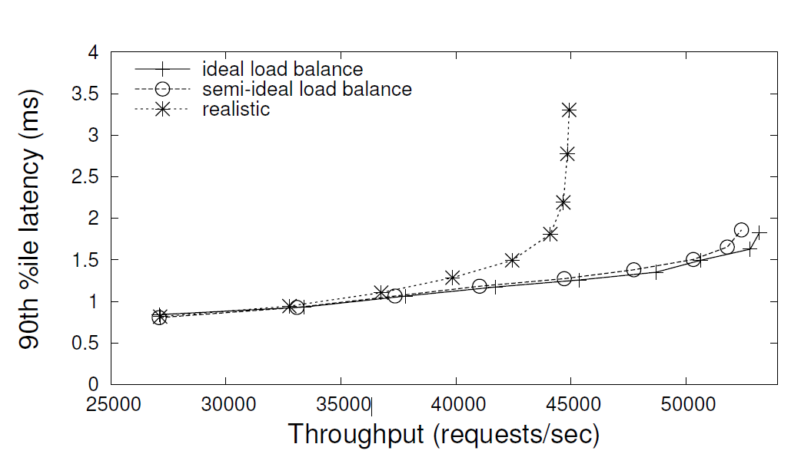
Change in popularity distribution from ideal (uniform) to realistic (zipf) has caused a an increase in tail latency and a massive fall in system throughput
From this we can conclude that skewed key popularity has a massive effect on the tail latency of the baseline memcached servers
Notes:
The researchers carried out experiments to show the impact of load imbalance.
The experimental setup consisted of a pool of 12 memcached servers exposed to various load-levels.
They plotted the 90th percentile latency on the Y-Axis versus the system throughout on the X-Axis. Note that along the X-Axis the load is increased, but the plot has system throughput since it is the affected metric.
They used three configurations of baseline memcached:
Ideal setting: this has perfect load balance with uniform key distribution and uniform random distribution of key popularity. As we all can imagine this is not pragmatic.
Semi-ideal setting: where the key distribution is realistic using a hash function and the popularity distribution is still uniform.
Realistic setting: where both key distribution as well popularity distribution is realistic i.e. both are non – uniform.
In all three settings we can see as load increases, the memcached layer eventually saturates and latency begins to degrade because of queueing delays.
From the graph we can see that the things that have changed from setting 2 to setting 3 is the idealistic normal popularity distribution and realistic zipf popularity distribution and that has had a major effect on the system throughput.
From this experiment we can conclude that the load imbalance caused due to skewed key popularity has a major impact on the performance of the baseline memcached system

Slide 13
Agenda
Motivation
Background
System design
Evaluation
Discussion
Notes:
Let us take a look at the system design of the SPORE.

Slide 14
SPORE design
SPORE stands for Self-adapting Popularity-based Replication
When there are no popular keys then each key is associated with only one server called “Home Server”
When mostly-read tuples become popular they are replicated on “Shadow Servers”
Replica count ‘γ’: number of replicas of the tuple not including the original tuple
*Disclaimer: Dilbert comic strip from World Wide Web
Notes:
SPORE is an augmented variant of memcached
It stands for Self-Adapting Popularity-based Replication.
It uses a form of redundancy (via replication) in order to mitigate the negative effects of load imbalance
SPORE achieves either better performance with the same number of servers or the same performance with fewer servers.
When there are no popular keys then the SPORE system behaves similar to the baseline memcached system where each key is associated with one memcached server by using consistent hashing. This server is called the Home Server.
When mostly-read tuples become popular, those tuples are replicated on additional servers and those servers are called as shadow servers.
Replica count is the number of replicas not including the original tuple in the home server. It is denoted by gamma γ

Slide 15
Several questions arise at this stage ?????
*Disclaimer: All images from World Wide Web
Notes:
Several questions arise at this point:
What is the mechanism that enables replication of tuples on shadow servers such that all clients discover the location of the replicas?
How does SPORE identify tuples to replicate ?
How are the clients notified of the creation and destruction of replicas ? How does client distribute load across replicas ?
What are the policies that determine when replicas are created / retired ?
How are writes handled ? What is the consistency model ?
How does SPORE handle server failures ?

Slide 16
Q1) How do home servers replicate keys on shadow servers?
Done via an algorithm called Reactive Internal Key Renaming (RIKR)
RIKR assigns suffixes ranging from 1,2,…,γ to all the keys with (γ > 1)
shadow server1
foo
home server
foo
foo1
set(k,v)
shadow server2
hash
foo2
foo
Notes:
We will answer each question one by one.
Firstly we will address how the home server replicates keys on the shadow servers
It uses an algorithm called Reactive Internal Key Renaming (RIKR)
RIKR appends a suffix to the original key. The suffix ranges from 1, 2, ….. Gamma
For example consider a key foo in its home server and it becomes popular.
RIKR kicks and generates renamed keys (assuming gamma = 2)
The home memcached server is augmented with a stub that used the same consistent hashing function to map the renamed keys to their shadow servers
The home server issues a set to the shadow servers and the key foo is now replicated on the shadow server
There are two things to note here:
the renamed keys are used only for key-to-server mapping, but not for the actual key operations to rule out possibility of any aliasing. For example assume that there two keys both name foo1 on the same server, one of which is a renamed key. Since operations on renamed key occur on the original name, SPORE avoids aliasing problems.
Each memcached server is aware of others servers in the pool and communicate with each other as opposed to baseline memcached

Slide 17
Q2) How does RIKR ensure load balancing?
But how does the client know about the replicas ??
The server needs to communicate about only γ to the clients. More on this later
*Disclaimer: image from the paper
Notes:
Consider this case where clients c1, c2, c3, c4 determine different servers based on renamed keys
How do clients discover that key foo is replicated ?????
The server communicates only about gamma to the client (by piggy backing this on existing communication. More on this later)
This ensures minimum overhead to communicate about the location of replicas to the client

Slide 18
Consistency Model
SPORE provides only eventual consistency
But SPORE offers “read monotonicity”
This means:
read from one client should always go to the same replica to ensure read monotonicity;
while write requests must always go to the home server to ensure sequential write order
Notes:
Now that we know the basics, Before we move on to answer the next few questions lets review the consistency model for read and writes.
Standalone memcached server ignoring persistent storage and server failure offer strong flavour of consistency called linearizability (with write atomicity). Off course this model is not practical since you need a persistent store for durability
Real memcached servers can offer only relaxed form of consistency called eventual consistency because you cannot guarantee write in the backend store and update / invalidate in the memory caching tier to be atomic
However SPORE like the baseline memcached offers read monotonicity which means write once seen will never unseen again in the future i.e. you either see the new value or you see the stale value; but once you see the new value you will not see the stale value again
Basically this means the following needs to be taken care of in SPORE:
Read request from different clients are distributed to all replicas; whereas requests from a single client are directed always to a single replica ( request from a single client are not load-balanced across replicas to ensure read-monotonicity. )
Write requests on the other hand must go always to the home server to preserve a sequential write order as the home server acts as an ordering point.

Slide 19
Q3) How do clients discover replicas?
1. hash(k) -> SA
5. P = rand(0,2) = 2 ;
Store(key, p, Texp) = (k, 2, timestamp)
in CSM data struct
Client
c1
2. get(k)
4. V, γ = 2
Client maintains a client side data structure called CSM where it stores : (key, renamed key suffix, timestamp)
Home Server SA
3. Is home(k) && isHot(k)
Notes:
Clients receive gamma value from the server. This is piggy backed by the server during normal operation
The client after receiving the non – zero gamma value does two things:
it randomly chooses a suffix between 0 and gamma and
stores both the key and the chosen suffix value in a client data structure called CSM ( CLIENT SIDE METADATA) ALONG WITH A TIMESTAMP. More on timestamp later
This ensures all accesses to a particular key from this client is redirected to the same replica always
This is to ensure read monotonicity
PLEASE NOTE THAT the above step of choosing suffix and adding to CSM is done only once per key and not for every client operation on that key.

Slide 20
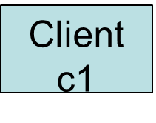
Q4) How do clients retire replicas?
6. p is 2 & t < Texp
hash(k2) -> SB
7. get(k)
9. t > Texp
hash(k) -> SA
8. (v, γ = 0)
Home Server SA
Shadow Server 1 SB
*Disclaimer: Dilbert comic strip from World Wide Web
Notes:
Every entry in the client data struct CSM has a short expiration time. This is equivalent of saying that each client takes a lease for certain amount of time on the replica
Let us consider this case where there is client c1 and it has the following entry for key k in its CSM. It checks if the lease has expired which it hasn’t. So it sends a get request to the shadow server SB.
But SB comes back with a value v (note that gamma here is 0 to show that the replica is currently being retired in the shadow server ie it is in COLD PENDING STATE. More on this later)
When c1 attempts the next operation it finds that the lease has expired and hence goes back to the home server
They additionally clean the CSM entry

Slide 21
Q5) How does the home server identify popular tuples?
Popular tuples are those that are accessed several times in the recent past
Server maintains a server side data structure called SSM where it stores (key, set of 4 counters, state of the key, timestamp)
When the EWMA (exponentital weighted moving average) maintained by the counter goes above a certain threshold value the key becomes hot
Only home server has to maintain metadata about the key
Notes:
Popular tuples are those that are accessed several times in the recent past
Popular keys are capture in a server side DS called Server Side Metadata (SSM) where it stores : (key, 4 counters, state of the key, timestamp)
STATE: indicates whether the key has been replicated or not
Timestamp is used for termination of replication
Counters are used to track popularity by maintaining an exponentially weighted moving average (EWMA) of accesses to the tuples
When the counters go beyond a particular threshold value the key becomes hot

Slide 22
Q5) How do servers retire replicas?
Timestamp indicates last time when this key was accessed in replicated state
When the EWMA maintained by the counter falls below a threshold value, then the key is not retired immediately. The server waits for an additional time out period until all clients lease expire.
However during this period, it is in COLD PENDING STATE. The γ value sent out is 0
*Disclaimer: Dilbert comic strip from World Wide Web
Notes:
Keys have skewed popularity
So a popular key can become quickly unpopular
So here we see how servers retire replicas
Timestamp maintained in the SSM which indicates the last time the key was accessed in the replicated state
Once this has hit a time out or if the EWMA (exponential weighted moving average) maintained by the counter falls below a particular threshold value, the key makes the transition from the HOT state to the COLD state
the server doesn’t immediately retire the key. This is because some clients still may have active leases
However these requests are served in COLD PENDING STATE which means the value is sent back with a gamma value of 0 to indicate that the replica is being retired

Slide 23
State Transition Diagram
(counter > Th_{hot}) / creating replicas
HOT
PENDING
creating replicas / none
miss / create new
write /
Update replicas
INVALID
COLD
HOT
(counter > Th_{hot}) / none
need an entry / none
all leases expire
COLD
PENDING
(counter < Th_{cold}) / none
Notes:
This diagram shows the state transition diagram for an entry of the metadata cache at the server side
SELF EXPLANATORY illustration of the state transition diagram of read transactions in SPORE
NOTE that while SPORE is in HOT state, it replies back to clients with the actual gamma value. This grants leases to the clients
But when it is in COLD PENDING or HOT PENDING STATE, although old clients may still have active leases, new leases are not issued.
SPORE uses LRU scheme to evict old keys that are becoming unpopular from the metadata cache

Slide 24
Q6) How does SPORE handle writes?
All writes are directed to the home server by the clients
Home server updates its own copy, replies back to the client and finally sends the update to the shadow servers
During the propagation:
Other clients may read stale data from the shadow servers
Clients who have chosen home server as their replica see the update before the other clients
However, read monotonicity is still guaranteed
In summary:
Other clients accessing shadow servers do not see stale data for more than T_{s} seconds
All writes are sent to the home server. This ensures that all the replicas see the writes in the same order as seen by the home server
Thus SPORE guarantees time-bound eventual consistency
Notes:
The high level goal of SPORE is to offer:
Read monotonicity
Eventual consistency with time-bounded delay for write propagation of replicas
All writes come to the home servers.
The home server first updates its own copy and replies back to the client.
The home server then sends update down to the shadow servers.
During the propagation:
other clients may till read still value from the shadow servers
Other clients that have picked the home server as the replica, can see the updated copy before all the replicas are updated.
This is the key source of non-atomicity of writes
However since every client operates only with one replica, they will either see the stale value or the new value during propagation, but will never see the stale value after seeing the new value
In summary:
Other clients accessing shadow servers do not see stale for more than T_{s} seconds
All writes are sent to the home server. This ensures that all the replicas see the writes in the same order as seeny by the home server
Thus SPORE guarantees eventual consistency with some time bound
BACKUP POINT: It also uses a HOT PENDING STATE during write propagation to ensure that a client which sees a new value at the home server does not revert to a shadow server that may potentially have stale values, we revoke the leases of any clients that request the tuple (by piggy-backing gamma = 0) till write-propagation completes. Upon completion, the leases are renewed.

Slide 25
SE – SPORE – another variant
SE - SPORE (standalone equivalent SPORE) provides atomic writes in the memory caching tier
Essentially, the home server waits for all replica updates before any node / replica can serve the value to a reader. This is done using a two – phase atomic – update protocol
This makes write operation 2 times slower (for 1 to 2 replicas)
Notes:
They also implemented another variant called SE – SPORE that provides atomic writes in the memory caching tier
This is equivalent of the standalone memcached server
Essentially, SE – SPORE waits for all updates on the replica to complete before any node supplies new values to a reader
This is done using a two-phase atomic-update protocol
This makes write 2 times slower than the SPORE for 1 to 2 replicas
For larger number of replicas, the latency increases

Slide 26
Optimizations
Sampling
Hotspot Triggering
Mixed read/write workloads
Notes:
SAMPLING
Short latency is critical for any memcached-based system
Only a small percentage of read requests (about 3%) are sampled i.e. only a small % of read requests actually lookup the SSM and update EWMA. Such small sampling rate is possible because of zipf distribution of key popularity
However write requests need to be looked up in the SSM to propagate updates to the replica
HOTSPOT TRIGGERING
For low load servers replication might be an overhead. So even if the server has a lot of hot keys but the overall load is pretty low, then there is no need for kicking in RIKR. In fact experiments have shown that with hotspot triggering turned off SPORE performs only marginally better than BMCd. But with it turned on it performs considerable better.
So RIKR is kicked in when a particular server becomes a hotspot and Further only popular keys in the hotspot servers are replicated.
However if every server is becoming a hotspot due incredible large load, replication causes a domino effect. So the only solution at this stage is to scale out.
MIXED READ / WRITE WORKLOADS
SPORE works best with read mostly workloads
In a write heavy work load, replication might have negative impacts
In order to differentiate between read mostly workloads and otherwise: SPORE doesn’t use a naive counter in SSM. It is a weighted counter (EWMA). It uses weighted increments for reads and weighted decrement for writes
For example reads can increment the counter by 1 whereas writes can decrement the counter by 9
So this ensures if your workload is write heavy then RIKR is not triggered
higher read:write ratio implies that they key is “trending”

Slide 27
Server Failures
Server failures are complicated in baseline memcached system and cause data staleness
Even gutter pools cannot prevent data staleness
In SPORE, home server failures causes orphans
Network partition wreck havoc
In summary, SPORE with or without replicas cannot avoid data staleness
This means replication purely serves load balancing and not Fault Tolerance
*Disclaimer: Dilbert comic strip from World Wide Web
Notes:
Evident from the DR plan shown in the picture both baseline memcached and SPORE do not handle server failures very gracefully
Server failures are complicated even in baseline memcached system. They need a global reconfiguration in all clients to update the number of servers for consistent hashing. If this global reconfiguration is not atomic, it might lead to data staleness
Since global reconfiguration is expensive FB uses a backup memcached pool called the Gutter pool where tuples are not invalidated / maintained and have short expiration times. So even gutter pools cannot prevent data staleness
SPORE without replicas is similar to the baseline memcached system and has the same data staleness
However if keys are replicated and a server fails and if it is the HOME SERVER of HOT TUPLES, then its replicas become orphans (i.e. they no longer are maintained). However since they have short term leases , they do not have long term impacts
So SPORE cannot guarantee data staleness in events of server failures and network partition with or without replicas
This means replication purely serves load balancing and not Fault Tolerance

Slide 28
Agenda
Motivation
Background
System design
Evaluation
Discussion
Notes:
Let us dive into some evaluation of the system

Slide 29
Evaluation
Client Configuration
Workload source | Yahoo ! Cloud Serving Benchmark
Client | Java based modified memcached client; spymemcached
Client machines | Powerful quad-core Linux Machines
Workload description | 10⁶ key-value tuples
Popularity distribution | Zipf with ά = 0.99
Server Configuration ( Wimpy Node )
CPU | ARM Cortex-A8 CPU at 600 MHz
Main Memory | 512 MB RAM
SPORE Configuration Sampling = 3 % γ = 1 timeout lease = 10 seconds
Notes:
The paper describes the expt setup well
They used YCSB to generate workloads. YCSB is designed to evaluate KV and cloud serving stores
They use a Java-based memcached client, Spymemcached 2.8 [35] with an added layer of a metadata cache for our replication mechanism.
Note that YCSB is very CPU-intensive compared with memcached. To ensure that YCSB does not become the performance bottleneck, YCSB and Spymemcached are run on three quad-core Linux machines, which are much more powerful than the memcached servers
workload consists of 1 million key-value tuples. The length of the keys ranges from 4 to 10 bytes (each key has a prefix and an ID number), and the length of the values is 200 Bytes.
The popularity distribution of the tuples is Zipfian with an a parameter of 0.99.

Slide 30
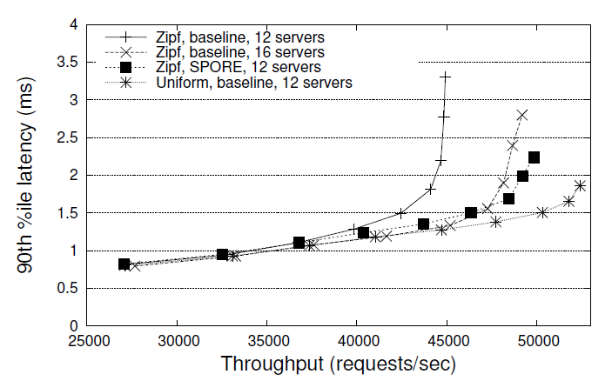
Performance and Cost Improvements of Read-mostly workloads with static key popularity
Key popularity is kept static
X- Axis: Tail latency
Y – Axis: throughput
Throughput is controlled by increasing the number of threads in the YCSB client threads
Comparative evaluation of 4 configurations ( 3 memcached and 1 SPORE)
Notes:
In this experiment they study the throughput of 4 different configurations ( 3 based on baseline memcached and 1 based on SPORE) with READ-MOSTLY WORKLOAD (99% read) and STATIC KEY POPULARITY
On the Y – AXIS we have tail latency
On the X – AXIS we have throughput (request / sec which is controlled by increasing the number of threads in the client)
We make two important observations
MERELY SCALING OUT DOESN’T MITIGATE LOAD IMBALANCE because of the way tail latency behaves BMCd with 16 servers doesn’t perform better than one with 12 but is not as good as BMCd (12) with uniform distribution Increasing servers will not necessarily decrease hotspots as key to server mapping may not change
SPORE (12) has higher throughput than BMCd with 16 servers (33% more servers)

Slide 31
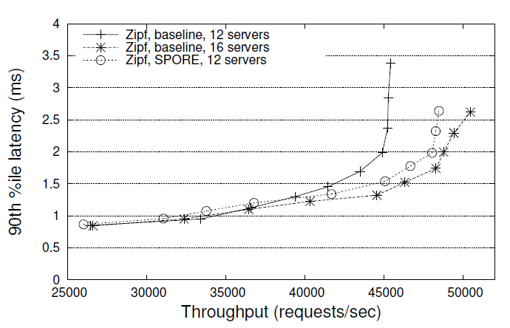
Performance and Cost Improvements of Read-mostly workloads with time - varying key popularity
Key popularity rank is changed every minute
X- Axis: Tail latency
Y – Axis: throughput
Throughput is controlled by increasing the number of threads in the YCSB client threads
Comparative evaluation of 3 configurations ( 2 memcached and 1 SPORE)
Notes:
In this experiment they study the throughput of 3 different configurations ( 2 based on baseline memcached and 1 based on SPORE) with READ-MOSTLY WORKLOAD (99% read) and TIME-VARYING key popularity
On the Y – AXIS we have tail latency
On the X – AXIS we have throughput (request / sec which is controlled by increasing the number of threads in the client)
This time SPORE with 12 servers degrades as compared to BMCd with 16 servers but still has better throughput than BMCd with 12 servers.

Slide 32
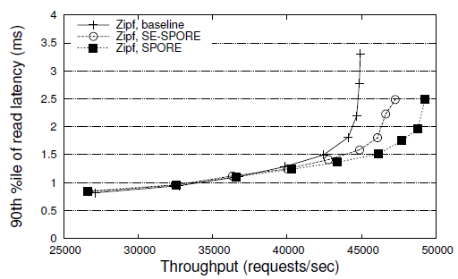
Evaluation of SE – SPORE – Read latency
THROUGHPUT v/s 90th %ile READ LATENCY
X- Axis: Tail latency
Y – Axis: throughput
Throughput is controlled by increasing the number of threads in the YCSB client threads
Comparative evaluation of 3 configurations ( 1 memcached, 1 SPORE and 1 SE - SPORE)
Notes:
In this experiment they study the throughput of 3 different configurations ( 1 based on baseline memcached and 1 based on SPORE and 1 more on SE – SPORE ) with READ-MOSTLY WORKLOAD (99% read)
On the Y – AXIS we have tail latency
On the X – AXIS we have throughput (request / sec which is controlled by increasing the number of threads in the client)
SE – SPORE still performs better than BMCd but degrades compared to SPORE

Slide 33
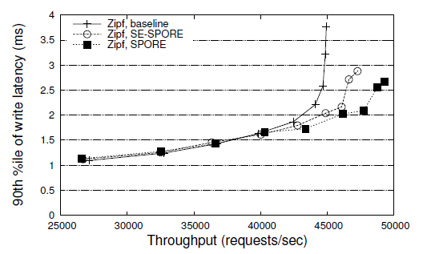
Evaluation of SE – SPORE – Write Latency
THROUGHPUT v/s 90th %ile WRITE LATENCY
X- Axis: Tail latency
Y – Axis: throughput
Throughput is controlled by increasing the number of threads in the YCSB client threads
Comparative evaluation of 3 configurations ( 1 memcached, 1 SPORE and 1 SE - SPORE)
Notes:
In this experiment they study the throughput of 3 different configurations ( 1 based on baseline memcached and 1 based on SPORE and 1 more on SE – SPORE ) with READ-MOSTLY WORKLOAD (99% read) and TIME-VARYING key popularity
On the Y – AXIS we have tail latency
On the X – AXIS we have throughput (request / sec which is controlled by increasing the number of threads in the client)
SE – SPORE still performs better than BMCd butdegrades compared to SPORE
ALSO NOTE THAT at low loads, replication is turned off since there are no hot spots so there is hardly any difference. But when the workloads gets higher, the effect of write propagation delay on queueing delays in see in the plot
ALSO POINT OUT AT THIS STAGE gamma = 1. If it were 3 or more MAYBE THE RESULTS WOULD HAVE BEEN ON THE NEGATIVE SIDE.

Slide 34
Performance and Cost Improvements of Mixed workloads
Throughput v/s Read Tail Latency
Throughput v/s Write Tail Latency
X- Axis: Tail latency; Y – Axis: throughput
Throughput is controlled by increasing the number of threads in the YCSB client threads
Comparative evaluation of 4 configurations ( 3 memcached and 1 SPORE)
Workload comprises of read-only and read-write tuples
Among non – read only tuples, read percentage is varied : 50%, 70%, 90%
Notes:
This experiment examines mixed workloads, where there are read-only tuples and read-write tuples.
plots show the latency-throughput for three such mixed workloads - 50%, 70%, and 90% reads for nonread-only tuples.
In this experiment we can see that compared to BMCd, SPORE achieves higher throughput and lower latency for all three workloads. This shows that as long as there are popular read-only workloads (or read-mostly) tuples, SPORE performs well by alleviating load well during hotspots
THEY ALSO RUN EXPERIMENTS ON REAL PUBLIC CLOUDS LIKE AMAZON EC2. Due to time constraints I wont be covering that .

Slide 35
Limitations of SPORE
Space overhead
Latency overhead
Communication overhead
Notes:
SPACE OVERHEAD
Both SSM and CSM takes up extra space in memory apart from application data
SSM may grow too large since they are maintained only in the home servers for only hot tuples which are usually lesser 0.01 % of the total tuples. Experiments show that it consumed only 60 KB per server and this had no effect on cache misses
If CSM grows too large they can be shrinked. This doesn’t impact correctness because, all the requests will simply be directed to the home server
LATENCY OVERHEAD
Since some lookups and updated need to be done on both SSM and CSM there is some latency overhead.
Sampling tries to reduce this latency. Experiments showed that with 100% sampling on a low load SPORE server has average latencies 7% higher than BMCd, but with 3% sampling it is well within 3% (ie the latency)
Off course there is write propagation delay in case of replicas. However, since it is read mostly workloads this is minimized too.
COMMUNICATION OVERHEAD
The value of gamma must be piggy backed in the communication from server to client. But this is negligible

Slide 36
Agenda
Motivation
Background
System design
Evaluation
Discussion
Notes:
Let us dive into some discussion points

Slide 37
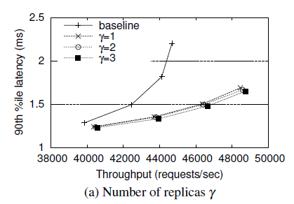
Discussion
CONS
All the evaluations were run with γ = 1. Increase in γ has effect on cost and performance improvements. Do you think a value of γ = 1 is practical ?
Notes:
Do you think a gamma value of 1 is practical?? Do you think that is sufficient to load balance a hot tuple. What if there are more than 2 concurrent accesses needed. Wont queueing effect kick in again ?

Slide 38
Discussion
Load balancing provided by SPORE is artificial.
Some caching system support replay of hot objects from persistent log after the cache server crashes and comes up. But in the case of SPORE since SSM is lost it has to start from scratch .
Domino Effect ? RIKR might be sending the replicated keys to other hotspot servers.
Could they have reused replication also to provide fault tolerance ?
PROS:
Scaling out in a distributed memory caching system is known to cause incast congestion and needs an atomic global reconfiguration. This paper shows that replication is a good way to mitigate load imbalance compared to scaling out.
Effectively handles retirement. Server does not directly send retire messages to notice retirement.
Notes:
Load balancing is artificial since load balancing occurs across different servers. Lets say that threads in the same client share the same CSM and have to come to the same replica. In that case will the system truly load balance ?????
RIKR might be sending the replicated keys to other hotspot servers since the consistent hashing stub behaves like a black box and has no idea about the overall picture

Slide 39
Thank you !

Slide 40
BACKUP SLIDES

Slide 41
Why do I need memcached ?
Web Server
Browser
MySQL / DB2
Problems ??
Notes:
Lets say that I have a web-based company maintaining web server and serving dynamic content to my customers.
Traditional architectures had web server directly interact with the durable backed datastore.
Traditional architecture would have the web server fetch objects from the backend store for each client request.
So, what’s wrong ??
Traditional backend stores are all durable storage and hence involve some disk I/O
Modern disks keep growing larger and cheaper but not necessarily faster (at least compared to CPUs). Hence disk I/Os are relatively slower. Thus they cause latency
And in the competitive internet world I bother about latency. I need to serve my customers the best content quicker than anybody else can.

Slide 42
“Cache” me if you can
Browser
Web Server
memcached
MySQL / DB2
*Disclaimer: All images from World Wide Web
Notes:
The solution to this is to introduce a new memory caching tier (in this case memcached server(s) ) to cache popular data.
The idea is to have memory-caching tier between the web / business logic and the storage tier
When a browser makes a request to the web server, the web server first checks at the memory-caching layer and if the object requested is already cached, then there is no need to make a slow I/O.
Only in cases such as this where there is a cache miss, there is a necessity to go to the backend storage and make a costly I/O. Off course after every cache miss the memory caching tier is updated with the missing object so that there are no further cache misses. If there isn’t sufficient space then an old object is removed based on the LRU caching scheme.

