Slide 1
Transaction chains: achieving serializability with low-latency in geo-distributed storage systems
Author: Yang Zhang[SOSP’ 13]
Presentator: Jianxiong Gao

Slide 2
Geo-distributed Nature
Large-scale Web applications
Geo-distributed storage
Replication
Shards
Derived Tables
Secondary Indices
Materialized Join Views
Geo-Replicas

Slide 3
Transaction in database management
Recovery from failure
Isolation among transactions

Slide 4
Prior work
Strict
serializable
High latency
Spanner [OSDI’12]
Serializable
Provably high latency according to CAP
?
Lynx[SOSP’13]
Various
non-serializable
Walter [SOSP’11]
COPS [SOSP’11]
Eiger [NSDI’13]
Low latency
Dynamo [SOSP’07]
Eventual
Key/value
only
Limited forms of
transaction
General
transaction
Notes:
Now let’s see the stat of art solution to this trade off.
//Now let’s see what low latency systems are possible.
Here, I show the semantics of a system along two dimensions.
The horizontal axis differentiates systems that provide generals transactions from those that are simple key-value stores.
The vertical axis shows the consistency level of operations.
The lowest level is eventual consistency and the stronger ones are serializable, and linearizable
Here, serializable means that there exists a single total ordering, such that all operations act as if they obey that order.
Linearizable is stronger, because it places some restriction on what is an acceptable total order.
@ In this landscape, we always know it’s easy to build a eventually consistent key/value store with low latency@, Dynamo is an example. Here, I mark the low latency region in green.
We also know, because of the CAP theorem, @ that one must pay for linearazability with cross data center communication and therefore high latency.
@ Spanner is a Google’s storage system that achieves linerazabile, general transactions, so it occupies the top right corner.
In the last two years, people have pushed the boundary of low latency systems. @ There are systems that guarantee more than eventual consistency and provide limited forms of transactions, such as read-only and write-only transactions.
@ However, there remains the big grey gap. Namely, we do not know whether it’s possible to build a low latency serializable system.
@ Our work shows that it’s possible.
So we pushed frontier further to achieve serializable transactions. Our transactions are not fully general and still have a few limitations, so the green region doesn’t go all the way to the right.

Slide 5
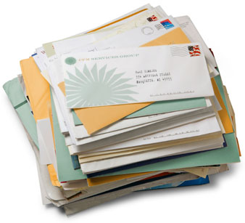
Transaction in database management while maintaining low latency
Recovery from failure
If the first hop of a chain commits, then all hops eventually commit
Users are only allowed to abort a chain in the first hop
Log chains durably at the first hop
Logs replicated to a nearby datacenter
Re-execute stalled chains upon failure recovery
Isolation among transactions
Home geo-replica
Sequence number vectors

Slide 6
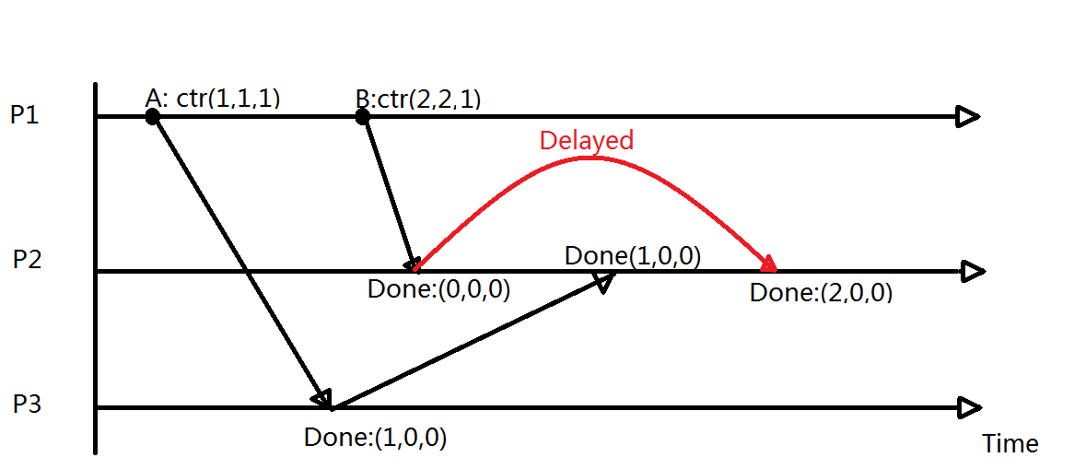
Sequence Number Vectors
Event A: Go through (P1 – P3 – P2)
Event B: Go through (P1 – P2 )

Slide 7
What are hops?
Serializability
Defination: Serializability of a schedule means equivalence (in the outcome, the database state, data values) to a serial schedule (i.e., sequential with no transaction overlap in time) with the same transactions.
Transactions
Ordering 1
Ordering 2
Notes:
Execution result appears as if obey a serial order for all transactions
No restrictions on the serial order

Slide 8
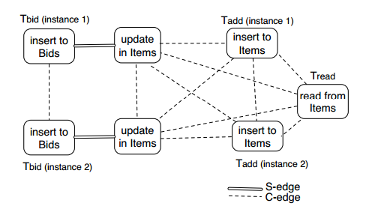
Serializable Example
Transaction 1: Tbid
Transaction 2: Tadd
Transaction 3: Tread
Time
Serializable
Strict serializable

Slide 9
What are hops?
Operation: Alice bids on Bob’s camera
1. Insert bid to Alice’s Bids
2. Update highest bid on Bob’s Items
Alice’s Bids
Alice | Book | $100
Bob
Alice
Bob’s Items
Bob | Camera | $100
Datacenter-1
Datacenter-2
Notes:
It would nice if we can chop this transaction into two parts, @ the first hop inserts the bid and the second hop updates the highest bid.
@ This chopped transaction becomes a chain. Each hop of a chain access data on a single server, and different hops execute sequentially one after another.

Slide 10
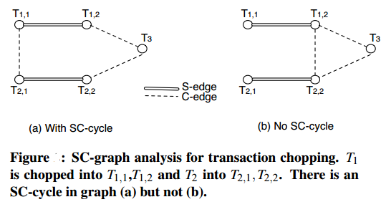
What are hops?
S-edge: Connecting unchopped transactions
C-edge: Connecting vertices write to the same item.
Chopping
When can we chop?

Slide 11
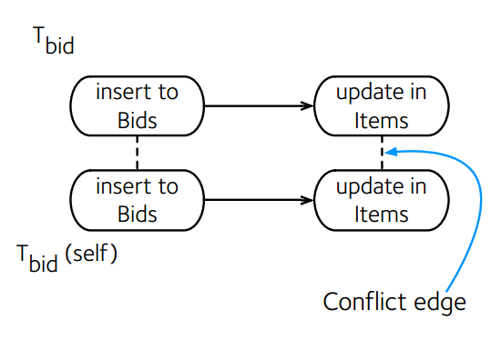
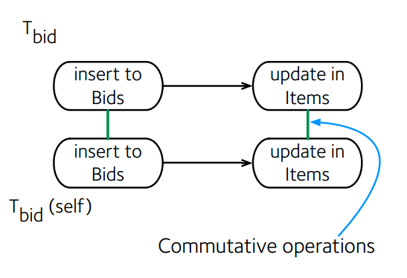
What are hops?
Serializable when no SC-cycles. Shasha[Transactions on Database Systems’ 95]
Solution: Remove C-edges.

Slide 12
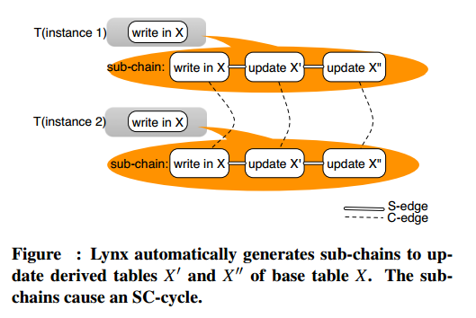
System Chains
Subchains either commute
Or
has origin ordering
Secondary Index
Join View
Geo-replication

Slide 13
Experimental setup
europe
153ms
102ms
Lynx protoype:
In-memory database
Local disk logging only.
82ms
us-east
us-west
Notes:
We ran our experiments on Amazon’s EC2,.
In each data center, we run@ four Lynx servers as well as@ four clients. In the experiments, @a client also issues chains whose first hop locate
In the same data center as itself. This is to model a practical deployment where a user’s web requests are always routed to a data center
that contains the user’s data shard.
@Our experiments run on three data centers, west coast, east coast and europe. @The roundtrip latency between these data centers are on the order of 100ms.
@Please note that our prototype stores data in memory, and persists logs to disk.

Slide 14
Results: Response Time
Chain completion
Notes:
The graph shows the latency of operations, such as following another user, posting a tweet and reading from one’s own timeline.
@The first two bars show the latency of follow and tweet operation if they wait for the completion of the whole chain.
//The Underlying ssytem chain for the follow-user operation takes 3 hops and for the post-tweet chain, 4 hops.
Therefore, the completion latency represents several cross data center RTTs.
@In the actual Twitter, we only need to wait for the first hop to complete. Since the first hop is local, both operations are very fast with only several miliseconds.
Also, we note that by using the materialized join view, we optimize the read-timeline operation to take only one local lookup.

Slide 15
Result: Throughput

Slide 16
Other thoughts & Coments
Can we always chop?
Too many derived table?
Actual transaction time not reduced.
More experiments?

Slide 17
Thanks!
Graphs and parts of slides accredit to author of the paper: Yang Zhang.

