Slide 1
The Tail at Scale
By Jeffrey Dean and Luiz André Barroso
Presented by Vikas Basavaraj Mallapura

Slide 2
Motivation
Improvements in Internet connectivity and the rise of warehouse-scale computing systems have enabled Web services that provide fluid responsiveness (Ex: Google search result updation based on query prediction in an interactive manner).
Challenging for service providers to keep the tail of latency distribution short for interactive services as even rare performance hiccups affect a significant fraction of all requests in large-scale distributed systems.
Eliminating all sources of latency variability in large-scale systems is impractical, especially in shared environments. Thus, it is useful to develop latency-tolerant techniques to create a predictably responsive whole out of less-predictable parts.

Slide 3
Reasons for variability in latency time
1. Shared resources - Contention for various resources between and within applications.
2. Daemons - Daemons when scheduled can generate multi-millisecond hiccups thus increasing latency.
3. Global resource sharing- Applications running on different machines might contend for global resources (such as network switches and shared file systems)
4.Maintenance activities - Periodic maintenance activities(for example, log compactions) can cause periodic spikes in latency.
5. Queueing - Multiple layers of queueing in intermediate servers and network switches amplify the variability in latency.
6. Power throttling in CPU - Modern CPUs are designed to run above their average power envelope, mitigating thermal effects by throttling if sustained for a long period ( ex: Turbo Boost feature in Intel core i7 processor which performs opportunistic increase of the frequency of the cores).
7. Garbage collection in SSD - Periodic garbage collection of data blocks increases SSD latency by a factor of 100.

Slide 4
Component level variability at scale
Common technique of parallelizing sub-operations across many different machines would require that all these sub-operations to complete within a strict deadline for the service to be responsive.
Variability in the latency distribution of individual components is magnified at the service level;
For example, consider a system where each server typically responds in 10ms but with a
99th-percentile latency of one second. If a user request is handled on just one
such server, one user request in 100 will be slow (one second).
If the same request’s processing is parallelized across 100 servers, then 63% of user requests will take more than one second.
Decreasing individual latency does not help as it is observed that even for services with only one in 10,000 requests experiencing more than one second latencies at the single-server level, a service with 2,000 such servers will see almost one in five user requests taking more than one second.

Slide 5
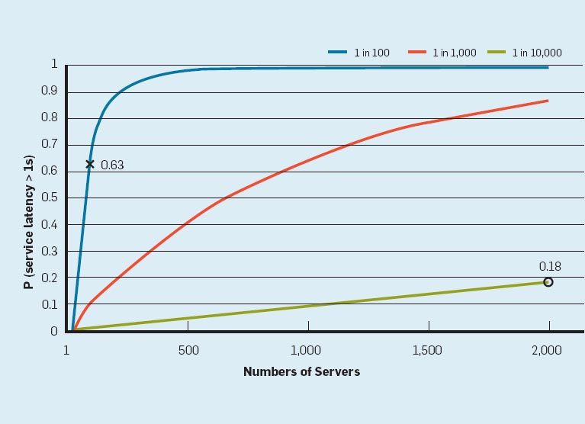
Latency variance graphs

Slide 6
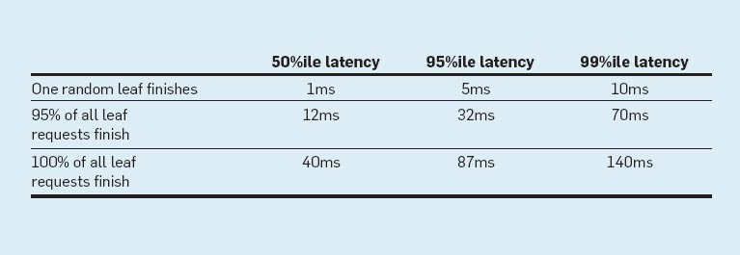
Latency measurements from a real Google service
Measurements from a real Google service that is logically similar to the idealized scenario;
Operation : Root servers distribute a request through intermediate servers to a very large number of leaf servers.
The 99th-percentile latency for a single random request to finish, measured at the root, is 10ms.
However, the 99th-percentile latency for all requests to finish is 140ms, and the 99th-percentile latency for 95% of the requests finishing is 70ms.
Above measurements illustrate that waiting for the slowest 5% of the requests to complete is responsible for half of the total 99%-percentile latency.
Thus, techniques that focus on eliminating these slow outliers can lead to dramatic improvements in overall service performance.

Slide 7
Techniques to reduce component level latency variability
Differentiating service classes - Prefer scheduling requests for which a user is waiting over non-interactive requests.
Higher-level queuing - Keeping lower-level queues (at system/disk level) short so that higher-level policies take effect more quickly. Shallow queue at the lower level allows quick reconfiguration of the requests based on priority.
Reducing head-of-line blocking - Requests may have widely varying intrinsic costs. It is useful to break the long-running requests to a sequence of smaller requests so that other short-leaved requests can be interleaved.
Managing background activities and synchronized disruption - Scheduling these type of activities at times of lower overall load and synchronizing these types of activities across different machines leads to only a brief but uniform across the machines spike in latency.

Slide 8
Latency-tolerant techniques
Scale and complexity of modern web services make it infeasible to eliminate all sources of latency variability.
Thus, it is beneficial to develop tail-tolerant techniques that work around temporary latency variations. Two classes of tail-tolerant techniques:
Within-request immediate-response techniques that operate at a time scale of tens of milliseconds
Cross-request long-term adaptations that perform on a time scale of tens of seconds to minutes

Slide 9
Within-request short-term adaptations
Use replication to reduce latency variability within a single higher-level request. Most effective when the request operate on largely read-only, loosely consistent datasets ( ex: spelling correction service)
Hedged requests: Simple way to reduce latency variation is to issue the same request to multiple replicas and to use the result of the fastest replica.
Naive implementations of the above technique would increase the overall system load.
An approach to reduce the load would be to defer sending the second request until the first request has been outstanding for more than 95th percentile expected latency for this class of requests.
Example : A Google benchmark that reads the values for 1,000 keys stored in a BigTable table distributed across 100 different servers, sending a hedging request after a 10ms delay reduces the 99.9th-percentile latency for retrieving all 1,000 values from 1,800ms to 74ms while sending just 2% more requests.
Limitations of hedged requests:
Hedged requests technique has a window of vulnerability in which multiple servers can execute the same request unnecessarily.Technique of waiting for 95th percentile to issue second request limits the benefit to only a small percentage of requests. How to improve this situation ?

Slide 10
Tied requests
One solution would be to enqueue copies of a request in multiple servers simultaneously and allowing the servers to communicate updates on the status of these copies to each other. We call requests where servers perform cross-server status updates “tied requests”.
In tied requests, each request is tagged with the identifier of the other server in which the request is enqueued (“tied”). When it begins execution, it sends a cancellation message to its counterpart.
To avoid the situation of both requests starting concurrent execution on both servers, client introduces a small delay between the first and second enqueue request.
Significant reduction of latency has been observed in Google’s BigTable cluster on employing the tied requests strategy, achieving nearly 40% reduction at the 99th-percentile latency.
Overhead of tied requests in disk utilization is less than 1%, indicating an effective cancellation strategy.

Slide 11
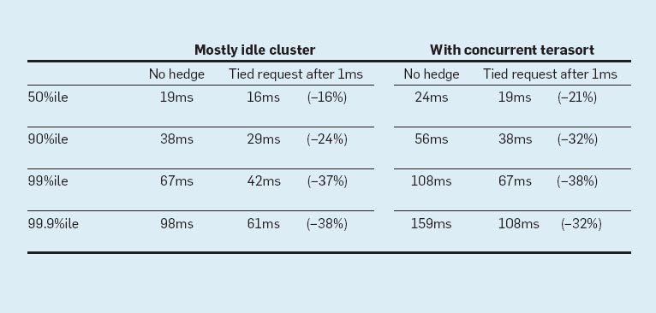
Impact of tied requests
Tied requests latency variance measurements from Google BigTable cluster for a small uncached read request

Slide 12
Cross-request long term adaptations
Reducing latency variability caused by coarser-grain phenomena (such as service-time variations and load imbalance). Techniques:
1. Micro partitions - Generate many more partitions than available machines to facilitate dynamic assignment and load balancing (Ex: BigTable system stores 20 to 1,000 tablets per machine).
2. Selective replication - Detect/predict popular items and increase replication for those items for better load balance.
3. Latency induced probation - Detecting when a system might perform better by excluding a slow machine and collecting statistics on its latency to include at a later date.

Slide 13
Latency in large information retrieval(IR) systems
Speed is a key quality metric in IR systems as it is better to return good results quickly than to return the best results slowly. Techniques to reduce latency
1. Good enough results: Instead of waiting for exceedingly slow server for results, IR systems can be tuned to respond with good-enough results when an acceptable fraction of corpus has been searched. Also, non-essential subsystems can be skipped in presence of high latency (for example, skipping results from ads in user queries)
2. Canary requests: Issue untested/new queries to one or two servers at most and query the remaining servers only if a fast response is obtained for the query from the two servers.

Slide 14
Mutation operations latency
Techniques discussed till now largely applicable for operations that do not mutate state.
For operations which mutate state, tolerating latency is easier due to:
1. Scale of latency-critical modifications is less.
2. Updates can be performed off critical path, after responding to query.
3. Some services can tolerate inconsistent update model for mutations.
4. For mutations requiring consistency, quorum-based algorithm (such as Paxos) are employed which are inherently tail-tolerant.

Slide 15
Hardware trends and their effects
Variability at hardware level likely to be higher in the future due to more aggressive power optimizations as well as device heterogeneity.
Fortunately, several emerging hardware trends also increase the relevance and effectiveness of latency-tolerating techniques.
Examples include:
1. Higher bisection bandwidth in data centers (Bisection bandwidth: bandwidth across smallest cut that divides network into two equal halves)
2. Network interface optimizations that reduce per-message overhead which will further reduce the cost of tied requests.
3. Lower per-message overhead allow more fine-grained requests, leading to better multiplexing and less head-of-line blocking effects.

Slide 16
Discussion points
1. More details on latency measurement/application monitoring to derive observations could have been provided in the paper (drawbacks of using coarse per-second measurement illustrated here: http://blog.serverfault.com/2011/06/27/per-second-measurements-dont-cut-it/ )
2. Tied request technique to reduce latency would work only if the original cause of latency does not also affect generation and cancellation of these additional requests.
3. Lack of experimental proof regarding synchronized scheduling of background tasks across machines.

