Slide 1
Scale-up vs Scale-out for Hadoop Time to think?
Ruisheng shi
cs525 spring 2014

Slide 2
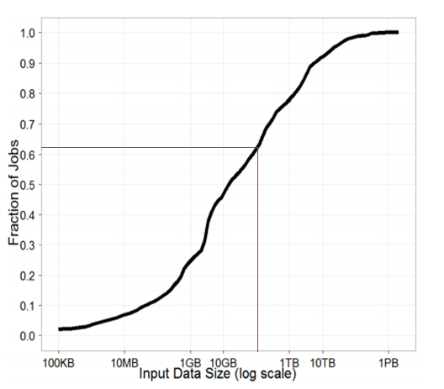
Motivation: Input data size
Distribution of input job size for 174,000 jobs for a large analytics cluster
Hadoop is designed for petascale processing.
MS & Yahoo have median job input sizes under 14G, 80% of the jobs had an input size under 1TB
90% of jobs on a Facebook cluster are under 100G

Slide 3
In a nutshell
Can we use an well-provisioned single server (Scale up) instead of a commodity workstation(Scale out)?
Pros:
In shuffle stage, we have fast intermediate storage and no network bottleneck
Low power consumptions and more computations per space budget

Slide 4
In a nutshell(continued)
Cons:
Not extensible: It reaches its limitation around sub Terascale
Inflexible Performance: depends on hardware
Expensive hardware: low hardware performance/$
Not Sure(without peeking the paper):
Hardware expense comparison
CPU bound jobs performance
Any IO bottleneck?

Slide 5
Why do we use hadoop?
scale-up versus scale-out trade off is well-known in the parallel database community, but not in map-reduce community, time to think?
The popularity of Hadoop and the rich ecosystem of technologies that have been built around it.
By making all our changes transparently “under the hood” of Hadoop, we allow the decision of scale-up versus scale-out to be made transparently to the application.

Slide 6
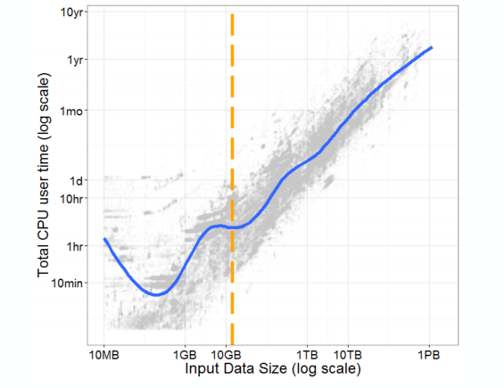
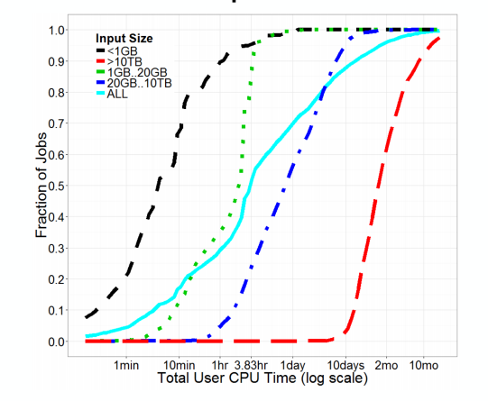
Feasibility study: CPU requirements
Median input size
The median job requires 3.83hr of CPU time, which is 7.2 mins per core on a 32 cores scale up server ideally. A large number of jobs would seem to fit comfortably within a “big memory” scale-up server with 32 cores and 512GB of memory.

Slide 7
Feasibility analysis: scale up hardware
A scale-up server can now have substantial CPU, memory, and storage I/O resources
Today’s servers can affordably hold 100s of GB of DRAM and 32 cores on a quad socket motherboard with multiple high-bandwidth memory channels per socket.
DRAM is now very cheap
Storage bottlenecks can be removed by using SSDs or with a scalable storage back-end, such as Amazon S3 or Azure Storage

Slide 8
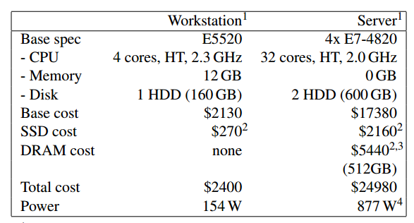
Feasibility analysis: cost
Comparison of a workstation of 16 nodes(for scale-out) and a scale up server, each machine is also equipped with 1Gpbs NIC connected to a single switch
8- and 16-node scale-out configurations cost $19k and $38k (they are the two configurations we used ) without including network switch. This is also excluding the other expenses like administration or cooling. It is likely the cost for workstation is underestimate in this paper.

Slide 9
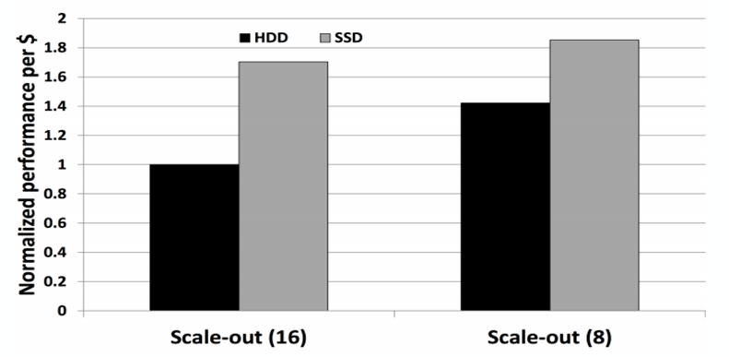
IO bottleneck in private cluster? Confirmed!
10GB TeraSort Benchmark on 8 and 16 node configurations with and without SSD
Graph is normalized so that the 16-node cluster using HDDs value is 1.
Without SSD, many Hadoop jobs become disk-bound
although SSDs add 13% to the base cost of the workstation-class machine, they improve the overall performance/$ of the cluster

Slide 10
Optimization: Storage
Problem | Problem description | Solution | type
Storage bottleneck | Hadoop is I/O-bound and has low CPU utilization. | using SSDs or with a scalable storage back-end, such as Amazon S3 or Azure Storage | Scale up/ Private cluster
substantial I/O overhead using HDFS | A scalable storage back end can easily saturate the data ingest capacity of a scale-up computer node, lots of unneccesary overheads | store the inputs on SSDs and access them via the local ﬁle system. | Scale up
 |  | store the inputs on SSDs, access them via HDFS. No replication | Scale out

Slide 11
Optimization: Concurrency
Problem | Problem description | Solution
number of map and reduce tasks to be optimal for each job | default “pseudo-distributed” : a separate JVM per task. | We use "pseudo-distributed" mode since when the number of tasks as well as the heap size for each tasks are well-tuned, there is no performance difference between the multi-threaded and pseudo-distributed mode.
 | We implemented a multi-threaded extension which allows us to run multiple map and reduce tasks as multiple threads within a single JVM.

Slide 12
Optimization: Heartbeats
Problem | Problem description | Solution
Hadoop typically tracks task liveness through periodic heartbeats. | When a task ﬁnishes much shorter than the heartbeat interval, the task tracker node will idle waiting for the next submission. | Set mapreduce.tasktracker.outofband.heartbeat = true to allow tasktrackers to send an out of band heartbeat on task-completion to improve job latency.

Slide 13
Scale up Optimization: Heap size
Problem | Problem description | Solution
Default heap size for map and reduce task is 200MB | 200MB per task leaves substantial amounts of memory unused; Too large heap size cause gabage collection overhead | For scale up, we set the heap size = 4GB per mapper/reducer task; Maximum number of task is set to # of processors

Slide 14
Scale up Optimization: Shuffle
Default configuration/problem | reason for default setting | scale up optimization
reducer copy the data from the mappers via http | Mapper and reducer are not on the same node | shufﬂe data is transferred by writing and reading the local ﬁle system
There is a restriction on the max number of concurrent connections | In a cluster, this is a reasonable throttling scheme to avoid a single node getting overloaded by copy requests | remove this restriction
scale up server has substantial excess memory after conﬁguring for optimal concurrency level and heap size | N/A | use this excess memory as a RAMdisk to store intermediate data rather than using an SSD or disk based ﬁle system.

Slide 15
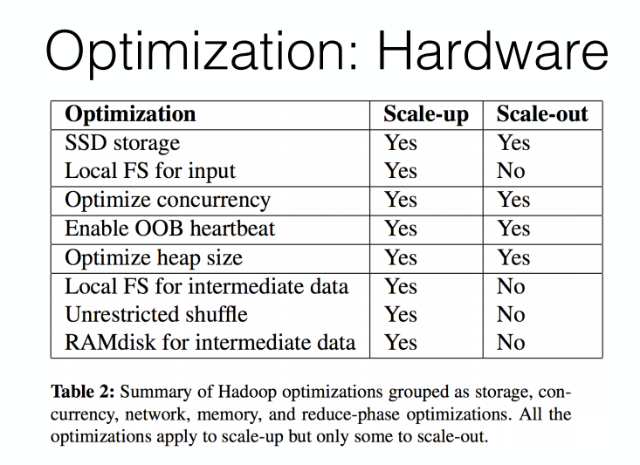

Slide 16
Representative job: log processing
Log processing is one of the original purpose of mapReduce. This paper uses two such jobs from a internal Cosmos cluster consisting of tens of thousands of servers. They rewrite the code to hadoop
FindUserUsage: processes one such log to aggregate resource.
ComputeIOVolumes: processes two log files to combine process-level and task-level information, hence to find the amount of input and intermediate data I/O done by each task

Slide 17
Representative job: analytic queries
PageRank
URL | Score
File 1
imdb.com | 1759.6
imdc.com | 18.2
… | …
File 2
Netflix.com | 892.1
… | …
Select Task: finds the top 1% of URLs from the PageRank score
User Visits
Source IP | date of visit | Revenue generated | URL visited
file U1
60.220.1.1 | 02/01/2014 | 0.1 | imdb.com
20.22.10.1 | 02/02/2014 | 0 | one.com
… | … | … | …
file U2
60.220.1.1 | 02/01/2014 | 0.1 | imdb.com
… | … | … | …
Aggregate task: calculates the total ad revenue per source IP address.
Join task: finds the source IP addresses that generates the most revenue within a particular date range and then computes the average page rank of all the pages visited by those IP addresses in that interval

Slide 18
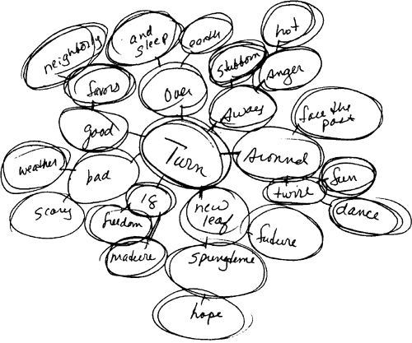
Representative job: mahout
Mahout machine learning framework is very popular recently
They used K mean to cluster the data.
Use tag Clustering to assist users in tagging items by suggesting relevant tags.
Based on Last.fm, a popular Internet radio site. The data set contains 950,000 records, 7 million tags assigned to over 20,000 artists.

Slide 19
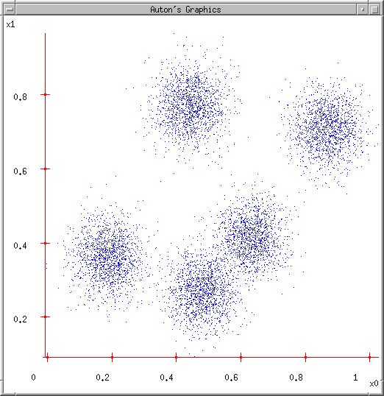
representative jobs: K Means
1. User set up the number of clusters they’d like. (e.g. K=5)
2. Randomly guess K cluster Center locations

Slide 20
representative jobs: K Means
1. User set up the number of clusters they’d like. (e.g. K=5)
2. Randomly guess K cluster Center locations
3. Each data point finds out which Center it’s closest to. (Thus each Center “owns” a set of data points)

Slide 21
representative jobs: K Means
1. User set up the number of clusters they’d like. (e.g. K=5)
2. Randomly guess K cluster Center locations
3. Each data point finds out which Center it’s closest to. (Thus each Center “owns” a set of data points)
4. Each centre finds the centroid of the points it owns

Slide 22
representative jobs: K Means
1. User set up the number of clusters they’d like. (e.g. K=5)
2. Randomly guess K cluster Center locations
3. Each data point finds out which Center it’s closest to. (Thus each Center “owns” a set of data points)
4. Each centre finds the centroid of the points it owns
5. …and jumps there
6. …Repeat until terminated
Hadoop version of K means could be found in the link below

Slide 23
Representative jobs: Pig query
Cogroup: final output much larger than either input or shuffle data. This is actually CPU-intensive job
S1
name | hits
John | 3
Harry | 4
George | 2
S2
name | errors
John | 2
John | 3
George | 0
Sue | 1
Foo = COGROUP s1 BY name, s2 BY name;
group | s1 | s2
John | (John, 3) | (John,2), (John, 3)
Harry | (Harry, 4)
George | (George, 2) | (George, 0)
Sue |  | (Sue, 1)

Slide 24
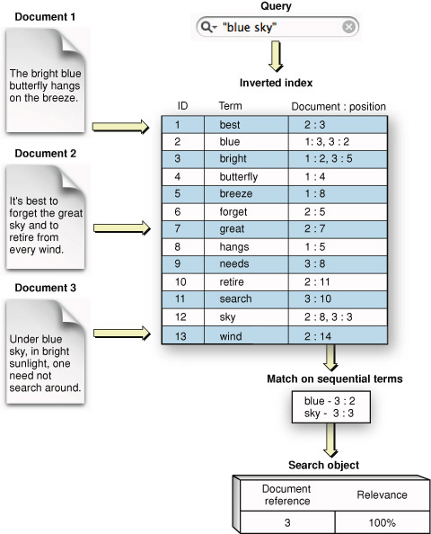
Representative job: indexing
Building a inverted index from text data is the part of the original motivation for Map Reduce. Used by almost all search engines
Inverted index including dictionary(not showed in graph) and posting(the blue table in left graph). Posting could be extremely large in size.

Slide 25
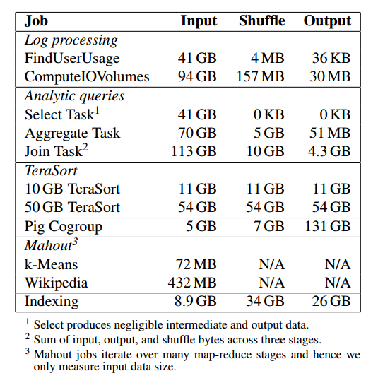
representative jobs: evaluation
FindUserUsage is a map-intensive job
TeraSort is a standard benchmark for data processing platforms. It is memory and shuffle intensive job

Slide 26
Throughtput measurement

Slide 27
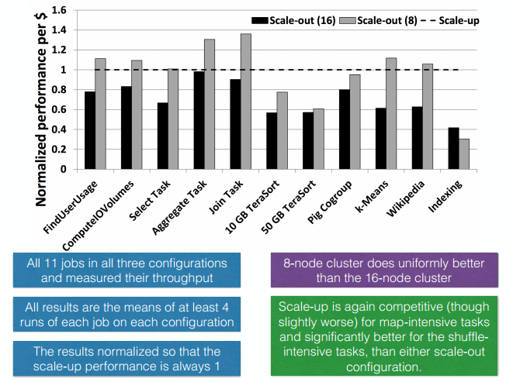
Throughput per dollar

Slide 28
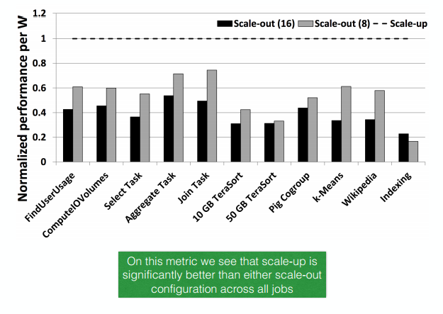
Power consumption

Slide 29
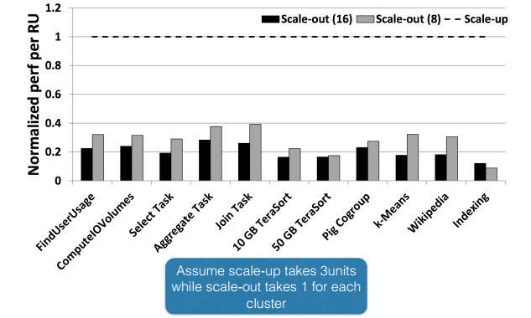
Server density

Slide 30
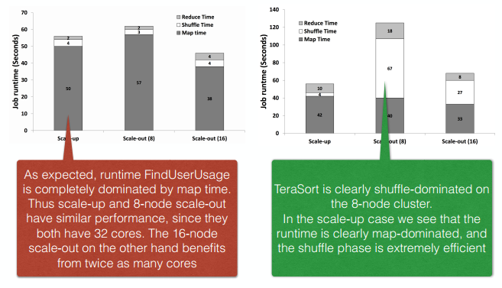
Phase by Phase analysis:

Slide 31
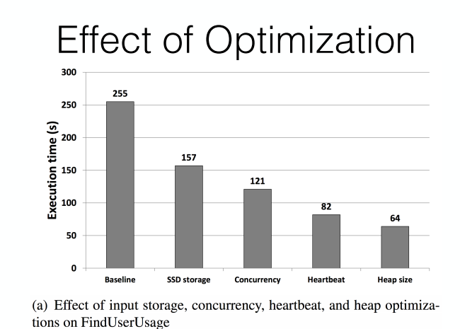

Slide 32
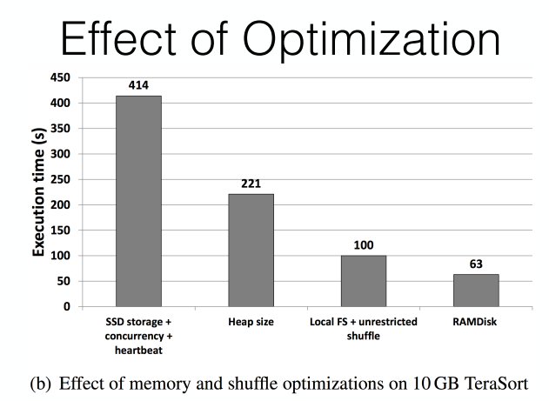

Slide 33
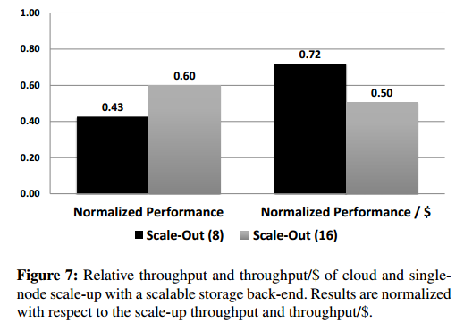
What about in the cloud
The data isn’t consistent in the original paper!
According to the paper, it is refer to “Used our own scale up server but read data from 10Gbps network”. Then since scale out(16) previous is roughly 1.2 times of scale up. Now is 64% of scale out in private cloud. On the other hand, scale up performance is 92% of original, we have scale-out(16) should be 1.2*0.64/0.92 = 0.834 Which is not 0.60.
Which scale up server is this refer to?

Slide 34
What about in cloud
What we can see is:
Due to contention for shared network bandwidth with other cloud users, Scale out tends to degradation more than Scale up.
The only possible explanation is: this scale up refer to High memory Cluster instance from EC2 (2 of 16 cores, 244GB memory and 10Gbps),although from the tone of the paper it looks very unlikely

Slide 35
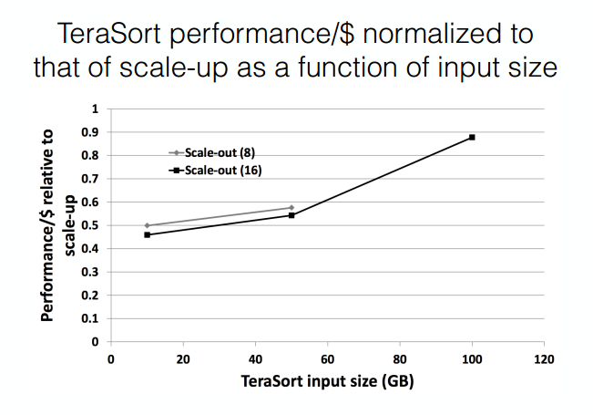
This data is not consistent with Figure4(a), also, they only test 2(3) input sizes , which is not enough.

Slide 36
Discussions
What about single point failure of the scale up server ?(Gopalakrishna, Manoj)
We can reassign the job to another scale up server(assuming scalable storage back end used)
In this case, it is always all or nothing
The scale-out cluster consists of only 16 data nodes and one name node(Guliz, Gopalakrishna, Shegufta)
This is for mapping the hardware level of scale up: 8 * 4 cores vs 32 cores etc. Otherwise comparing a scale up server with 100+ nodes workstation is worthless.

Slide 37
Discusssion
SSD was used for both scale-up and scale-out server, but SSD is expensive(Shegufta)
SSD is used in private cluster to remove the storage bottleneck. Without SSDs, Hadoop is I/O-bound and has low CPU utilization. But this is not a realistic configuration in a modern data center.
In cloud, they do state cloud doesn’t use SSD
It is not about how can you run faster than a tiger, it is about how can you run faster than other people.

Slide 38
Discussion
One instance of limitation of Scale up - they mentioned in the Mahoot benchmark that they had to limit outgoing links(Shadi)
The Wikipedia data set contains 130 million links, with 5 million sources and 3 million sinks. Due to the limited SSD space, we had to limit the maximum number of outlinks from any given page to 10, and, hence, our data set had 26 million links.

Slide 39
Discussion
Disabling replications in the scale out approach seems like a bad idea; to me that seems like major use case of HDFS and disabling it doesn’t give us a realistic view of how scale out clusters are being used (Read)
They have no replication for performance evaluation purpose, this doesn’t necessarily mean we can’t have replications in cloud.

Slide 40
Discussion
when should a job run with scale-up rather than scale-out(Phuong)
input job sizes and static analysis of the application code.
for jobs larger than even the largest scale-up machine, should we scale them out with a few large machines or with many small ones?
How to predict if the job is shuffle intensive or map intensive at the schedule stage

