Slide 1
Heterogeneity and Dynamicity of Clouds at Scale: Google Trace Analysis [1]
4/24/2014
Presented by: Rakesh Kumar
[1]

Slide 2
Google Trace
Available Online:
https://code.google.com/p/googleclusterdata/wiki/ClusterData2011_1
Contains:
Obfuscated IDs for jobs, usernames, machine platforms and configuration
One month activity in a12K machine cluster
O(100,000) jobs, O(1) to O(10,000) tasks per job
Task resource requested: (RAM, CPU) and constraints and actual usage every five minutes
Timestamps for task events (Submission, Machine Assignment, Schedule)
Does not contain:
Precise purpose of tasks and machine configuration

Slide 3
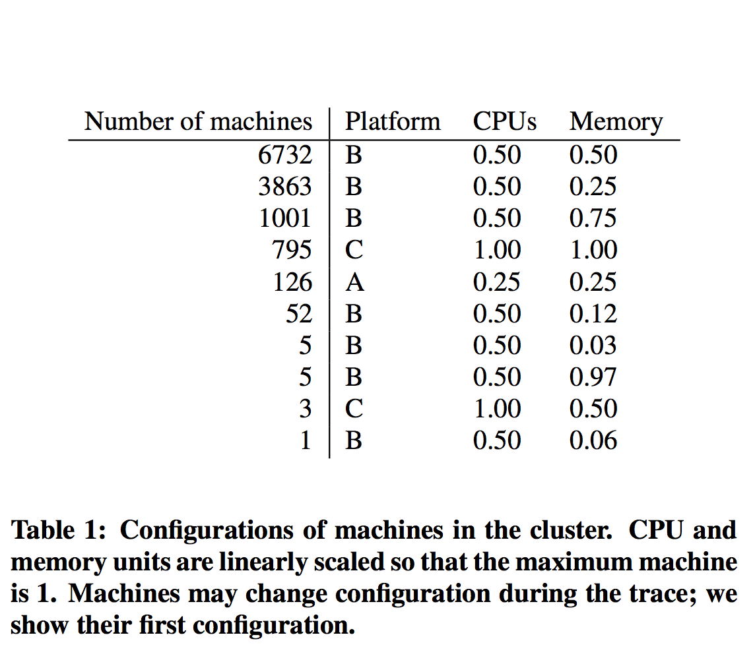
Heterogeneity - Machines
Machine are heterogeneous and lead to scale up with time hypothesis.
Design question: How to allocate units of resources to jobs/tasks in evolving, multi-tenant clusters?

Slide 4
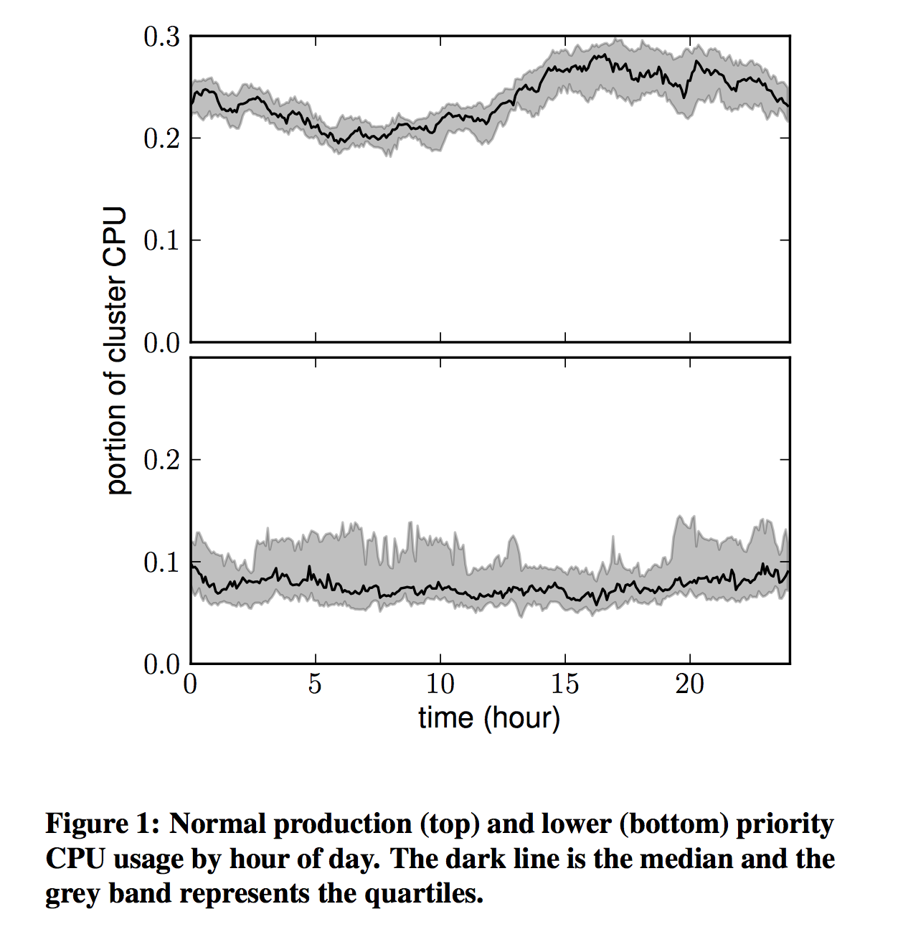
Heterogeneity - Workload types
Jobs are labeled using twelve distinct priorities 0 – 11 and scheduling class.
Some jobs are never evicted due to over-allocation (determined using some other attribute, not priority).
Production priority jobs form 7% of all jobs.

Slide 5
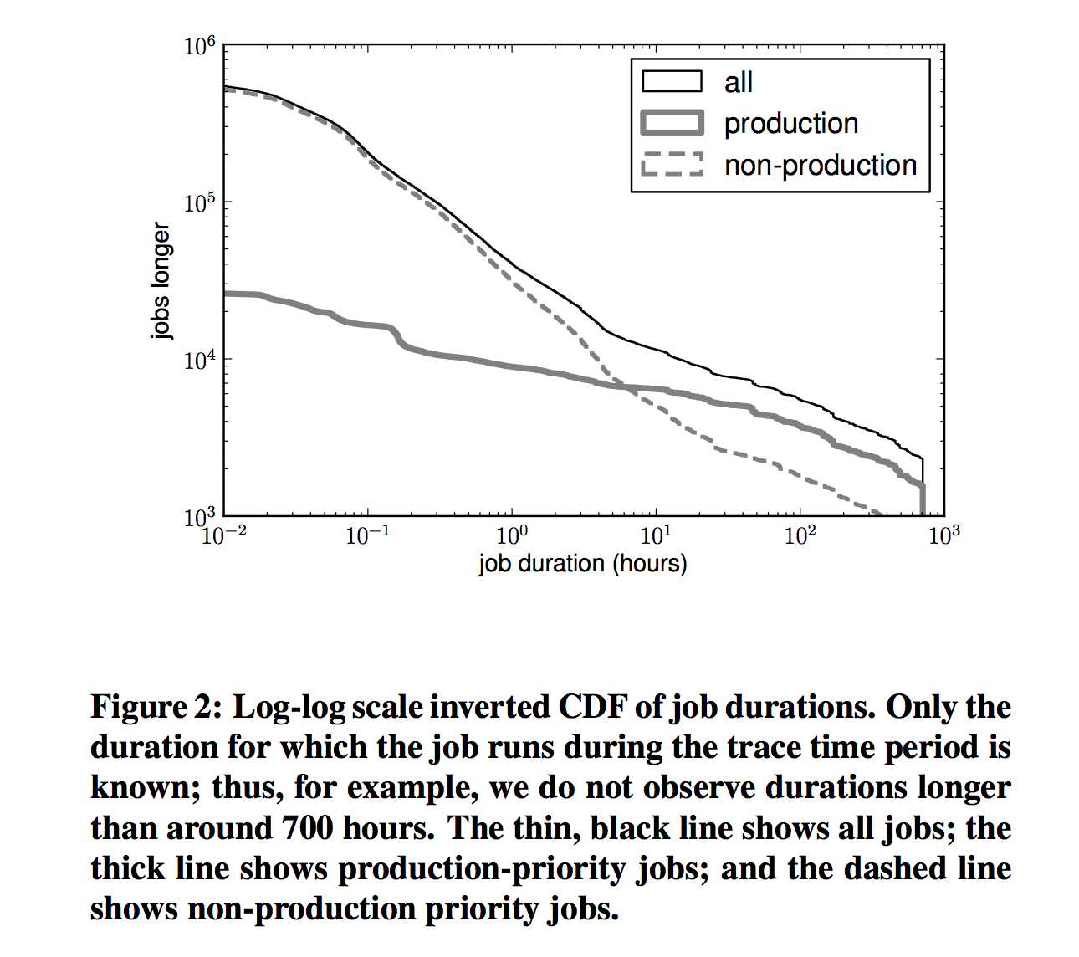
Heterogeneity - Job Durations
Production priority forms a majority of long running jobs.
Scheduling classes evenly distributed across short and long run jobs.
Design Question: Job duration is heavy tailed, even when sliced by priority or scheduling class, but fails to pass fitness test for power-law distributions. Given that, what assumptions should be made about distribution?

Slide 6
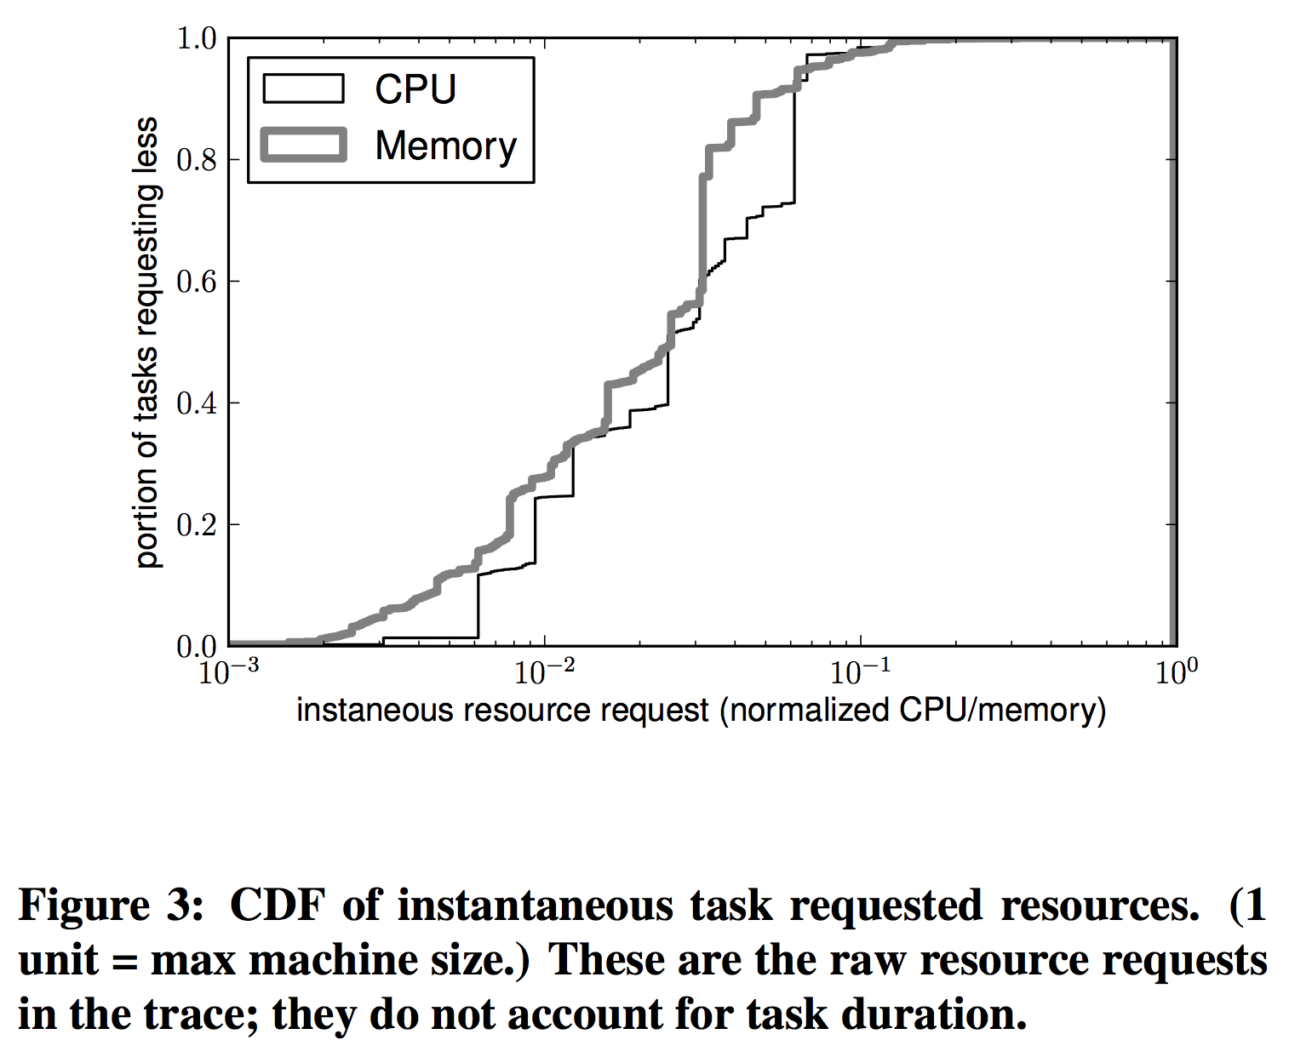
Heterogeneity - Task Shapes
Resources request per task for both CPU and memory have wide variations.
The CPU and memory request per task has little correlation (R² = 0.14) and CPU : Memory ratio spans two orders of magnitude

Slide 7
Dynamicity – Machine Churn
Spread: 40% of the all machines are unavailable to the scheduler at once during the 30 day trace.
Period: 9.7 losses of availability per machine per year
Availability: Over 95% of time, 99% machines are available.

Slide 8
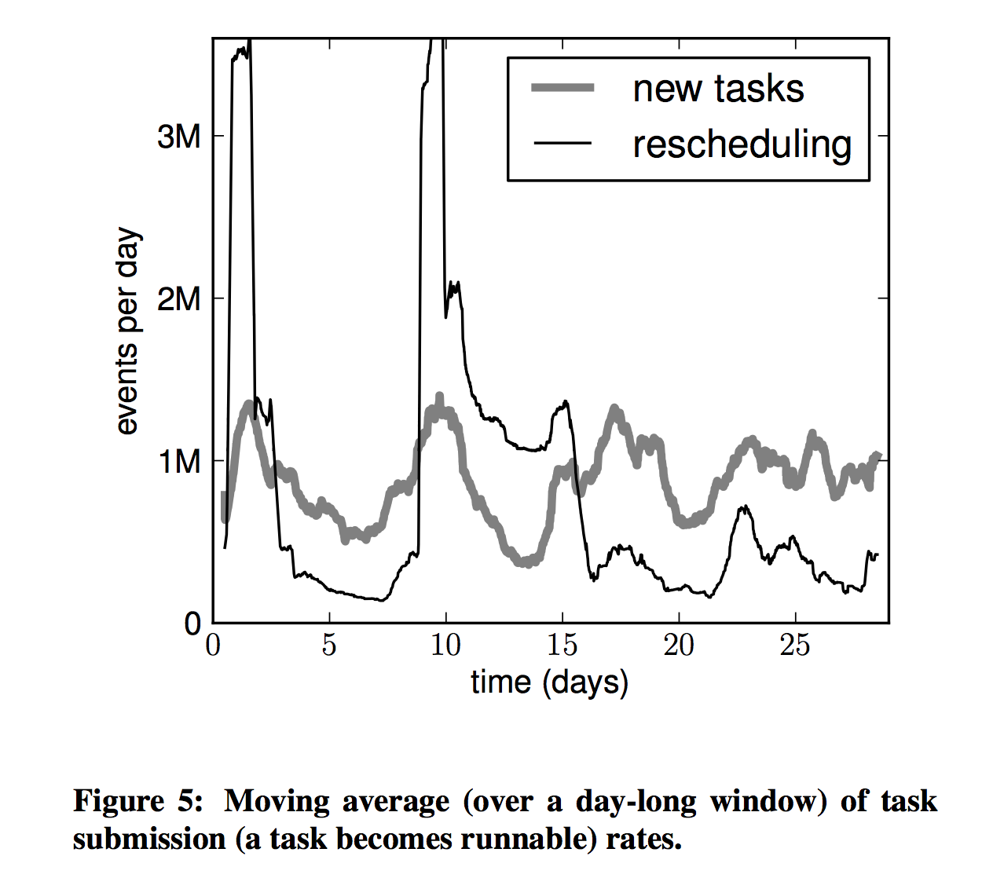
Dynamicity – Submissions and Resubmissions
100s of task placement decisions per second, driven by short-duration tasks and resubmission.
14M, 4.5M and 4.1M resubmissions events caused by failed tasks, evictions due machine configuration changes or priority and job kills respectively.
10M resubmissions in three crash looping jobs causing spikes.

Slide 9
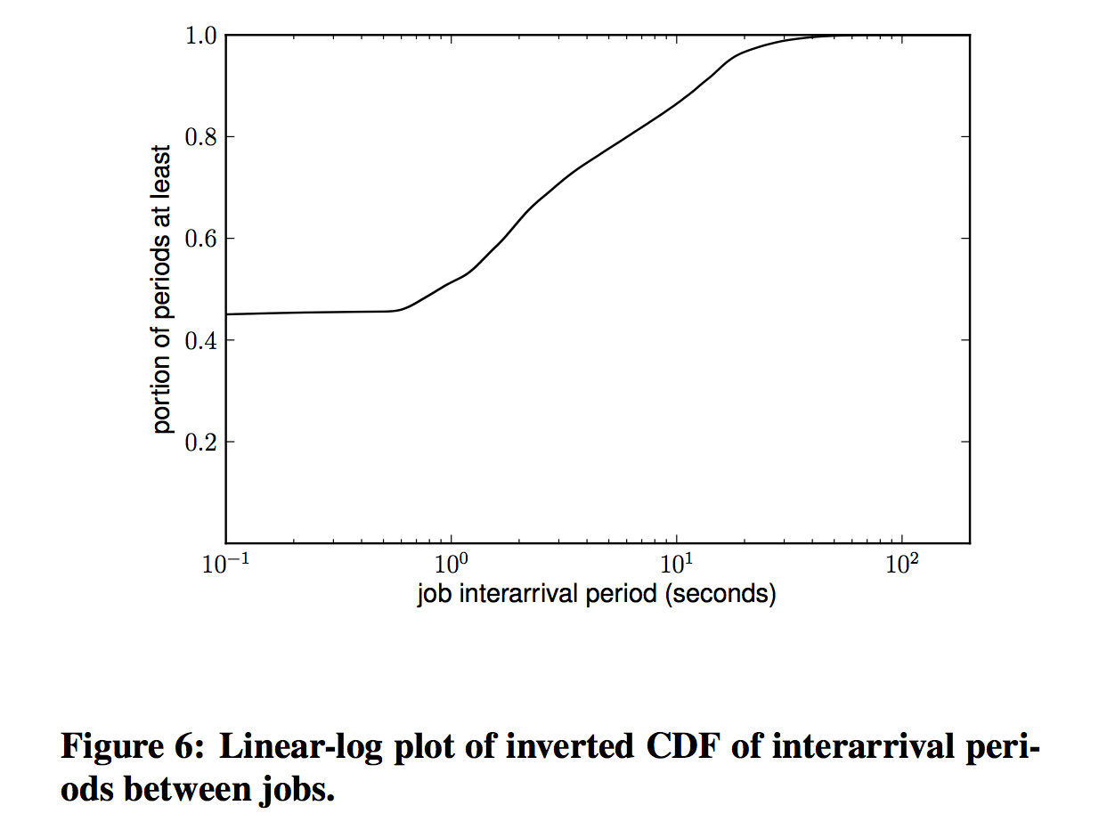
Dynamicity – Small Jobs
75% of jobs consists of one task, Embarrassingly parallel programs?
50% of jobs run for less than 3 minutes
Job submissions are clustered suggesting jobs being part of same larger program.

Slide 10
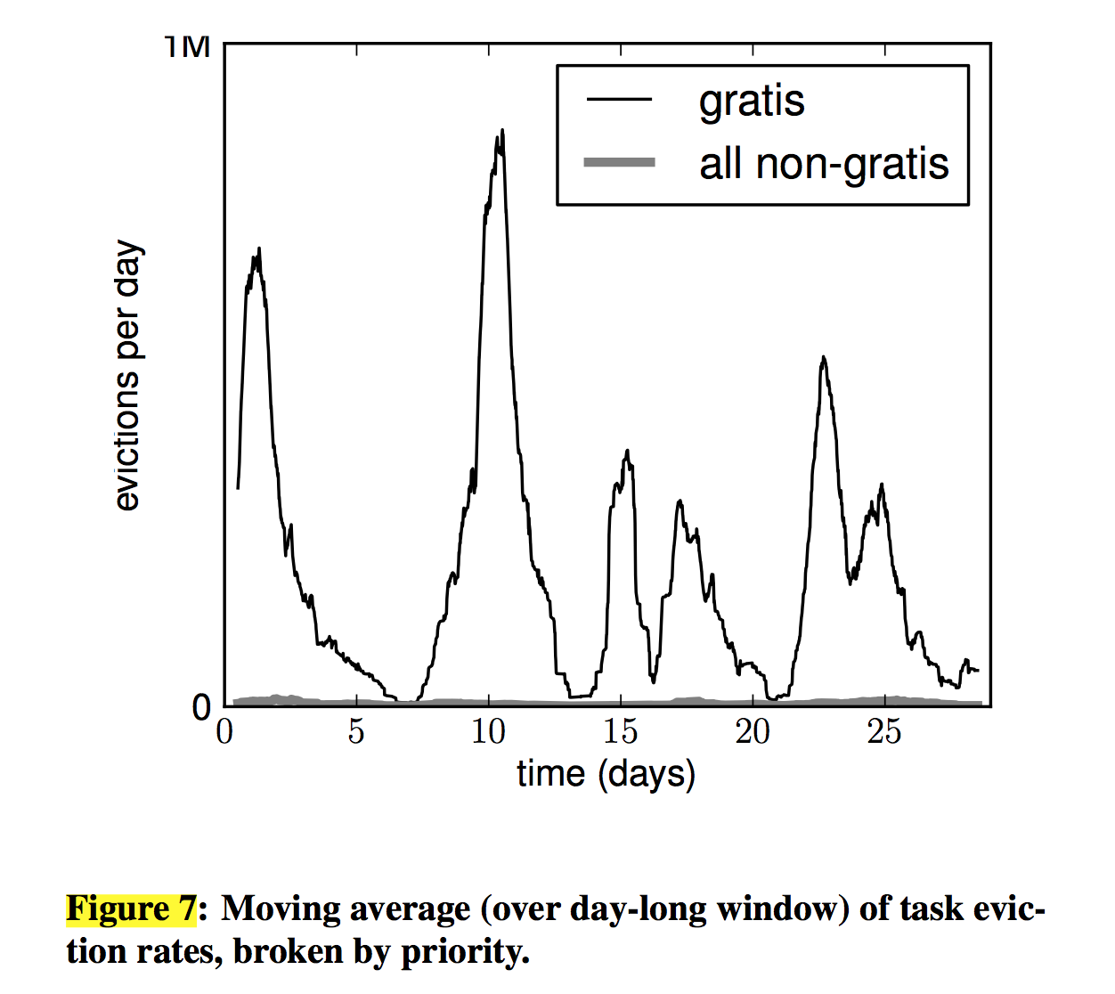
Dynamicity – Evictions
Causes: Machine configuration changes and priority.
Failure Rate for low priority jobs: 1 task every 15 minutes.
Evictions within half a second of scheduling of another task of same or higher probability.

Slide 11
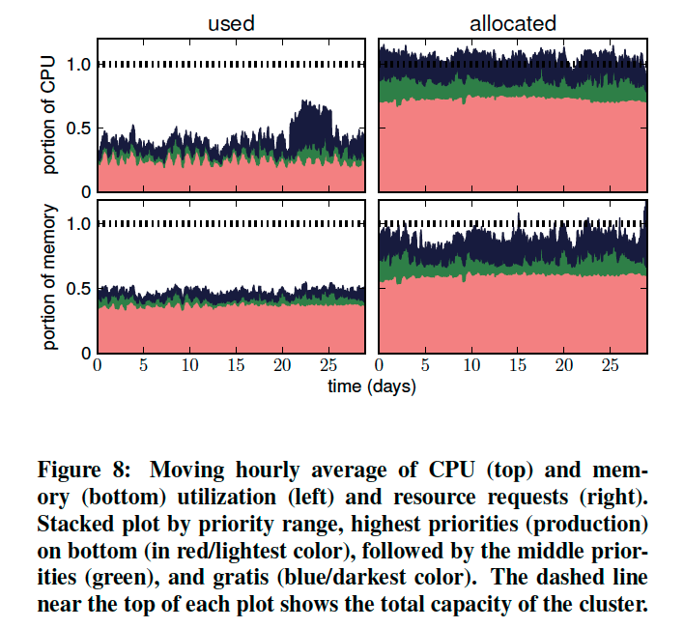
Usage Overview
On average, only 50% of the memory and 60% of CPU is utilized, while much larger share is requested in jobs. Can we do better?

Slide 12
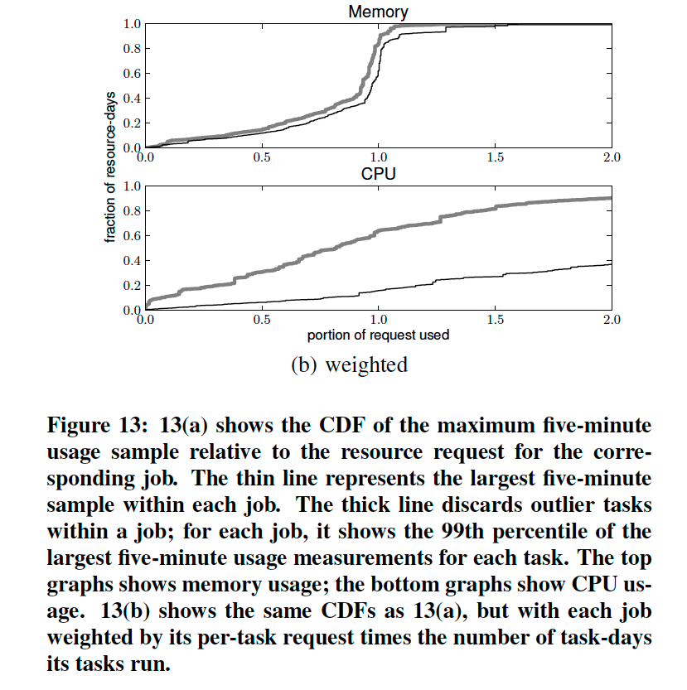
Resource Request “Accuracy”
Using 99th percentile usage for memory and CPU as maximum.
The maximum task usage is then weighted by product of per-task resource request and number of days on which task is run to determine “requests are usually too high or too low”.
Users seemingly predict maximum memory consumption better than maximum CPU usage.
Design question: Should scheduler trust user input at all?

Slide 13
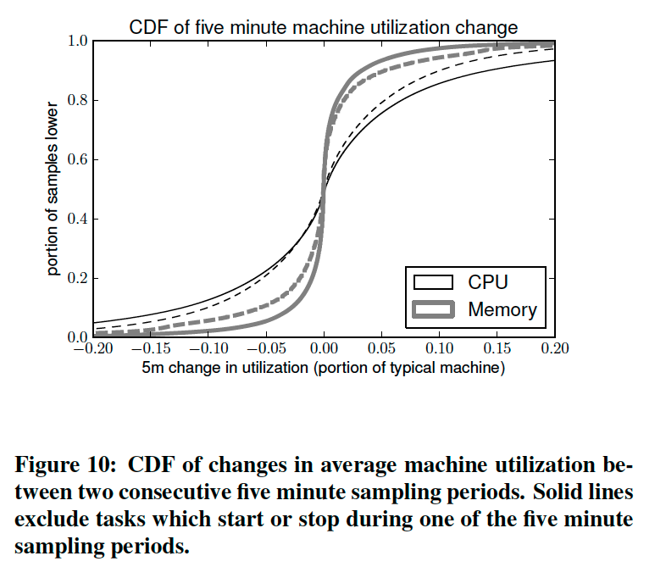
Usage Stability
Machine utilization is predictable over timescales of minutes.
Design question: Can scheduling scheme utilize this fact and that tasks last multiple minutes to design predictive scheduling?

Slide 14
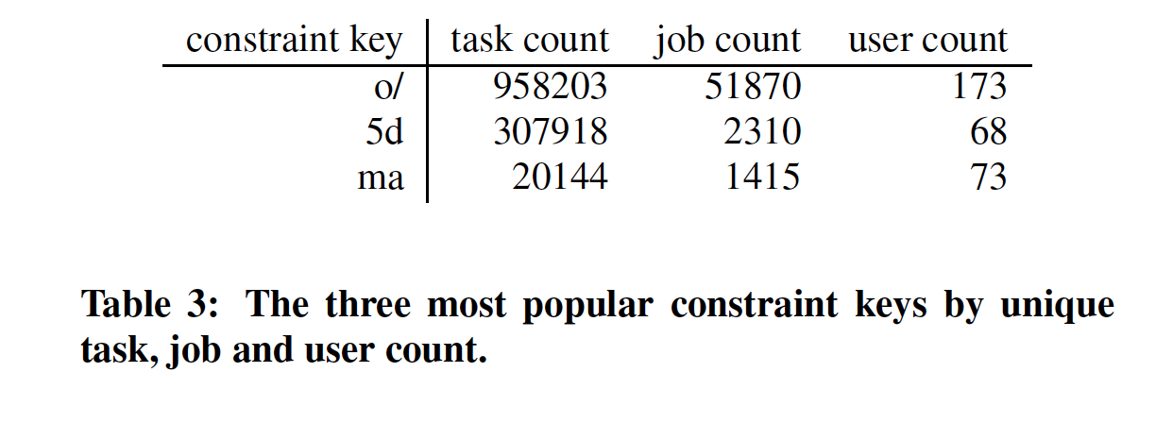
Task Constraints - I
Hard vs Soft constraints
6% of tasks have hard constraints in the trace: Resource attribute based and anti-affinity constraints.
Constraint key ‘o/’ seems to mean “avoid machine with a certain attribute”

Slide 15
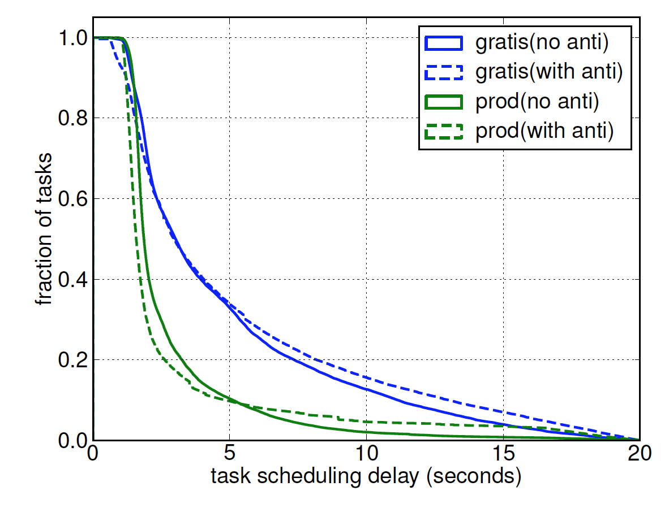
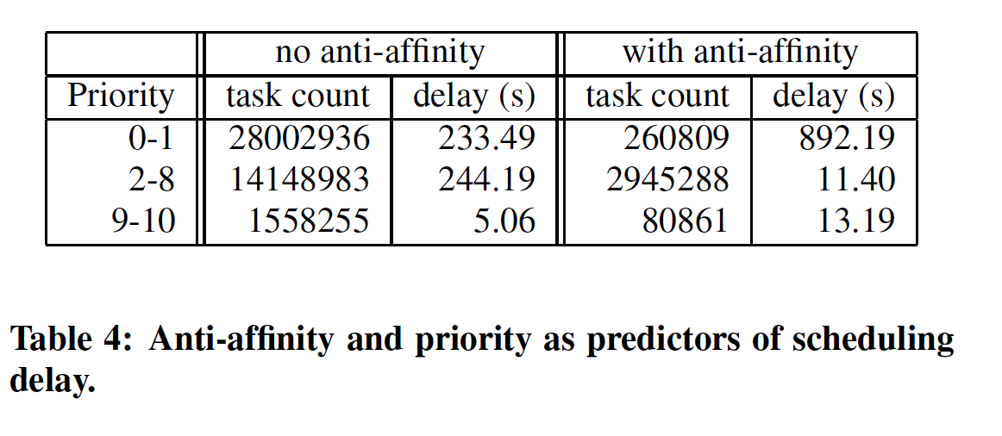
Task Constraints - II
Anti-affinity constraints cause scheduling delay.

Slide 16
Discussion
Question the context: How much is the trace data result of the deployed scheduler and how much is it a function of natural task demands?
Waster Work: Evictions appear speculative and not driven by resource monitoring and in some cases unnecessary. Can we do better?
How to measure: 99th percentile sample for estimating maximum usage by a task may not be accurate. How would you measure the resource usage by a given task?
Whacky Notions: Think flexible tasks: Can a compute framework be designed which “always” trades-off memory and CPU resource? So, the scheduler is then able to adapt tasks to what resources are available instead of other way around.

