Slide 1
IOFlow: A Software-defined Storage Architecture Eno Thereska, Hitesh Ballani, Greg O’Shea, Thomas Karagiannis, Antony Rowstron, Tom Talpey, Richard Black, Timothy Zhu
Presented by: Sangeetha Abdu Jyothi

Slide 2
Virtualized storage
VM
VM
VM
VM
VM
VM
Virtual Machine
Virtual Machine
Hypervisor
vDisk
vDisk
NIC
NIC
NIC
NIC
Switch
Switch
Switch
S-NIC
S-NIC
Storage server
Storage server

Slide 3
Motivation
Tenants require predictable behavior and performance guarantees. But . . .
IP traffic and storage traffic share network resources.
IO path to storage comprises of multiple stages.
Difficult to provide performance guarantees for storage IO flows.

Slide 4
Key requirements
IO differentiation along flow paths
Global visibility
Should not require application or VM changes

Slide 5
Key Components
IO differentiation along flow paths
- Data-plane queues
Global visibility
- Logically centralized controller
Should not require application or VM changes
- Applications not affected. Simple interface between controller and applications

Slide 6
Other challenges
Block device
C: (/device/scsi1)
Flow name resolution
Distributed enforcement
Dynamic enforcement
Admission control
VM
VM
VM
VM
VM
VM
Virtual Machine
Virtual Machine
Hypervisor
vDisk
vDisk
NIC
NIC
NIC
NIC
Switch
Switch
Switch
Server and VHD
\\server1\123.vhd
S-NIC
S-NIC
Storage server
Storage server
Volume and file
H:\123.vhd
Block device
/device/ssd5

Slide 7
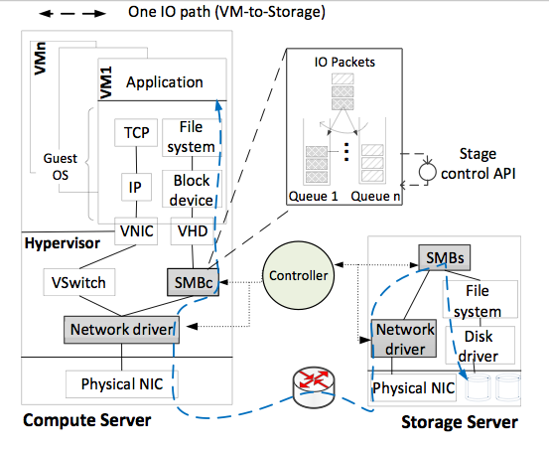
IOFlow architecture

Slide 8
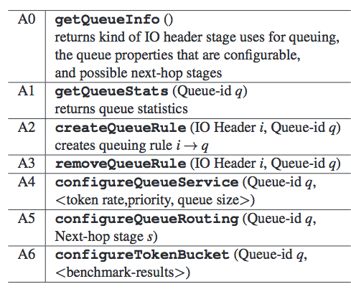
API for data-plane stages
Classification
Queue servicing
Routing

Slide 9
Some policies
{VM p, Share X } → Bandwidth B
{ p, X } → Min Bandwidth B
{ p, X } → Sanitize
{ p, X } → High priority
{ [p,q,r] , [X ,Y]} → Bandwidth B

Slide 10
Enforcing policy
{VM 4, Share X } → Bandwidth B
SMBc:
1: getQueueInfo();
2: createQueueRule(<VM 4,//server X/*>, Q1)
3: createQueueRule(<*,*>, Q0)
4: configureQueueService(Q1, <B, 0, 1000>)
5: configureQueueService(Q0, <C-B, 0, 1000>)

Slide 11
Properties
Stages
Soft-state queues
If no match for a request, it is blocked and controller is contacted.
Configurable plumbing possible
Rate-limiting with tokens – based on end-to-end cost
Allows splitting of IO requests for better performance
Location of policy implementation can be critical for performance

Slide 12
Properties
Controller
Discovery component generates stage level graph
Flow name resolution to match stage specific queuing rules
Batched updates for non-critical applications
Uses version numbers in configuration updates

Slide 13
Evaluation – Policy enforcement
Windows-based IO stack
Clients
10 hypervisor servers, 12 VMs each
4 tenants, 30 VMs/tenant, 3 VMs/tenant/server
1 storage server
SMB 3.0 file server protocol
3 types of backend: RAM, SSD, Disk
1 controller
1 s control interval

Slide 14
Evaluation – Policy enforcement
4 Hotmail tenants {Index, Data, Message, Log}
Tenant | Policy
Index | {VM 1 -30, X} -> Min 800 Mbps
Data | {VM 31 - 60, X} -> Min 800 Mbps
Message | {VM 61 -90, X} -> Min 2500 Mbps
Log | {VM 91 -120, X} -> Min 1500 Mbps

Slide 15
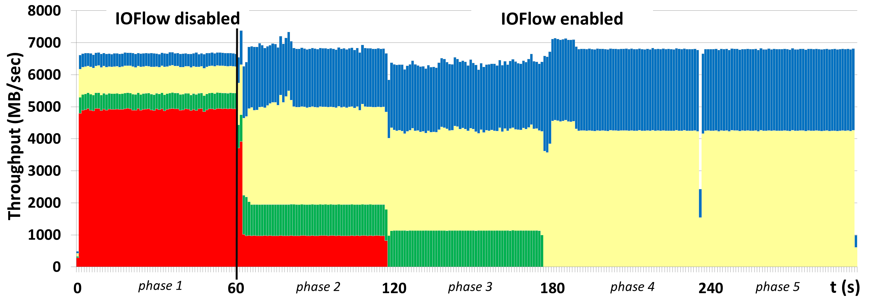
Evaluation – Policy enforcement
Controller notices red tenant’s performance
Intra-tenant work conservation
Inter-tenant work conservation
Tenants’ SLAs enforced.

Slide 16
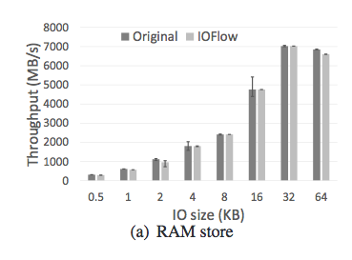
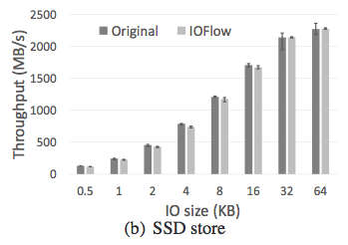
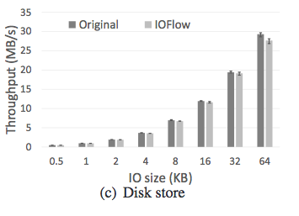
Evaluation – Performance & scalability
Worst case reduction in throughput:
RAM – 14%
SSD – 9%
Disk – 5%
Worst case overhead in CPU consumption at hypervisors:
< 5%

Slide 17
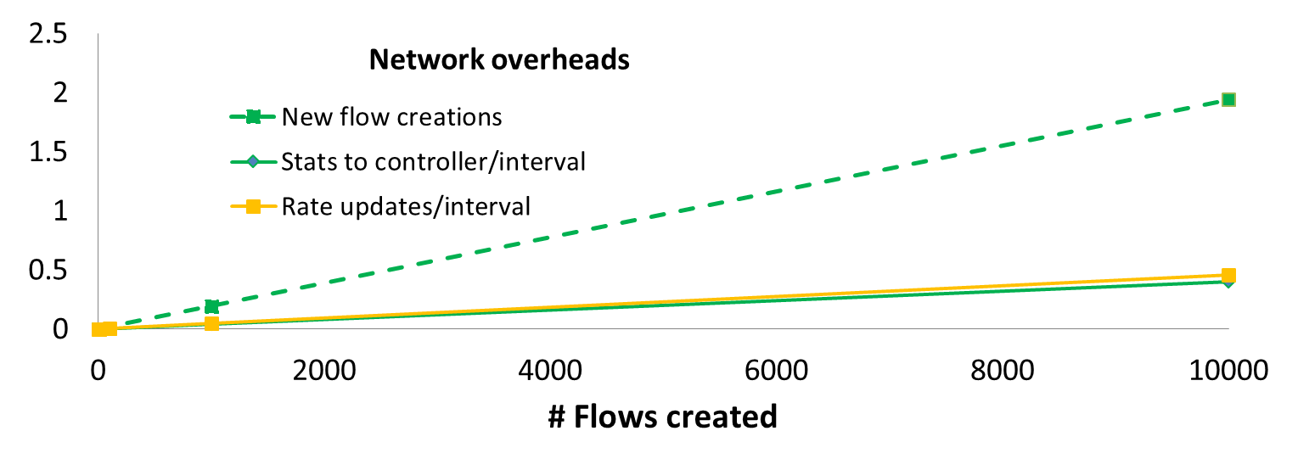
Evaluation – Performance & scalability
Overhead (MB)

Slide 18
Summary
Software defined storage architecture
Data-plane queues facilitate fine-grained control over storage IO performance
Compact and extremely useful API between control plane and data plane
Control applications – performance control and middlebox – successfully built with IOFlow API

Slide 19
Discussion
Integration with network traffic
Scalability
More applications and functionalities – latency guarantees?
Failure at one stage blocks all the requests using it

