Slide 1
Effective Straggler Mitigation: Attack of the Clones ^{[1]}
[1] Ananthanarayanan, Ganesh, et al. "Effective straggler mitigation: attack of the clones." Proc. NSDI. 2013.
Shy-Yauer Lin (slin52)
CS525 Spring 2014 ver04221417

Slide 2
Contribution of this thesis
New programming paradigm (e.g., Map-Reduce) has intrinsic straggler problem
What’s the problem?? (next slide)
Proposed technique mitigate straggler problem
Shorten job time, speed up 34% to 46%
Trade off is inexpensive (5% additional resource)
What’s technique?? (discuss later)
Note the scope of this thesis: smaller jobs (discuss later)
Practical scenario (Facebook, Bing)
This proposed system called Dolly (mainly modified scheduler)

Slide 3
Straggler problem
Job = multiple parallel tasks
Task: process unit
Job time = longest task time (slowest one dominate)
job time
task 1.1
task 2.1
task 1.2
task 2.2
task 1.3
task 2.3
task 1.4
t
task 2.4
t
Single stage??
Job 1
Job 2
More imbalance task times, more severe “straggler problem”

Slide 4
Solve Straggler problem
job time
Insight: clone job (run concurrently)
Assumption: task times are not constant
Job time = shortest clone job time (fastest dominate)
Trade off: more resource usage
Job level vs. Task level clone
task 1.1
task 1.2
task 1.3
task 1.4
t
Job 1
job time
task 1c.1
task 1c.2
task 1c.3
task 1c.4
t
Job 1c

Slide 5
Good clone approach shall…
Trade off: shorten job time at the expense of additional resource usage
Rule of thumb:
shorten job time as much as possible given additional resource usage constraint (Budget Clone)
speculative execution??
resource (less good)
job time (less good)
reactive/lazy
(clone after straggler)
proactive/eager
(clone before straggler)
Spectrum of clone timing

Slide 6
Solve Straggler problem (another approach)
Insight: black list (run tasks on good machines; block bad machines)
task 2.1
task 2.1
task 2.2
task 2.2
task 2.3
task 2.3
task 2.4
t
task 2.4
t
Job 2
Job 2 with black list
How to predict??
Clone and black list are orthogonal?

Slide 7
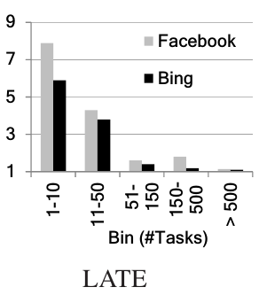
We are not satisfied for sols
(Reactive) clone job and black list works well for larger jobs
Not good for smaller job (job with few tasks: <10)
6.2% vs. 29% (ideal), 8.4% vs. 47% (ideal)
“slowdown ratio” (y-axis) in single stage
slowdown ratio = “progress rate” of median task / “progress rate” of slowest task
“progress rate” = task input data size / task duration
High “progress rate” : faster data processing
Higher slowdown ratio : slowest (dominant) task lag behind median task more
Higher slowdown ratio : severe straggler problem
smaller
larger
(1 for ideal balancing; >5 for LATE/Mantri)
(mitigation)

Slide 8
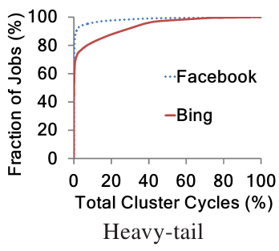
Why care about smaller job
This thesis focus on scope of smaller job with highly proactive clone job approach
Why focus on smaller job??
Not solved yet
Heavy tail fact
(smaller job scenario is indeed the most important)
Smaller job clone need much less resource overhead
Thesis still use many resource-aware technique to reduce this overhead
So many smaller job for Facebook!
Google: 92% jobs with 2% resource

Slide 9
Insight of this thesis
Unconditionally/proactively clone smaller job
Clone timing: clone jobs run simultaneously
Not good enough: some modifications (next slides)
less resource overhead is even better
More problems to solve for multistage (talk later)
Rule of thumb:
shorten job time as much as possible given additional resource usage constraint: Budget Clone
End of story??

Slide 10
Modification 1: Task level clone
job time
job time
task 1.1
task 1.1
task 1.2
task 1c.1
task 1.3
task 1.2
task 1c.2
task 1.4
t
task 1.3
Job 1
task 1c.3
job time
task 1.4
task 1c.4
t
task 1c.1
Job 1 with task level clone
task 1c.2
Task level at least has the same (or shorter) job time to job level
trade off??
task 1c.3
task 1c.4
t
Job 1c

Slide 11
Job clone vs. task clone
job2
-------
task2.1 4sec
task2.2 5sec
job level clone
-------
5sec = min(job2, job2c)
where job2 = max(task2.1, task2.2) = max(4, 5) = 5
and job2c = max(task2c.1, task2c.2) = max(5, 4) = 5
job2c
-------
task2c.1 5sec
task2c.2 4sec
task level clone
-------
4sec = max(t1, t2)
where t1 = min(task2.1, task2c.1) = min(4, 5) = 4
and t2 = min(task2.2, task2c.2) = min(5, 4) = 4

Slide 12
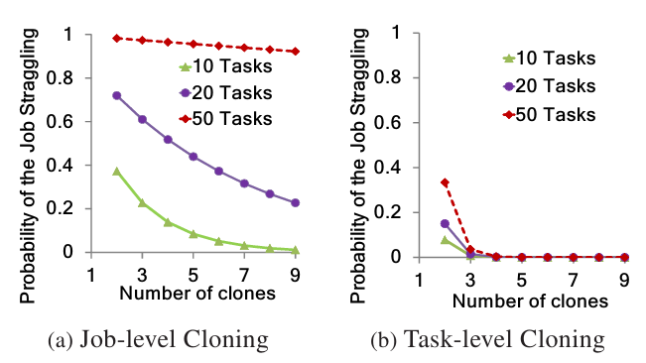
Modification 1: Task level clone
(1-(1-p)^{n})^{c}
1-(1-p^{c})^{n}
Fix prob., we need much less copies in task level than job level.
n tasks for a job
Less required clone c, less resource overhead
“Straggler” problem source is too complicated to find out, we model this phenomenon as a probabilistic event: straggler occur with probability p

Slide 13
Budget Clone Insight
Step 1: estimate system parameters, like straggler prob. p, available resource budget B, desired straggler prob. upper bound ɛ
step 2: Calc required clone number c given p, ɛ
step 3: Spend budget B for c clone if budget is enough
Or, no-clone at all if budget is not enough
(Spend or not-at-all approach: room for improvement)
step 4: update budget B (budget decrease; utilized budget increase)
Admission control??
Larger job is unlikely to clone; mainly for smaller job clone.

Slide 14
Clone seems good, but…
Multistage fact (E.g., Map-Reduce) has new assignment problem
Clone maps, clone reduces (clone groups)
Mapping strategy between clone maps and clones reduces is an assignment problem
one-to-many (one map to many reduces) assignment may cause (I/O) contention
one-to-one assignment may be inefficient (reduce wait for slow map)
clone group
U1
U1
U2
U2
??
??
??
??
Shuffle vs.
Assignment??
Shuffle constraint
U1 → D1, D2
D1
D1
D2
D2
U2 → D1, D2

Slide 15
Shuffle vs. Assignment
Shuffle (Mapper→Reducers)
Assignment (Mapper clones→Reducer clones)
clone group
clone group
U1
U1
U2
U2
U1
U1
U2
U2
D1
D1
D2
D2
D1
D1
D2
D2
Shuffle constraint
U1 → D1, D2
U2 → D1, D2

Slide 16
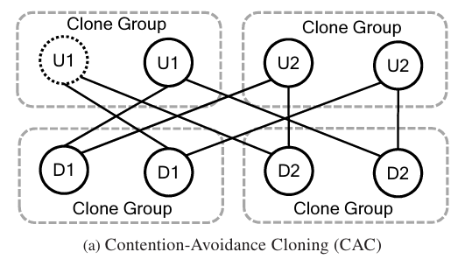
One-to-one assignment (CAC)
Contention Avoidance Cloning (CAC)
one-to-one assignment may be inefficient (reduce wait for slow map)
Longer wait time, longer job time in higher prob.
slow
Exclusive data path. e.g. U1 → D1; U1c → D1c
Shuffle constraint
Assign timing??
U1 → D1, D2
U2 → D1, D2

Slide 17
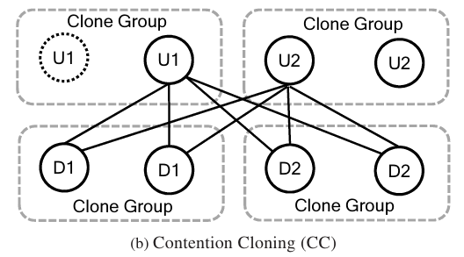
One-to-many assignment (CC)
Contention Cloning (CC)
one-to-many (one map to many reduces) assignment may cause (I/O) contention
no wait at all
More contention, longer job time.
Contention data path. e.g., U1c → D1; U1c → D1c since U1 is straggler
Shuffle constraint
Assign timing??
U1 → D1, D2
U2 → D1, D2

Slide 18
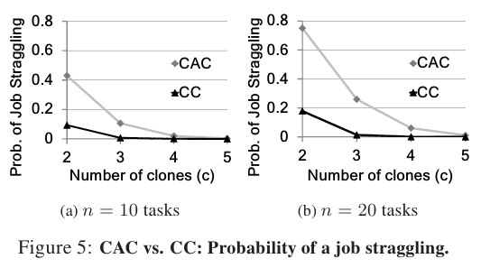
New problem: assignment problem for multistage
Fix prob., we need much less copies in CC than CAC.
Wait vs. no-wait

Slide 19
Solution
(w = 0)
CC is “no wait at all” approach: bad
CAC is “always wait” approach: even worse
Insight: “wait for a short period” approach (delay assignment)
short period: window w
Fine tune window w leads better results than CC and CAC
Properly choose w for minimum expected task time (p.192, see next slide)
Periodically estimates parameters (like bandwidth) of those formulas
One-to-one after wait and waited less than window w
waited (< w) -> exclusive data path
One-to-many after waiting longer than window w
waiting (> w) -> contention data path
(w = ∞)
(2.5s to 4.7 is decent)
Assign timing??

Slide 20
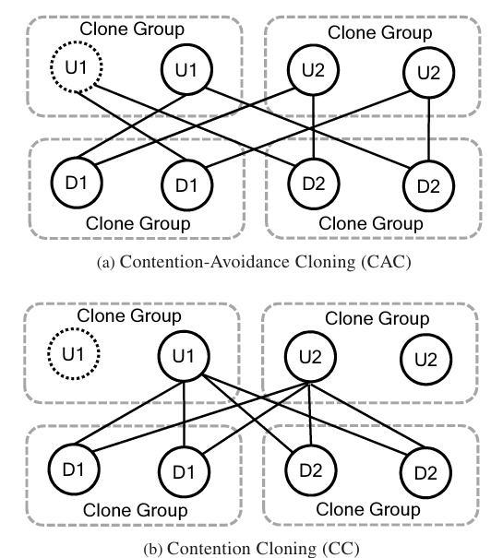
Solution (formula1)
Object: find w that minimize expected job time: p_{c} Tc + (1 - p_{c}) T_{E}
Contention prob. p_{c} : prob. that wait time ≤ w (window)
w
contention Tx
t
B : bandwidth without contention, not budget
α B: bandwidth while contention
r: data size
Case 1. T_{c} (waiting for w, enforce contention)

Slide 21
Solution (formula2)
Object: find w that minimize expected job time: p_{c} Tc + (1 - p_{c}) T_{E}
Contention prob. p_{c} : prob. that wait time ≤ w (window)
w
t
w
B : bandwidth without contention, not budget
r: data size
t
Case 2. T_{E} (waiting less than w, no contention)
is upper bound

Slide 22
Evaluation settings
150 machines
1Gbp network links
12 cores CPU
24GB RAM
2TB storage
Competitors: LATE, Mantri (speculative execution solutions)
Workflow: Facebook (Hadoop), Bing (Dryad)
Jobs scales (# of tasks): 1-10 (bin-1), 11-50, 50-150, 150-500, >500
smaller job
larger job

Slide 23
Straggler mitigation
4X% for smaller job
Still better for larger job
?
smaller job
larger job

Slide 24
Straggler mitigation
3X% for smaller job
Less improvement (3X%) than facebook flow (4X%), why?
?
smaller job
larger job

Slide 25
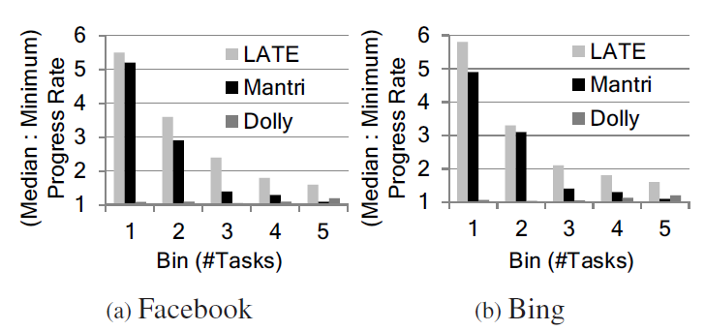
Straggler mitigation
Balanced: 1.06 – 1.17 (Dolly); > 5 (LATE, Mantri) for smaller job by slowdown ratio (y-axis)

Slide 26
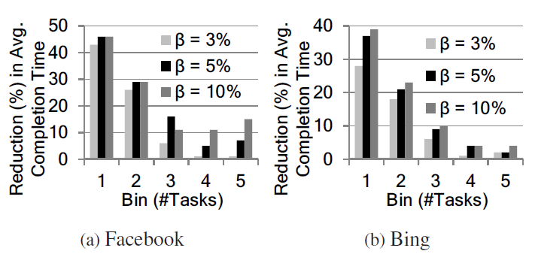
Resource tradeoff
5% budget is enough for smaller and medium job
?

Slide 27
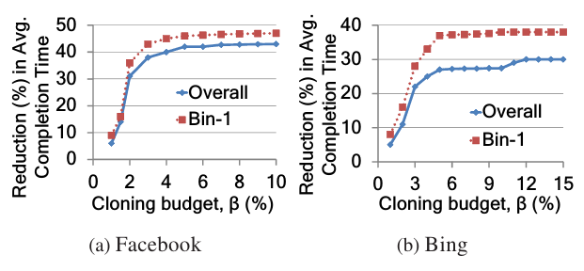
Resource tradeoff
“saturate” after resource budget reaches 5%
3% - 5% budget is enough for smaller job
smaller job

Slide 28
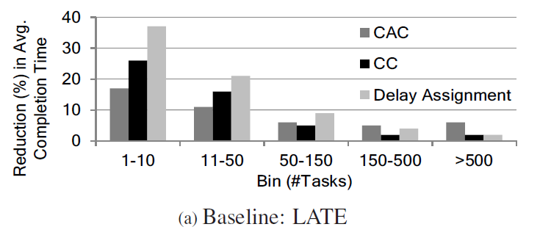
Delay assignment vs. CC, CAC
Delay assignment seems good for smaller job (Delay Assign > CC > CAC)
?
?
smaller job

Slide 29
Delay assignment for multistage
Delay assignment decays slow while stage grows

Slide 30
Communication pattern
Delay assignment not only works for all-to-all

Slide 31
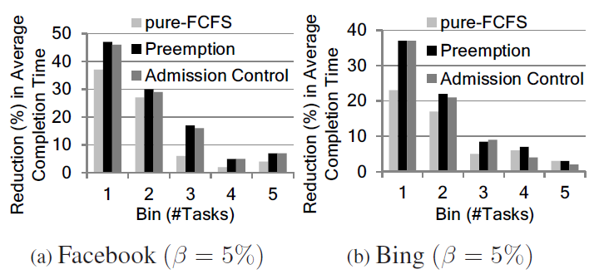
Admission control
“Spend or not-at-all (step3)” is good enough
Preemption: smaller job first policy
?
smaller job
smaller job

Slide 32
Parameter Estimation
2.5 to 4.7 sec for w (window) is a good rule of thumb
How about larger job?
smaller job
Estimation period seems not important with other interval setting (written)

Slide 33
Discussions
Smaller job vs. larger job?
Dolly still benefits larger job, why?
Analytical prob. formulas for CAC, but no for CC, why?
Straggler phenomena probabilistic formulation assumption?
Delay assignment should be as good as better(CAC, CC); but it is not true for larger job, why? (Hint: parameter w graph does not show the case for larger job)

