Slide 1
The Design of the Borealis Stream Processing Engine
Daniel J. Abadi1, Yanif Ahmad2, Magdalena Balazinska1, Ug ̆ur C ̧ etintemel2, Mitch Cherniack3, Jeong-Hyon Hwang2, Wolfgang Lindner1, Anurag S. Maskey3, Alexander Rasin2, Esther Ryvkina3, Nesime Tatbul2, Ying Xing2, and Stan Zdonik2
1 MIT Cambridge, MA
2 Brown University
3 Brandeis University Providence, RI Waltham, MA
Presenter: Le Xu

Slide 2
Second Generation Stream Engine
Developed from Aurora (first generation of stream processing engine)
sharing input format and similar system architecture
New feature:
Dynamic modification of operator
Query revision

Slide 3
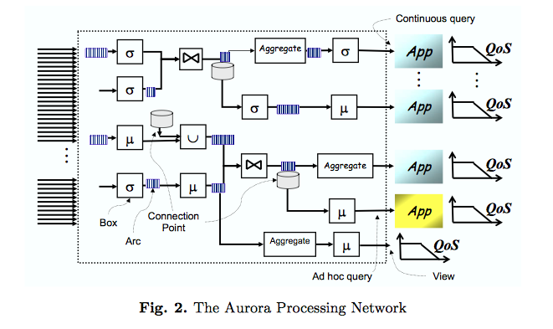
Aurora Processing Network
Source: The Aurora and Borealis Stream Processing Engines: http://homes.cs.washington.edu/~magda/borealis-book.pdf
Notes:
Standard input format for both aurora and borealis
Stream data, operator, data storage
Not on one node

Slide 4
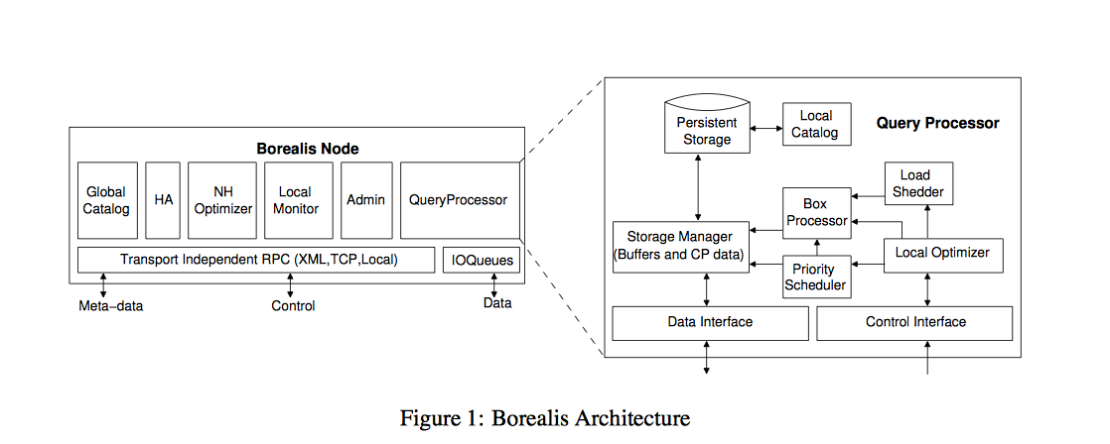
System Architecture
Notes:
The most important part of borealis node is its query processor

Slide 5
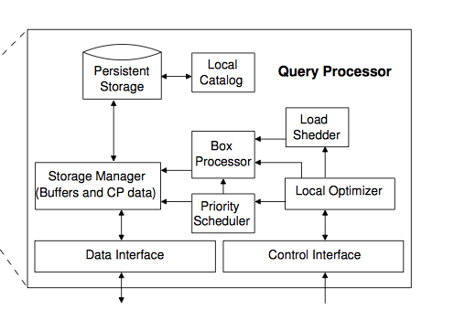
A Borealis Query Processor
Notes:
Local Optimizer further communicates with major run-time components of the QP to give performance improving directions.
PriorityScheduler, determines the order of box execution based on tuple priorities;
Box Processors, one for each different type of box, that can change behavior on the fly based on control messages from the Local Optimizer;
Load Shedder, which discards low-priority tuples when the node is overloaded.

Slide 6
A Borealis Query Processor
Data interface:
- Stream Data Input
Control interface
- Control messages
Box Processor
- Main operation (Aggregate, Filter, Join, read, write, etc.)

Slide 7
A Borealis Query Processor
Local Optimizer
Load Shedder
Priority Scheduler

Slide 8
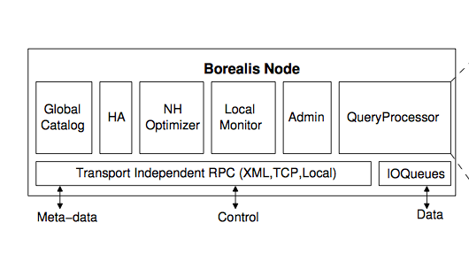
Take a loser look at the Borealis node architecture
Notes:
HA: High Availability module

Slide 9
Borealis, after Aurora
Dynamic Revision of Query Results
- diagram history replay
- stateless and stateful operation replay
- challenges: Cost & Storage; proliferation
Query Modification (dynamic!)
- control line
Dynamic System Optimization

Slide 10
Dynamic revising query results
- Motivation: wrong/missing input, shed load…
Each box (operator) has a diagram history stored in the connection point of the input (has a history bound, of course)
Start revise while a revision message received (add, delete, replace)
Dynamic revision only generates the “delta” reflecting the change of result to save space
Notes:
There can be many reason for borealis to revise query:
Wrong input
Missing input
Shed load and delay work
Connection point store diagram history while receive add/delete/replace the revision is triggered
Revision message is only small part of message so its inefficient to rerun all history

Slide 11
Stateless revision
Replace: 4
Delete: 6
Stateless operator (e.g. Filter) only affects the revised message itself
Dynamic revision only generates message of operation to revise the old result
1
6
8
x>5
6
8

Slide 12
Stateful revision
REVISED
Stateful operator(e.g. Aggregation by window) revision require all messages involve in computation
Dynamic revision only generates message of operation to revise the old result
Aggregation
W,R,F
T, W, R
M, T, W

Slide 13
Dynamic Revision Challenge
Revision Proliferation (misalignment in size-based operation)
Before: After insert:
All messages (start from revision point to present) need to be revised!
- Revision message need to be ignored sometimes.
3
2
1
3
1
2
Notes:
Optimization:
TRADE OFF:
Upstream history bound 5 HRS Downstream 10 hours
PROLIFERATION:
Size-base operation

Slide 14
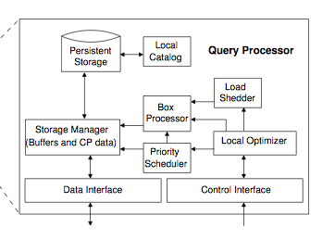
Dynamic Modification of Queries
Control Lines
Triggered while receiving control message specifying <attribute, value> pair
Timing:
- Control message before data
- Control message after data

Slide 15
Time Travel
Connection Point (CP) View
CP view has two operations to enable time travel:
- replay
- undo
box1
CP
box
2

Slide 16
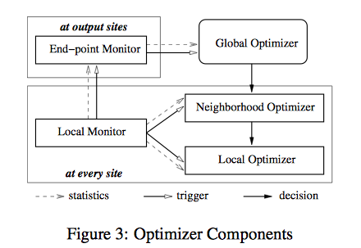
Borealis Optimization
Notes:
Mainly discuss load balance

Slide 17
Borealis Optimization
1. Initial Diagram Distribution
- Read/Write close to database site
- Run correlation algorithm to find best operator/node match
2. Dynamic Optimization
- Local Optimization
load shedding/query delay, scheduling
- Neighborhood Optimization
Edge box sliding (limited bandwidth), correlation maximization, upstream load shedding
Notes:
Initial set up
- settle table and related read/write (most demanding) to io/storage (most) abundant location
- find out cpu slack and allocate the rest of them
Dynamic optimization
Local
delay/load shedding
scheduling
Neighborhood Optimization
box sliding while the network bandwidth
upstream load shedding (to reduce the minimized total lost of all application
correlation maximization
Global Optimization

Slide 18
Edge box slide
Before slide (left node overload)
After slide
Node 1
Node 2
Node 1
Node 2
1
2
3
1
2
3
Example of downstream slide: while network bandwidth is limited, this benefits the neighborhood while box 2 produce more output than input. And vice versa for upstream slide (e.g. box 2: join)

Slide 19
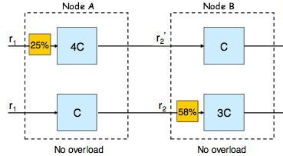
Neighborhood load shedding
Source: Presentation: The Design of the Borealis stream Processing Engine
http://www.seas.upenn.edu/~mengmeng/presentations/Borealis.pdf
Notes:
Minimize total loss of all application

Slide 20
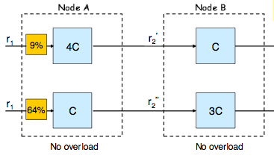
Neighborhood load shedding (less total loss)
Source: Presentation: The Design of the Borealis stream Processing Engine
http://www.seas.upenn.edu/~mengmeng/presentations/Borealis.pdf

Slide 21
Discussion and Open questions
Progress on time travel and dynamic modification of query
Possible high latency in the set up stage that reduce the flexibility of the system
Revision-heavy application stall the processing
Centralized global optimization
Is it possible that the sharing load between the nodes never stops?

Slide 22
Dynamic Load Distribution in the Borealis Stream Processor *
Ying Xing
Brown University yx@cs.brown.edu
Stan Zdonik
Brown University sbz@cs.brown.edu
Jeong-Hyon Hwang
Brown University jhhwang@cs.brown.edu

Slide 23
More on Load Balancing
Pairwise Load Balancing
Define score of Operator o while node 1 offload to node 2
Denotes the correlation coefficient between load of operator o and the load of all other operators in the node N.

Slide 24
Global Load Balancing
1. Settle non-removable node
2. (initial distribution)Greedy algorithm assigning the node with lowest node with operator with largest score of the node
3. Dynamic pairwise load balancing
Score:

Slide 25
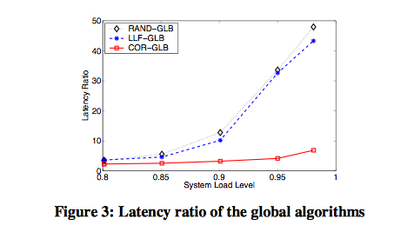
Experiment
Latency Ratio: end-to-end latency/end-to-end processing delay

Slide 26
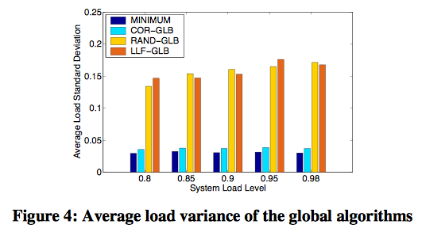
Experiment

