Slide 1
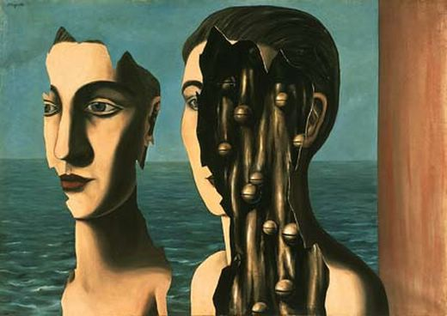
Cutting Images: Graphs and Boundary Finding
09/14/10
Computational Photography
Derek Hoiem, University of Illinois
“The Double Secret”, Magritte

Slide 2
Last two classes: Color and Light
Questions?

Slide 3
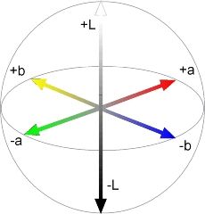
LAB Color Space
Luminance = brightness
Chrominance = color

Slide 4
If you had to choose, would you rather go without luminance or chrominance?

Slide 5
If you had to choose, would you rather go without luminance or chrominance?

Slide 6
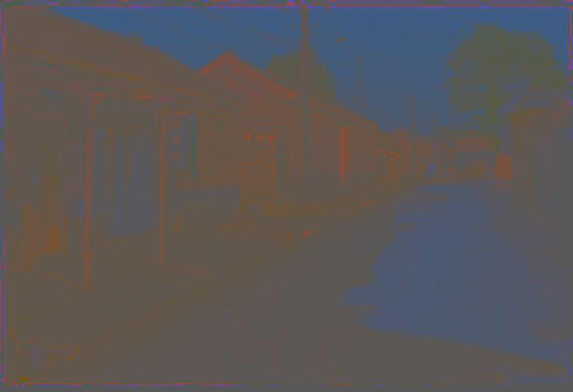
Most information in intensity
Only color shown – constant intensity

Slide 7
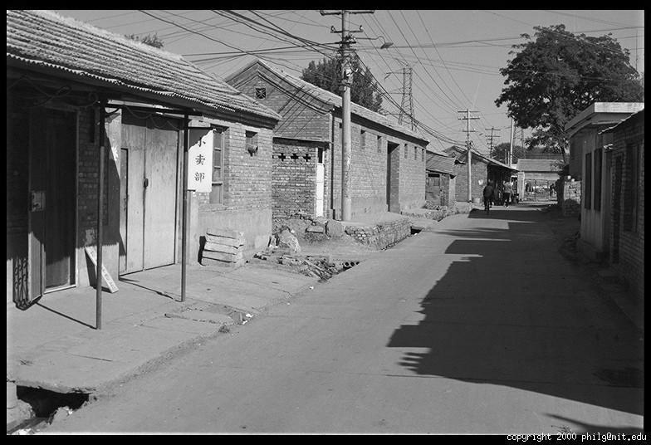
Most information in intensity
Only intensity shown – constant color

Slide 8
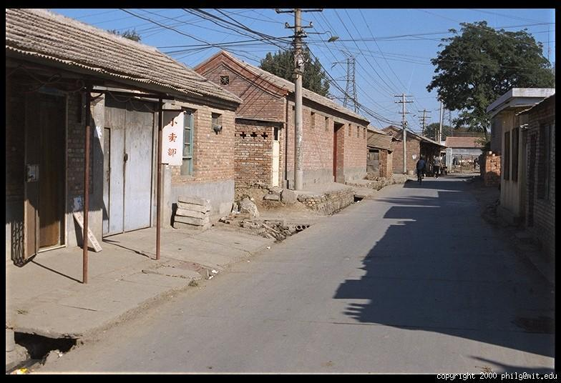
Most information in intensity
Original image

Slide 9
Project 1 Results
Class Favorite Projects (tie)
Charles Park
Jia-Bin Huang
Class Favorite Results (tie):
“Underwear woman(lion???) to the rescue” by Wei (Alex) Lou
“Who’s sitting there?” by Guenther Charwat
Brimeley and Cat (Set #1) by Steve Melnicki
About half of the class got at least one vote for favorite project or result

Slide 10
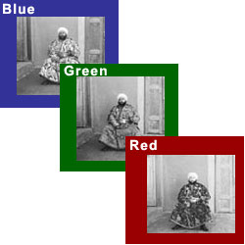
Project 2: Images of the Russian Empire: Colorizing the Prokudin-Gorskii photo collection
Due Monday (Sept 20), 11:59pm
Simple image alignment
Coarse-to-fine alignment
Bells and whistles
Automatically crop borders
Automatically adjust colors
Align using FFT

Slide 11
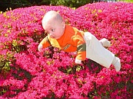
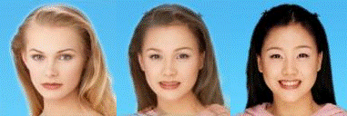
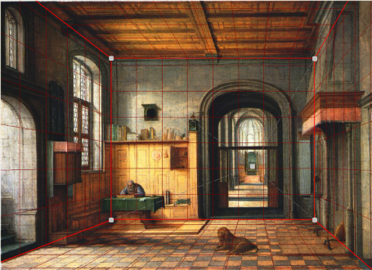
This month: The digital canvas
Cutting and pasting objects, filling holes, and blending
Image warping and object morphing
Camera models, single-view geometry, and 3D reconstruction

Slide 12
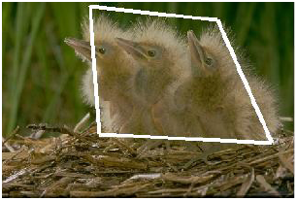
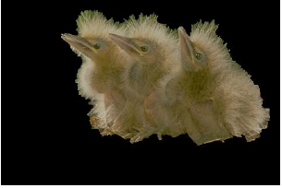
This Lecture: Finding Seams and Boundaries
Segmentation

Slide 13
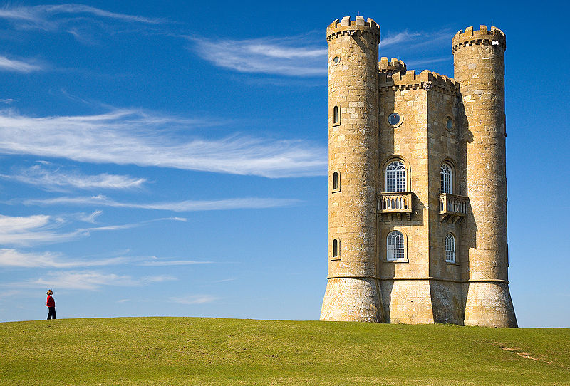
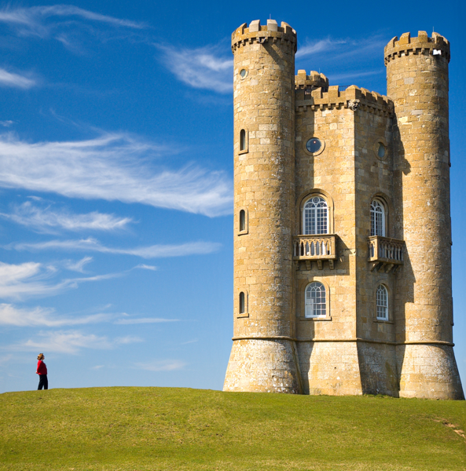
This Lecture: Finding Seams and Boundaries
Retargetting
http://swieskowski.net/carve/

Slide 14
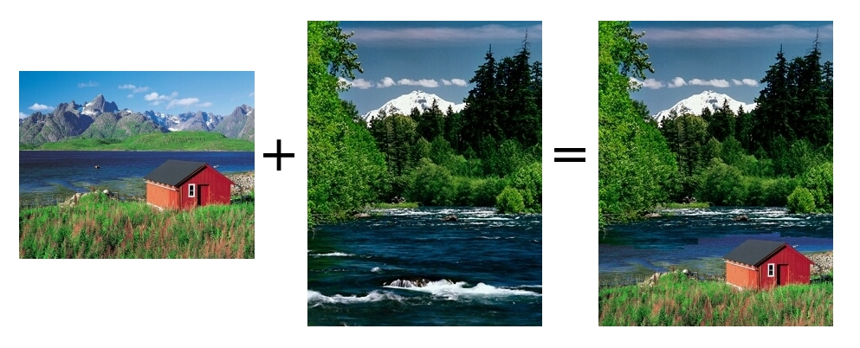
This Lecture: Finding Seams and Boundaries
Stitching

Slide 15
This Lecture: Finding seams and boundaries
Fundamental Concept: The Image as a Graph
Intelligent Scissors: Good boundary = short path
Graph cuts: Good region is has low cutting cost

Slide 16
Semi-automated segmentation
User provides imprecise and incomplete specification of region – your algorithm has to read his/her mind.
Key problems
What groups of pixels form cohesive regions?
What pixels are likely to be on the boundary of regions?
Which region is the user trying to select?

Slide 17
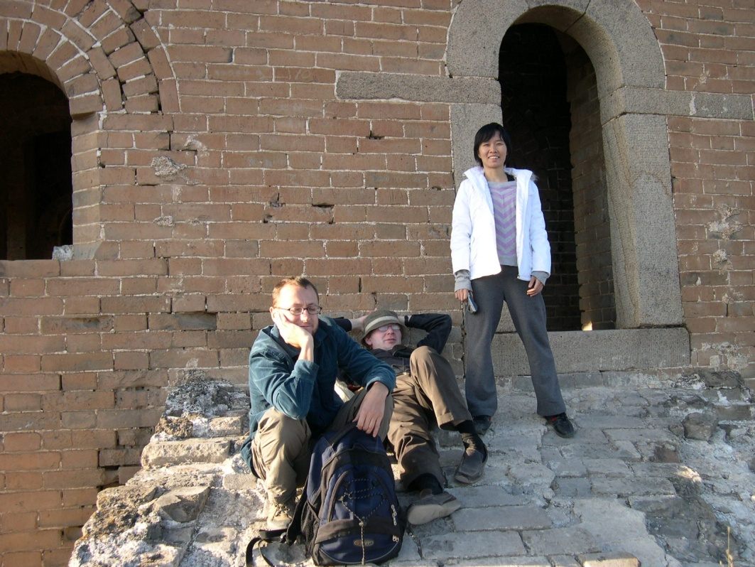
What makes a good region?
Contains small range of color/texture
Looks different than background
Compact
Notes:
Similar color/texture, compact

Slide 18
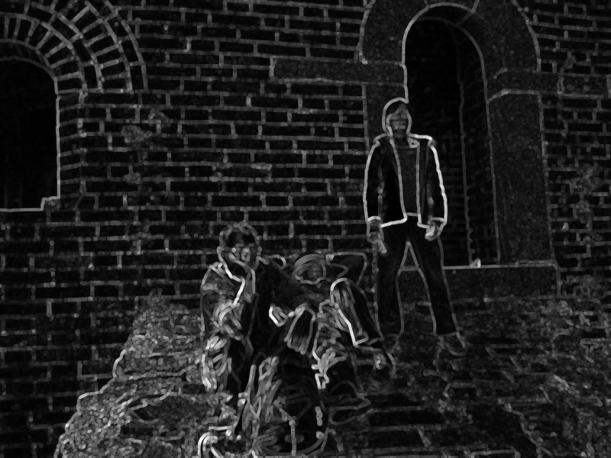
What makes a good boundary?
High gradient along boundary
Gradient in right direction
Smooth
Notes:
Smooth, high gradient along boundary

Slide 19
The Image as a Graph
Node: pixel
Edge: cost of path or cut between two pixels

Slide 20
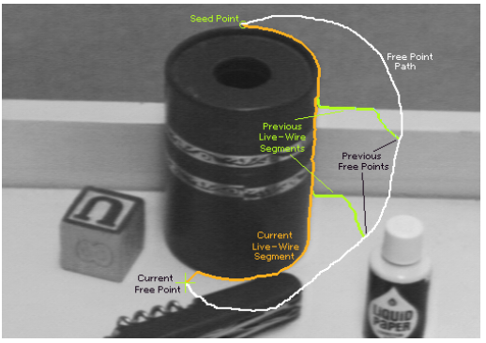
Intelligent Scissors
Mortenson and Barrett (SIGGRAPH 2005)

Slide 21
Intelligent Scissors
Mortenson and Barrett (SIGGRAPH 2005)
A good image boundary has a short path through the graph.
1
2
1
Start
2
1
1
9
5
4
4
3
3
3
6
1
1
End
1

Slide 22
Intelligent Scissors
Formulation: find good boundary between seed points
Challenges
Minimize interaction time
Define what makes a good boundary
Efficiently find it

Slide 23
Intelligent Scissors: method
Define boundary cost between neighboring pixels
User specifies a starting point (seed)
Compute lowest cost from seed to each other pixel
Get new seed, get path between seeds, repeat

Slide 24
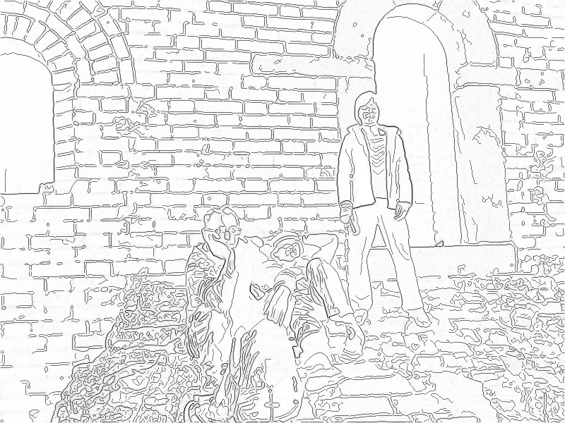
Intelligent Scissors: method
Define boundary cost between neighboring pixels
Lower if edge is present (e.g., with edge(im, ‘canny’))
Lower if gradient is strong
Lower if gradient is in direction of boundary

Slide 25
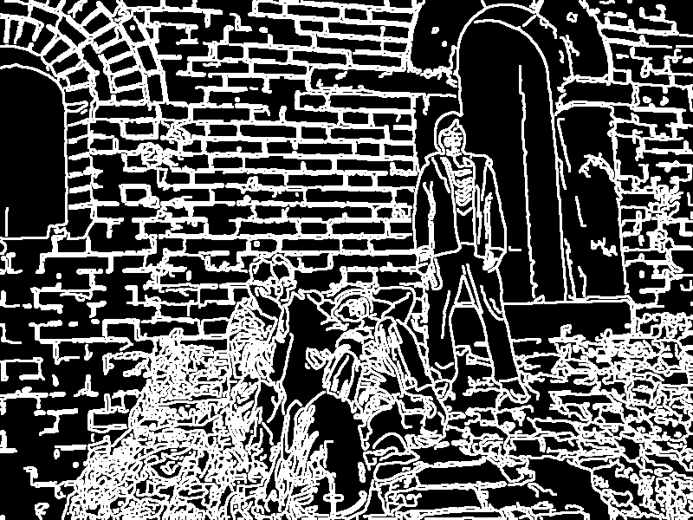
Gradients, Edges, and Path Cost
Gradient Magnitude
Path Cost
Edge Image

Slide 26
Intelligent Scissors: method
Define boundary cost between neighboring pixels
User specifies a starting point (seed)
Snapping

Slide 27
Intelligent Scissors: method
Define boundary cost between neighboring pixels
User specifies a starting point (seed)
Compute lowest cost from seed to each other pixel
Djikstra’s shortest path algorithm

Slide 28
Djikstra’s shortest path algorithm
Initialize, given seed s:
Compute cost₂(q, r) % cost for boundary from pixel q to neighboring pixel r
cost(s) = 0 % total cost from seed to this point
A = {s} % set to be expanded
E = { } % set of expanded pixels
P(q) % pointer to pixel that leads to q
Loop while A is not empty
1. q = pixel in A with lowest cost
for each pixel r in neighborhood of q that is not in E
cost_tmp = cost(q) + cost₂(q,r)
if (r is not in A) OR (cost_tmp < cost(r))
cost(r) = cost_tmp
P(r) = q
Add r to A

Slide 29
Intelligent Scissors: method
Define boundary cost between neighboring pixels
User specifies a starting point (seed)
Compute lowest cost from seed to each other pixel
Get new seed, get path between seeds, repeat

Slide 30
Intelligent Scissors: improving interaction
Snap when placing first seed
Automatically adjust as user drags
Freeze stable boundary points to make new seeds

Slide 31
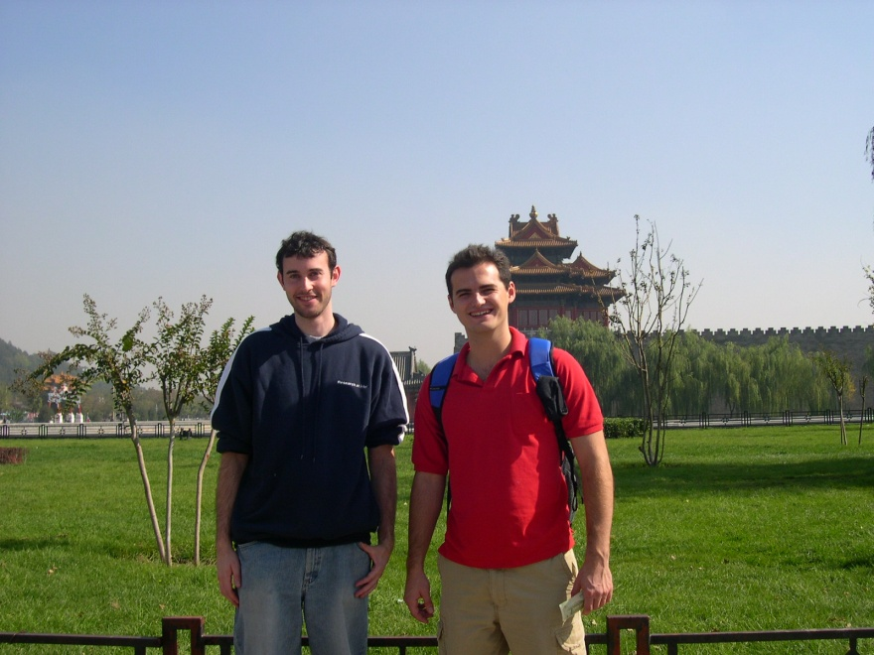
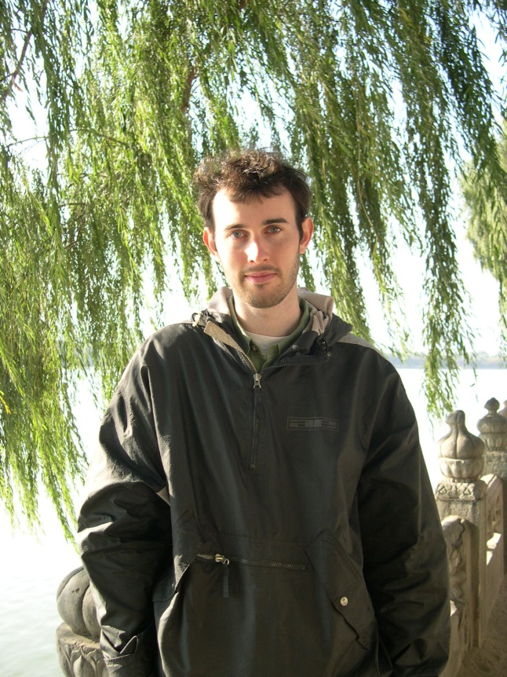
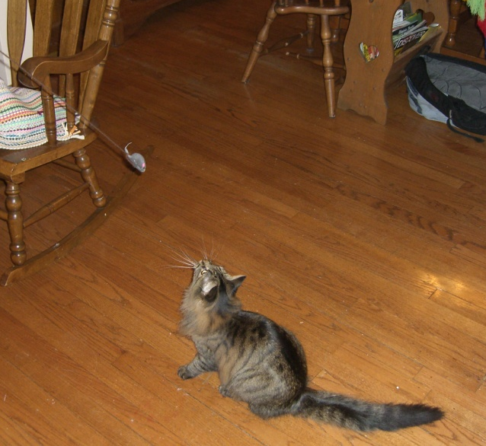
Where will intelligent scissors work well, or have problems?
Notes:
What information is intelligent scissors missing?

Slide 32
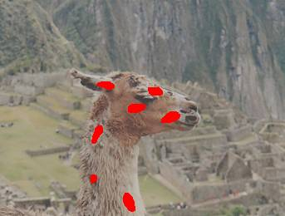
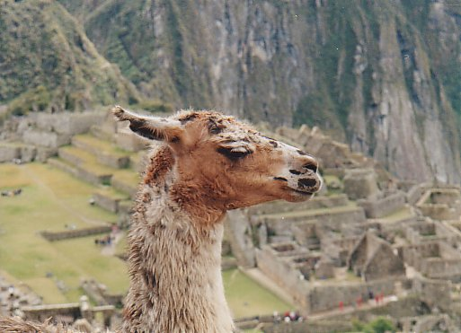
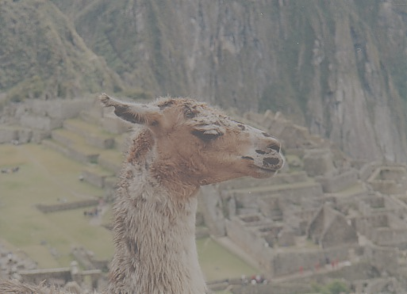
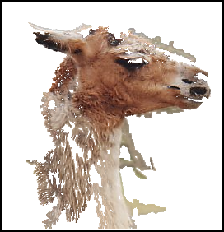
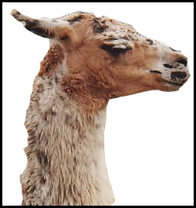
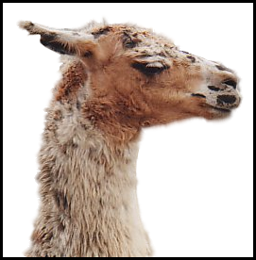
Grab cuts and graph cuts
Magic Wand (198?)
Intelligent Scissors Mortensen and Barrett (1995)
GrabCut
User Input
Result
Regions
Boundary
Regions & Boundary
Source: Rother
Notes:
Basic idea is to combine the information which was used in the 2 well known tools: MW and IS.
MS select a region of similar colour according to your input. Fat pen and the boundary snapps to high contrast edges.
Grabcut combines it. And this allows us to simplify the user interface considerably by …

Slide 33
Segmentation with graph cuts
Source (Label 0)
Cost to assign to 0
Cost to split nodes
Cost to assign to 1
Sink (Label 1)

Slide 34
Segmentation with graph cuts
Source (Label 0)
Cost to assign to 0
Cost to split nodes
Cost to assign to 1
Sink (Label 1)

Slide 35
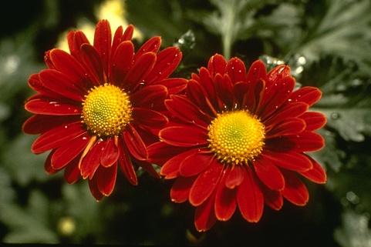
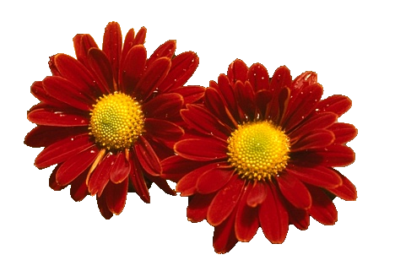
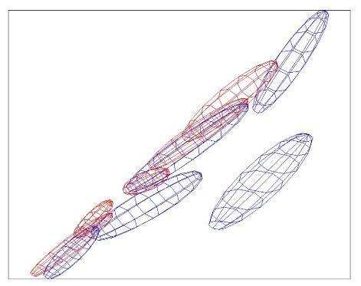
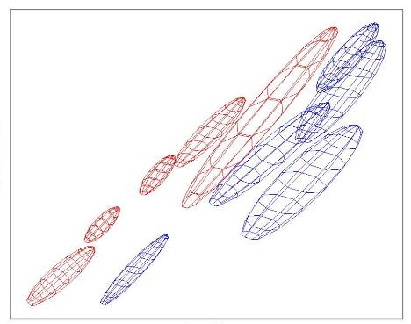
Colour Model
R
R
Foreground & Background
Iterated graph cut
Foreground
Background
G
Background
G
Gaussian Mixture Model (typically 5-8 components)
Source: Rother
Notes:
Color enbergy.
Iterations have the effect of pulling them away;
D is – log likelyhood of the GMM.

Slide 36
Graph cuts Boykov and Jolly (2001)
Foreground (source)
Image
Min Cut
Background (sink)
Cut: separating source and sink; Energy: collection of edges
Min Cut: Global minimal enegry in polynomial time
Source: Rother
Notes:
Optimization engine we use Graph Cuts. By now everybody should know what graph cut is. IN case you missed it here is a very brief introduction.
To image. 3D view. First task to construct a graph.
All pixels on a certain scanline. Just a few of them.
Next step introduce artificial nodes. fgd and background.
Edges – contrast. Boundary is quite likely between black and white.
Min Cut - Minimum edge strength.

Slide 37
Graph cuts segmentation
Define graph
usually 4-connected or 8-connected
Set weights to foreground/background
Color histogram or mixture of Gaussians for background and foreground
Set weights for edges between pixels
Apply min-cut/max-flow algorithm
Return to 2, using current labels to compute foreground, background models

Slide 38
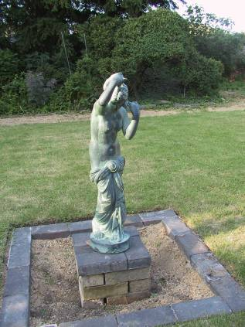
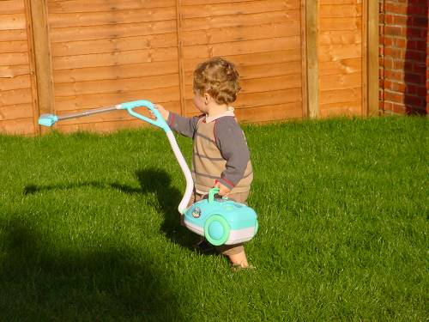
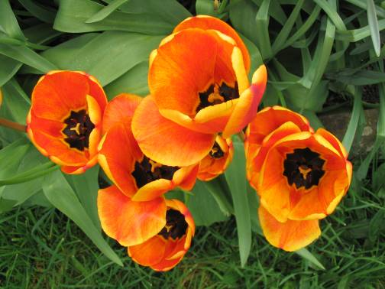
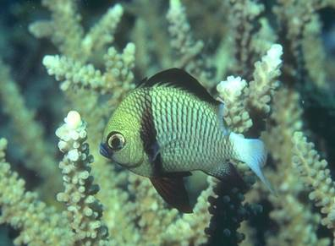
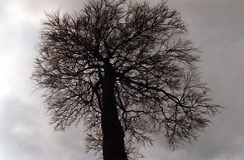
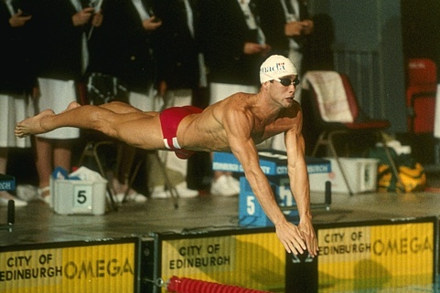
What is easy or hard about these cases for graphcut-based segmentation?

Slide 39
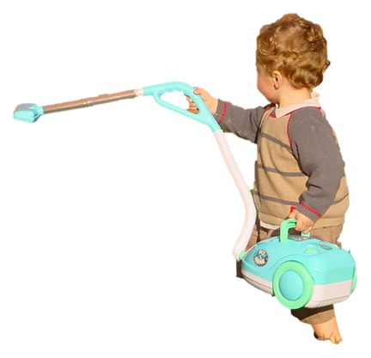
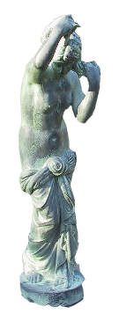
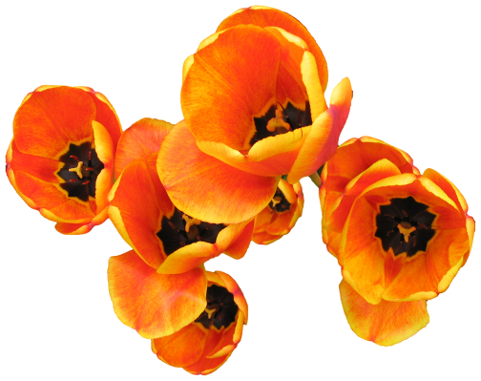
Easier examples
GrabCut – Interactive Foreground Extraction 10
Notes:
Moderately straightforward examples- after the user input automnatically

Slide 40
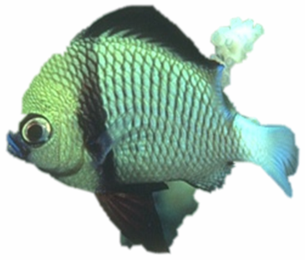
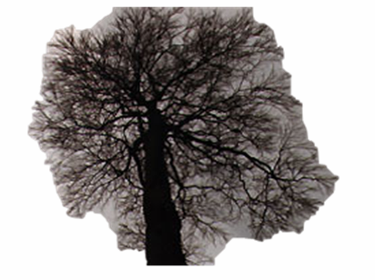
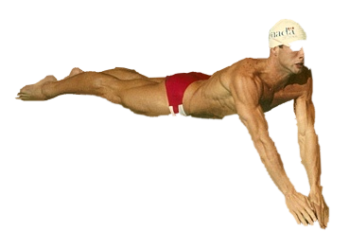
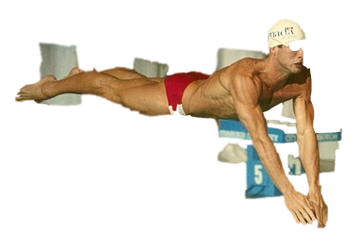
More difficult Examples
Camouflage &
Low Contrast
Fine structure
Harder Case
Initial Rectangle
Initial Result
GrabCut – Interactive Foreground Extraction 11
Notes:
You might wonder when does it fail. 4 cases. Low contrats – an edge not good visible

Slide 41
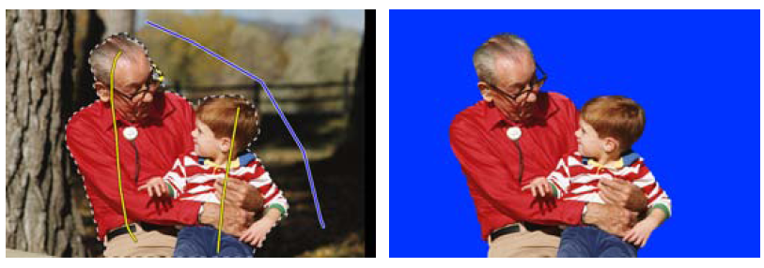
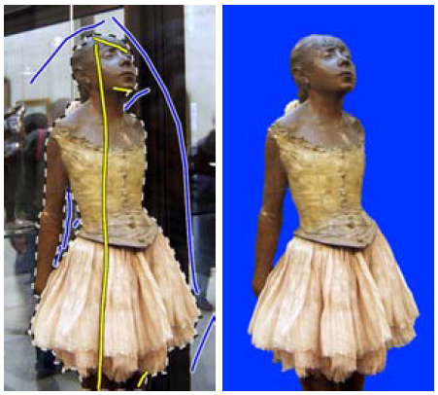
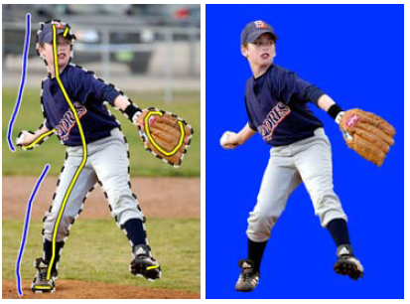
Lazy Snapping (Li et al. SG 2004)

Slide 42
Limitations of Graph Cuts
Requires associative graphs
Connected nodes should prefer to have the same label
Is optimal only for binary problems

Slide 43
Other applications: Seam Carving
Seam Carving – Avidan and Shamir (2007)
Demo: http://swieskowski.net/carve/

Slide 44
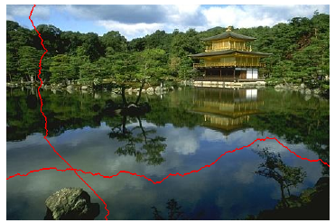
Other applications: Seam Carving
Find shortest path from top to bottom (or left to right), where cost = gradient magnitude
http://www.youtube.com/watch?v=6NcIJXTlugc
Seam Carving – Avidan and Shamir (2007)
Demo: http://swieskowski.net/carve/

Slide 45
Other applications: stitching
Graphcut Textures – Kwatra et al. SIGGRAPH 2003

Slide 46
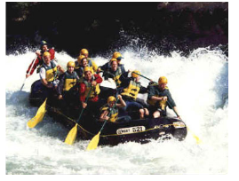
Other applications: stitching
Graphcut Textures – Kwatra et al. SIGGRAPH 2003
+
Ideal boundary:
Similar color in both images
High gradient in both images

Slide 47
Summary of big ideas
Treat image as a graph
Pixels are nodes
Between-pixel edge weights based on gradients
Sometimes per-pixel weights for affinity to foreground/background
Good boundaries are a short path through the graph (Intelligent Scissors, Seam Carving)
Good regions are produced by a low-cost cut (GrabCuts, Graph Cut Stitching)

Slide 48
Take-home questions
09/14/10
1.
Possible factors: albedo, shadows, texture, specularities, curvature, lighting direction
Slides: http://www.cs.illinois.edu/~dhoiem/courses/vision_spring10/lectures/LightandColor.pdf

Slide 49
Take-home questions
09/14/10
2. What would be the result in “Intelligent Scissors” if all of the edge costs were set to 1?
3. Typically, “GrabCut” will not work well on objects with thin structures. How could you change the boundary costs to better segment such objects?

Slide 50
Next class
Discussion of project 1
Texture synthesis and hole-filling

