Slide 1
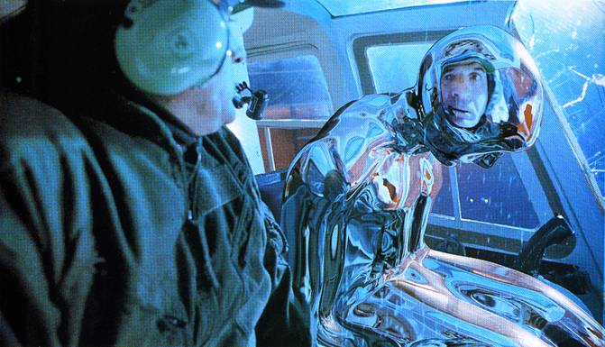
Image-based Lighting (Part 2)
11/18/10
T2
Computational Photography
Derek Hoiem, University of Illinois
Many slides from Debevec, some from Efros

Slide 2
Today
Brief review of last class
Show how to get an HDR image from several LDR images, and how to display HDR
Show how to insert fake objects into real scenes using environment maps

Slide 3
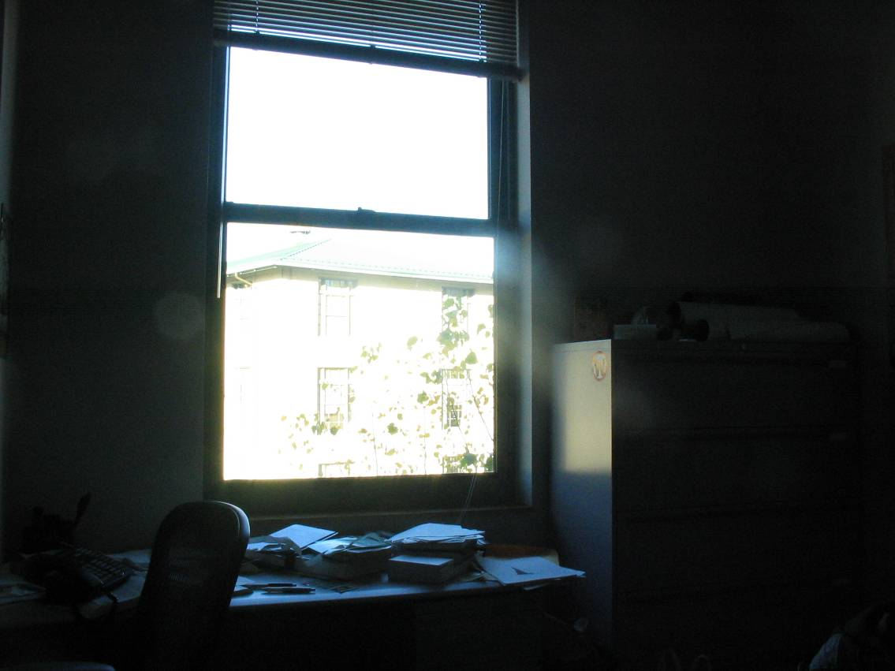
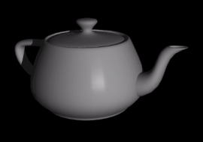
How to render an object inserted into an image?
Notes:
Lighting, no shadows, blending, etc.

Slide 4
How to render an object inserted into an image?
Traditional graphics way
Manually model BRDFs of all room surfaces
Manually model radiance of lights
Do ray tracing to relight object, shadows, etc.
Notes:
Lighting, no shadows, blending, etc.

Slide 5
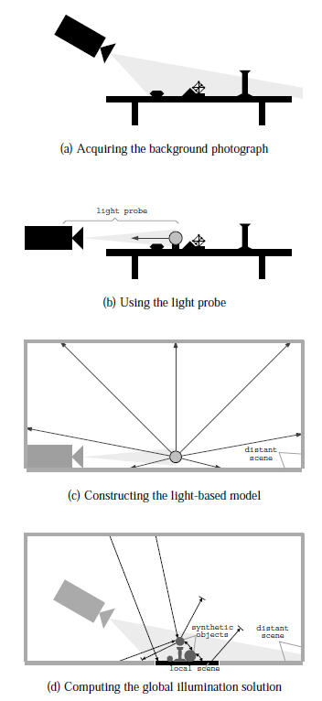
How to render an object inserted into an image?
Image-based lighting
Capture incoming light with a “light probe”
Model local scene
Ray trace, but replace distant scene with info from light probe
Debevec SIGGRAPH 1998

Slide 6


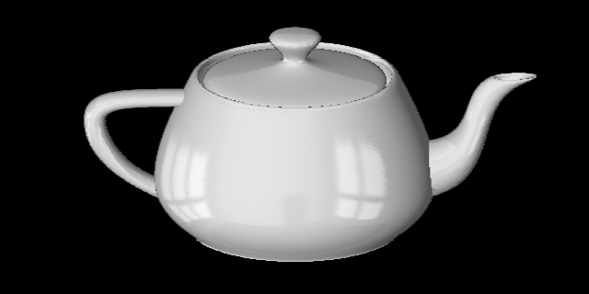
Key ideas for Image-based Lighting
Environment maps: tell what light is entering at each angle within some shell
+

Slide 7
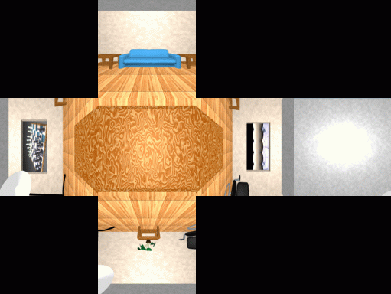
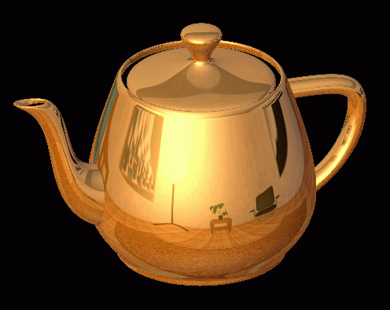
Cubic Map Example

Slide 8
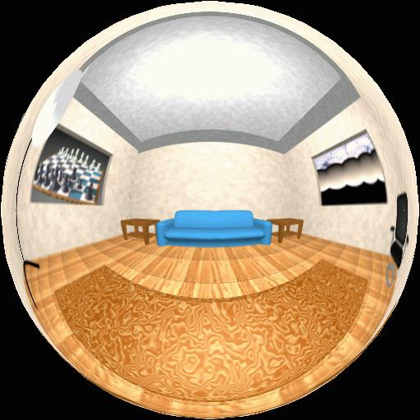
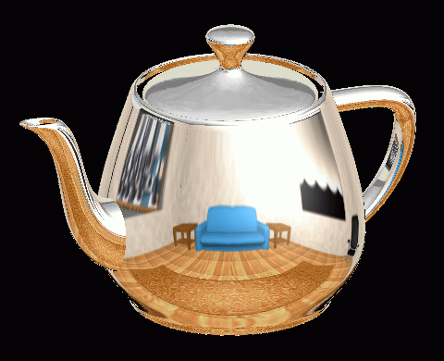
Spherical Map Example

Slide 9
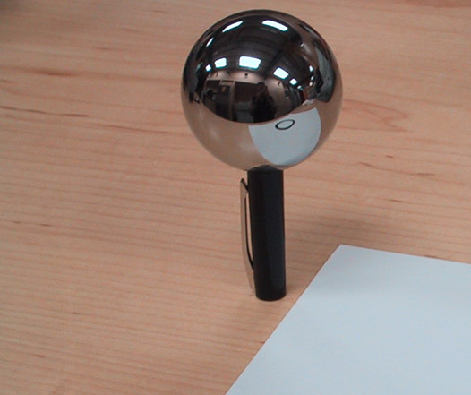
Key ideas for Image-based Lighting
Light probes: a way of capturing environment maps in real scenes

Slide 10
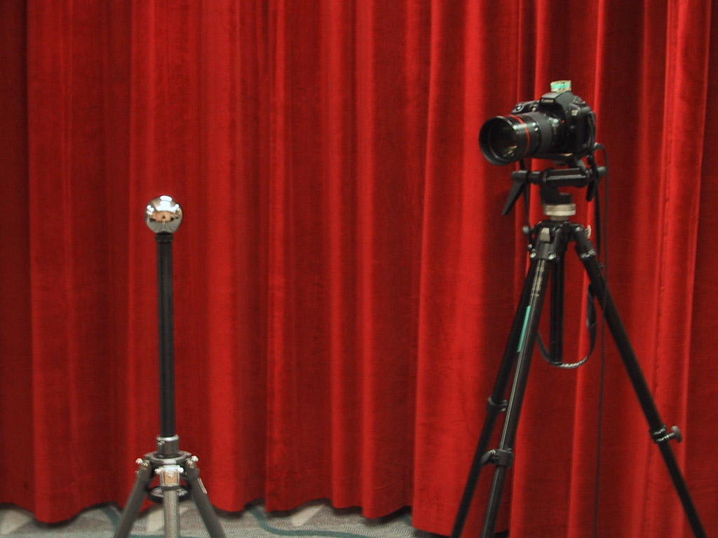
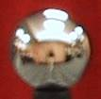
Mirrored Sphere

Slide 11
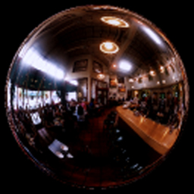
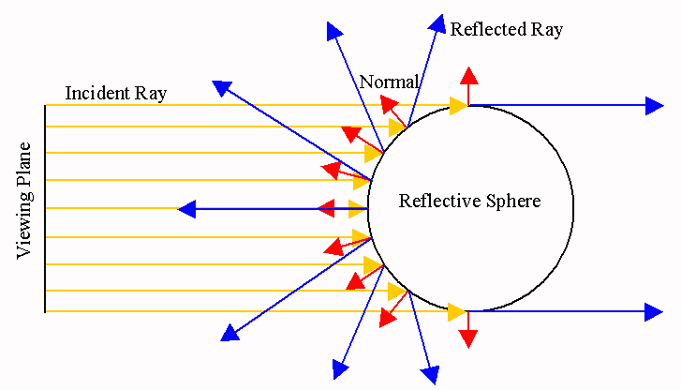

Slide 12
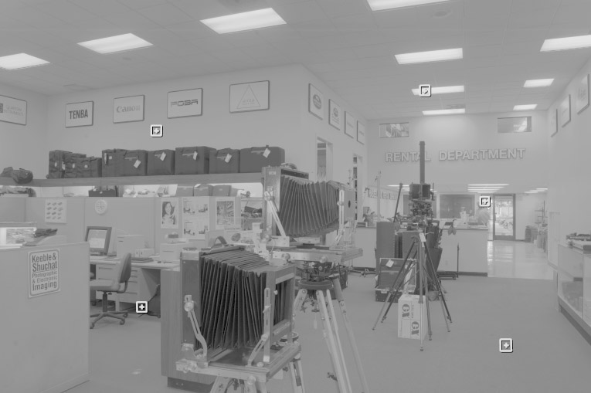
One small snag
How do we deal with light sources? Sun, lights, etc?
  They are much, much brighter than the rest of the environment
Use High Dynamic Range photography!
Relative Brightness
1907
.
46
.
.
15116
1
.
.
18

Slide 13
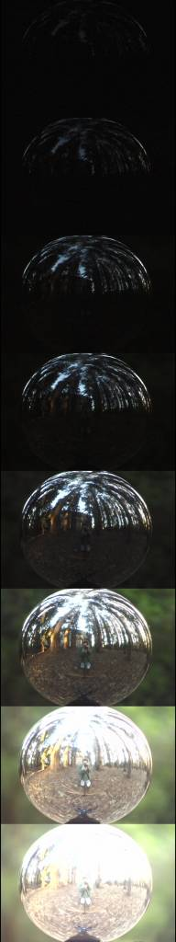
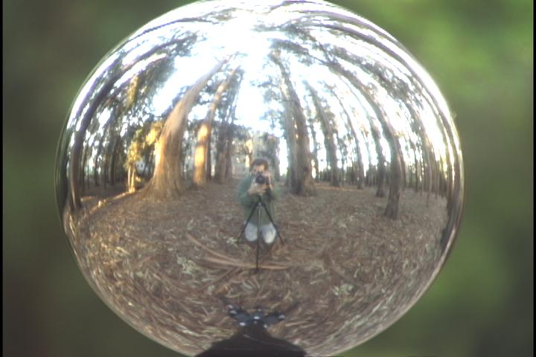
Key ideas for Image-based Lighting
Capturing HDR images: needed so that light probes capture full range of radiance

Slide 14
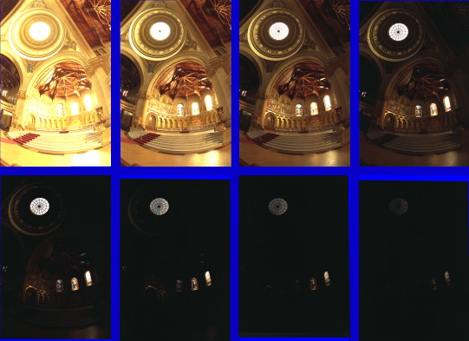
Problem: Dynamic Range

Slide 15
Long Exposure
10⁻⁶
High dynamic range
10⁶
Real world
10⁻⁶
10⁶
Picture
^{0 to 255}

Slide 16
Short Exposure
10⁻⁶
High dynamic range
10⁶
Real world
10⁻⁶
10⁶
Picture
^{0 to 255}

Slide 17
Recovering High Dynamic Range
Radiance Maps from Photographs
Paul Debevec
Jitendra Malik
Computer Science Division
University of California at Berkeley
August 1997
Notes:
1

Slide 18
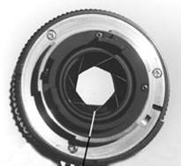
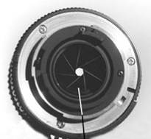
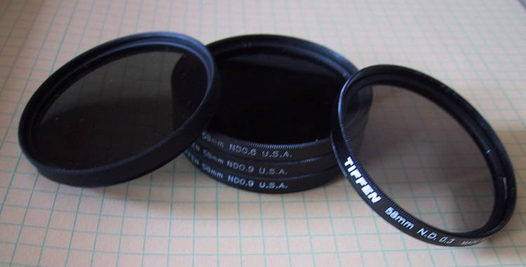
Ways to vary exposure
Shutter Speed (*)
F/stop (aperture, iris)
Neutral Density (ND) Filters

Slide 19
Shutter Speed
Ranges: Canon D30: 30 to 1/4,000 sec.
Sony VX2000: ¼ to 1/10,000 sec.
Pros:
Directly varies the exposure
Usually accurate and repeatable
Issues:
Noise in long exposures

Slide 20
The Approach
Get pixel values Z_{ij} for image with shutter time Δt_{j} (i^{th} pixel location, j^{th} image)
Exposure is radiance integrated over time:
To recover radiance R_{i}, we must map pixel values to log exposure: ln(E_{ij})= g(Z_{ij})
Solve for R, g by minimizing:

Slide 21
The objective
Solve for radiance R and mapping g for each of 255 pixel values to minimize:
give pixels near 0 or 255 less weight
known shutter time for image j
exposure should smoothly increase as pixel intensity increases
radiance at particular pixel site is the same for each image
exposure, as a function of pixel value

Slide 22
The Math
Let g(z) be the discrete inverse response function
For each pixel site i in each image j, want:
Solve the overdetermined linear system:
fitting term
smoothness term
Notes:
g(z) maps the pixel intensity to an exposure

Slide 23
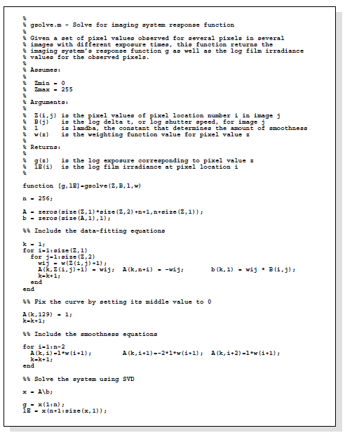
Matlab Code

Slide 24
Matlab Code
function [g,lE]=gsolve(Z,B,l,w)
n = 256;
A = zeros(size(Z,1)*size(Z,2)+n+1,n+size(Z,1));
b = zeros(size(A,1),1);
k = 1; %% Include the data-fitting equations
for i=1:size(Z,1)
for j=1:size(Z,2)
wij = w(Z(i,j)+1);
A(k,Z(i,j)+1) = wij; A(k,n+i) = -wij; b(k,1) = wij * B(i,j);
k=k+1;
end
end
A(k,129) = 1; %% Fix the curve by setting its middle value to 0
k=k+1;
for i=1:n-2 %% Include the smoothness equations
A(k,i)=l*w(i+1); A(k,i+1)=-2*l*w(i+1); A(k,i+2)=l*w(i+1);
k=k+1;
end
x = A\b; %% Solve the system using SVD
g = x(1:n);
lE = x(n+1:size(x,1));

Slide 25
Illustration
Image series
• 1
• 1
• 1
• 1
• 1
• 2
• 2
• 2
• 2
• 2
• 3
• 3
• 3
• 3
• 3
Δt =
1/64 sec
Δt =
1/16 sec
Δt =
1/4 sec
Δt =
1 sec
Δt =
4 sec
Pixel Value Z = f(Exposure)
Exposure = Radiance × Δt
log Exposure = log Radiance + log Δt
Notes:
10

Slide 26
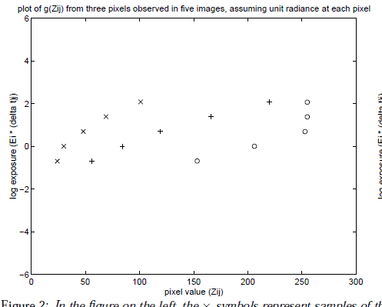
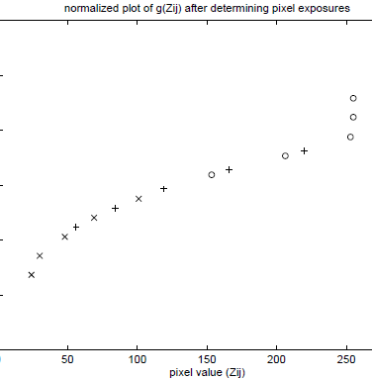
Illustration: Response Curve
ln(exposure)

Slide 27
Response Curve
Assuming unit radiance
for each pixel
After adjusting radiances to obtain a smooth response curve
3
2
Pixel value
Pixel value
1
ln Exposure
ln Exposure

Slide 28
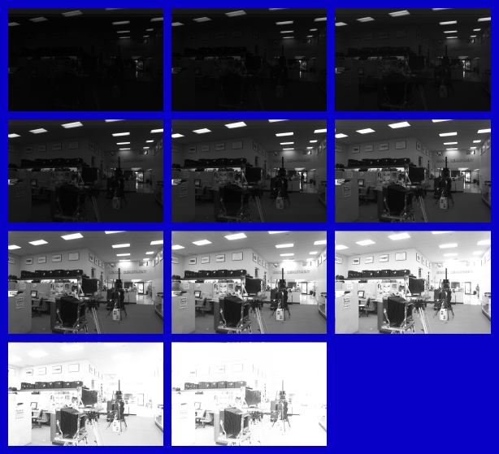
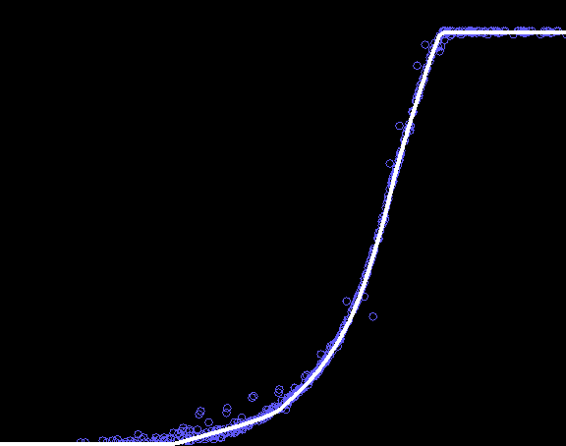
Results: Digital Camera
Kodak DCS460
1/30 to 30 sec
Recovered response curve
Pixel value
log Exposure
Notes:
13

Slide 29
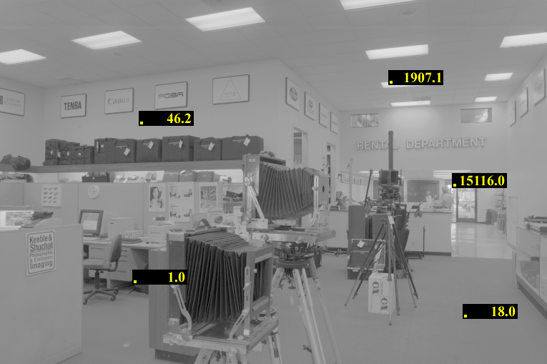
Reconstructed radiance map

Slide 30
Results: Color Film
Kodak Gold ASA 100, PhotoCD
Notes:
14

Slide 31
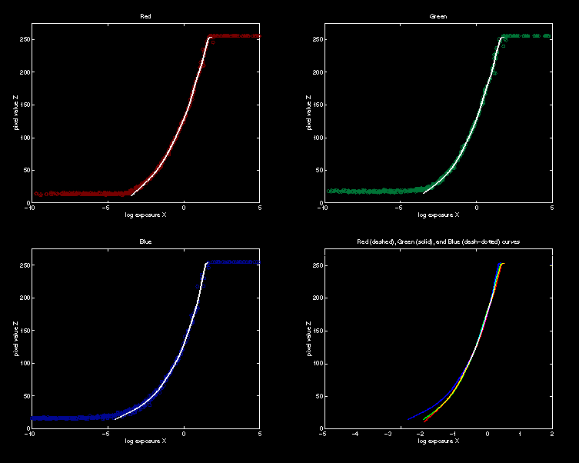
Recovered Response Curves
Red
Green
Blue
RGB
Notes:
15

Slide 32
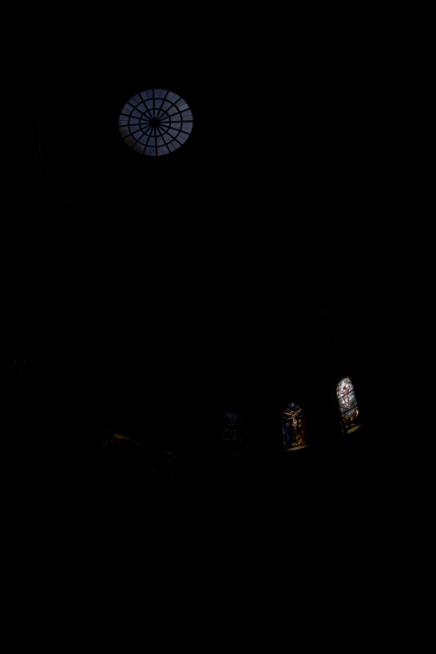
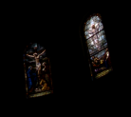
How to display HDR?
Linearly scaled to
display device

Slide 33
Simple Global Operator
Compression curve needs to
  Bring everything within range
  Leave dark areas alone
In other words
  Asymptote at 255
  Derivative of 1 at 0

Slide 34
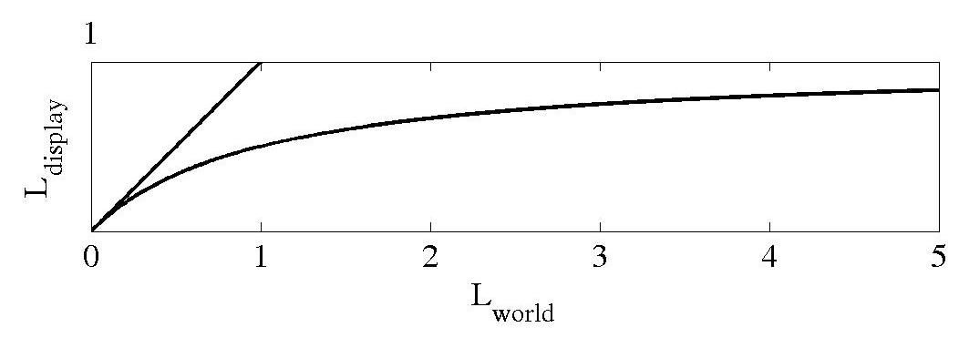
Global Operator (Reinhart et al)

Slide 35
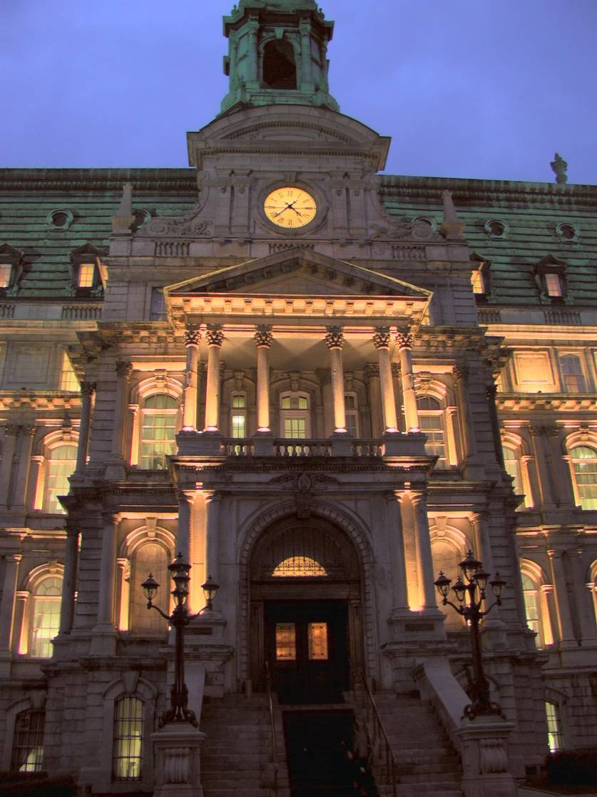
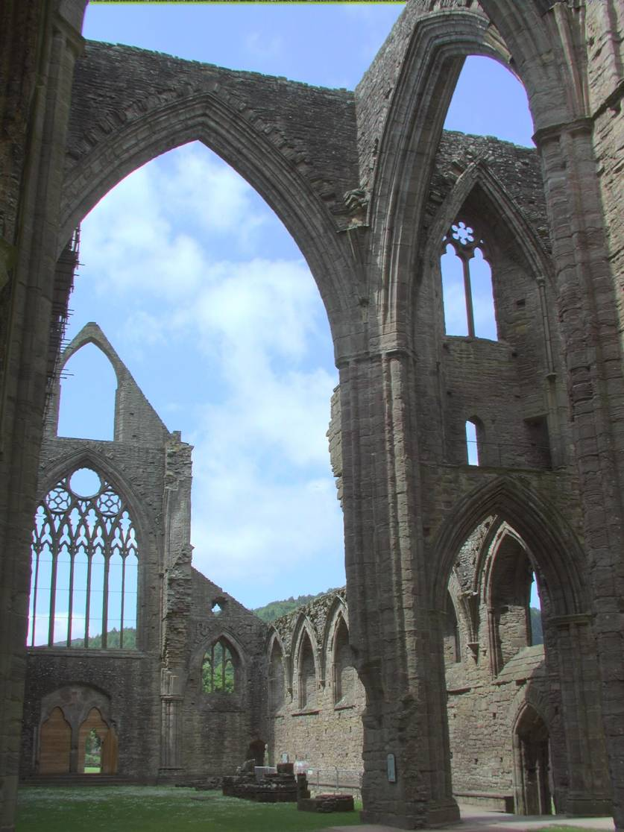
Global Operator Results

Slide 36
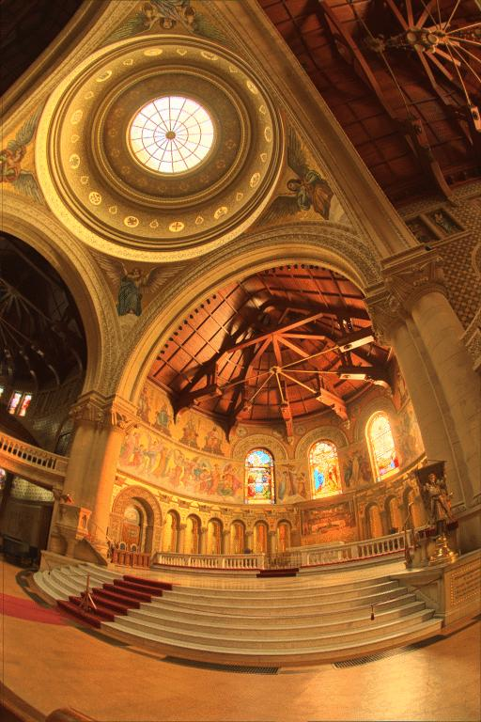
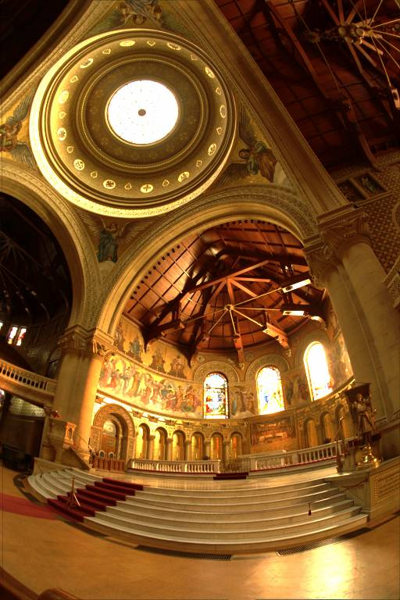
Reinhart Operator
Darkest 0.1% scaled
to display device

Slide 37
What do we see?
Vs.

Slide 38
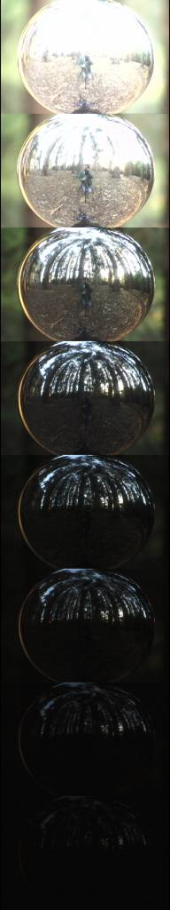
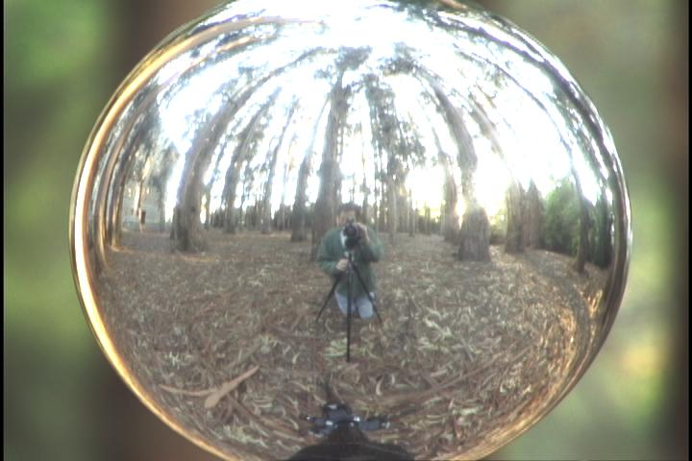
Acquiring the Light Probe

Slide 39
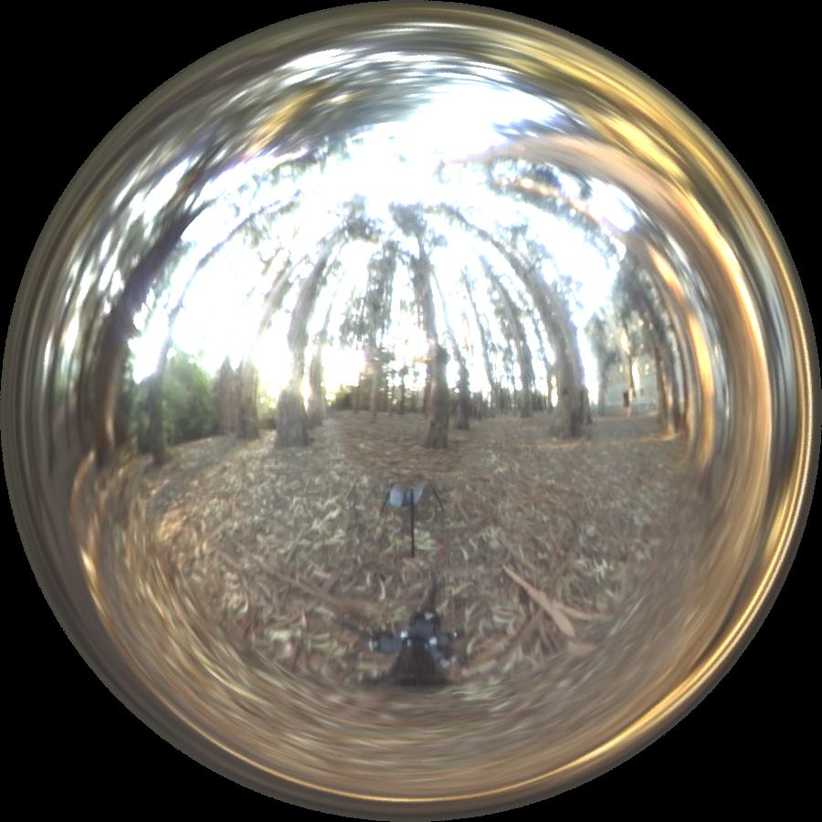
Assembling the Light Probe

Slide 40
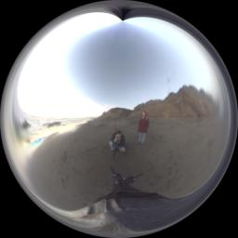
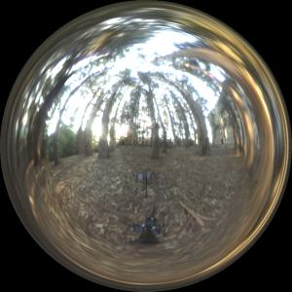
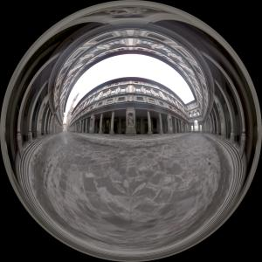
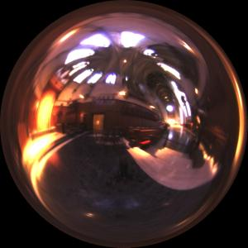
Real-World HDR Lighting Environments
Funston
Beach
Eucalyptus
Grove
Uffizi
Gallery
Grace
Cathedral
Lighting Environments from the Light Probe Image Gallery:
http://www.debevec.org/Probes/

Slide 41
Not just shiny…
We have captured a true radiance map
We can treat it as an extended (e.g spherical) light source
Can use Global Illumination to simulate light transport in the scene
  So, all objects (not just shiny) can be lighted
  What’s the limitation?

Slide 42
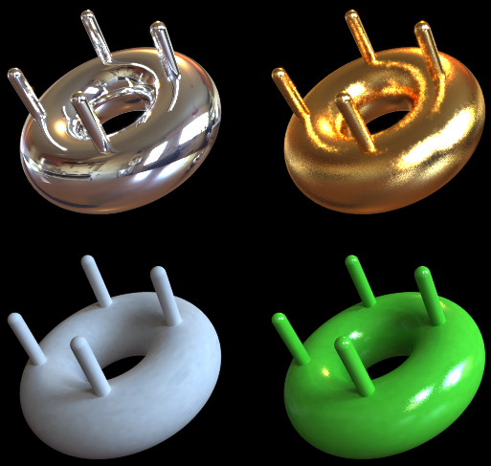
Illumination Results
Rendered with Greg Larson’s RADIANCE
synthetic imaging system
Notes:
HDR is revealed with rough specularities.

Slide 43
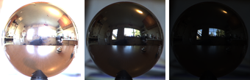
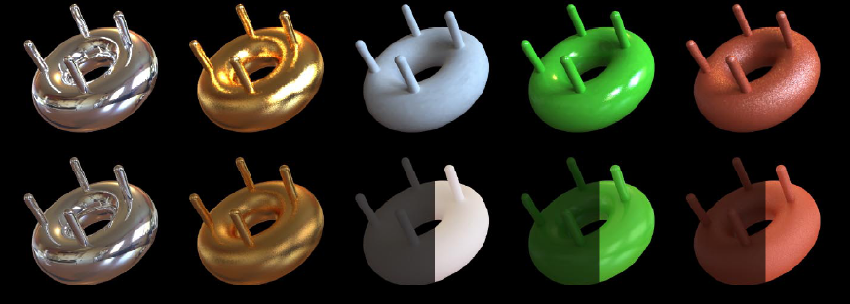
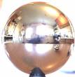
Comparison: Radiance map versus single image
HDR
LDR

Slide 44
Synthetic Objects
+
Real light!

Slide 45
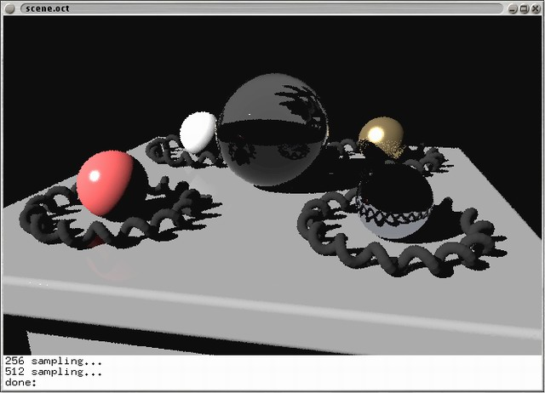
CG Objects Illuminated by a Traditional CG Light Source

Slide 46
Illuminating Objects using Measurements of Real Light
Light
Environment assigned “glow” material property in
Greg Ward’s RADIANCE system.
Object
http://radsite.lbl.gov/radiance/

Slide 47
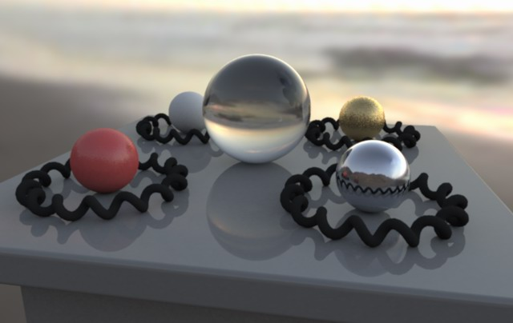
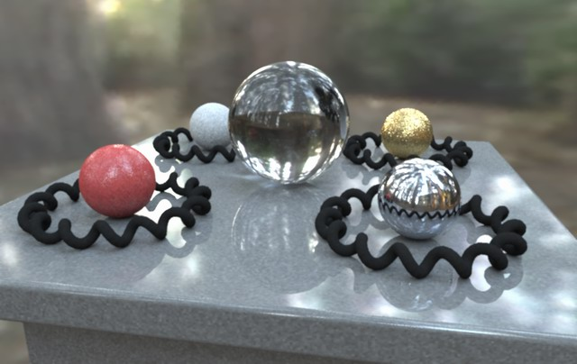
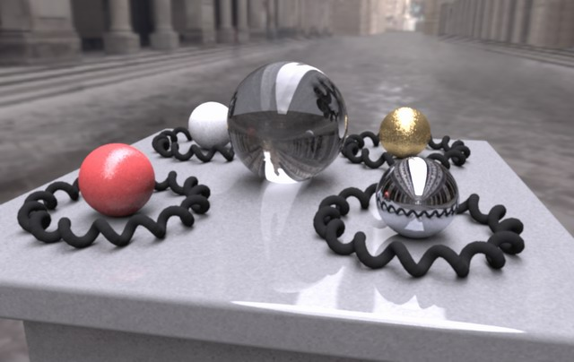

Paul Debevec. A Tutorial on Image-Based Lighting. IEEE Computer Graphics and Applications, Jan/Feb 2002.

Slide 48

Rendering with Natural Light
SIGGRAPH 98 Electronic Theater

Slide 49
Movie
http://www.youtube.com/watch?v=EHBgkeXH9lU

Slide 50

Illuminating a Small Scene

Slide 51


Slide 52
  We can now illuminate
  synthetic objects with real light.
  - Environment map
  - Light probe
  - HDR
  - Ray tracing
How do we add synthetic objects to a
real scene?

Slide 53

Real Scene Example
Goal: place synthetic objects on table

Slide 54
Light Probe / Calibration Grid

Slide 55
Modeling the Scene
light-based model
real scene

Slide 56

The Light-Based Room Model

Slide 57
Modeling the Scene
light-based model
local scene
synthetic objects
real scene

Slide 58
The Lighting Computation
distant scene (light-based, unknown BRDF)
synthetic objects
(known BRDF)
local scene
(estimated BRDF)

Slide 59
Rendering into the Scene
Background Plate

Slide 60

Rendering into the Scene
Objects and Local Scene matched to Scene

Slide 61

Differential Rendering
Local scene w/o objects, illuminated by model

Slide 62

Differential Rendering
Difference in local scene
-
=

Slide 63

Differential Rendering
Final Result

Slide 64
How to render an object inserted into an image?
Image-based lighting
Capture incoming light with a “light probe”
Model local scene
Ray trace, but replace distant scene with info from light probe
Debevec SIGGRAPH 1998

Slide 65

IMAGE-BASED LIGHTING IN FIAT LUX
Paul Debevec, Tim Hawkins, Westley Sarokin, H. P. Duiker, Christine Cheng, Tal Garfinkel, Jenny Huang
SIGGRAPH 99 Electronic Theater

Slide 66
Fiat Lux
http://ict.debevec.org/~debevec/FiatLux/movie/
http://ict.debevec.org/~debevec/FiatLux/technology/

Slide 67


Slide 68






HDR Image Series
2 sec
1/4 sec
1/30 sec
1/250 sec
1/2000 sec
1/8000 sec

Slide 69

Stp1 Panorama

Slide 70

Assembled Panorama

Slide 71



Light Probe Images

Slide 72














Capturing a Spatially-Varying Lighting Environment

Slide 73



What if we don’t have a light probe?
Zoom in on eye
Insert Relit Face
Environment map from eye
http://www1.cs.columbia.edu/CAVE/projects/world_eye/ -- Nishino Nayar 2004

Slide 74


Slide 75

Environment Map from an Eye

Slide 76




Can Tell What You are Looking At
Eye Image:
Computed Retinal Image:

Slide 77





Slide 78

Summary
Real scenes have complex geometries and materials that are difficult to model
We can use an environment map, captured with a light probe, as a replacement for distance lighting
We can get an HDR image by combining bracketed shots
We can relight objects at that position using the environment map

Slide 79
Have a good break!
Next class – computational cameras (really!)

