Slide 1
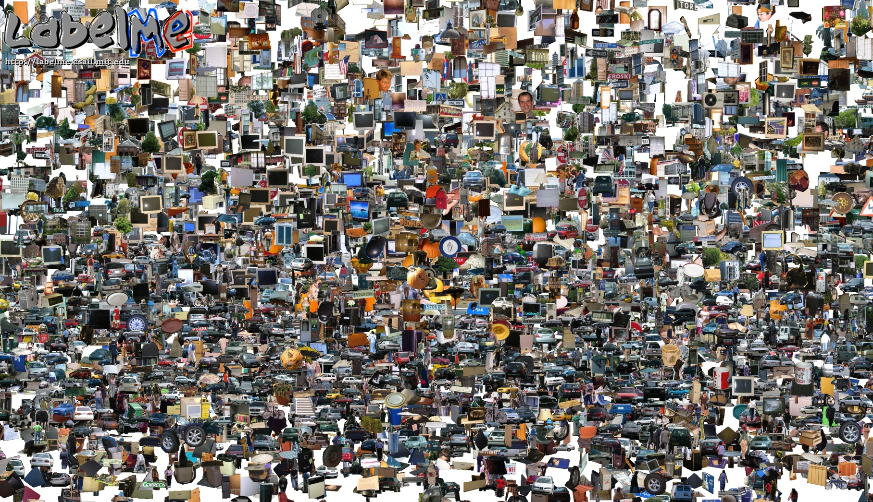
Opportunities of Scale
11/01/12
Computational Photography
Derek Hoiem, University of Illinois
Most slides from Alyosha Efros
Graphic from Antonio Torralba

Slide 2
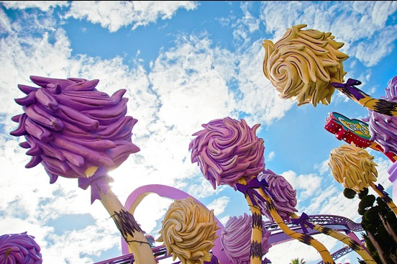
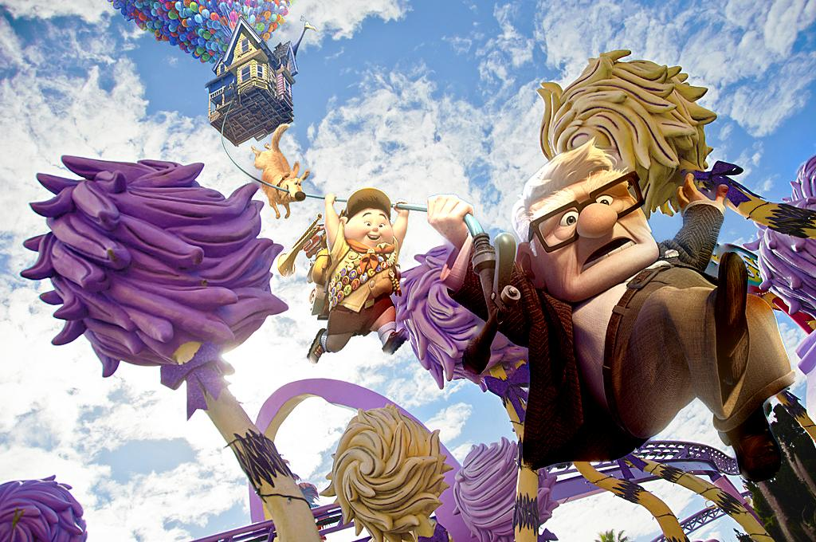
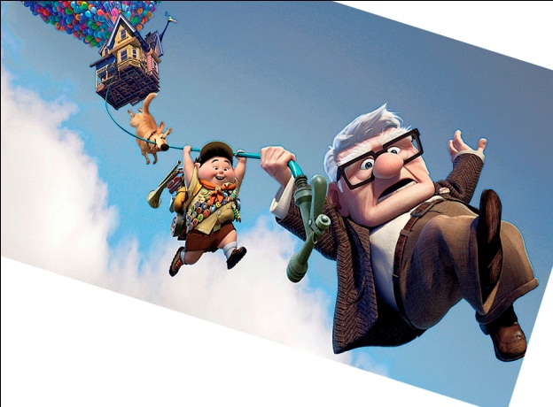
Project 3 Favorites
Favorite Project: Jiqin Wang
  Runners-up: Mike M., Joanne, Abdel
Pixar Result
Poisson

Slide 3
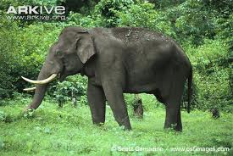
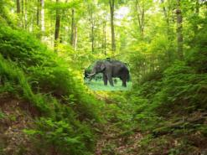
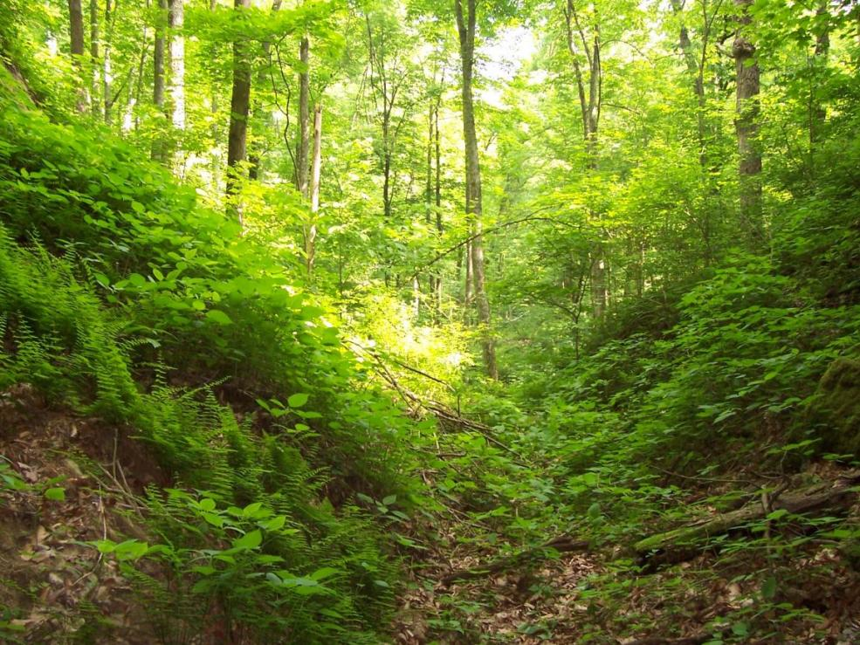
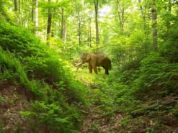
Fave Result: Brian Wang, elephant
direct
Poisson

Slide 4
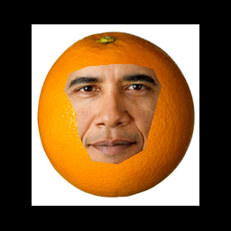
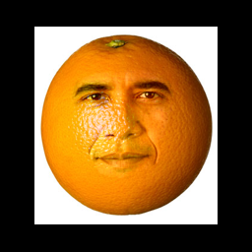
Fave result: Nemo, Orange
Mixed Gradients

Slide 5
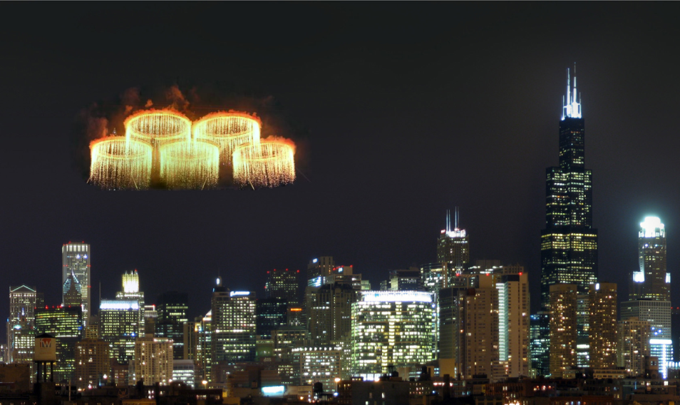
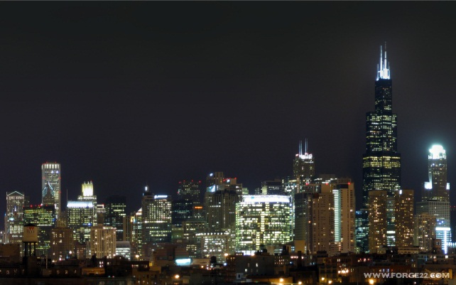
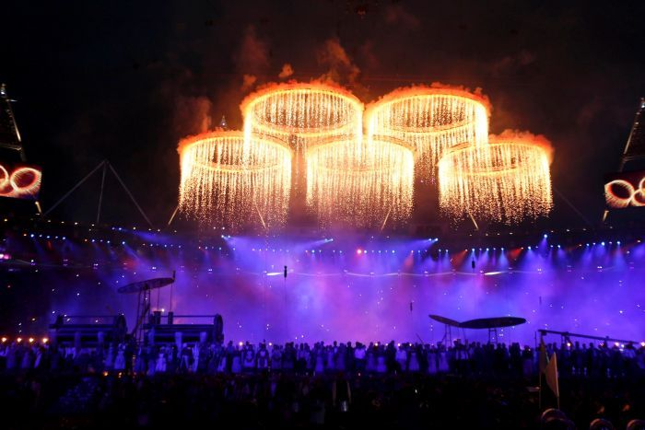
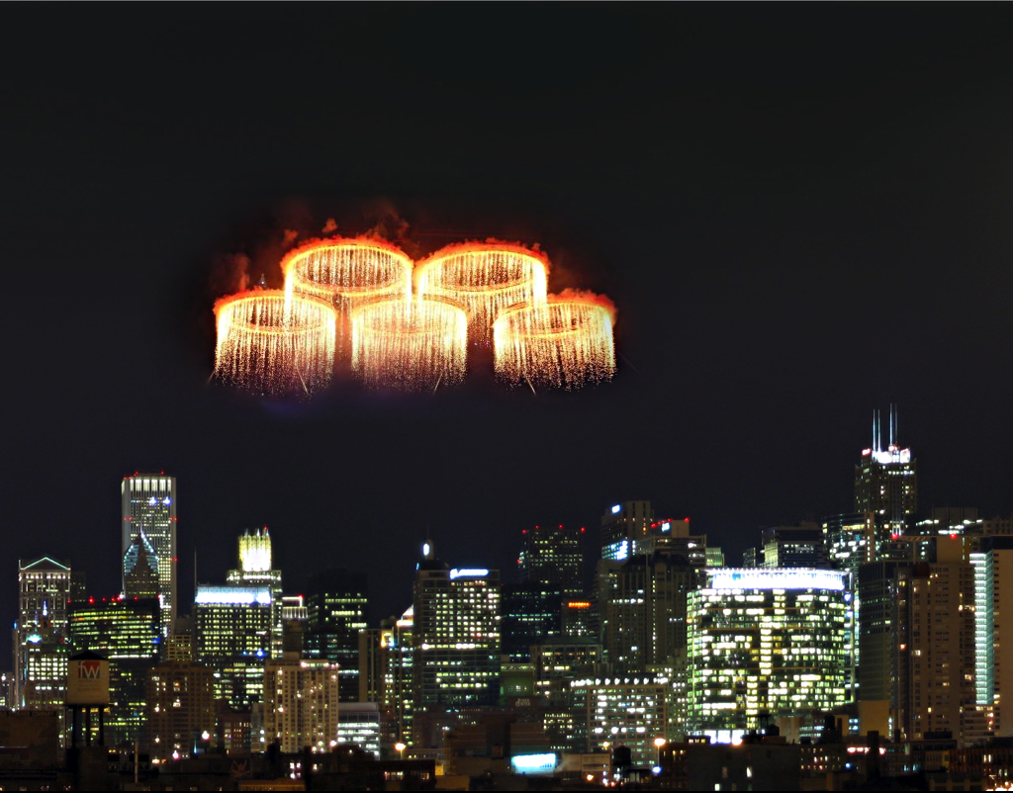
Fave result: Nemo, Fireworks
Poisson
Laplacian Pyramids

Slide 6
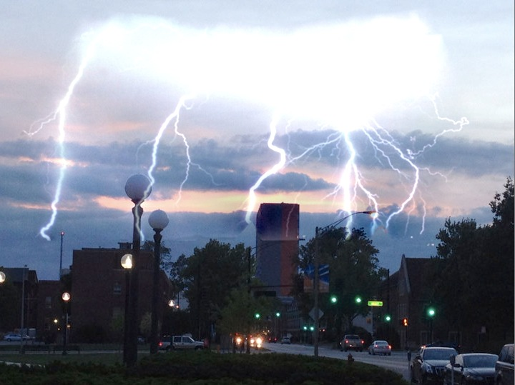
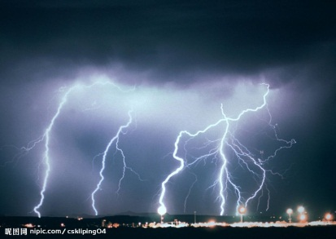
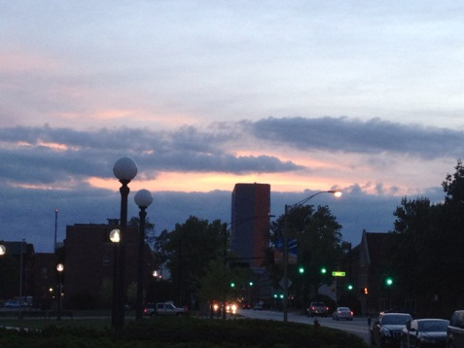
Fave Result: Nan, Lightning on Campus
Mixed Gradient Blending

Slide 7
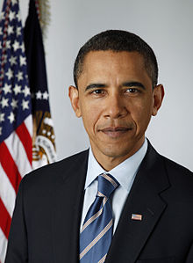


Michael Wlodarz

Slide 8
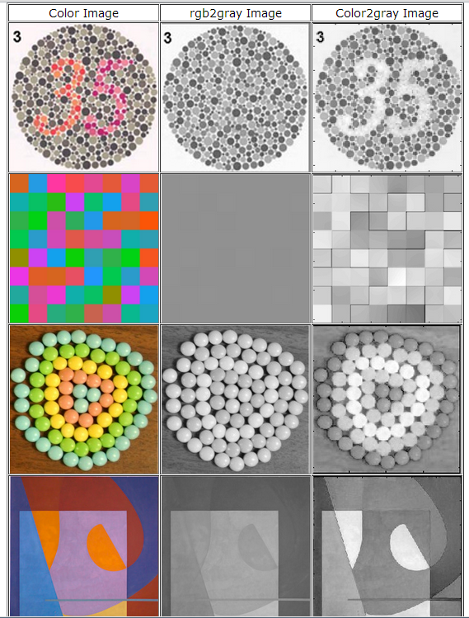
Color2gray by Nan

Slide 9
Today’s class
Opportunities of Scale: Data-driven methods
  Scene completion
  Im2gps
  3D reconstruction
  Colorizing
  Infinite zoom/panorama
  and much more…

Slide 10
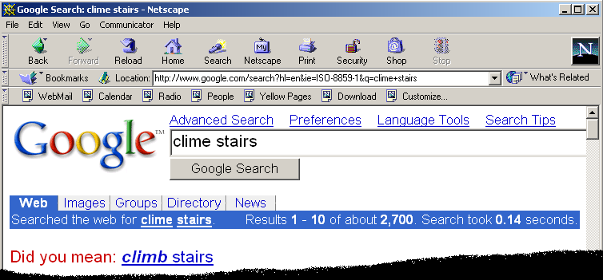
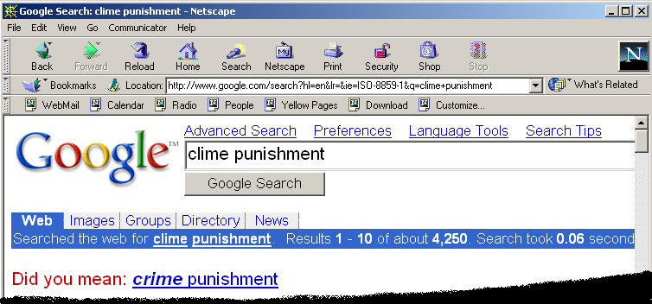
Google and massive data-driven algorithms
A.I. for the postmodern world:
  all questions have already been answered…many times, in many ways
  Google is dumb, the “intelligence” is in the data

Slide 11
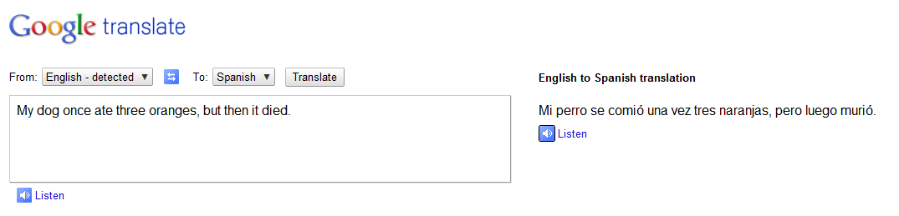
Google Translate

Slide 12
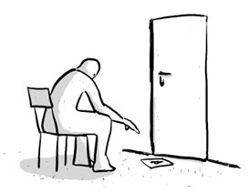
Chinese Room
John Searle (1980)

Slide 13
Image Completion Example
[Hays and Efros. Scene Completion Using Millions of Photographs. SIGGRAPH 2007 and CACM October 2008.]

Slide 14
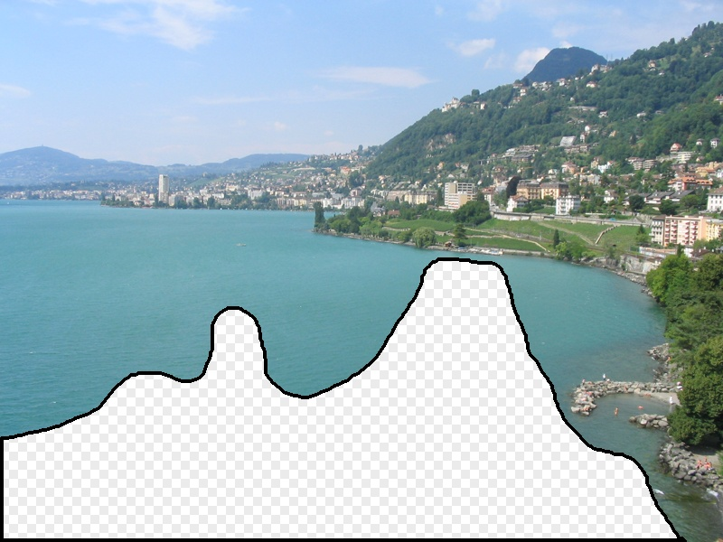
What should the missing region contain?
Notes:
14
What should go here and why?

Slide 15
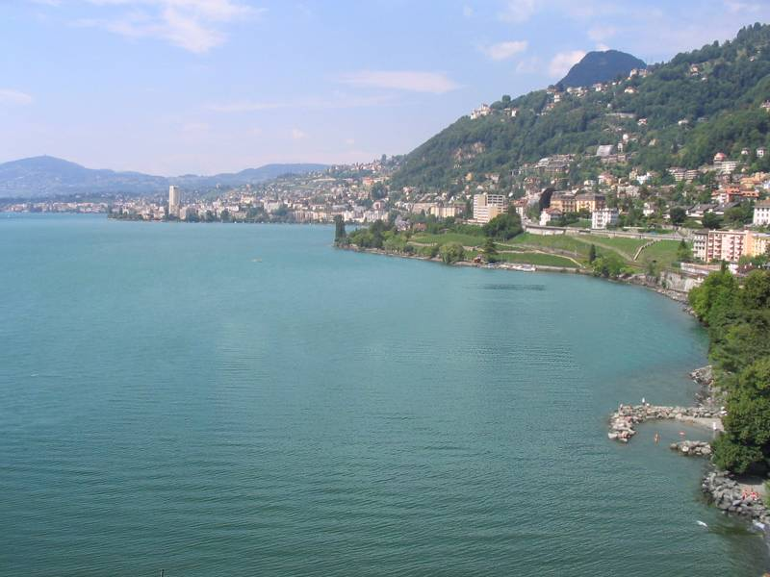

Slide 16
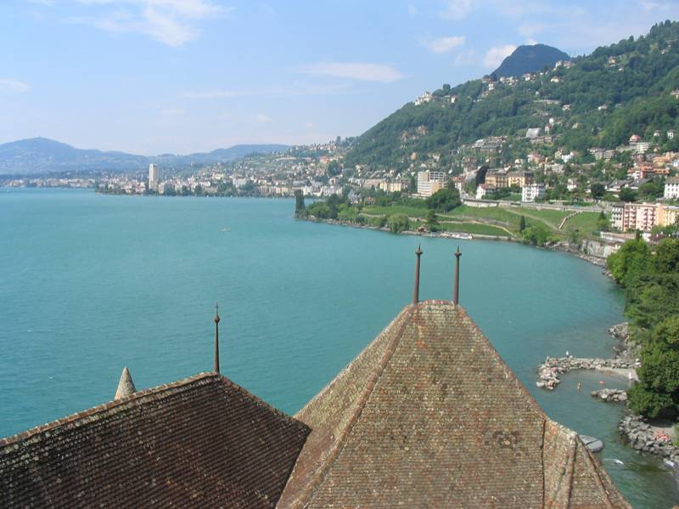
Notes:
16
Introduce gist.

Slide 17
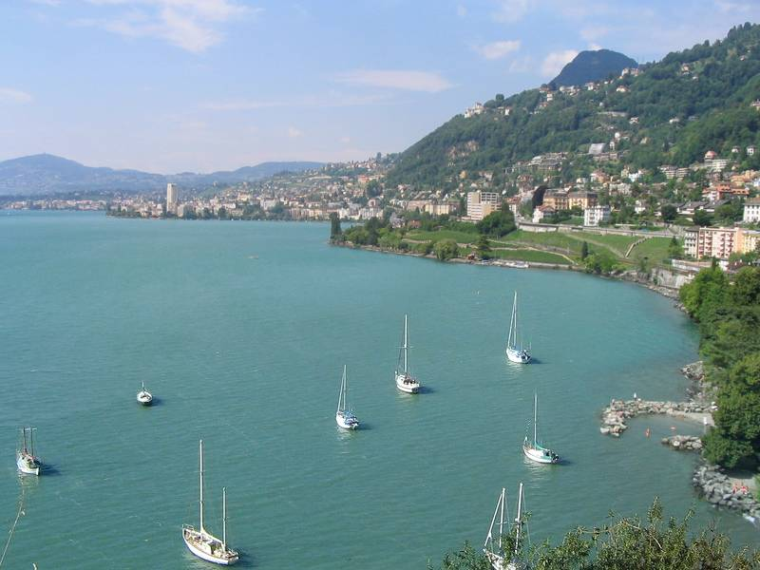

Slide 18
Which is the original?
(a)
(c)
(b)

Slide 19
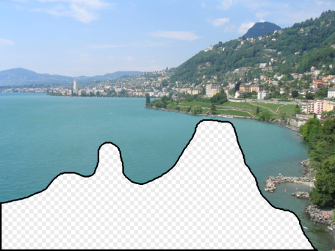
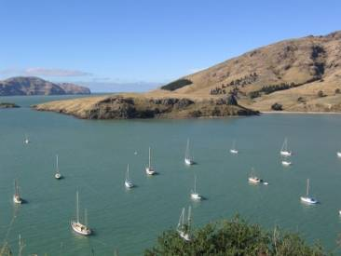
How it works
Find a similar image from a large dataset
Blend a region from that image into the hole
Dataset

Slide 20
General Principal
Huge Dataset
Images
image
matching
Info from Most Similar Images
Input Image
Associated Info
Trick: If you have enough images, the dataset will contain very similar images that you can find with simple matching methods.

Slide 21
How many images is enough?

Slide 22
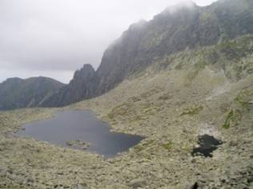
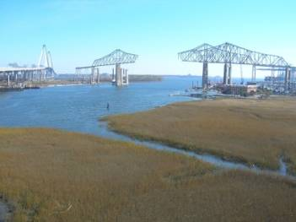
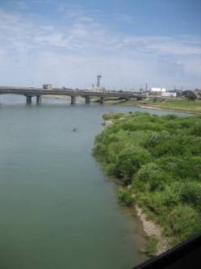
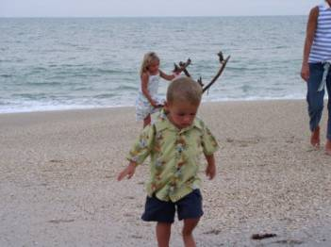
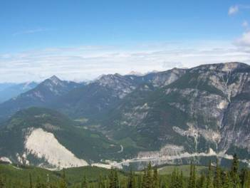
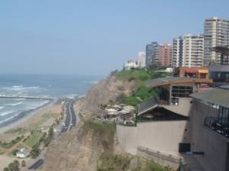
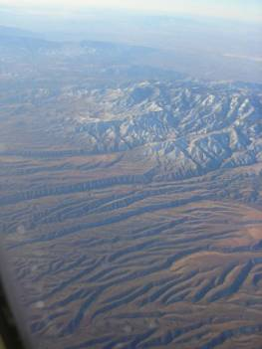
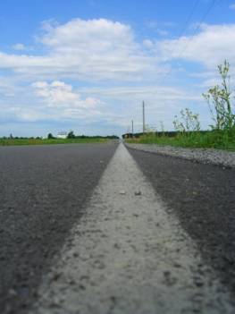
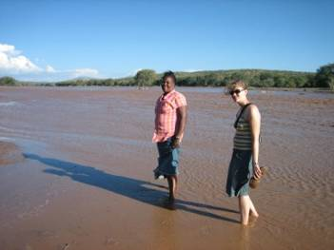
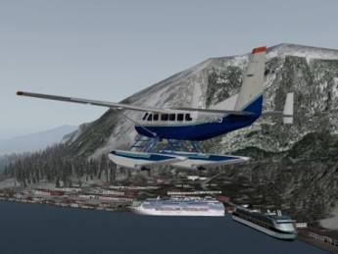
Nearest neighbors from a
collection of 20 thousand images
Notes:
22

Slide 23
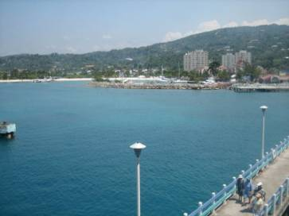
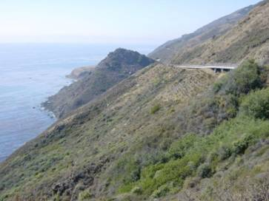
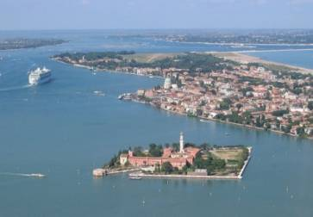
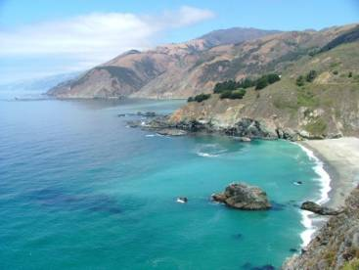

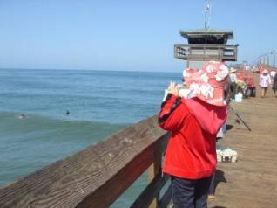
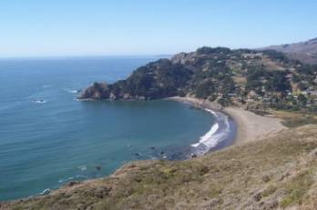
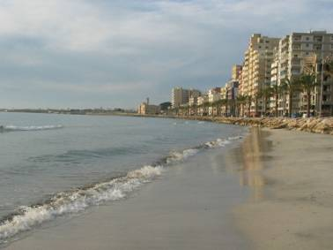
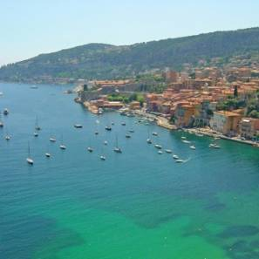
Nearest neighbors from a
collection of 2 million images
Notes:
23

Slide 24
Image Data on the Internet
Flickr (as of Sept. 19th, 2010)
  5 billion photographs
  100+ million geotagged images
Imageshack (as of 2009)
  20 billion
Facebook (as of 2009)
  15 billion
http://royal.pingdom.com/2010/01/22/internet-2009-in-numbers/

Slide 25
Image completion: how it works
[Hays and Efros. Scene Completion Using Millions of Photographs. SIGGRAPH 2007 and CACM October 2008.]

Slide 26
The Algorithm
Notes:
26
Introduce gist.

Slide 27
Scene Matching
Notes:
27
Introduce gist.

Slide 28
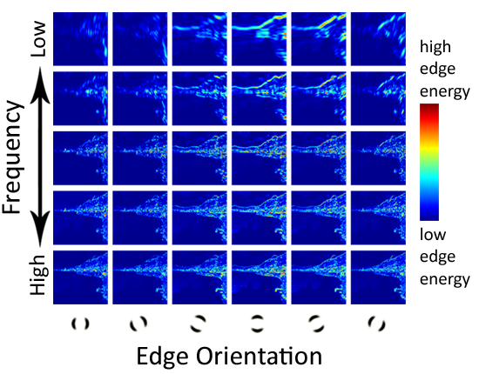
Scene Descriptor
Notes:
Edge energy is just the magnitude of directional derivatives of image intensity.
28

Slide 29
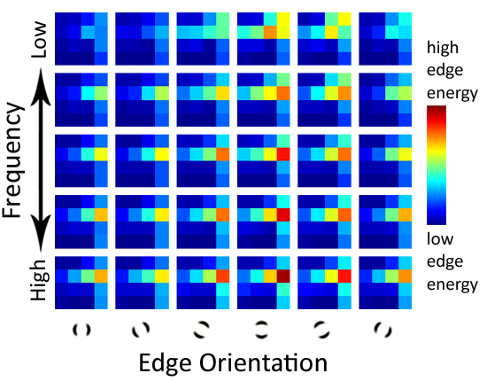
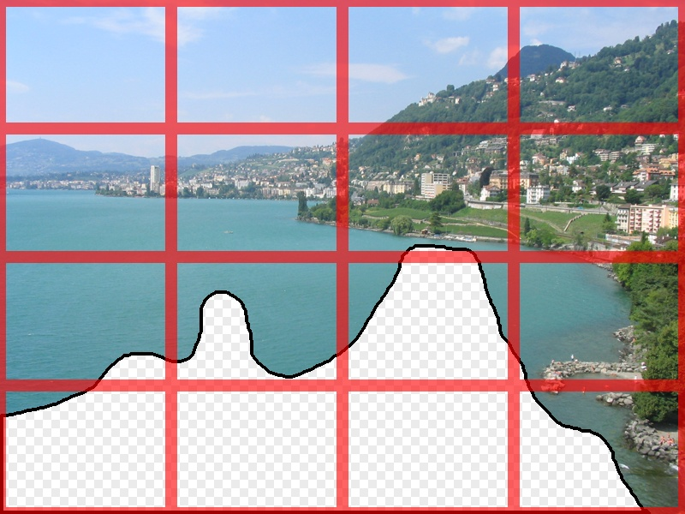
Scene Descriptor
Scene Gist Descriptor
(Oliva and Torralba 2001)

Slide 30

Scene Descriptor
+
Scene Gist Descriptor
(Oliva and Torralba 2001)

Slide 31

2 Million Flickr Images
Notes:
31
Now we take our gist (and mask and color image) and find it’s L2 nearest neighbors in the database of 2.3 million images, and here they are

Slide 32


… 200 total
Notes:
32

Slide 33


Context Matching

Slide 34


Graph cut + Poisson blending

Slide 35





Result Ranking
We assign each of the 200 results a score which is the sum of:
The scene matching distance
The context matching distance
(color + texture)
The graph cut cost
Notes:
35
Johnson et al. used the graph cut cost to sort results for users in Semantic Photo Synthesis

Slide 37


Slide 38


Slide 40

Notes:
40

Slide 41

Notes:
41

Slide 42

Notes:
42

Slide 43


… 200 scene matches
Notes:
43

Slide 44

Notes:
44
Not actually the same scene, even though they’re startlingly similar

Slide 46


Slide 47


Slide 48


Slide 49


Which is the original?

Slide 50


Slide 51

Notes:
51

Slide 52

Notes:
52
Can justify broader use of image completion here

Slide 53

Diffusion Result
Notes:
53

Slide 54

Efros and Leung result
Notes:
54
Efros and leung result

Slide 55
Notes:
55
We don’t want to manually specify any semantics- contours or region labels.
We want to try and get our semantics (and our data) from other images
What semantics? This should be road, the building stops here, the vanishing point is in that direction.

Slide 56



Scene Matching for Image Completion
Notes:
56
How does a human do it? Interesting point – we don’t use labels.
We don’t want to manually specify any semantics- contours or region labels.
We want to try and get our semantics (and our data) from other images
What semantics? This should be road, the building stops here, the vanishing point is in that direction.
But can you find such a close match? That is the biggest question, and we certainly didn’t know the answer when we set out.
------
We’re going to try and find a similar scene and steal content from it
But this doesn’t answer any questions yet. Is scene matching good enough?
How big is the space of images?
Can we really expect to find a match that’s good enough for a generic image?

Slide 57

Scene Completion Result

Slide 58
Other uses of lots of data

Slide 59

im2gps (Hays & Efros, CVPR 2008)
6 million geo-tagged Flickr images

Slide 60

How much can an image tell about its geographic location?

Slide 61


Slide 62


Slide 63

Im2gps

Slide 64

Example Scene Matches

Slide 65

Voting Scheme
Notes:
Probability map for that same image
Explain the green circles and how they relate to evaluation
65

Slide 66

im2gps

Slide 67


Slide 68


Slide 69

Population density ranking

Slide 70

Where is This?
[Olga Vesselova, Vangelis Kalogerakis, Aaron Hertzmann, James Hays, Alexei A. Efros. Image Sequence Geolocation. ICCV’09]
Notes:
70

Slide 71

Where is This?

Slide 72

Where are These?
15:14,
June 18th, 2006
16:31,
June 18th, 2006
Notes:
Individually each photograph is 16%, but together they reinforce each other well
72

Slide 73

Where are These?
15:14,
June 18th, 2006
16:31,
June 18th, 2006
17:24,
June 19th, 2006
Notes:
If you know that brits love to vacation in greece…
73

Slide 74
Results
im2gps – 10% (geo-loc within 400 km)
temporal im2gps – 56%

Slide 75



3D Reconstruction from Flickr
Create detailed 3D scenes from thousands of consumer photographs
Challenges include variations in season, lighting, occluding objects, etc.

Slide 76


3D Reconstruction from Flickr: How it works
Download ~10,000 images, convert to grayscale, compute SIFT++ keypoints
Match images
  Get similar images with vocabulary tree (like in recognition from last class)
  Match keypoints across similar images and perform geometric verification with RANSAC (similar to photo stitching)
Form a graph of matched images
3D Reconstruction by triangulating points, bundle adjustment

Slide 77
Large-scale 3D Reconstruction
Useful references
Dense reconstruction: “Towards Internet-scale Multi-view Stereo”, Furukawa et al., CVPR 2010 http://grail.cs.washington.edu/software/cmvs/
Sparse reconstruction: “Building Rome in a Day”, Goesler et al., ICCV 2009 http://grail.cs.washington.edu/projects/rome/
Code: Bundler Software

Slide 78




Photo Clip Art [SG’07]
Inserting a single object -- still very hard!
object size, orientation
scene illumination
Lalonde et al, SIGGRAPH 2007

Slide 79


Photo Clip Art [SG’07]
Use database to find well-fitting object
Lalonde et al, SIGGRAPH 2007
Notes:
Instead of trying to solve this impossibly hard problem, we observe that object insertion becomes much easier if we have a database of objects, and we try to insert AN object instead of THIS object. One major contribution of this work is to pose the problem of image compositing in a data-driven way: instead of creating new appearance, query a large database. It’s a bit like visual google for compositing.

Slide 80
CG2Real
CG2Real: Improving the Realism of Computer Generated Images using a Large Collection of Photographs, Johnson, Dale, Avidan, Pfister, Freeman, Matusik, Tech. Rep. MIT-CSAIL-TR-2009-034

Slide 81
Image Restoration using Online Photo Collections [ICCV’09]
Dale, Johnson, Sunkavalli, Matusik, Pfister, ICCV’09

Slide 82

Tour from a single image
Scene matching with camera transformations

Slide 83





Tour from a single image
Navigate the virtual space using intuitive motion controls

Slide 84
Video
http://www.youtube.com/watch?v=E0rboU10rPo

Slide 85

Tiny Images
80 million tiny images: a large dataset for non-parametric object and scene recognition Antonio Torralba, Rob Fergus and William T. Freeman. PAMI 2008.
http://groups.csail.mit.edu/vision/TinyImages/

Slide 86


Slide 87

Human Scene Recognition

Slide 88





Powers of 10
Number of images on my hard drive: 10⁴
Number of images seen during my first 10 years: 10⁸
(3 images/second * 60 * 60 * 16 * 365 * 10 = 630720000)
Number of images seen by all humanity: 10²⁰
106,456,367,669 humans¹ * 60 years * 3 images/second * 60 * 60 * 16 * 365 =
1 from http://www.prb.org/Articles/2002/HowManyPeopleHaveEverLivedonEarth.aspx
Number of photons in the universe: 10⁸⁸
Number of all 32x32 images: 10⁷³⁷³
256 ^{32*32*3} ~ 10⁷³⁷³
Notes:
so don’t listen to anyone claiming to brute force image space
But most of image space is empty, never observed

Slide 89



Scenes are unique
Notes:
Scene and object recognition at human performance is very hard because we are able to deal with so many different kinds of scenes…
Scenes are so unique.

Slide 90









But not all scenes are so original
Notes:
But most scenes are not really like that. Most of the time, scenes are boring places in which nothing really surprising happens. For instance, this street… there is nothing really special about it. In fact, I can easily find thousands of other street pictures that look just like this. Of course, these scenes are different in the details, just as two faces are different, but at a coarser level they are form by similar objects arranged in a similar spatial configuration.

Slide 91
Lots
Of
Images
A. Torralba, R. Fergus, W.T.Freeman. PAMI 2008

Slide 92
Lots
Of
Images
A. Torralba, R. Fergus, W.T.Freeman. PAMI 2008

Slide 93
Lots
Of
Images

Slide 94






Automatic Colorization
Input
Color Transfer
Color Transfer
Matches (gray)
Matches (w/ color)
Avg Color of Match

Slide 95






Automatic Colorization
Input
Color Transfer
Color Transfer
Matches (gray)
Matches (w/ color)
Avg Color of Match

Slide 96

Automatic Orientation Examples
A. Torralba, R. Fergus, W.T.Freeman. 2008
Notes:
Images change size as rotated
96

Slide 97
Summary
Many questions have been asked before, photos have been taken before
Sometimes, we can shortcut hard problems by looking up the answer

Slide 98
Next week
Mon: project due
Tues: midterm review
Thurs: midterm exam

