Slide 1
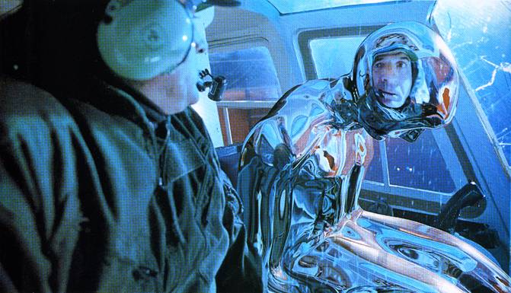
Image-based Lighting
11/15/11
T2
Computational Photography
Derek Hoiem, University of Illinois
Many slides from Debevec, some from Efros

Slide 2
Next two classes
Today
Reminder on final project
Go over some exam questions
Start on ray tracing, environment maps, and relighting 3D objects
Thursday
More HDR, light probes, etc.

Slide 3
Project 5 questions?

Slide 4
Final Projects
To do (11/28 or sooner): Send me an e-mail with ~50 word summary of your project idea
Project page write-up due on Dec 8 (11:59pm)
Similar to other projects, but with some more detail on how to do it
Can be in html or pdf
Store at url below or include a link from there http://<username>.projects.cs.illinois.edu/cs498dwh/final/
Class presentations on Dec 9 (1:30-4:30pm)
~5 minutes per presentation
Project Grade
10%: project proposal (full credit if on time, complete)
70%: completion and ambition of project
10%: clarity, completeness, extent of results
10%: class presentation
No free late days
Details here: http://www.cs.illinois.edu/class/fa11/cs498dh/projects/Details%20for%20Final%20Projects.pdf

Slide 5
Exam questions

Slide 6
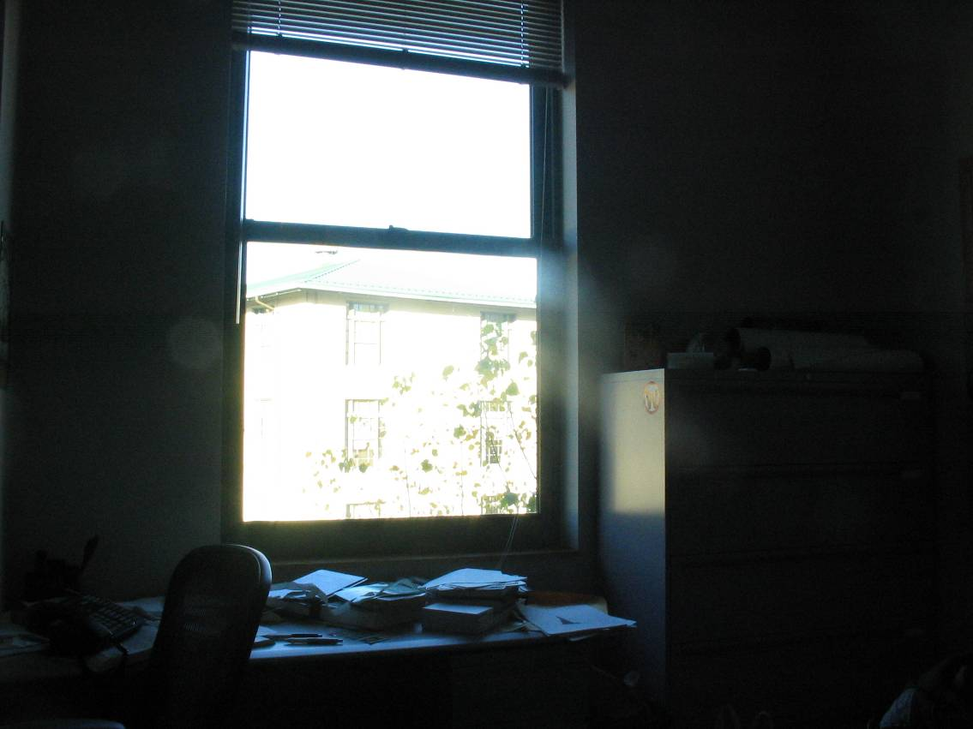
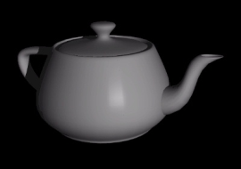
How to render an object inserted into an image?
What’s wrong with the teapot?
Notes:
Lighting, no shadows, blending, etc.

Slide 7
How to render an object inserted into an image?
Traditional graphics way
Manually model BRDFs of all room surfaces
Manually model radiance of lights
Do ray tracing to relight object, shadows, etc.
Notes:
Lighting, no shadows, blending, etc.

Slide 8
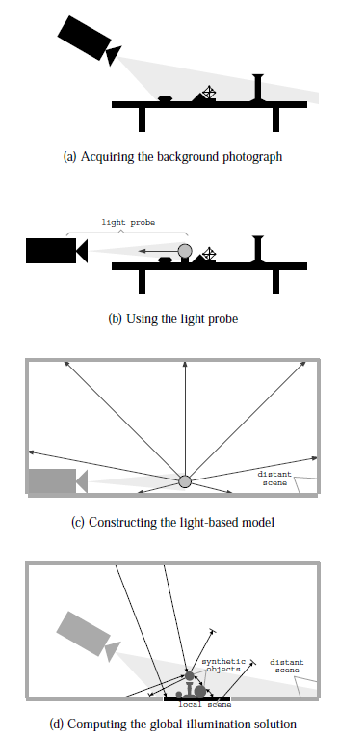
How to render an object inserted into an image?
Image-based lighting
Capture incoming light with a “light probe”
Model local scene
Ray trace, but replace distant scene with info from light probe
Debevec SIGGRAPH 1998

Slide 9
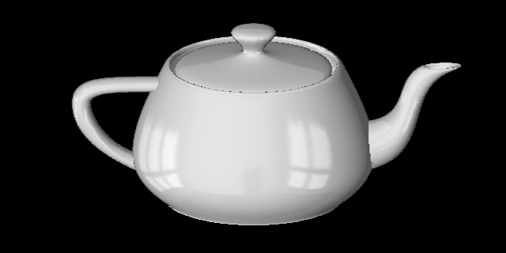
Key ideas for Image-based Lighting
Environment maps: tell what light is entering at each angle within some shell
+

Slide 10
Key ideas for Image-based Lighting
Light probes: a way of capturing environment maps in real scenes

Slide 11
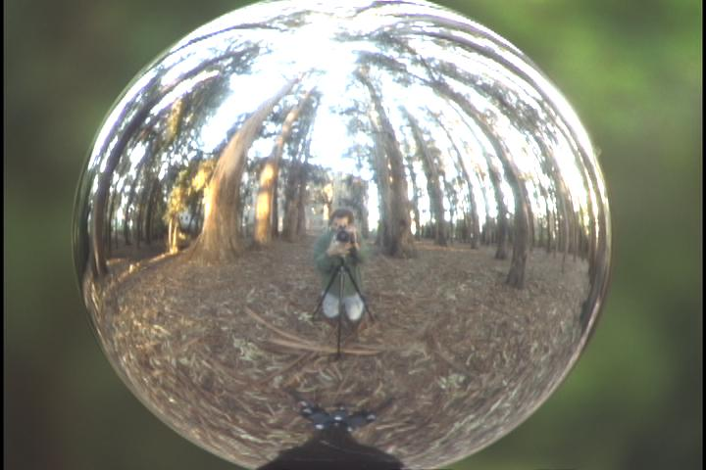
Key ideas for Image-based Lighting
Capturing HDR images: needed so that light probes capture full range of radiance

Slide 12
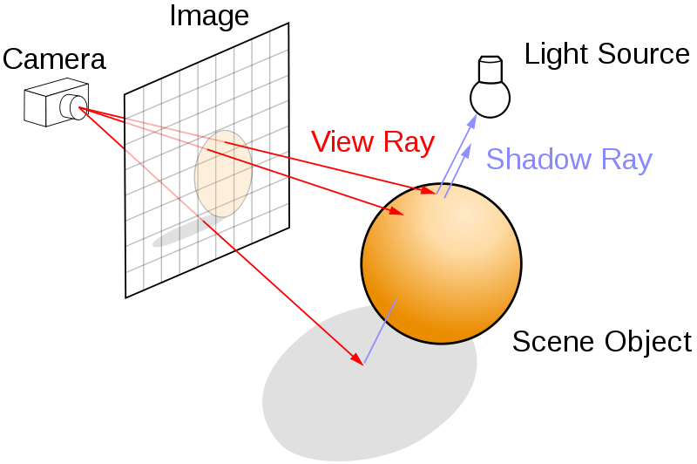
Key ideas for Image-based Lighting
Ray tracing: synthesize light paths between camera and light sources

Slide 13
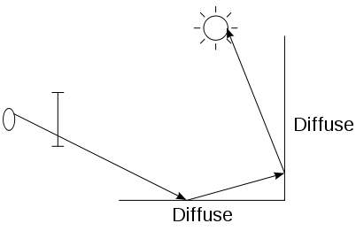
Key ideas for Image-based Lighting
Ray tracing: determining pixel intensity by shooting out rays from the camera

Slide 14
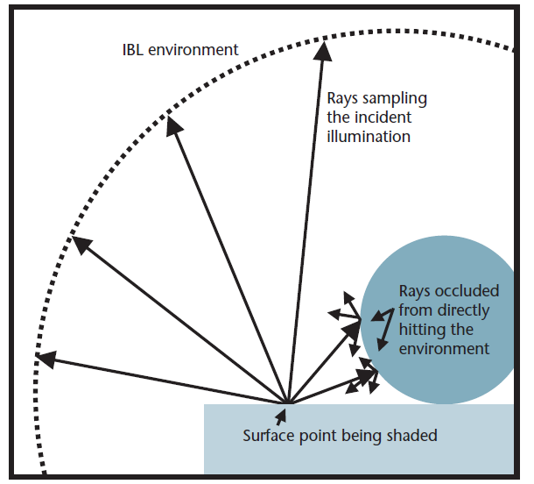
Key ideas for Image-based Lighting
Relighting: environment map acts as light source, substituting for distant scene

Slide 15
Today
Ray tracing
Capturing environment maps

Slide 16
A photon’s life choices
Absorption
Diffusion
Reflection
Transparency
Refraction
Fluorescence
Subsurface scattering
Phosphorescence
Interreflection
light source
λ
?

Slide 17
A photon’s life choices
Absorption
Diffusion
Reflection
Transparency
Refraction
Fluorescence
Subsurface scattering
Phosphorescence
Interreflection
light source
λ

Slide 18
A photon’s life choices
Absorption
Diffuse Reflection
Reflection
Transparency
Refraction
Fluorescence
Subsurface scattering
Phosphorescence
Interreflection
light source
λ

Slide 19
A photon’s life choices
Absorption
Diffusion
Specular Reflection
Transparency
Refraction
Fluorescence
Subsurface scattering
Phosphorescence
Interreflection
light source
λ

Slide 20
A photon’s life choices
Absorption
Diffusion
Reflection
Transparency
Refraction
Fluorescence
Subsurface scattering
Phosphorescence
Interreflection
light source
λ

Slide 21
A photon’s life choices
Absorption
Diffusion
Reflection
Transparency
Refraction
Fluorescence
Subsurface scattering
Phosphorescence
Interreflection
light source
λ

Slide 22
A photon’s life choices
Absorption
Diffusion
Reflection
Transparency
Refraction
Fluorescence
Subsurface scattering
Phosphorescence
Interreflection
light source
λ₁
λ₂

Slide 23
A photon’s life choices
Absorption
Diffusion
Reflection
Transparency
Refraction
Fluorescence
Subsurface scattering
Phosphorescence
Interreflection
light source
λ

Slide 24
A photon’s life choices
Absorption
Diffusion
Reflection
Transparency
Refraction
Fluorescence
Subsurface scattering
Phosphorescence
Interreflection
light source
t=1
t=n

Slide 25
A photon’s life choices
Absorption
Diffusion
Reflection
Transparency
Refraction
Fluorescence
Subsurface scattering
Phosphorescence
Interreflection
light source
λ
(Specular Interreflection)

Slide 26
A photon’s life choices
Absorption
Diffusion
Reflection
Transparency
Fluorescence
Interreflection
Subsurface scattering
Phosphoresence
image plane
light source
camera center
λ
?

Slide 27
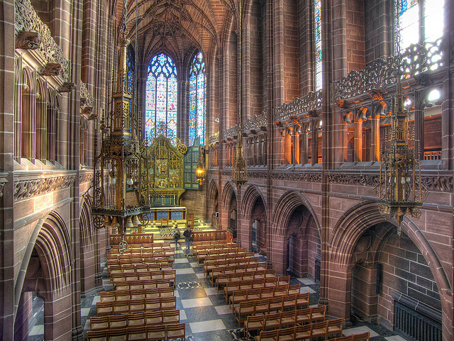
Where are the light sources are in this room?
http://www.flickr.com/photos/chrisdonbavand/493707413/sizes/z/in/photostream/

Slide 28
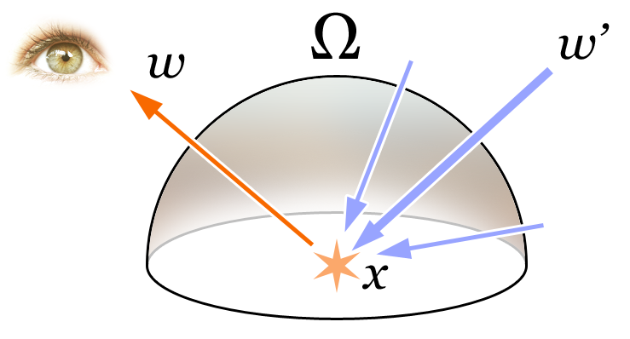
Rendering Equation
Total reflected light
Outgoing light
Generated light
BRDF
Incoming Light
Incident angle

Slide 29
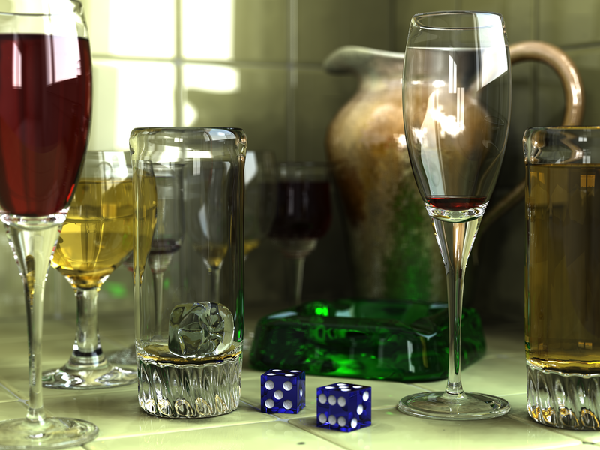
Rendering a scene with ray tracing
http://en.wikipedia.org/wiki/File:Glasses_800_edit.png

Slide 30
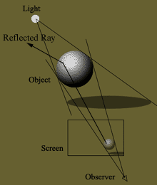
Ray tracing: basics
image plane
light source
camera center
λ

Slide 31
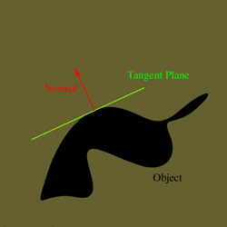
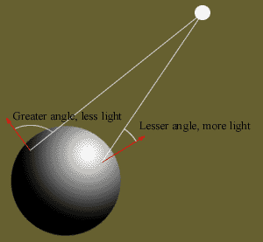
Diffuse shading
http://www.groovyvis.com/other/raytracing/basic.html

Slide 32
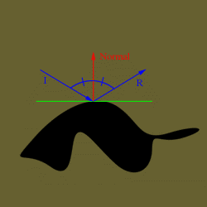
Reflections

Slide 33
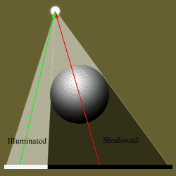
Shadows

Slide 34
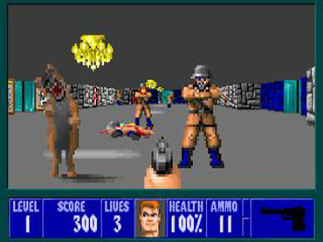
Ray casting
Store colors of surfaces, cast out rays, see what colors each ray hits
Wolfenstein 3D (1992)

Slide 35
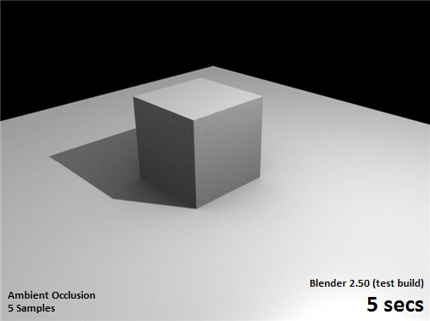
Ray tracing: fast approximation
Upon hitting a surface
Cast reflection/refraction ray to determine reflected or refracted surface
Cast shadow ray: go towards light and see if an object is in the way
http://en.wikipedia.org/wiki/File:Ray_trace_diagram.svg

Slide 36
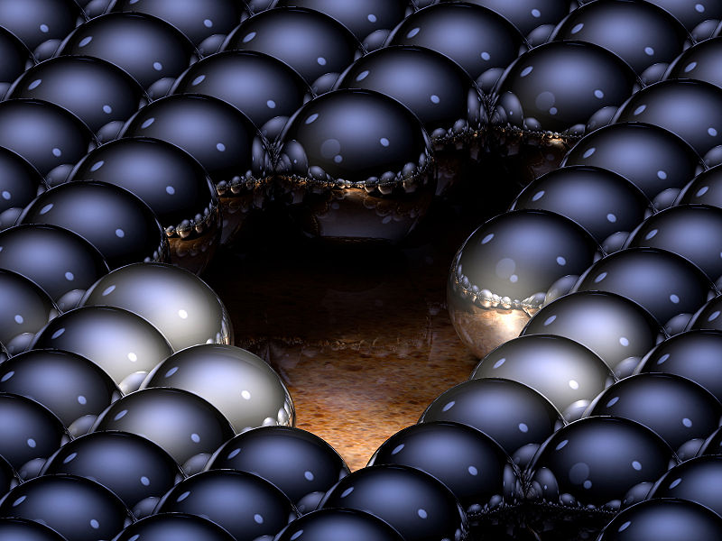
Ray tracing: interreflections
Reflect light N times before heading to light source
N=2
N=16

Slide 37
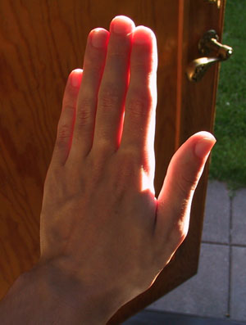
Ray tracing
Conceptually simple but hard to do fast
Full solution requires tracing millions of rays for many inter-reflections
Design choices
Ray paths: Light to camera vs. camera to light?
How many samples per pixel (avoid aliasing)?
How to sample diffuse reflections?
How many inter-reflections to allow?
Deal with subsurface scattering, etc?

Slide 38
Environment Maps
The environment map may take various forms:
Cubic mapping
Spherical mapping
other
Describes the shape of the surface on which the map “resides”
Determines how the map is generated and how it is indexed

Slide 39
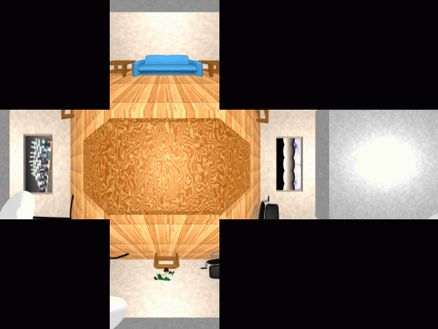
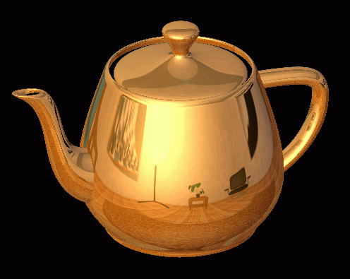
Cubic Map Example

Slide 40
Cubic Mapping
The map resides on the surfaces of a cube around the object
Typically, align the faces of the cube with the coordinate axes
To generate the map:
For each face of the cube, render the world from the center of the object with the cube face as the image plane
Rendering can be arbitrarily complex (it’s off-line)
To use the map:
Index the R ray into the correct cube face
Compute texture coordinates

Slide 41
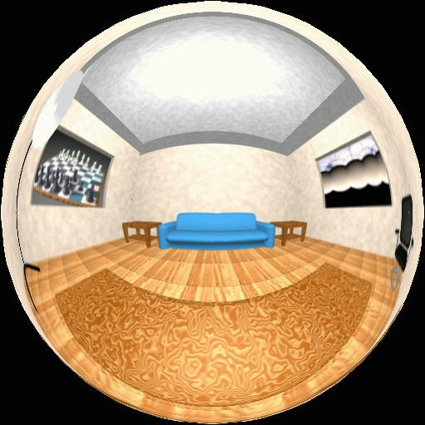
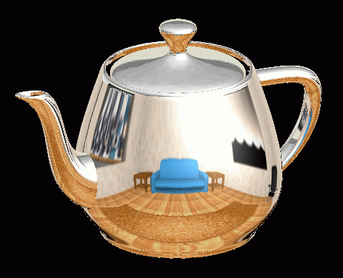
Spherical Map Example

Slide 42
Sphere Mapping
Map lives on a sphere
To generate the map:
Render a spherical panorama from the designed center point
Rendering with environment map:
Use the orientation of the R ray to index directly into the sphere

Slide 43
What approximations are made?
The map should contain a view of the world with the point of interest on the object as the Center of Projection
We can’t store a separate map for each point, so one map is used with the COP at the center of the object
Introduces distortions in the reflection, but we usually don’t notice
Distortions are minimized for a small object in a large room
The object will not reflect itself!

Slide 44
More accurate rendering with environment map
image plane
camera center

Slide 45
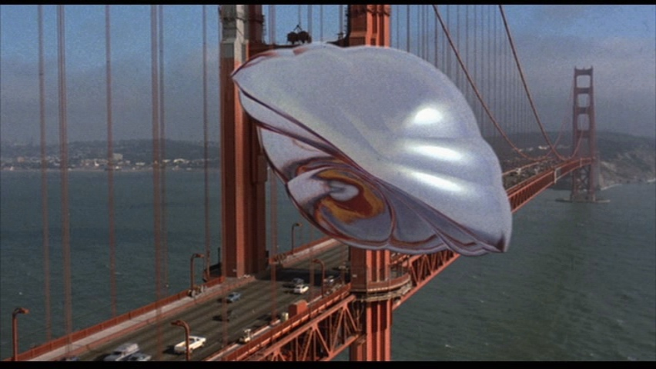
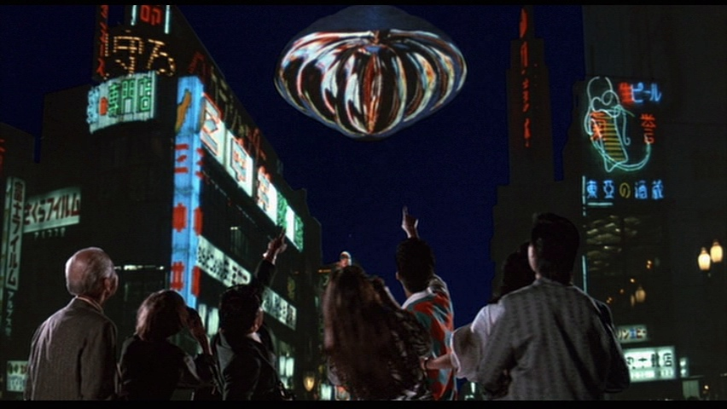
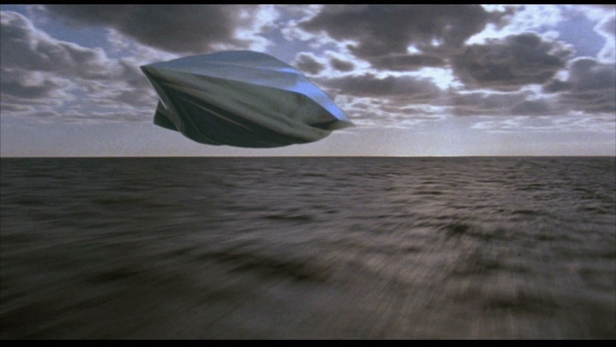
What about real scenes?
From Flight of the Navigator

Slide 46
What about real scenes?
from Terminator 2

Slide 47
Real environment maps
We can use photographs to capture environment maps
The first use of panoramic mosaics
Fisheye lens
Mirrored balls (light probes)

Slide 48
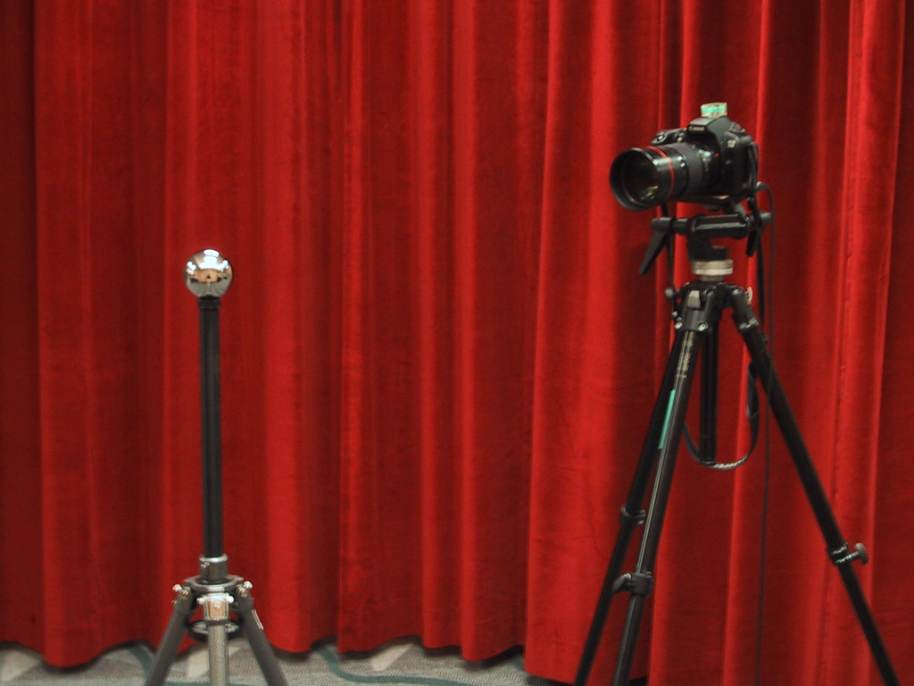
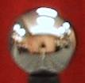
Mirrored Sphere

Slide 49
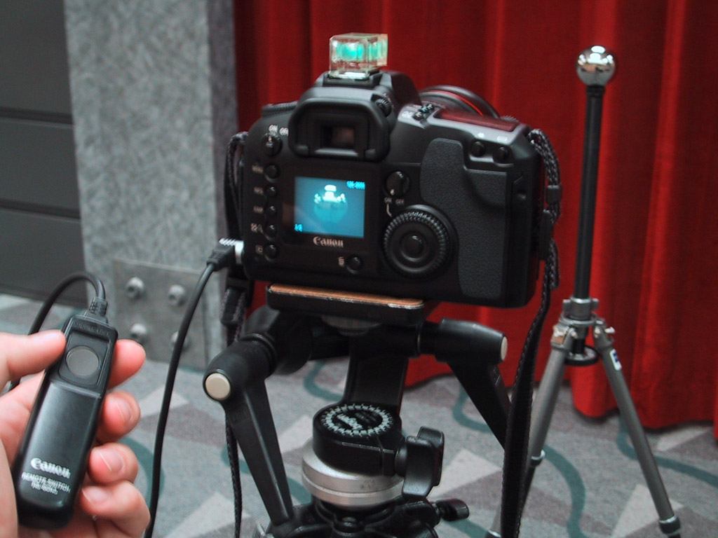

Slide 50
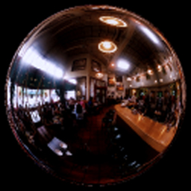
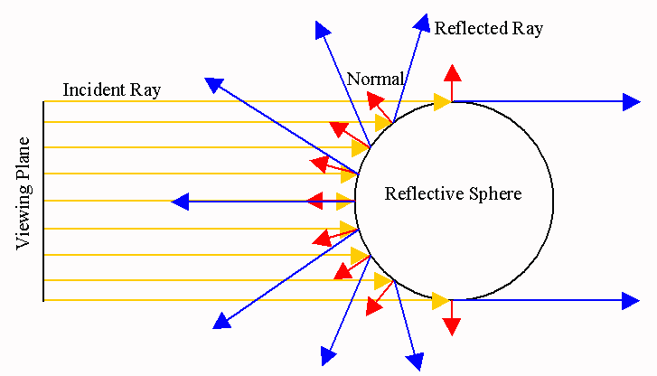

Slide 51
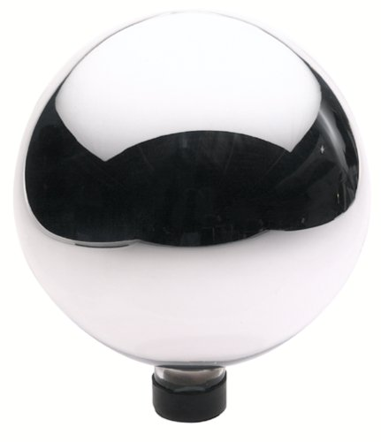
Sources of Mirrored Balls
2-inch chrome balls ~ $20 ea.
McMaster-Carr Supply Company www.mcmaster.com
6-12 inch large gazing balls
Baker’s Lawn Ornaments www.bakerslawnorn.com
Hollow Spheres, 2in – 4in
Dube Juggling Equipment www.dube.com
FAQ on www.debevec.org/HDRShop/

Slide 52
0.34
=> 59% Reflective
Calibrating Mirrored Sphere Reflectivity
0.58

Slide 53
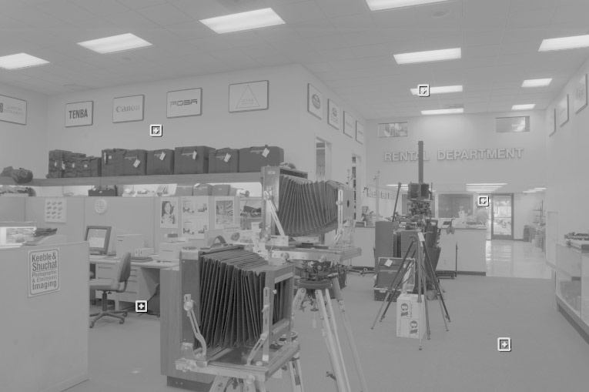
One small snag
How do we deal with light sources? Sun, lights, etc?
They are much, much brighter than the rest of the environment
1907
.
46
.
.
15116
1
.
.
18

Slide 54
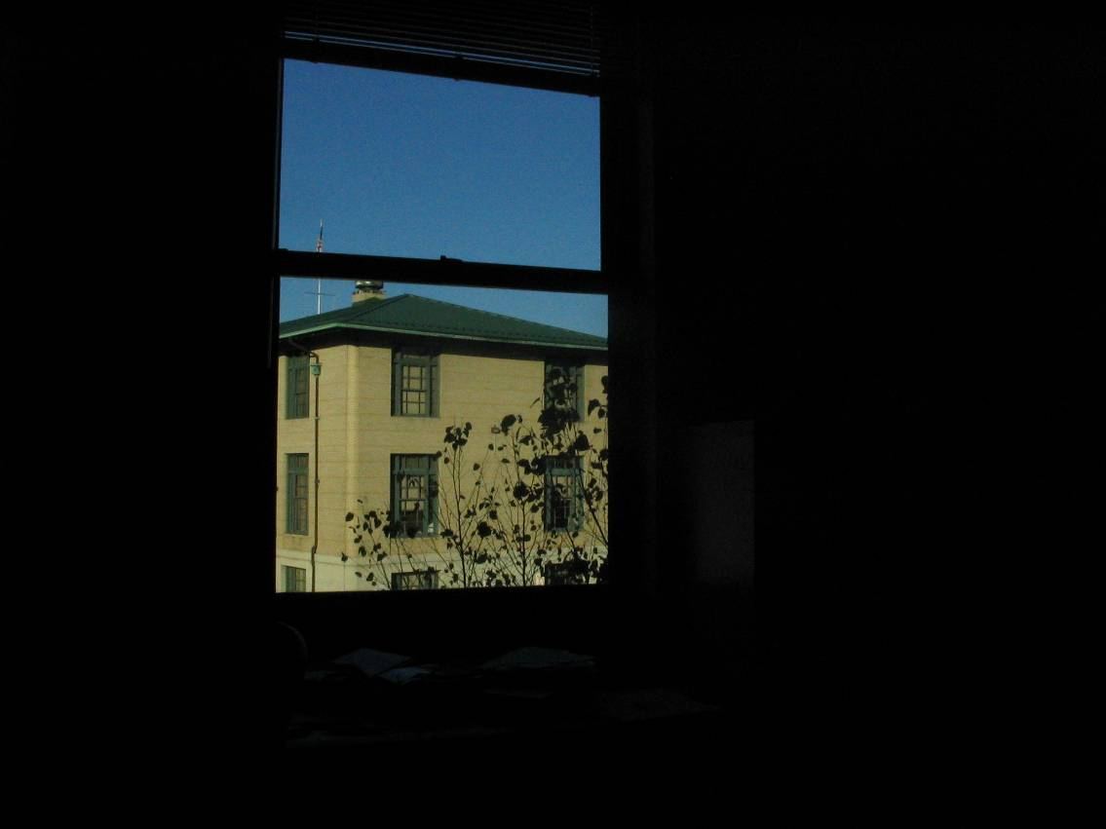
Problem: Dynamic Range

Slide 55
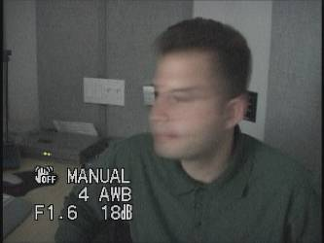
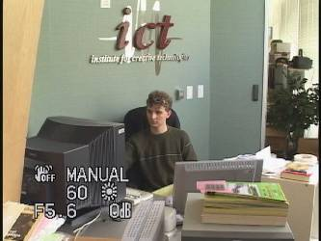
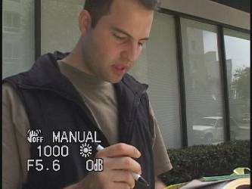
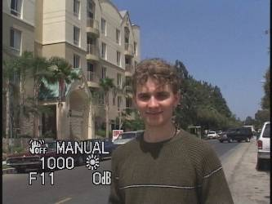
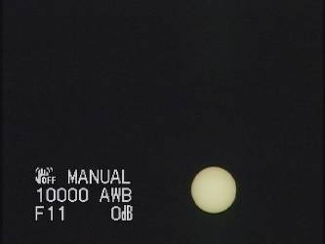
Problem: Dynamic Range
1
The real world is high dynamic range.
1500
25,000
400,000
2,000,000,000

Slide 56
Long Exposure
10⁻⁶
High dynamic range
10⁶
Real world
10⁻⁶
10⁶
Picture
^{0 to 255}

Slide 57
Short Exposure
10⁻⁶
High dynamic range
10⁶
Real world
10⁻⁶
10⁶
Picture
^{0 to 255}

Slide 58
Camera Calibration
Geometric
How pixel coordinates relate to directions in the world
Photometric
How pixel values relate to radiance amounts in the world

Slide 59
The Image Acquisition Pipeline
Lens
Shutter
Film
scene
radiance
(W/sr/m )
sensor
irradiance
∫
sensor
exposure
latent
image
2
Δt
Electronic Camera
Development
CCD
ADC
Remapping
film
density
analog
voltages
digital
values
pixel
values
Notes:
3

Slide 60
Imaging system response function
255
Pixel
value
0
log Exposure = log (Radiance * Δt)
(CCD photon count)
Notes:
1

Slide 61
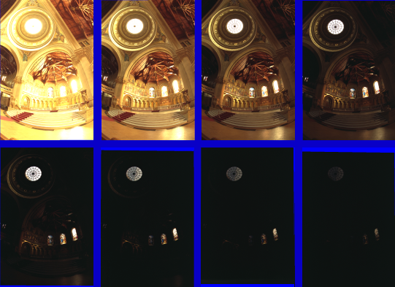
Varying Exposure

Slide 62
Camera is not a photometer!
Limited dynamic range
Perhaps use multiple exposures?
Unknown, nonlinear response
Not possible to convert pixel values to radiance
Solution:
Recover response curve from multiple exposures, then reconstruct the radiance map
Notes:
4

Slide 63
Next class
How to capture HDR image using “bracketing”
How to relight an object from an environment map

