Slide 1
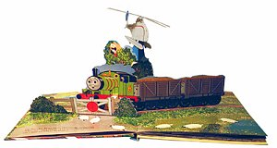
Single-view 3D Reconstruction
10/13/11
Computational Photography
Derek Hoiem, University of Illinois
Some slides from Alyosha Efros, Steve Seitz

Slide 2
Questions about Project 4?
Get me your labels asap if not already done (will count as late days after today)
  Will post everything I’ve got later today
So far have labels from: Adair, Arash, Bret, Brian, Derek, Doheum, Lewis, Prateek, Raj, Russ, SteveD, WeiLou

Slide 3
Project 3
Class favorites: vote please
  “Favorites” will be presented next Thurs

Slide 4
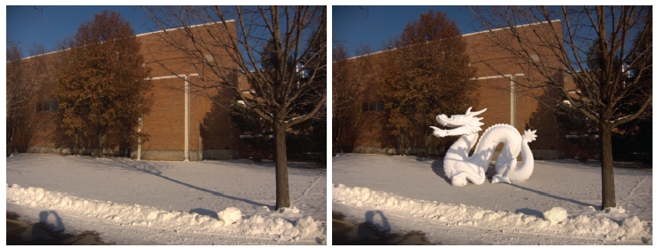
Next Tuesday
I’m out of town
Kevin Karsch is talking about physically grounded image editing, including inserting 3D objects into photographs

Slide 5
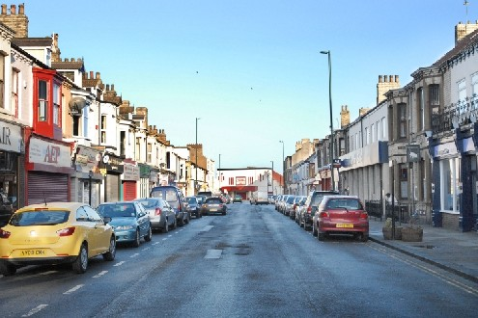
Take-home question
10/04/2011
Suppose we have two 3D cubes on the ground facing the viewer, one near, one far.
What would they look like in perspective?
What would they look like in weak perspective?
Photo credit: GazetteLive.co.uk

Slide 6
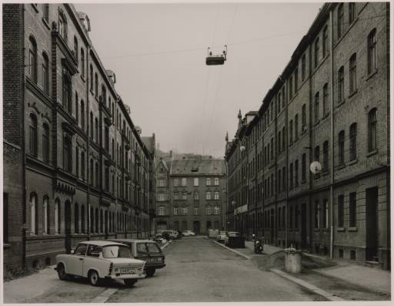
Take-home question
10/11/2011
Suppose you have estimated three vanishing points corresponding to orthogonal directions. How can you recover the rotation matrix that is aligned with the 3D axes defined by these points?
  Assume that intrinsic matrix K has three parameters
  Remember, in homogeneous coordinates, we can write a 3d point at infinity as (X, Y, Z, 0)
VP_{y}
.
VP_{x}
VP_{z}
Photo from online Tate collection

Slide 7
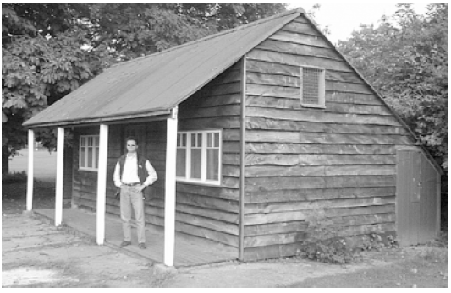
Take-home question
10/11/2011
Assume that the camera height is 5 ft.
  What is the height of the man?
  What is the height of the building?

Slide 8
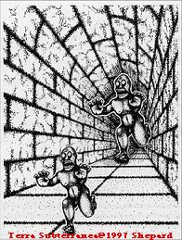

Slide 9
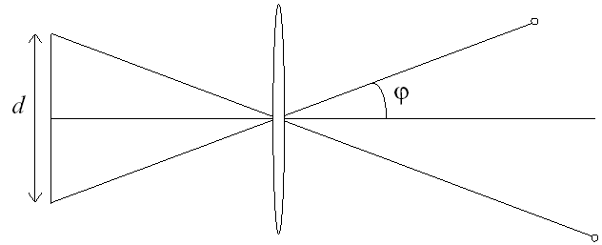
Relation between field of view and focal length
Field of view (angle width)
Film/Sensor Width
Focal length

Slide 10
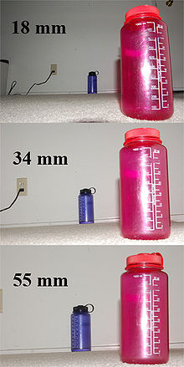
Dolly Zoom or “Vertigo Effect”
http://www.youtube.com/watch?v=nAhGM2Fyl8Q
How is this done?
Zoom in while moving away
http://en.wikipedia.org/wiki/Focal_length

Slide 11
Dolly zoom (or “Vertigo effect”)
Field of view (angle width)
Film/Sensor Width
Focal length
width of object
Distance between object and camera

Slide 12
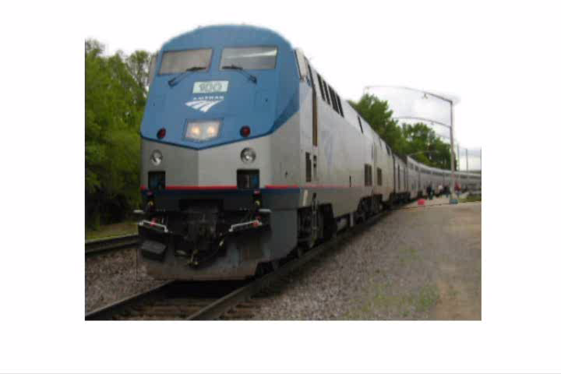
Today’s class: 3D Reconstruction

Slide 13
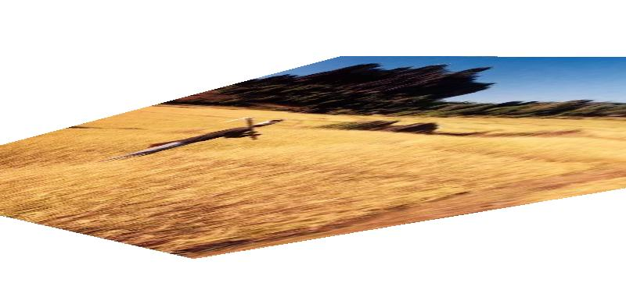
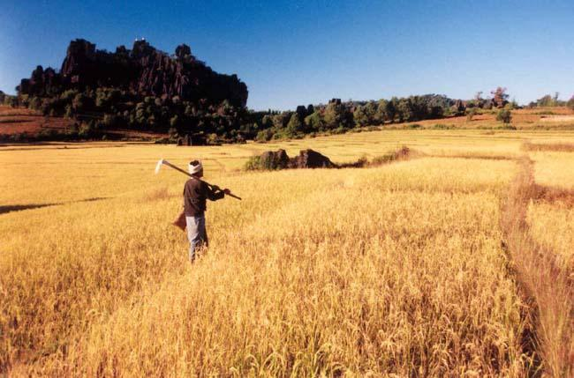
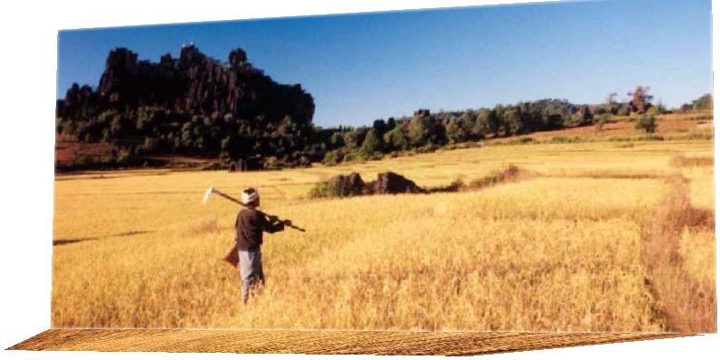
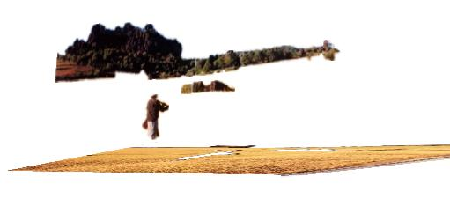
The challenge
One 2D image could be generated by an infinite number of 3D geometries
?
?
?

Slide 14
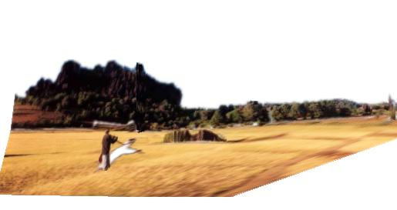
The solution
Make simplifying assumptions about 3D geometry
Unlikely
Likely

Slide 15
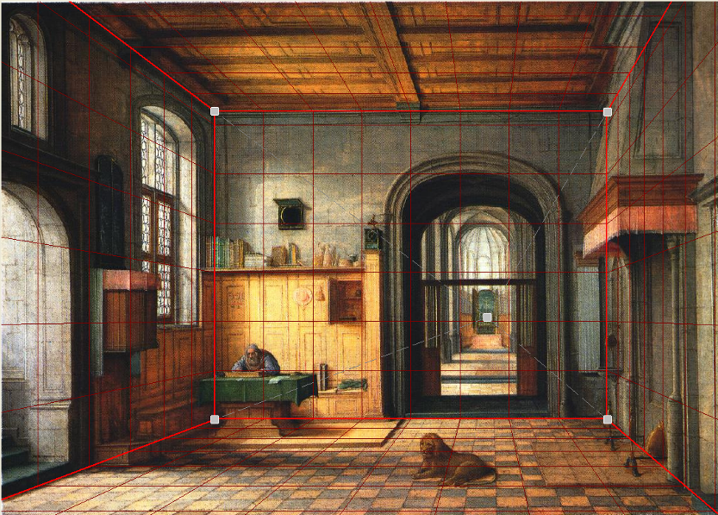
Today’s class: Two Models
Box + frontal billboards
Ground plane + non-frontal billboards

Slide 16
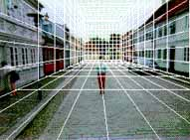
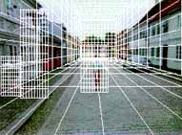
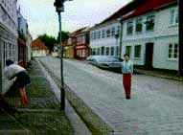
“Tour into the Picture” (Horry et al. SIGGRAPH ’97)
Create a 3D “theatre stage” of five billboards
Specify foreground objects through bounding polygons
Use camera transformations to navigate through the scene
Following slides modified from Efros

Slide 17
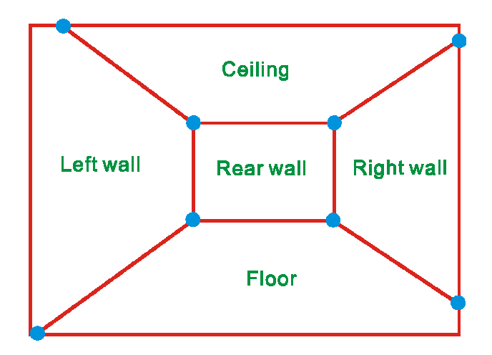
The idea
Many scenes (especially paintings), can be represented as an axis-aligned box volume (i.e. a stage)
Key assumptions
All walls are orthogonal
Camera view plane is parallel to back of volume
How many vanishing points does the box have?
Three, but two at infinity
Single-point perspective
Can use the vanishing point
to fit the box to the particular
scene

Slide 18
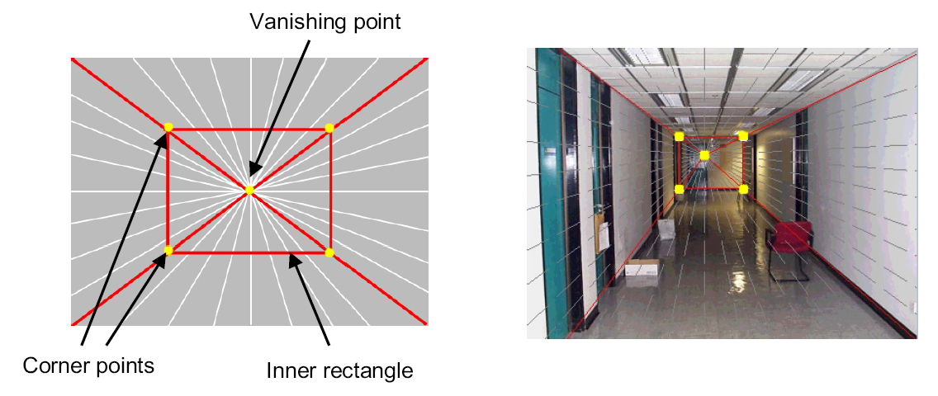
Fitting the box volume
User controls the inner box and the vanishing point placement (# of DOF???)
Q: What’s the significance of the vanishing point location?
A: It’s at eye (camera) level: ray from COP to VP is perpendicular to image plane
  Under single-point perspective assumptions, the VP should be the optical center of the image

Slide 19
Example of user input: vanishing point and back face of view volume are defined
High
Camera

Slide 20
Example of user input: vanishing point and back face of view volume are defined
High
Camera

Slide 21
Example of user input: vanishing point and back face of view volume are defined
Low
Camera

Slide 22
Example of user input: vanishing point and back face of view volume are defined
Low
Camera

Slide 23
Comparison of how image is subdivided based on two different camera positions. You should see how moving the box corresponds to moving the eyepoint in the 3D world.
High Camera
Low Camera

Slide 24
Another example of user input: vanishing point and back face of view volume are defined
Left
Camera

Slide 25
Another example of user input: vanishing point and back face of view volume are defined
Left
Camera

Slide 26
Another example of user input: vanishing point and back face of view volume are defined
Right
Camera

Slide 27
Another example of user input: vanishing point and back face of view volume are defined
Right
Camera

Slide 28
Comparison of two camera placements – left and right. Corresponding subdivisions match view you would see if you looked down a hallway.
Left Camera
Right Camera

Slide 29
Question
Think about the camera center and image plane…
  What happens when we move the box?
  What happens when we move the vanishing point?

Slide 30
2D to 3D conversion
First, we can get ratios
left
right
top
vanishing
point
bottom
back
plane

Slide 31
2D to 3D conversion
Size of user-defined back plane determines width/height throughout box (orthogonal sides)
Use top versus side ratio
to determine relative
height and width
dimensions of box
Left/right and top/bot
ratios determine part of
3D camera placement
left
right
top
camera
pos
bottom

Slide 32
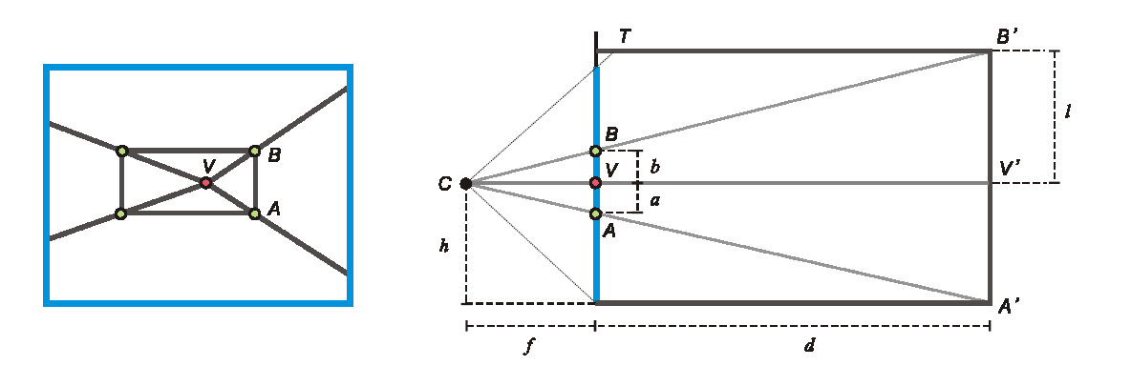
Depth of the box
Can compute by similar triangles (CVA vs. CV’A’)
Need to know focal length f (or FOV)
Note: can compute position on any object on the ground
  Simple unprojection
  What about things off the ground?

Slide 33
Homography
2d coordinates
3d plane coordinates
A
B’
A’
C
D
B
C’
D’

Slide 34


Image rectification
p’
p
To unwarp (rectify) an image solve for homography H given p and p’: wp’=Hp

Slide 35
Computing homography
Assume we have four matched points: How do we compute homography H?
Direct Linear Transformation (DLT)

Slide 36
Computing homography
Direct Linear Transform
Apply SVD: UDV^{T} = A
h = V_{smallest} (column of V corr. to smallest singular value)
Matlab
[U, S, V] = svd(A);
h = V(:, end);
Explanations of SVD and solving homogeneous linear systems
Notes:
SVD gives the homogeneous least squares solution constrained to have a norm of 1

Slide 37




Solving for homographies

Slide 38


Solving for homographies
A
h
0
2n × 9
9
2n
Defines a least squares problem:
  Since h is only defined up to scale, solve for unit vector ĥ
  Solution: ĥ = eigenvector of A^{T}A with smallest eigenvalue
  Works with 4 or more points

Slide 39
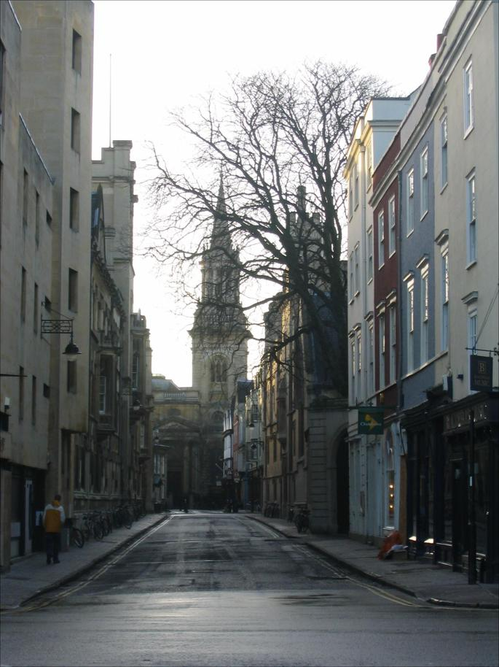
Tour into the picture algorithm
Set the box corners

Slide 40
Tour into the picture algorithm
Set the box corners
Set the VP
Get 3D coordinates
  Compute height, width, and depth of box
Get texture maps
  homographies for each face
x

Slide 41
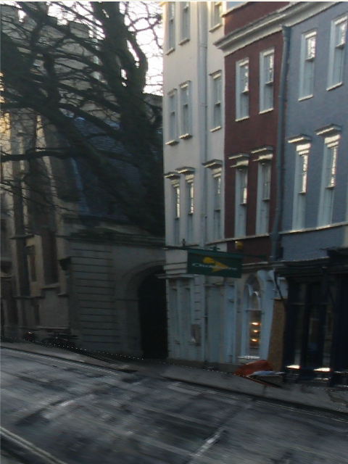
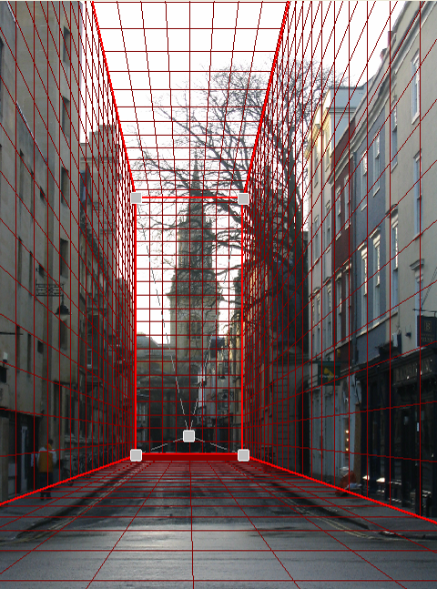
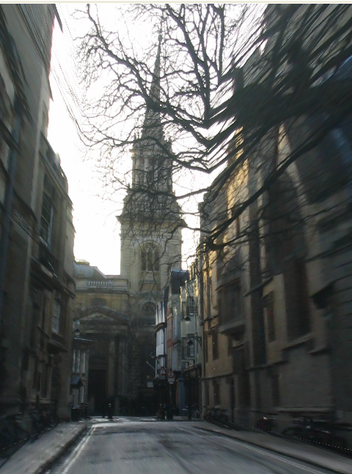
Result
Render from new views
http://www.cs.cmu.edu/afs/cs.cmu.edu/academic/class/15463-f08/www/proj5/www/dmillett/

Slide 42
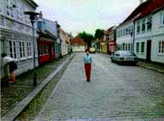

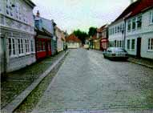
Foreground Objects
Use separate billboard for each
For this to work, three separate images used:
  Original image.
  Mask to isolate desired foreground images.
  Background with objects removed

Slide 43
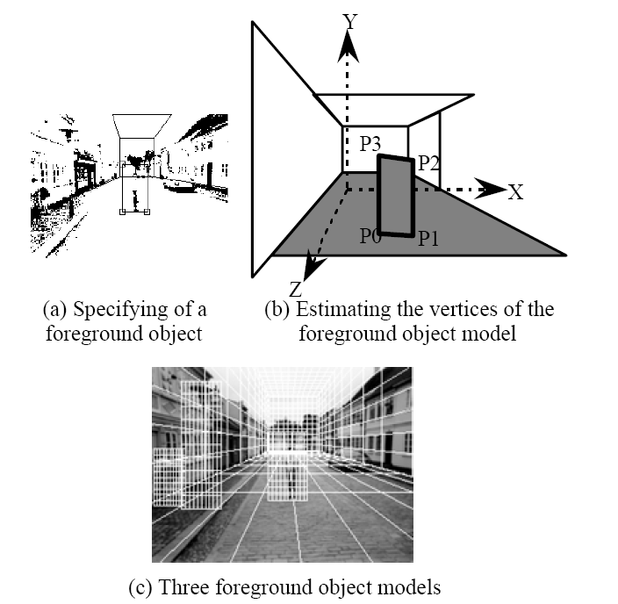
Foreground Objects
Add vertical rectangles for each foreground object
Can compute 3D coordinates P0, P1 since they are on known plane.
P2, P3 can be computed as before (similar triangles)

Slide 44
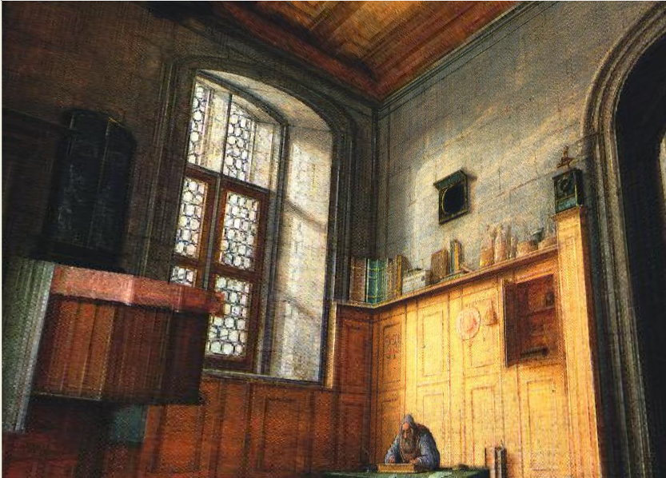
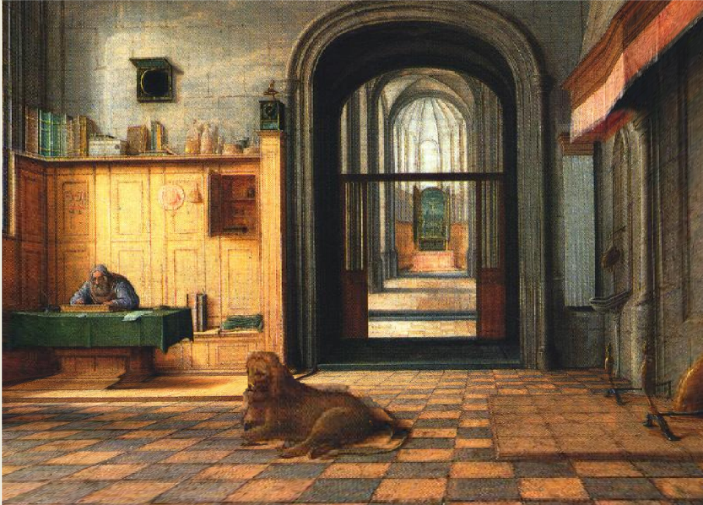
Foreground Result
Video from CMU class: http://www.youtube.com/watch?v=dUAtdmGwcuM

Slide 45
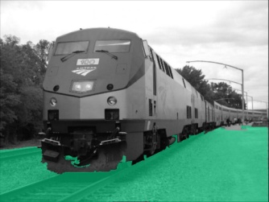
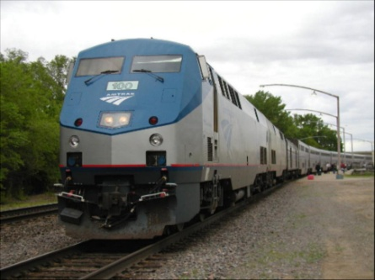
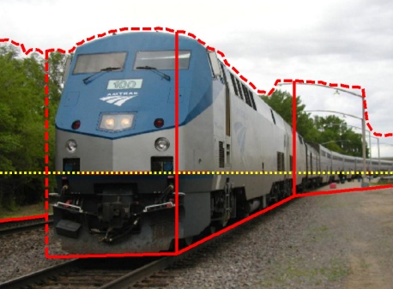
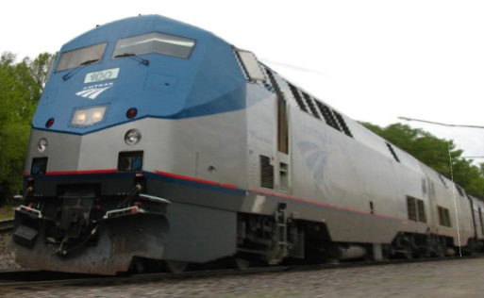
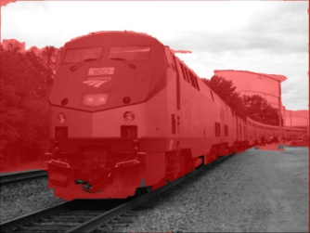












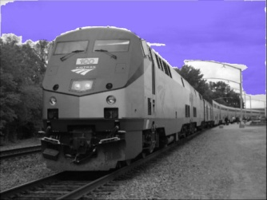
Automatic Photo Pop-up
Input
Geometric Labels
Cut’n’Fold
3D Model
Ground
Image
Vertical
Learned Models
Sky
Hoiem et al. 2005

Slide 46
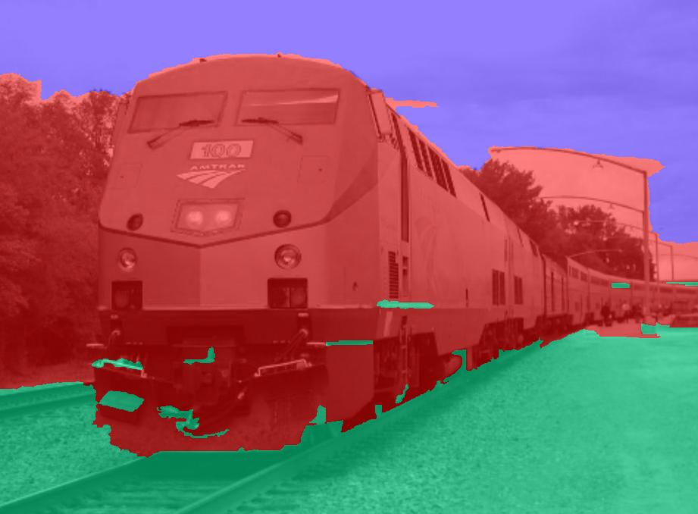
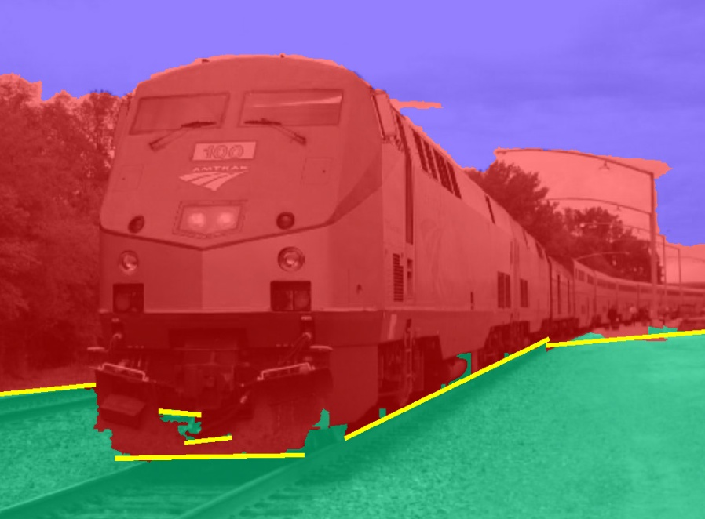
Cutting and Folding
Fit ground-vertical boundary
  Iterative Hough transform

Slide 47
Cutting and Folding
Form polylines from boundary segments
  Join segments that intersect at slight angles
  Remove small overlapping polylines
Estimate horizon position from perspective cues

Slide 48

Cutting and Folding
``Fold’’ along polylines and at corners
``Cut’’ at ends of polylines and along vertical-sky boundary

Slide 49
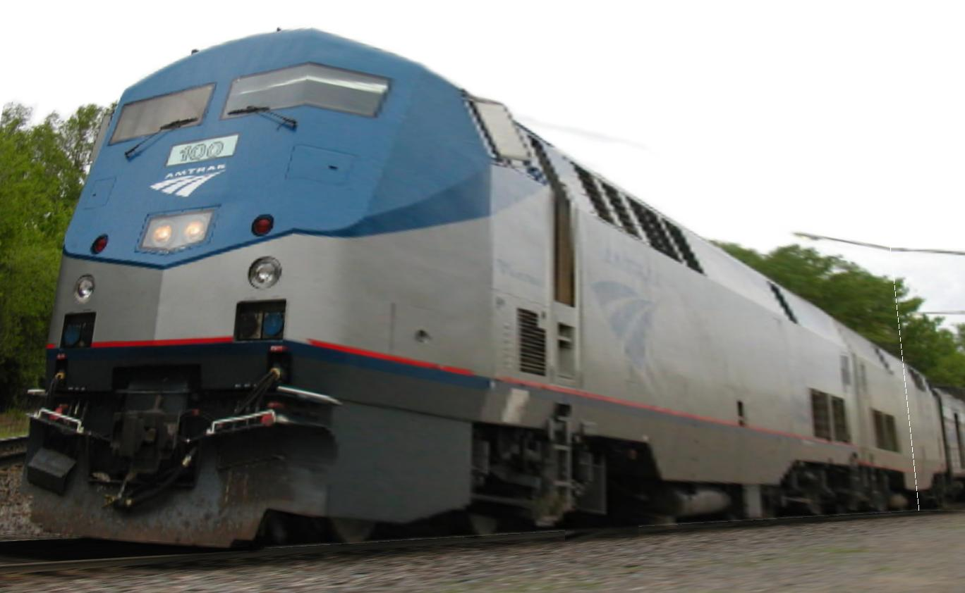
Cutting and Folding
Construct 3D model
Texture map

Slide 50
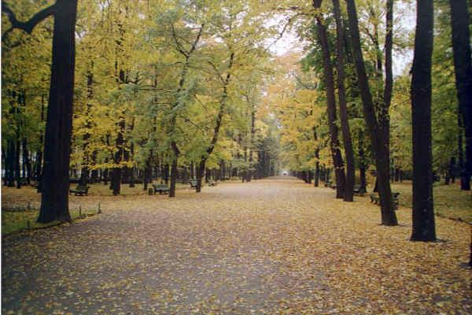
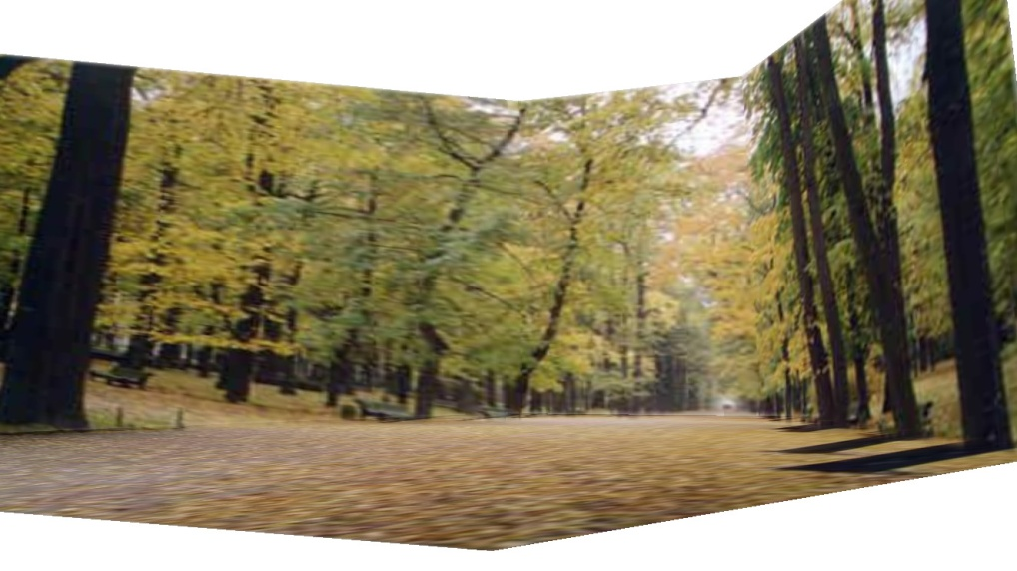
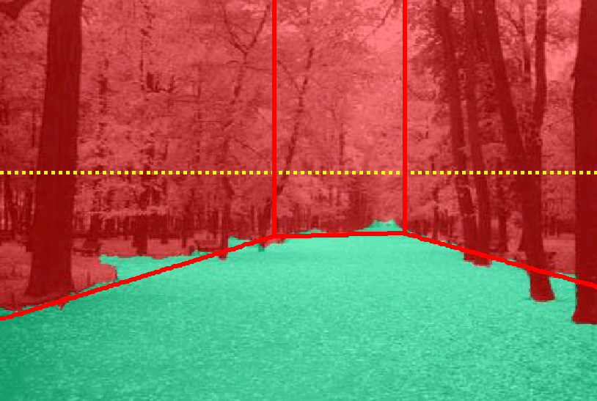
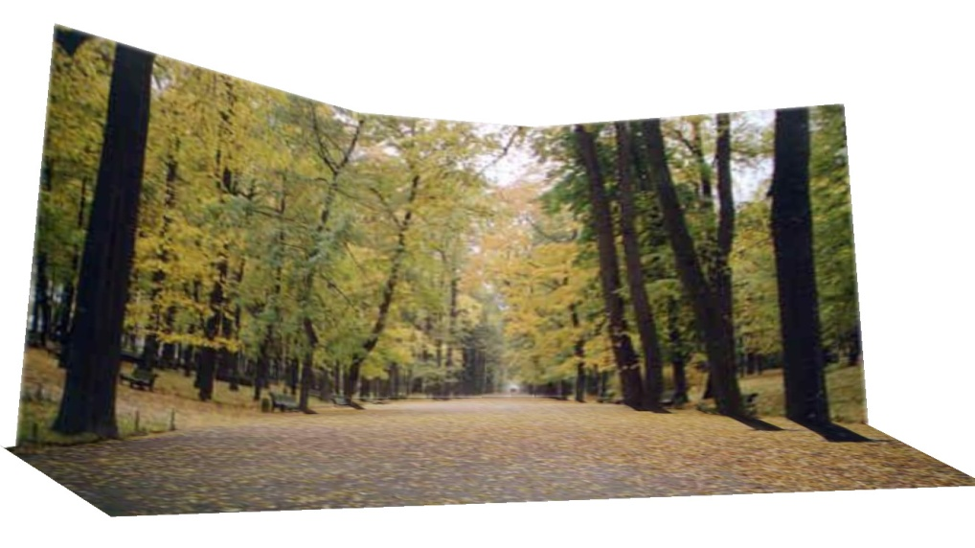
Results
http://www.cs.illinois.edu/homes/dhoiem/projects/popup/
Input Image
Cut and Fold
Automatic Photo Pop-up

Slide 51
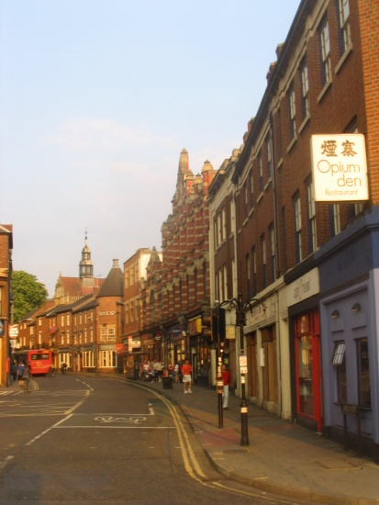
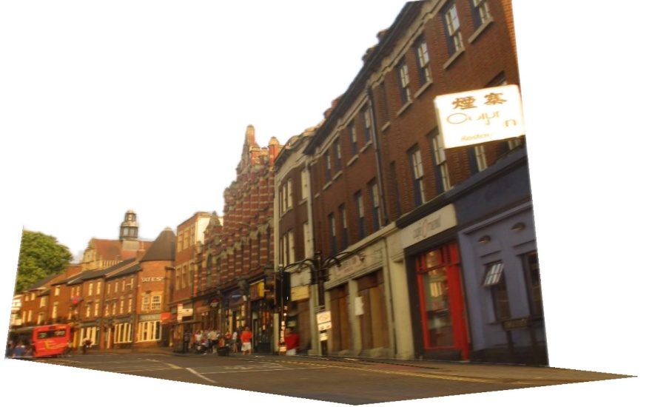
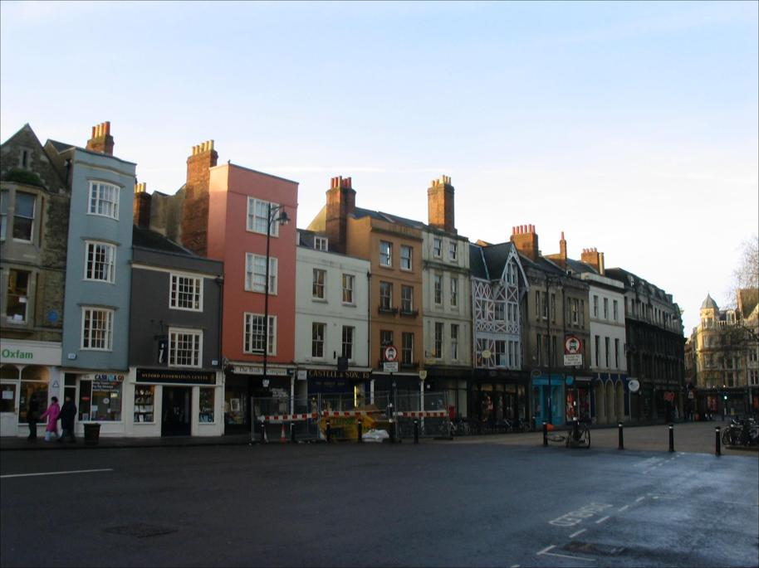
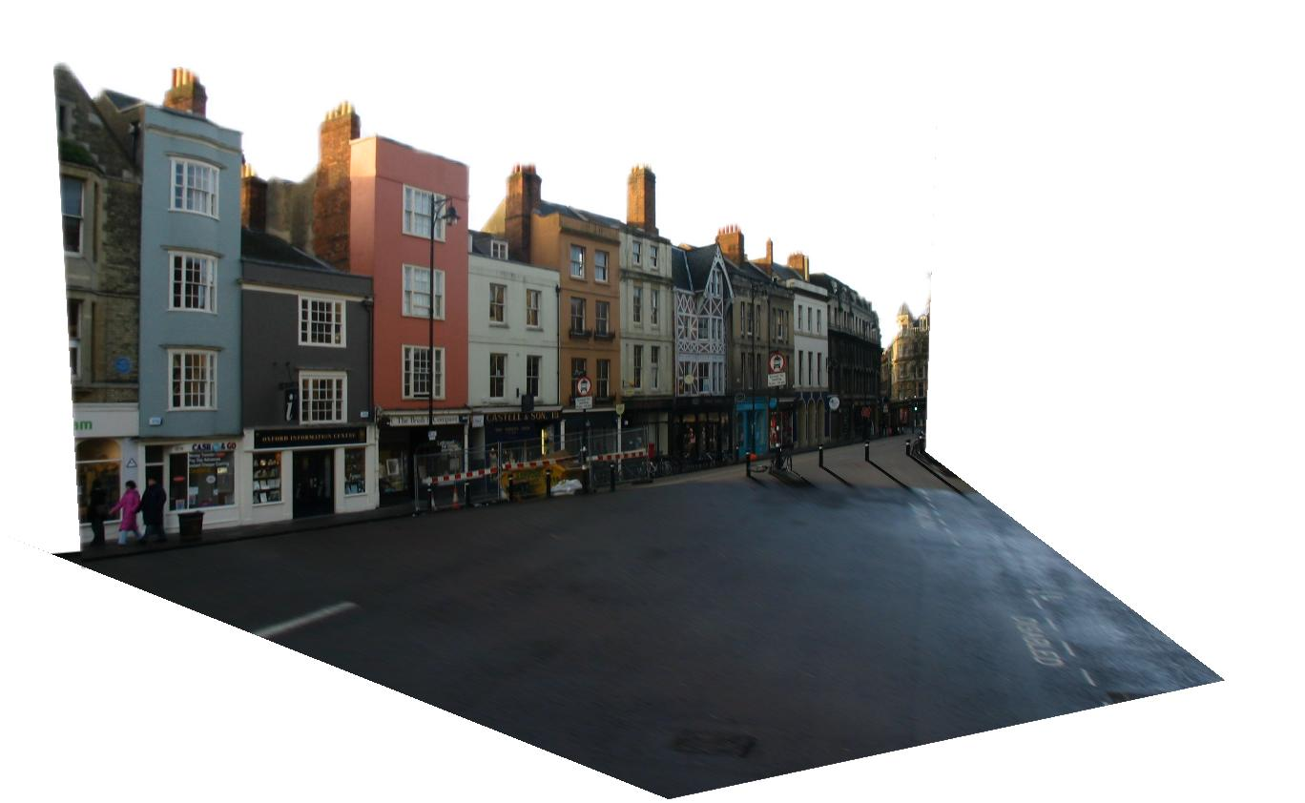
Results
Input Image
Automatic Photo Pop-up

Slide 52
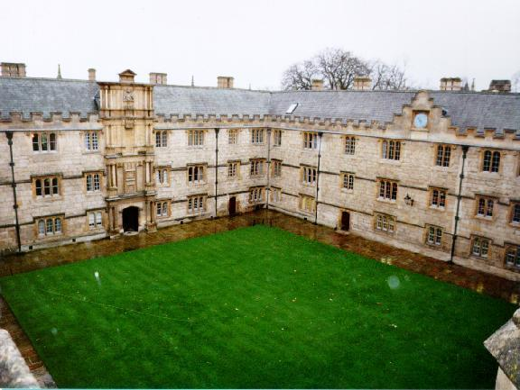
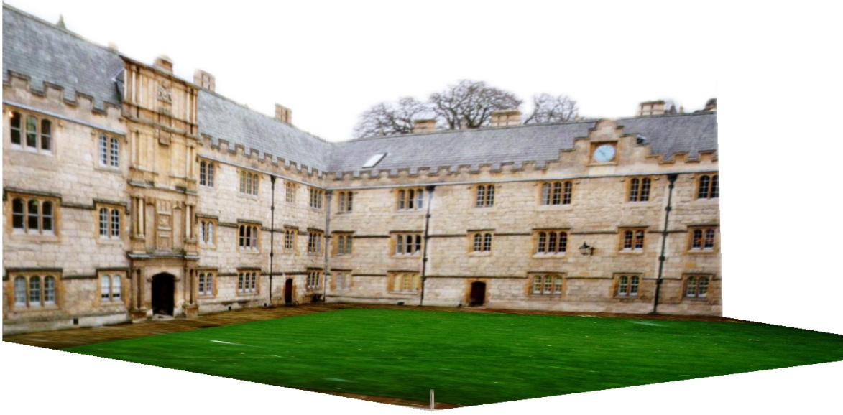
Comparison with Manual Method
[Liebowitz et al. 1999]
Input Image
Automatic Photo Pop-up (30 sec)!
Notes:
From the results of Liebowitz et al. As you can see, their model is slightly better in that the roof is slanted, but our method is fully automatic requiring none of the user’s time, while their method requires extensive manual labeling.

Slide 53
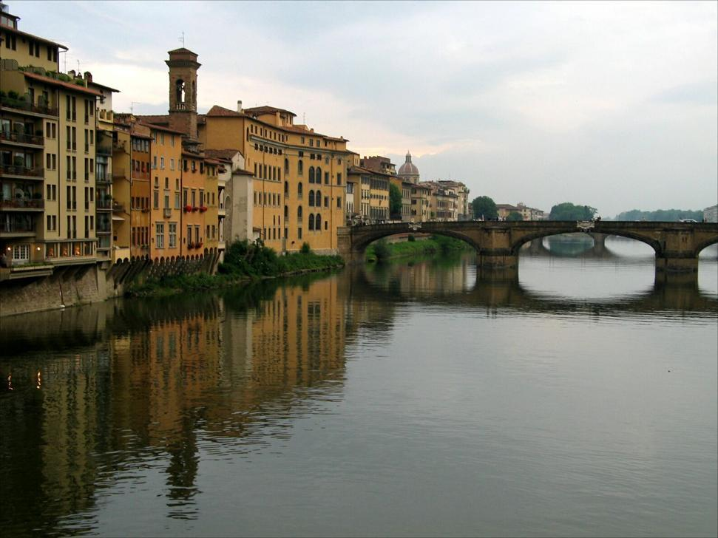


Failures
Labeling Errors

Slide 54




Failures
Foreground Objects

Slide 55

Adding Foreground Labels
Recovered Surface Labels +
Ground-Vertical Boundary Fit
Object Boundaries + Horizon

Slide 56

Notes:
Explain holes

Slide 57
Final project ideas
If a one-person project:
  Interactive program to make 3D model from an image (e.g., output in VRML, or draw path for animation)
If a two-person team, 2nd person:
  Add tools for cutting out foreground objects and automatic hole-filling

Slide 58
Summary
2D→3D is mathematically impossible
Need right assumptions about the world geometry
Important tools
  Vanishing points
  Camera matrix
  Homography

Slide 59
Next Class
Kevin Karsch will show his work that applies many ideas from this section (cutting, texture synthesis, projective geometry, etc.)
Next Thursday: start of new section
  Finding correspondences automatically
  Image stitching
  Various forms of recognition

