Slide 1
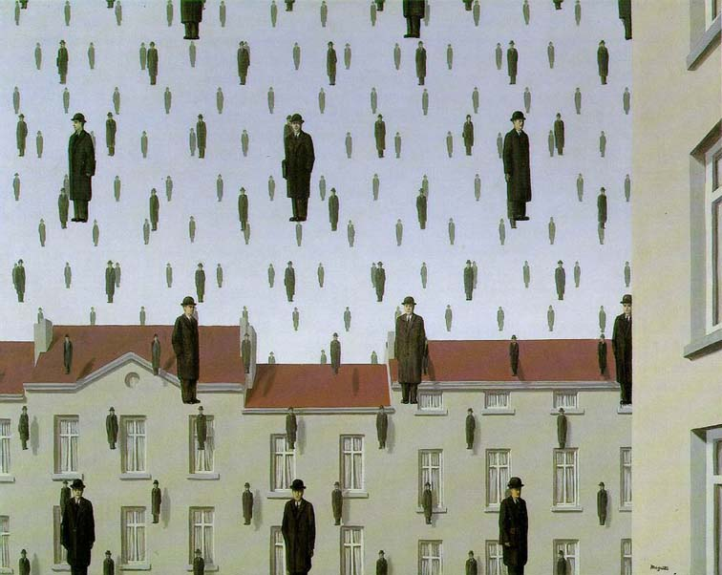
Templates and Image Pyramids
09/06/11
Computational Photography
Derek Hoiem, University of Illinois

Slide 2
Project 1
Due Monday at 11:59pm
Options for displaying results
Web interface or redirect (http://www.pa.msu.edu/services/computing/faq/auto-redirect.html)
Backup (e.g., project server not working): send me a link
E-mail me: expected points, code, link to webpage; no need to e-mail images/results
Questions?
Remember to sign up for bulletin board (if not done already)

Slide 3
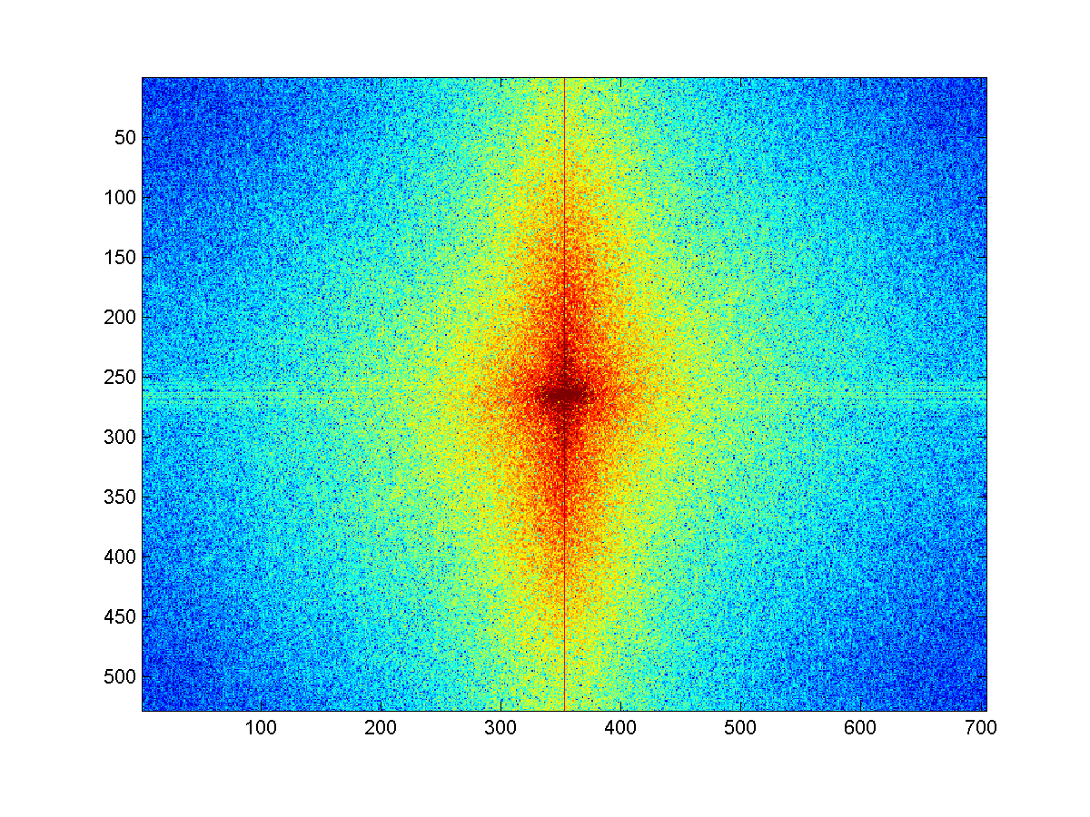
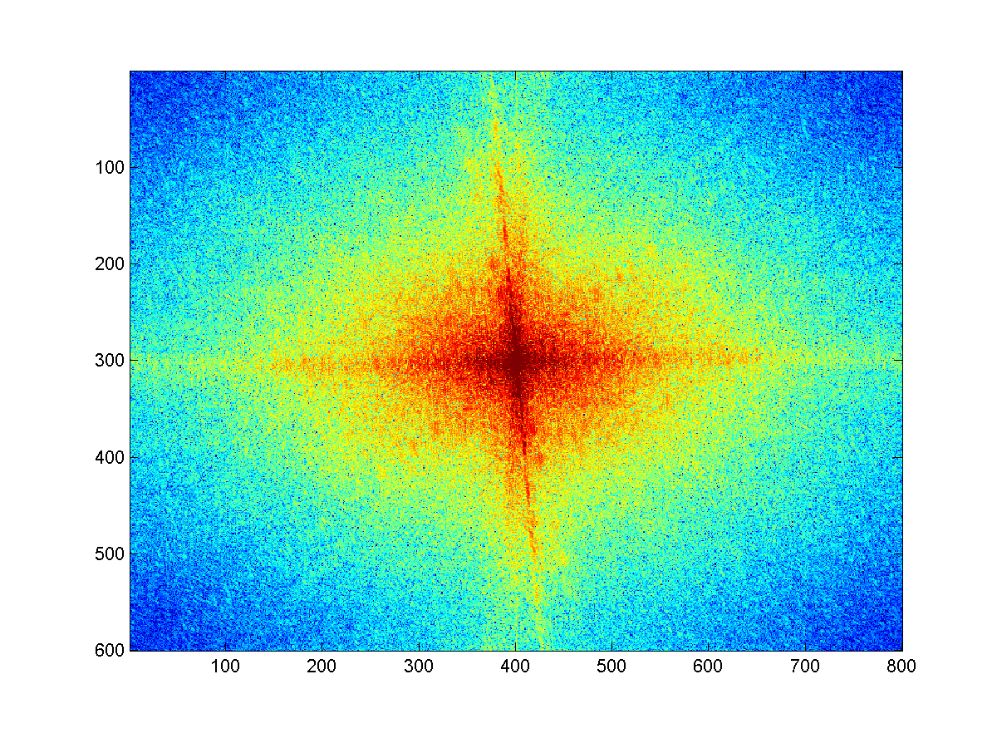
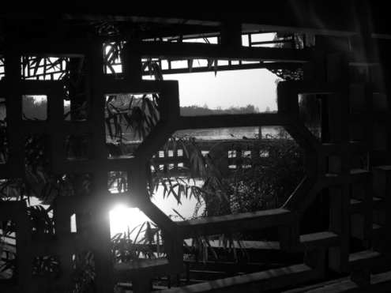
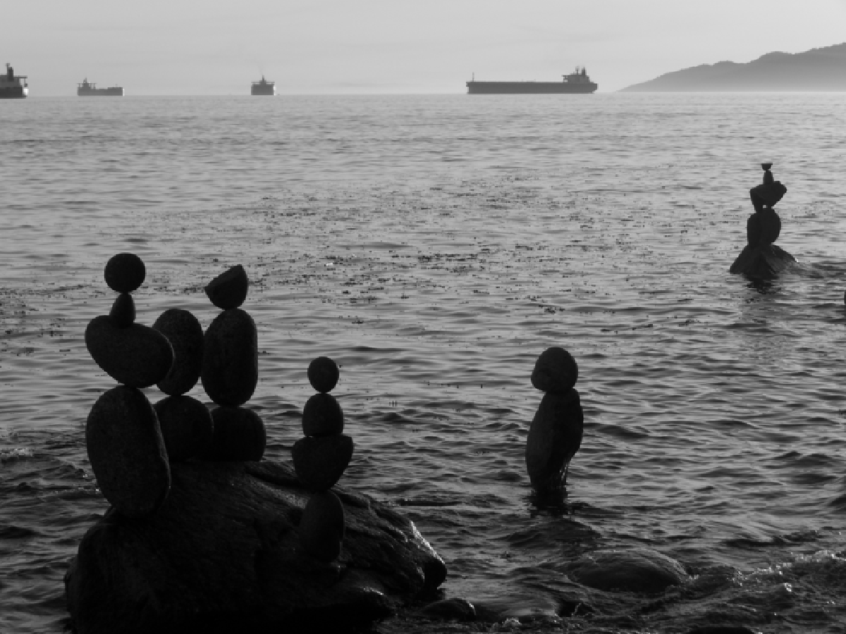
Review
Match the spatial domain image to the Fourier magnitude image
1
2
3
4
5
B
A
C
E
D

Slide 4
Today’s class: applications of filtering
Template matching
Coarse-to-fine alignment
Project 2
Denoising, Compression (as time allows)

Slide 5
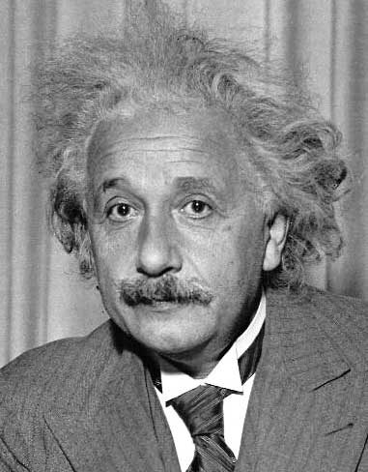
Template matching
Goal: find in image
Main challenge: What is a good similarity or distance measure between two patches?
Correlation
Zero-mean correlation
Sum Square Difference
Normalized Cross Correlation

Slide 6
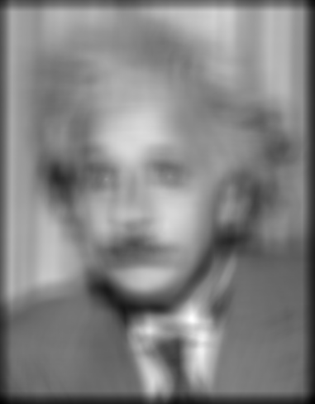
Matching with filters
Goal: find in image
Method 0: filter the image with eye patch
f = image
g = filter
What went wrong?
Input
Filtered Image
Notes:
Problem: response is stronger for higher intensity

Slide 7
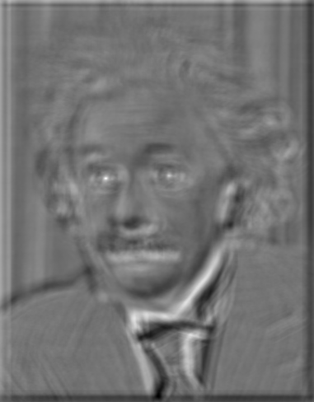
Matching with filters
Goal: find in image
Method 1: filter the image with zero-mean eye
mean of f
True detections
False detections
Input
Filtered Image (scaled)
Thresholded Image
Notes:
Likes bright pixels where filters are above average, dark pixels where filters are below average. Problems: response is sensitive to gain/contrast, pixels in filter that are near the mean have little effect, does not require pixel values in image to be near or proportional to values in filter.

Slide 8
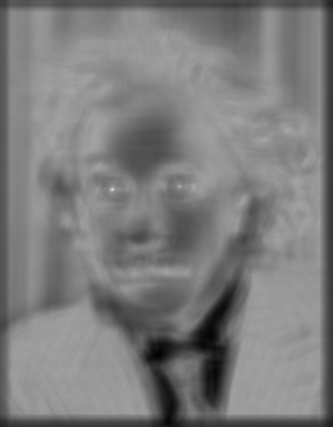
Matching with filters
Goal: find in image
Method 2: SSD
True detections
Input
1- sqrt(SSD)
Thresholded Image
Notes:
Problem: SSD sensitive to average intensity

Slide 9
Matching with filters
Can SSD be implemented with linear filters?

Slide 10
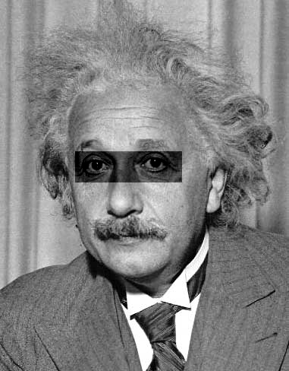
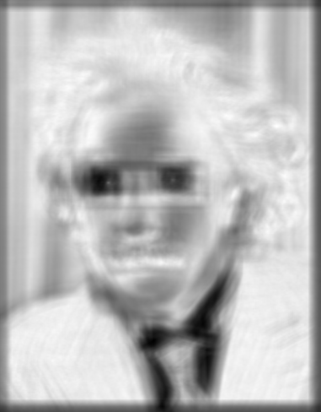
Matching with filters
Goal: find in image
Method 2: SSD
What’s the potential downside of SSD?
Input
1- sqrt(SSD)
Notes:
Problem: SSD sensitive to average intensity

Slide 11
Matching with filters
Goal: find in image
Method 3: Normalized cross-correlation
mean template
mean image patch
Matlab: normxcorr2(template, im)
Notes:
Invariant to mean and scale of intensity

Slide 12
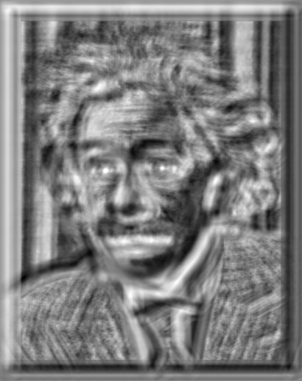
Matching with filters
Goal: find in image
Method 3: Normalized cross-correlation
True detections
Input
Normalized X-Correlation
Thresholded Image

Slide 13
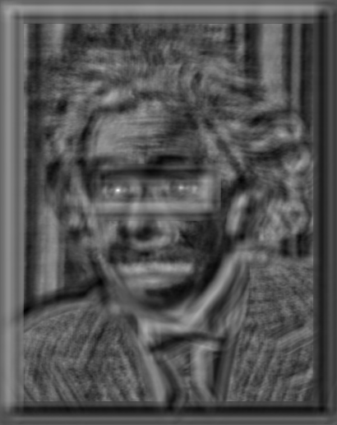
Matching with filters
Goal: find in image
Method 3: Normalized cross-correlation
True detections
Input
Normalized X-Correlation
Thresholded Image

Slide 14
Q: What is the best method to use?
A: Depends
Zero-mean filter: fastest but not a great matcher
SSD: next fastest, sensitive to overall intensity
Normalized cross-correlation: slowest, invariant to local average intensity and contrast

Slide 15
Q: What if we want to find larger or smaller eyes?
A: Image Pyramid

Slide 16
Review of Sampling
Gaussian
Filter
Image
Low-Pass Filtered Image
Sample
Low-Res Image

Slide 17
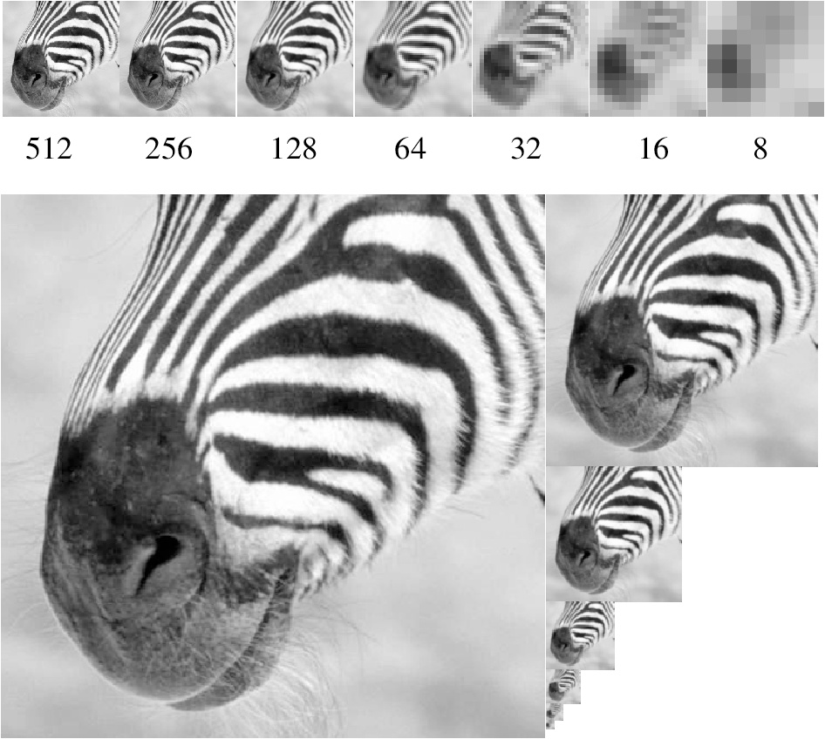
Gaussian pyramid
Source: Forsyth

Slide 18
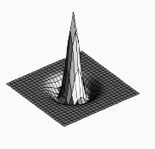
Laplacian filter
unit impulse
Gaussian
Laplacian of Gaussian
Source: Lazebnik

Slide 19
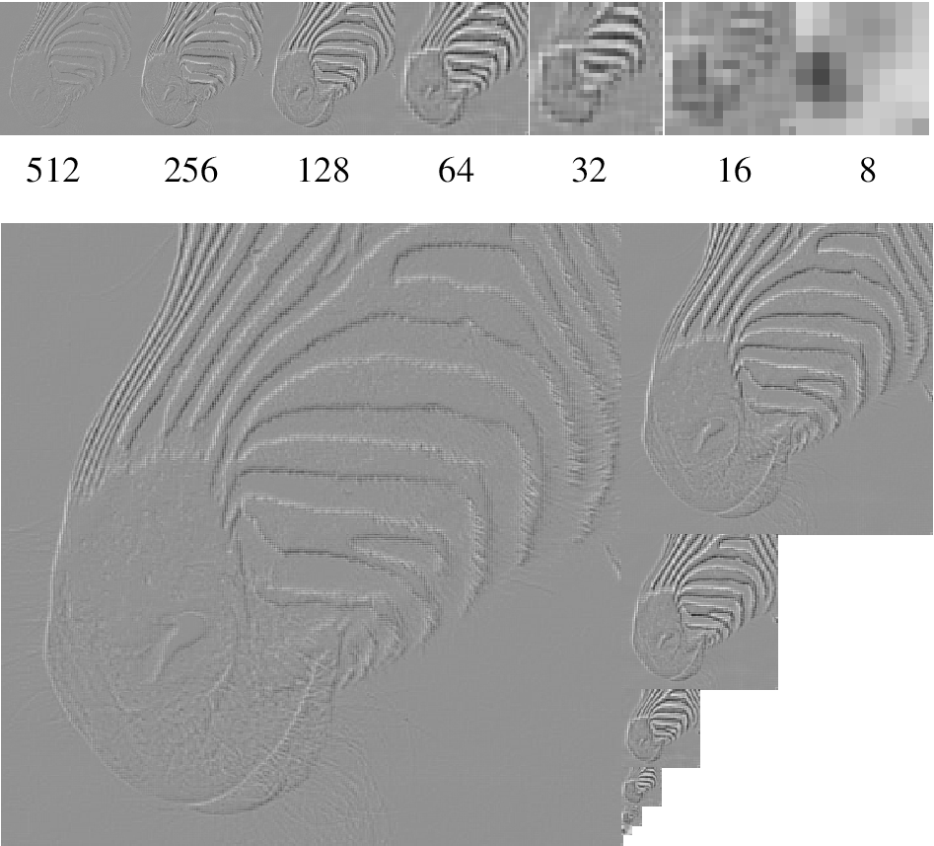
Laplacian pyramid
Source: Forsyth

Slide 20
Computing Gaussian/Laplacian Pyramid
Can we reconstruct the original from the laplacian pyramid?
http://sepwww.stanford.edu/~morgan/texturematch/paper_html/node3.html

Slide 21
Hybrid Image in Laplacian Pyramid
Extra points for project 1
High frequency → Low frequency

Slide 22
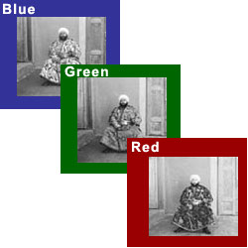
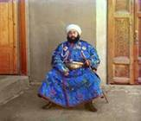
Project 2: Image Alignment
Try SSD alignment
Try normxcorr2 alignment
Simple implementation will work for small images
But larger images will take forever (well, many hours)

Slide 23
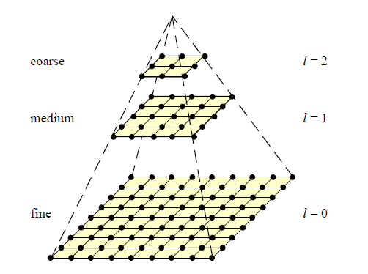
Coarse-to-fine Image Registration
Compute Gaussian pyramid
Align with coarse pyramid
Successively align with finer pyramids
Search smaller range
Why is this faster?
Are we guaranteed to get the same result?

Slide 24
Question
Can you align the images using the FFT?
Implementation is extra points for project 2

Slide 25
Compression
How is it that a 4MP image can be compressed to a few hundred KB without a noticeable change?

Slide 26
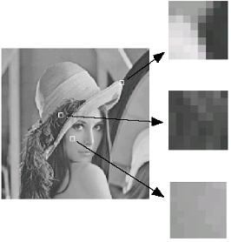
Lossy Image Compression (JPEG)
Block-based Discrete Cosine Transform (DCT)
Slides: Efros

Slide 27
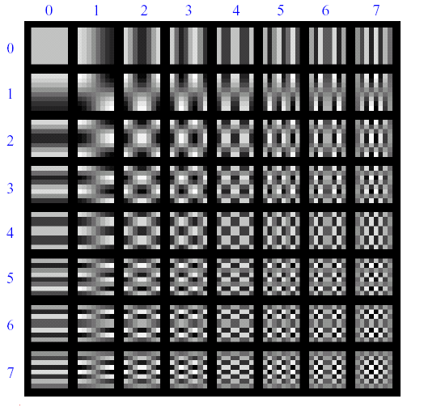
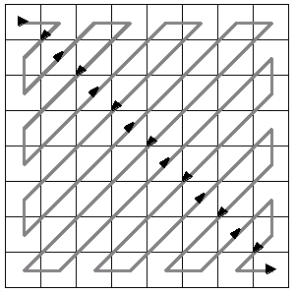
Using DCT in JPEG
The first coefficient B(0,0) is the DC component, the average intensity
The top-left coeffs represent low frequencies, the bottom right – high frequencies

Slide 28
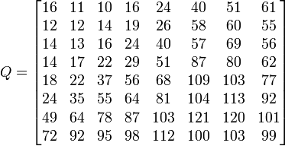
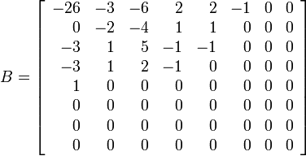
Image compression using DCT
Quantize
More coarsely for high frequencies (which also tend to have smaller values)
Many quantized high frequency values will be zero
Encode
Can decode with inverse dct
Filter responses
Quantization table
Quantized values

Slide 29
JPEG Compression Summary
Convert image to YCrCb
Subsample color by factor of 2
People have bad resolution for color
Split into blocks (8x8, typically), subtract 128
For each block
Compute DCT coefficients
Coarsely quantize
Many high frequency components will become zero
Encode (e.g., with Huffman coding)
http://en.wikipedia.org/wiki/YCbCr
http://en.wikipedia.org/wiki/JPEG

Slide 30
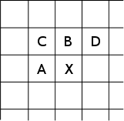
Lossless compression (PNG)
Predict that a pixel’s value based on its upper-left neighborhood
Store difference of predicted and actual value
Pkzip it (DEFLATE algorithm)

Slide 31
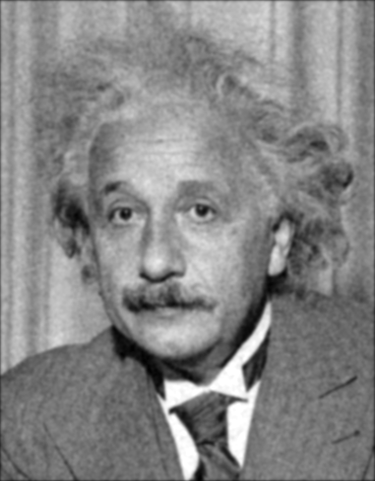
Denoising
Gaussian Filter
Additive Gaussian Noise

Slide 32
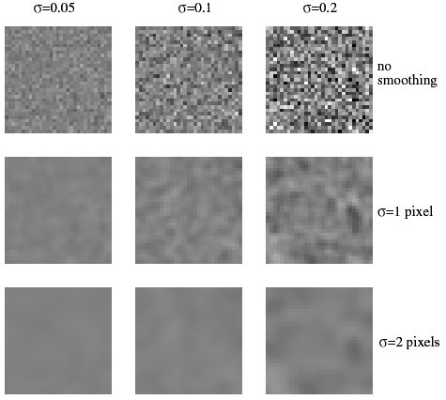
Reducing Gaussian noise
Smoothing with larger standard deviations suppresses noise, but also blurs the image
Source: S. Lazebnik

Slide 33
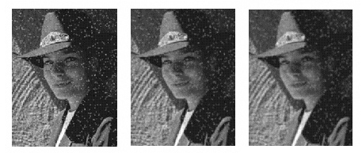
Reducing salt-and-pepper noise by Gaussian smoothing
3x3
5x5
7x7
Notes:
What’s wrong with these results?

Slide 34
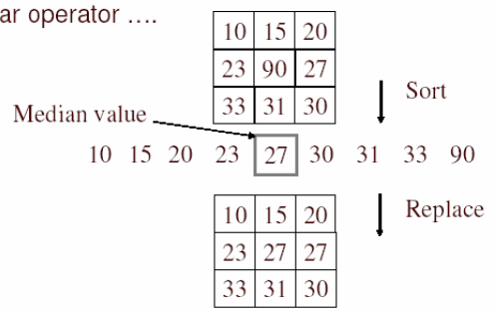
Alternative idea: Median filtering
A median filter operates over a window by selecting the median intensity in the window
Is median filtering linear?
Source: K. Grauman
Notes:
Better at salt’n’pepper noise
Not convolution: try a region with 1’s and a 2, and then 1’s and a 3

Slide 35
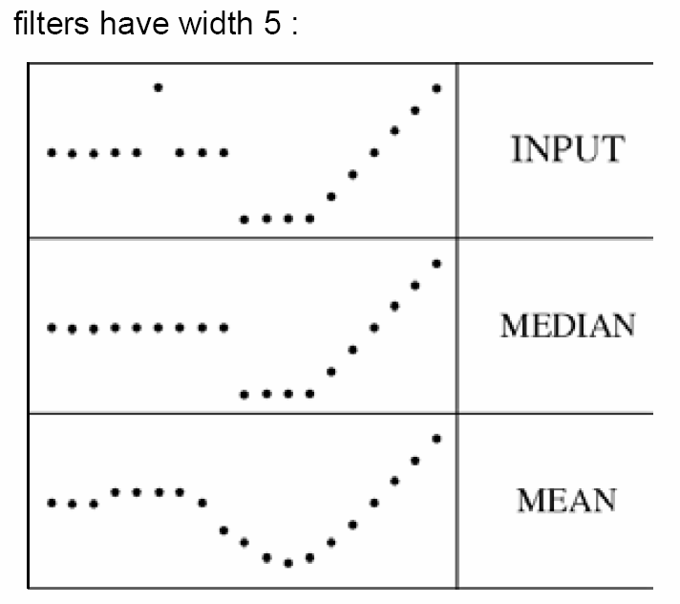
Median filter
What advantage does median filtering have over Gaussian filtering?
Robustness to outliers
Source: K. Grauman

Slide 36
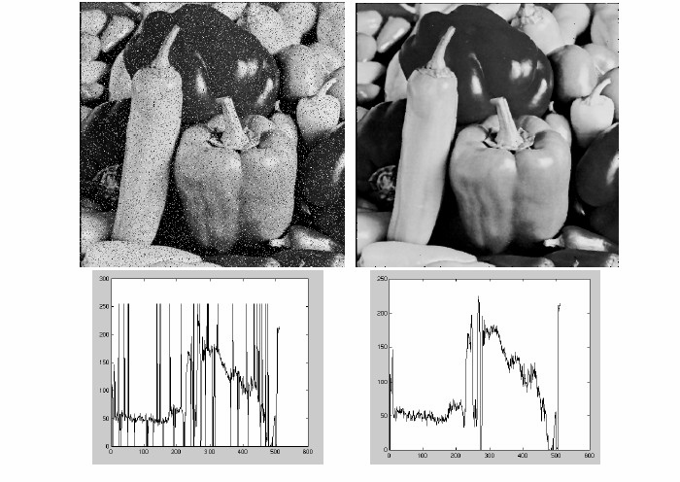
Median filter
Salt-and-pepper noise
Median filtered
MATLAB: medfilt2(image, [h w])
Source: M. Hebert

Slide 37
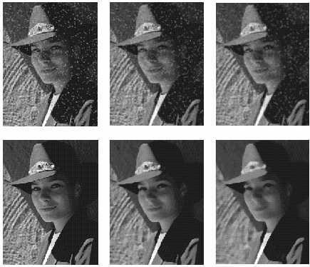
Median vs. Gaussian filtering
3x3
5x5
7x7
Gaussian
Median

Slide 38
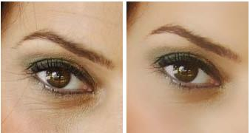
Other filter choices
Weighted median (pixels further from center count less)
Clipped mean (average, ignoring few brightest and darkest pixels)
Bilateral filtering (weight by spatial distance and intensity difference)
Bilateral filtering
Image:
http://vision.ai.uiuc.edu/?p=1455

Slide 39
Review of Last 3 Days
Filtering in spatial domain
Slide filter over image and take dot product at each position
Remember linearity (for linear filters)
Examples
1D: [-1 0 1], [0 0 0 0 0.5 1 1 1 0.5 0 0 0]
1D: [0.25 0.5 0.25], [0 0 0 0 0.5 1 1 1 0.5 0 0 0]
2D: [1 0 0 ; 0 2 0 ; 0 0 1]/4

Slide 40
Review of Last 3 Days
Linear filters for basic processing
Edge filter (high-pass)
Gaussian filter (low-pass)
[-1 1]
Gaussian
FFT of Gradient Filter
FFT of Gaussian

Slide 41
Review of Last 3 Days
Derivative of Gaussian

Slide 42
Review of Last 3 Days
Filtering in frequency domain
Can be faster than filtering in spatial domain (for large filters)
Can help understand effect of filter
Algorithm:
Convert image and filter to fft (fft2 in matlab)
Pointwise-multiply ffts
Convert result to spatial domain with ifft2

Slide 43
Review of Last 3 Days
Applications of filters
Template matching (SSD or Normxcorr2)
SSD can be done with linear filters, is sensitive to overall intensity
Gaussian pyramid
Coarse-to-fine search, multi-scale detection
Laplacian pyramid
Can be used for blending (later)
More compact image representation

Slide 44
Review of Last 3 Days
Applications of filters
Downsampling
Need to sufficiently low-pass before downsampling
Compression
In JPEG, coarsely quantize high frequencies
Reducing noise (important for aesthetics and for later processing such as edge detection)
Gaussian filter, median filter, bilateral filter

Slide 45
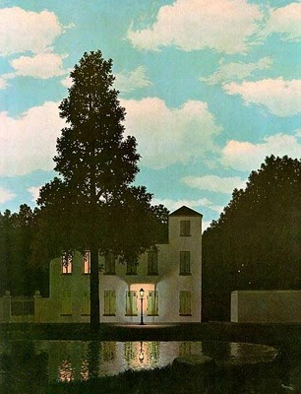
Next class
Light and color

