Slide 1
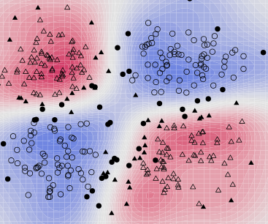
Neural networks and support vector machines

Slide 2
Outline
Neural Networks
Perceptron review
Differentiable perceptron
Multilayer perceptron
Support vector machine (SVM)
Other Machine Learning Tasks
Structured prediction
Clustering, quantization, density estimation
Semi-supervised and active learning

Slide 3
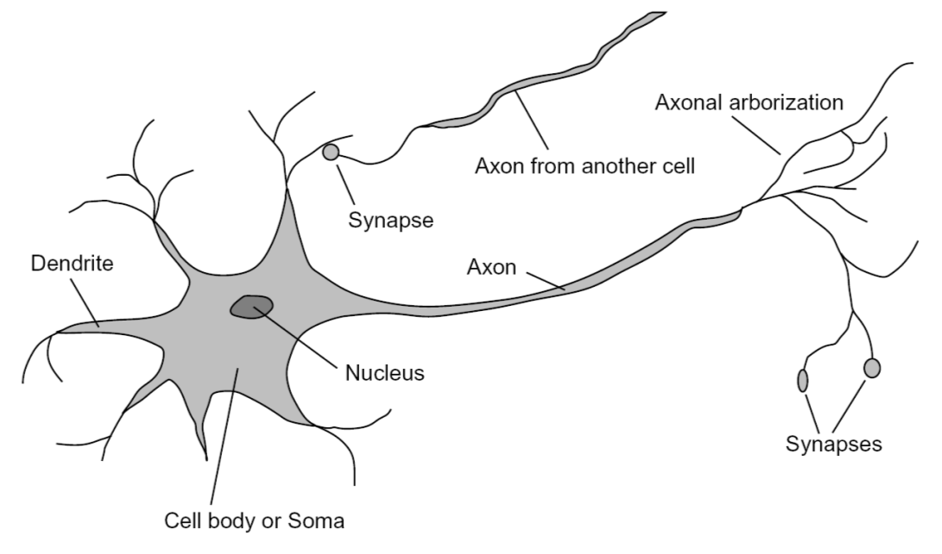
Loose inspiration: Human neurons
Notes:
From Wikipedia: At the majority of synapses, signals are sent from the axon of one neuron to a dendrite of another... All neurons are electrically excitable, maintaining voltage gradients across their membranes… If the voltage changes by a large enough amount, an all-or-none electrochemical pulse called an action potential is generated, which travels rapidly along the cell's axon, and activates synaptic connections with other cells when it arrives.

Slide 4
Perceptron
Input
Weights
x₁
w₁
x₂
w₂
Output: sgn(w⋅x + b)
x₃
w₃
.
.
.
Can incorporate bias as component of the weight vector by always including a feature with value set to 1
w_{D}
x_{D}

Slide 5
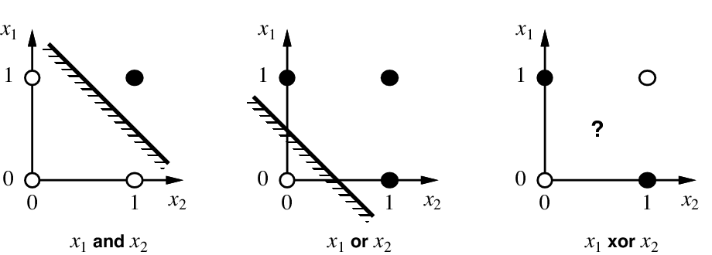
Linear separability

Slide 6
Perceptron update rule
For each training instance x with label y:
Classify with current weights: y’ = sgn(w⋅x)
Update weights: w ← w + α(y-y’)x
α is a learning rate that should decay as a function of epoch t, e.g., 1000/(1000+t)
What happens if y’ is correct?
Otherwise, consider what happens to individual weights w_{i} ← w_{i} + α(y-y’)x_{i}
If y = 1 and y’ = -1, w_{i} will be increased if x_{i} is positive or decreased if x_{i} is negative → w⋅x will get bigger
If y = -1 and y’ = 1, w_{i} will be decreased if x_{i} is positive or increased if x_{i} is negative → w⋅x will get smaller

Slide 7
Outline
Neural Networks
Perceptron review
Differentiable perceptron
Multilayer perceptron
Support vector machine (SVM)
Other Machine Learning Tasks
Structured prediction
Clustering, quantization, density estimation
Semi-supervised and active learning

Slide 8
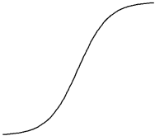
Differentiable perceptron
Input
Weights
x₁
w₁
x₂
w₂
Output: σ(w⋅x + b)
x₃
w₃
.
.
.
Sigmoid function:
w_{d}
x_{d}

Slide 9
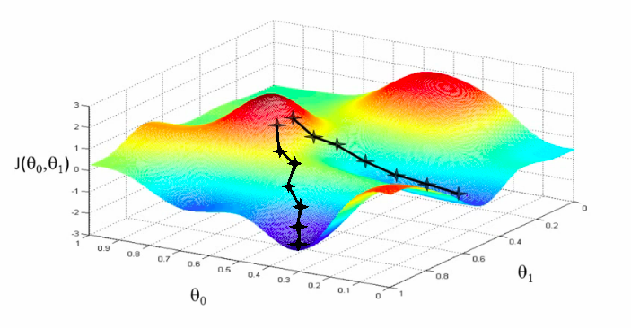
Update rule for differentiable perceptron
Define total classification error or loss on the training set:
Update weights by gradient descent:
w₂
w₁

Slide 10
Update rule for differentiable perceptron
Define total classification error or loss on the training set:
Update weights by gradient descent:
For a single training point, the update is:

Slide 11
Update rule for differentiable perceptron
For a single training point, the update is:
Compare with update rule with non-differentiable perceptron:

Slide 12
Outline
Neural Networks
Perceptron review
Differentiable perceptron
Multilayer perceptron
Support vector machine (SVM)
Other Machine Learning Tasks
Structured prediction
Clustering, quantization, density estimation
Semi-supervised and active learning

Slide 13
Linear separability

Slide 14
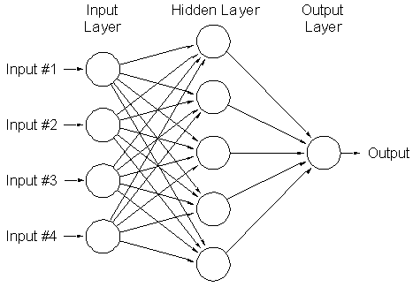
Multi-Layer Neural Network
weights w’
weights w_{j}
Can learn nonlinear functions

Slide 15
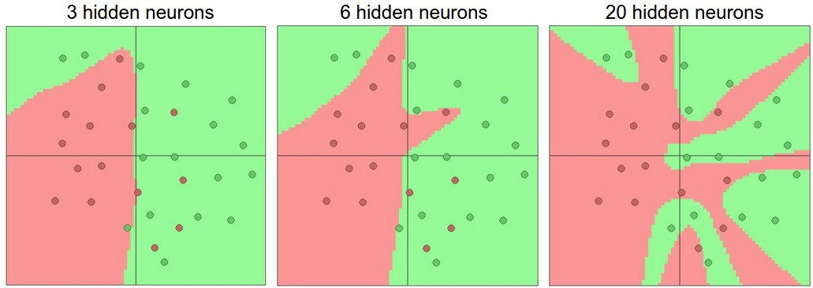
Multi-Layer Neural Network
Hidden layer size and network capacity:
Source: http://cs231n.github.io/neural-networks-1/

Slide 16
Multi-Layer Neural Network
Training: find network weights to minimize the error between true and estimated labels of training examples:
Minimization can be done by gradient descent provided f is differentiable
This training method is called back-propagation

Slide 17
Multi-Layer Neural Network
Regularization: add a penalty on weight magnitudes to the objective function:
Discourages network weights from growing too large, encourages network to use all of its inputs “a little” rather than a few inputs “a lot”

Slide 18
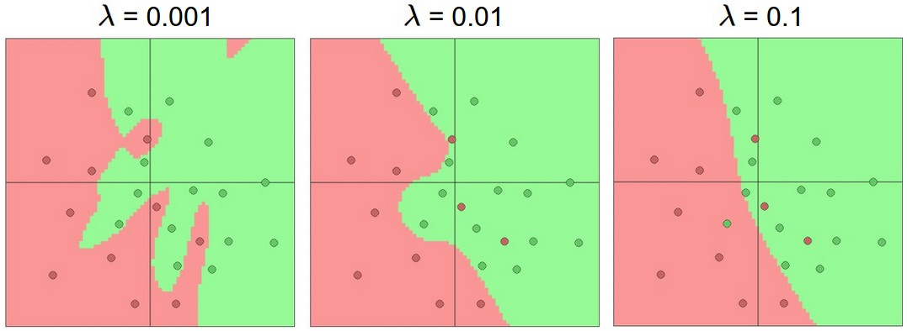
Multi-Layer Neural Network
Hidden layer size and network capacity (each network has 20 units in hidden layer):
Source: http://cs231n.github.io/neural-networks-1/

Slide 19
Neural networks: Pros and cons
Pros
Flexible and general function approximation framework
Can build extremely powerful models by adding more layers
Cons
Hard to analyze theoretically (e.g., training is prone to local optima)
Huge amount of training data, computing power required to get good performance
The space of implementation choices is huge (network architectures, parameters)

Slide 20
Outline
Neural Networks
Perceptron review
Differentiable perceptron
Multilayer perceptron
Support vector machine (SVM)
Other Machine Learning Tasks
Structured prediction
Clustering, quantization, density estimation
Semi-supervised and active learning

Slide 21
Linear separability

Slide 22
Support vector machines
When the data are linearly separable, there may be more than one separator (hyperplane)
Which separator is best?

Slide 23
Support vector machines
Find hyperplane that maximizes the margin between the positive and negative examples
Support vectors
Margin
C. Burges, A Tutorial on Support Vector Machines for Pattern Recognition, Data Mining and Knowledge Discovery, 1998

Slide 24
SVM parameter learning
Separable data:
Non-separable data:
Maximize margin
Classify training data correctly
Maximize margin
Minimize classification mistakes

Slide 25
SVM parameter learning
w·x+b=+1
Margin
w·x+b=0
w·x+b=-1
Demo: http://cs.stanford.edu/people/karpathy/svmjs/demo

Slide 26
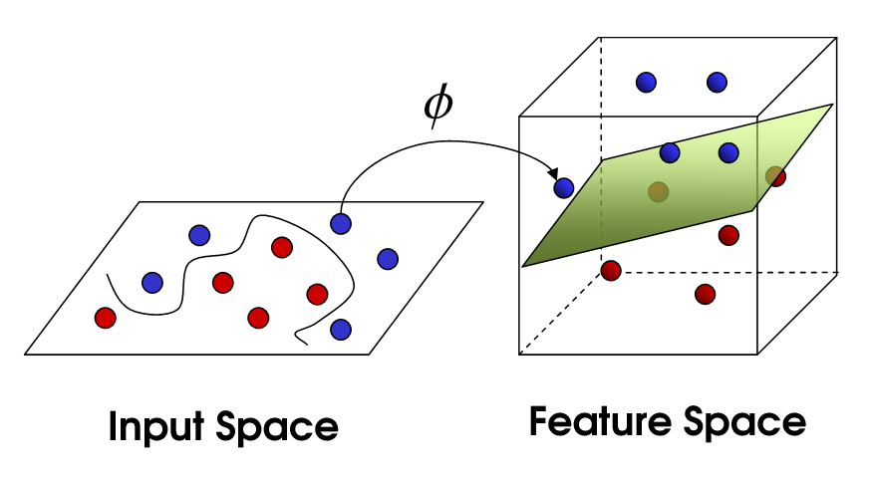
Nonlinear SVMs
General idea: the original input space can always be mapped to some higher-dimensional feature space where the training set is separable
Φ: x → φ(x)
Image source

Slide 27
Nonlinear SVMs
Linearly separable dataset in 1D:
Non-separable dataset in 1D:
We can map the data to a higher-dimensional space:
0
x
0
x
x²
0
x
Slide credit: Andrew Moore

Slide 28
The kernel trick
General idea: the original input space can always be mapped to some higher-dimensional feature space where the training set is separable
The kernel trick: instead of explicitly computing the lifting transformation φ(x), define a kernel function K such that K(x , y) = φ(x) · φ(y)
(to be valid, the kernel function must satisfy Mercer’s condition)

Slide 29
The kernel trick
Linear SVM decision function:
learned weight
Support vector
C. Burges, A Tutorial on Support Vector Machines for Pattern Recognition, Data Mining and Knowledge Discovery, 1998

Slide 30
The kernel trick
Linear SVM decision function:
Kernel SVM decision function:
This gives a nonlinear decision boundary in the original feature space
C. Burges, A Tutorial on Support Vector Machines for Pattern Recognition, Data Mining and Knowledge Discovery, 1998

Slide 31
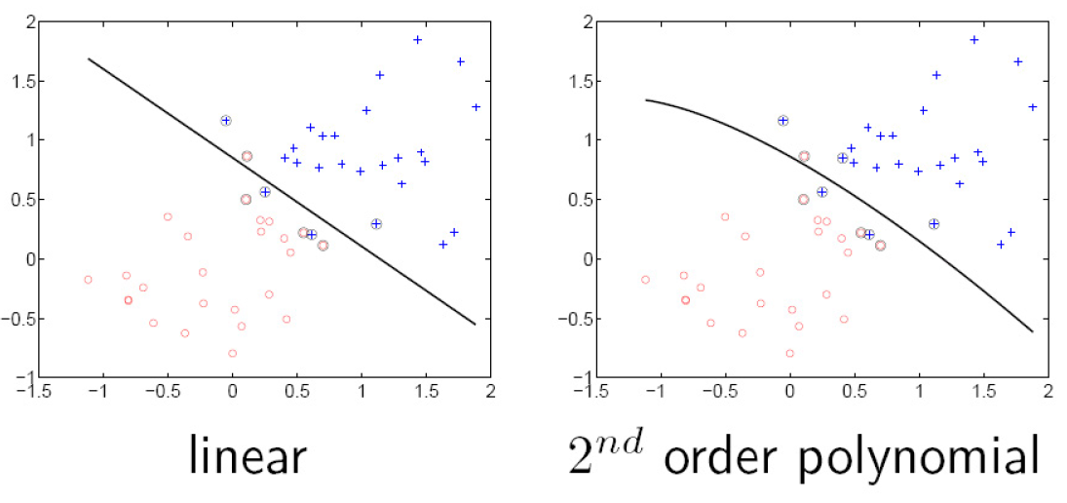
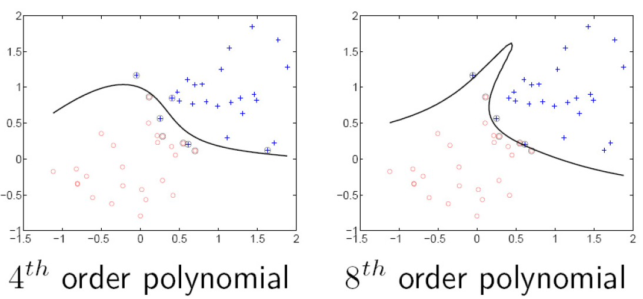
Polynomial kernel:

Slide 32
Gaussian kernel
Also known as the radial basis function (RBF) kernel:
K(x, y)
||x – y||

Slide 33
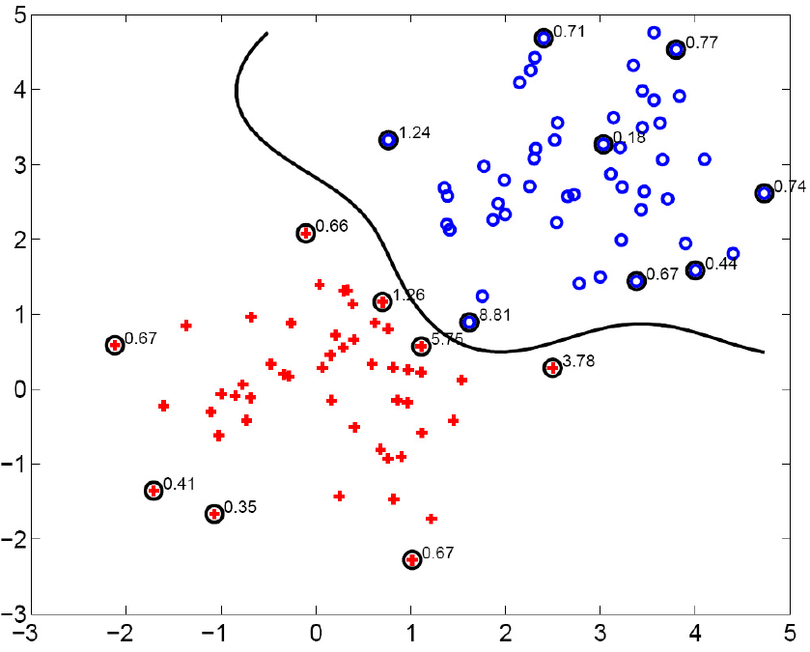
Gaussian kernel
SV’s

Slide 34
SVMs: Pros and cons
Pros
Kernel-based framework is very powerful, flexible
Training is convex optimization, globally optimal solution can be found
Amenable to theoretical analysis
SVMs work very well in practice, even with very small training sample sizes
Cons
No “direct” multi-class SVM, must combine two-class SVMs (e.g., with one-vs-others)
Computation, memory (esp. for nonlinear SVMs)

Slide 35
Outline
Neural Networks
Perceptron review
Differentiable perceptron
Multilayer perceptron
Support vector machine (SVM)
Other Machine Learning Tasks
Structured prediction
Clustering, quantization, density estimation
Semi-supervised and active learning

Slide 36
Other machine learning scenarios
Other prediction scenarios
Regression
Structured prediction
Other supervision scenarios
Unsupervised learning
Semi-supervised learning
Active learning
Lifelong learning

Slide 37
Beyond simple classification: Structured prediction
Word
Image
Source: B. Taskar

Slide 38
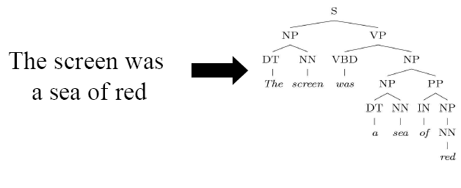
Structured Prediction
Parse tree
Sentence
Source: B. Taskar

Slide 39
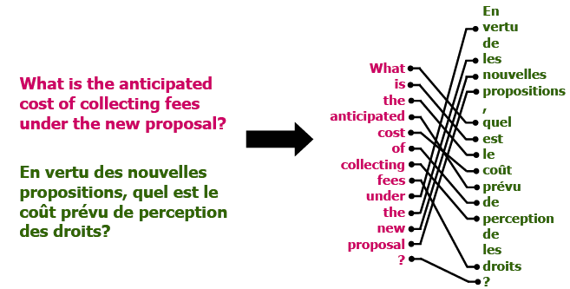
Structured Prediction
Sentence in two languages
Word alignment
Source: B. Taskar

Slide 40
Structured Prediction
Amino-acid sequence
Bond structure
Source: B. Taskar

Slide 41
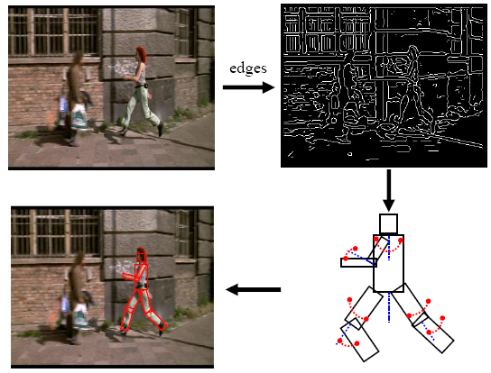
Structured Prediction
Many image-based inference tasks can loosely be thought of as “structured prediction”
model
Source: D. Ramanan

Slide 42
Outline
Neural Networks
Perceptron review
Differentiable perceptron
Multilayer perceptron
Support vector machine (SVM)
Other Machine Learning Tasks
Structured prediction
Clustering, quantization, density estimation
Semi-supervised and active learning

Slide 43
Unsupervised Learning
Idea: Given only unlabeled data as input, learn some sort of structure
The objective is often more vague or subjective than in supervised learning
This is more of an exploratory/descriptive data analysis

Slide 44
Unsupervised Learning
Clustering
Discover groups of “similar” data points

Slide 45
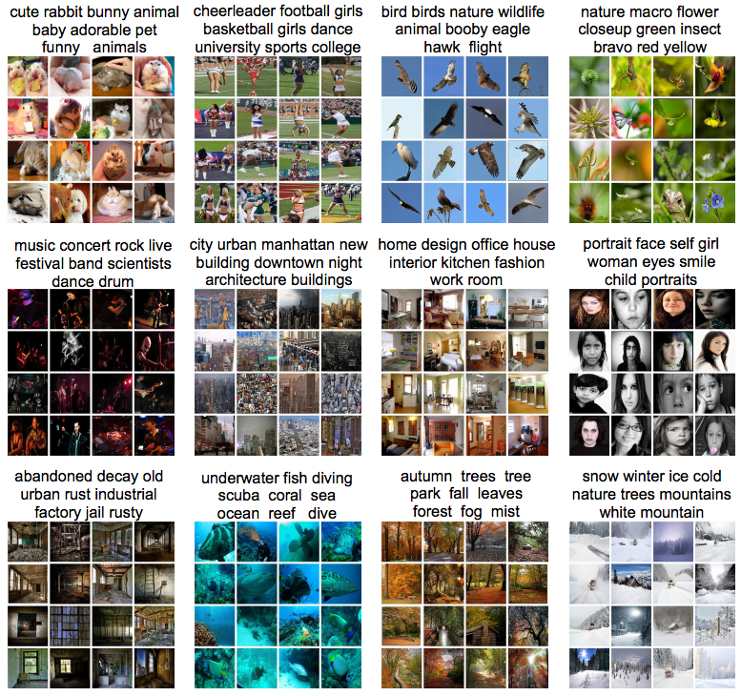

Slide 46
Unsupervised Learning
Quantization
Map a continuous input to a discrete (more compact) output
2
1
3

Slide 47
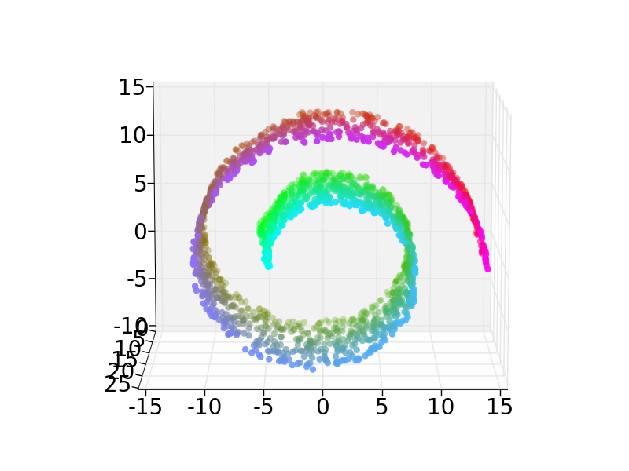
Unsupervised Learning
Dimensionality reduction, manifold learning
Discover a lower-dimensional surface on which the data lives

Slide 48
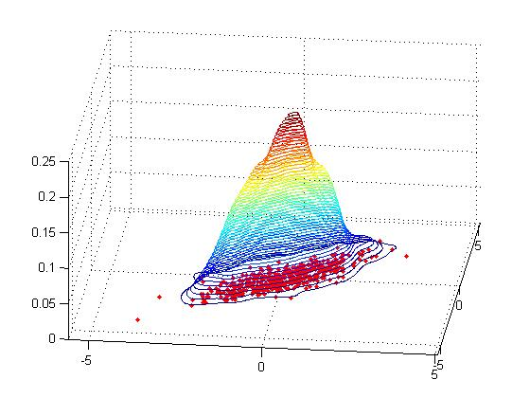
Unsupervised Learning
Density estimation
Find a function that approximates the probability density of the data (i.e., value of the function is high for “typical” points and low for “atypical” points)
Can be used for anomaly detection

Slide 49
Outline
Neural Networks
Perceptron review
Differentiable perceptron
Multilayer perceptron
Support vector machine (SVM)
Other Machine Learning Tasks
Structured prediction
Clustering, quantization, density estimation
Semi-supervised and active learning

Slide 50
Semi-supervised learning
Lots of data are available, but only small portion is labeled (e.g. since labeling is expensive)
Why is learning from labeled and unlabeled data better than learning from labeled data alone?
?

Slide 51
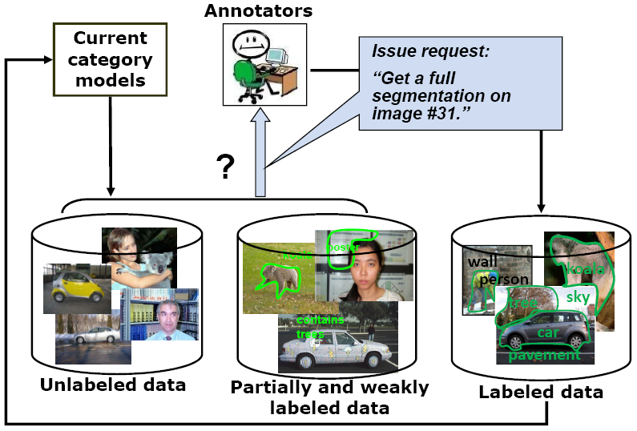
Active learning
The learning algorithm can choose its own training examples, or ask a “teacher” for an answer on selected inputs
S. Vijayanarasimhan and K. Grauman, “Cost-Sensitive Active Visual Category Learning,” 2009

Slide 52
Lifelong learning
http://rtw.ml.cmu.edu/rtw/

Slide 53
Lifelong learning
http://rtw.ml.cmu.edu/rtw/

Slide 54
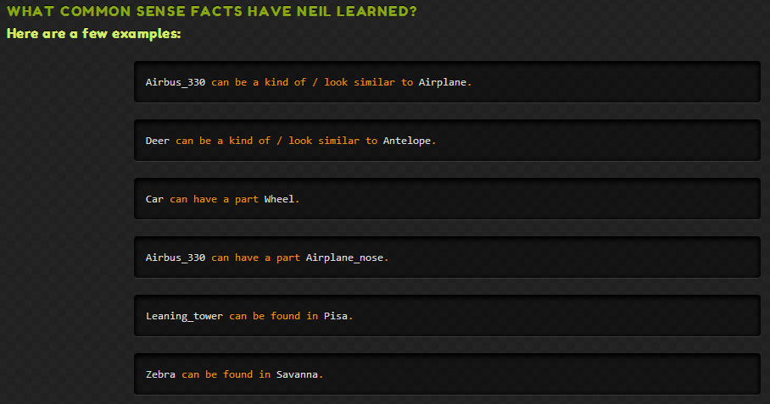
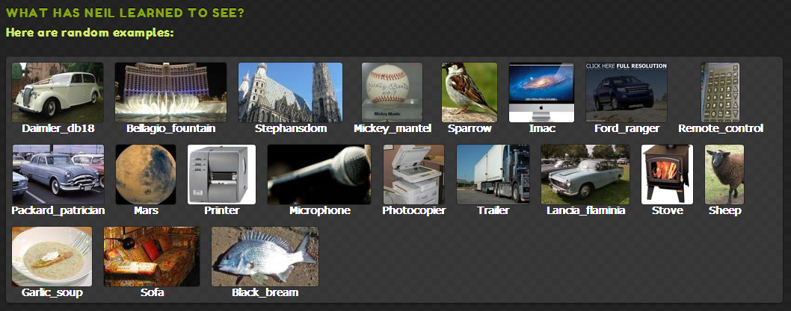
Xinlei Chen, Abhinav Shrivastava and Abhinav Gupta. NEIL: Extracting Visual Knowledge from Web Data. In ICCV 2013

Slide 55
Outline
Neural Networks
Perceptron review
Differentiable perceptron
Multilayer perceptron
Support vector machine (SVM)
Other Machine Learning Tasks
Structured prediction
Unsupervised learning
Clustering, quantization, density estimation
Semi-supervised and active learning
Example: the Never-Ending Language Learner

