Slide 1
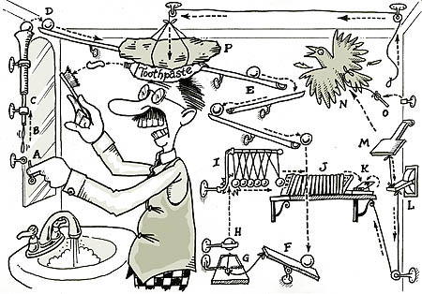
Planning (Chapter 10)
http://en.wikipedia.org/wiki/Rube_Goldberg_machine

Slide 2
Planning
Problem: I’m at home and I need milk, bananas, and a drill.
How is planning different from regular search?
States and action sequences typically have complex internal structure
State space and branching factor are huge
Multiple subgoals at multiple levels of resolution
Examples of planning applications
Scheduling of tasks in space missions
Logistics planning for the army
Assembly lines, industrial processes
Robotics
Games, storytelling

Slide 3
A representation for planning
STRIPS (Stanford Research Institute Problem Solver): classical planning framework from the 1970s
States are specified as conjunctions of predicates
Start state: At(home) ∧ Sells(SM, Milk) ∧ Sells(SM, Bananas) ∧ Sells(HW, drill)
Goal state: At(home) ∧ Have(Milk) ∧ Have(Banana) ∧ Have(drill)
Actions are described in terms of preconditions and effects:
Go(x, y)
Precond: At(x)
Effect: ¬At(x) ∧ At(y)
Buy(x, store)
Precond: At(store) ∧ Sells(store, x)
Effect: Have(x)
Planning is “just” a search problem

Slide 4
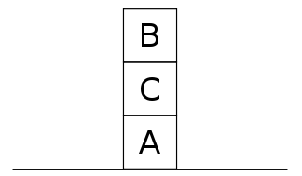
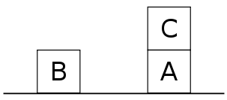
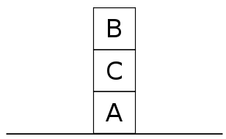
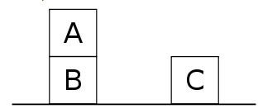
Challenges of planning: “Sussman anomaly”
Start state:
Goal state:
On(A,B)
On(B,C)
Let’s try to achieve On(A,B):
Let’s try to achieve On(B,C):
http://en.wikipedia.org/wiki/Sussman_Anomaly

Slide 5
Challenges of planning: “Sussman anomaly”
Shows the limitations of non-interleaved planners that consider subgoals in sequence and try to satisfy them one at a time
If you try to satisfy subgoal X and then subgoal Y, X might undo some preconditions for Y, or Y might undo some effects of X
More powerful planning approaches must interleave the steps towards achieving multiple subgoals
http://en.wikipedia.org/wiki/Sussman_Anomaly

Slide 6
Algorithms for planning
Forward (progression) state-space search: starting with the start state, find all applicable actions (actions for which preconditions are satisfied), compute the successor state based on the effects, keep searching until goals are met
Can work well with good heuristics
https://www.youtube.com/watch?v=QLNSkFnBYuM

Slide 7
Algorithms for planning
Forward (progression) state-space search: starting with the start state, find all applicable actions (actions for which preconditions are satisfied), compute the successor state based on the effects, keep searching until goals are met
Can work well with good heuristics
Backward (regression) relevant-states search: to achieve a goal, what must have been true in the previous state?

Slide 8
Situation space planning vs. plan space planning
Situation space planners: each node in the search space represents a world state, arcs are actions in the world
Plans are sequences of actions from start to finish
Must be totally ordered
Plan space planners: nodes are (incomplete) plans, arcs are transformations between plans
Actions in the plan may be partially ordered
Principle of least commitment: avoid ordering plan steps unless absolutely necessary

Slide 9
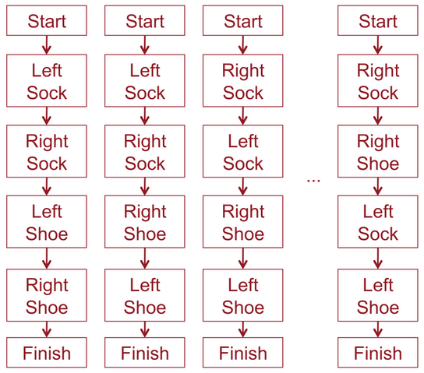
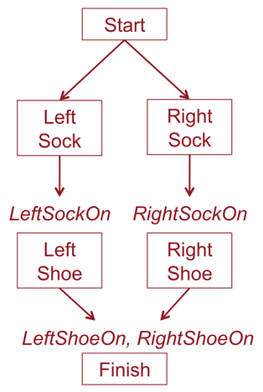
Partial order planning
Task: put on socks and shoes
Partial order plan
Total order (linear) plans

Slide 10
Partial Order Planning Example
Start
Sells(SM, Milk)
At(Home)
Sells(SM, Bananas)
Start: empty plan
Action: find flaw in the plan and modify plan to fix the flaw
Have(Milk)
Have(Bananas)
Finish

Slide 11
Partial Order Planning Example
Start
Sells(SM, Milk)
At(Home)
Sells(SM, Bananas)
At(x3)
Go(x3, SM)
At(SM)
Sells(x1, Milk)
At(x1)
At(x2)
Sells(x2, Bananas)
Buy(x1, Milk)
Buy(x2, Bananas)
Have(Milk)
Have(Bananas)
x1 = SM
Have(Milk)
Have(Bananas)
x2 = SM
x3 = Home
Finish

Slide 12
Application of planning: Automated storytelling
https://research.cc.gatech.edu/inc/mark-riedl

Slide 13
Application of planning: Automated storytelling
Applications
Personalized experience in games
Automatically generating training scenarios (e.g., for the army)
Therapy for kids with autism
Computational study of creativity
https://research.cc.gatech.edu/inc/mark-riedl

Slide 14
Complexity of planning
Planning is PSPACE-complete
The length of a plan can be exponential in the number of “objects” in the problem!
Example: towers of Hanoi

Slide 15
Complexity of planning
Planning is PSPACE-complete
The length of a plan can be exponential in the number of “objects” in the problem!
So is game search
Archetypal PSPACE-complete problem: quantified boolean formula (QBF)
Example: is this formula true? ∃x₁∀x₂ ∃x₃∀x₄ (x₁∨¬x₃∨x₄)∧(¬x₂∨x₃∨¬x₄)
Compare to SAT: ∃x₁ ∃x₂ ∃x₃ ∃x₄ (x₁∨¬x₃∨x₄)∧(¬x₂∨x₃∨¬x₄)
Relationship between SAT and QBF is akin to the relationship between puzzles and games

Slide 16
Real-world planning
Resource constraints
Actions at different levels of granularity: hierarchical planning
Incorporating sensing and feedback
Contingencies: actions failing
Uncertainty

