Slide 1
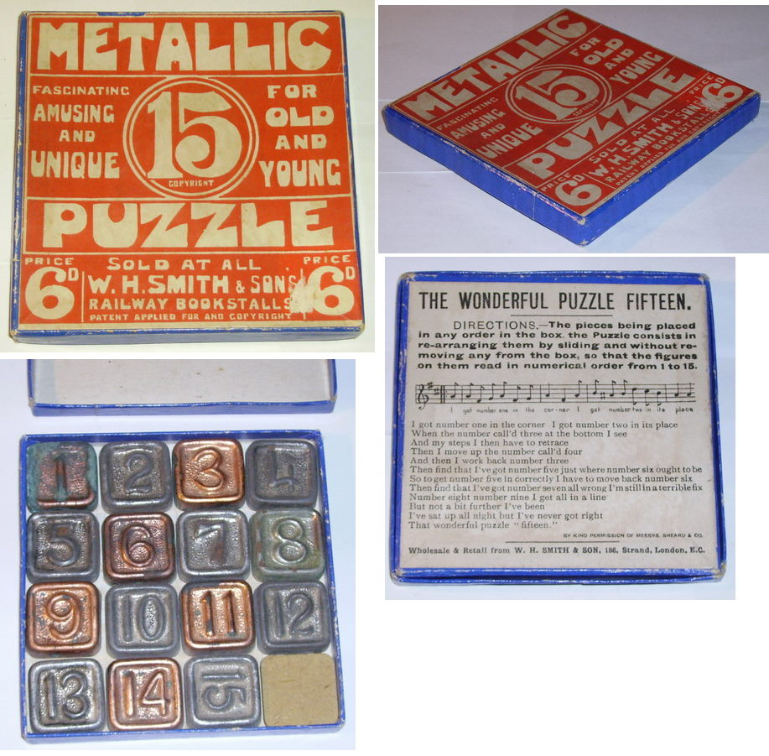
Solving problems by searching
Chapter 3

Slide 2
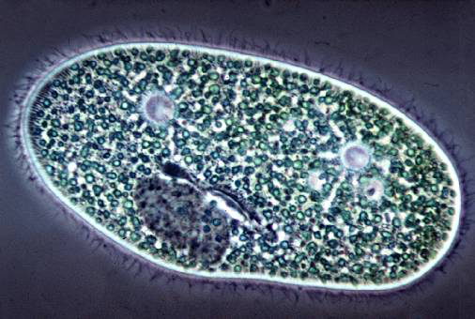
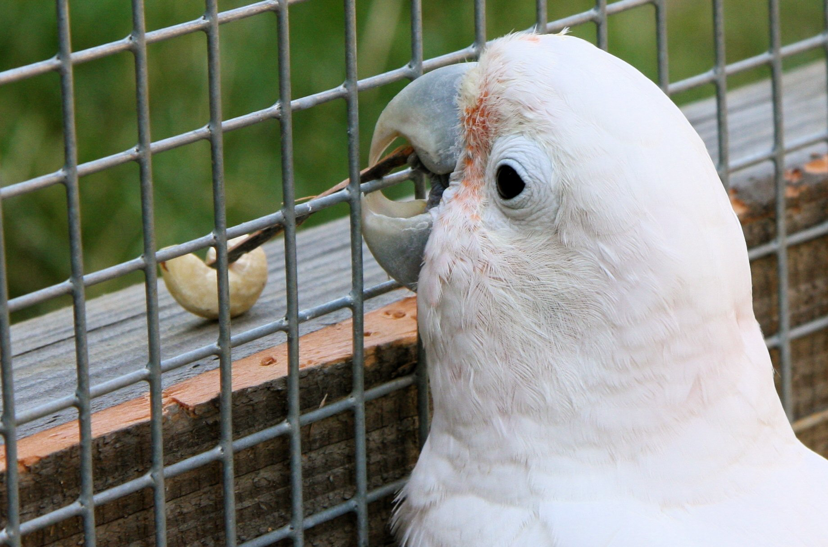
Types of agents
Reflex agent
Planning agent
Consider how the world IS
Choose action based on current percept
Do not consider the future consequences of actions
Consider how the world WOULD BE
Decisions based on (hypothesized) consequences of actions
Must have a model of how the world evolves in response to actions
Must formulate a goal
Source: D. Klein, P. Abbeel
Notes:
Can a reflex agent be rational?

Slide 3
Search
We will consider the problem of designing goal-based agents in fully observable, deterministic, discrete, known environments
Start state
Goal state

Slide 4
Search
We will consider the problem of designing goal-based agents in fully observable, deterministic, discrete, known environments
The agent must find a sequence of actions that reaches the goal
The performance measure is defined by (a) reaching the goal and (b) how “expensive” the path to the goal is
We are focused on the process of finding the solution; while executing the solution, we assume that the agent can safely ignore its percepts (open-loop system)

Slide 5
Search problem components
Problem={I,A,T,G,C}
I = Initial state
A = Set of Actions
T = Transition model
What state results from performing a given action in a given state?
G = Goal state
C = Path cost
Assume that it is a sum of nonnegative step costs
The optimal solution is the sequence of actions that gives the lowest path cost for reaching the goal
Initial
state
Goal state

Slide 6
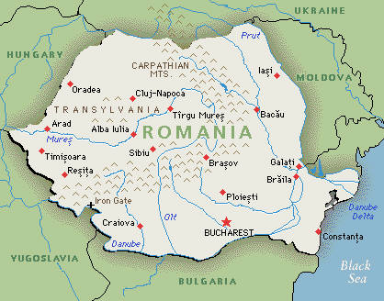
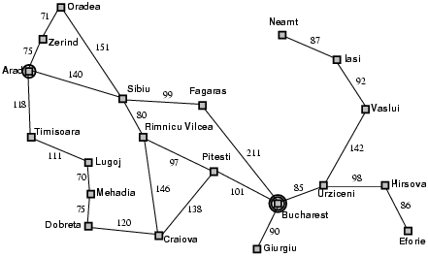
Example: Romania
On vacation in Romania; currently in Arad
Flight leaves tomorrow from Bucharest
Initial state
Arad
Actions
Go from one city to another
Transition model
If you go from city A to city B, you end up in city B
Goal state
Bucharest
Path cost
Sum of edge costs (total distance traveled)

Slide 7
State space
The initial state, actions, and transition model define the state space of the problem
State = all the information you need to decide what to do next
State space = The set of all states reachable from initial state by any sequence of actions
Can be represented as a directed graph where the nodes are states and links between nodes are actions
What is the state space for the Romania problem?

Slide 8
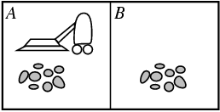
Example: Vacuum world
States
Agent location and dirt location
How many possible states?
What if there are n possible locations?
The size of the state space grows exponentially with the “size” of the world!
Actions
Left, right, suck
Transition model

Slide 9
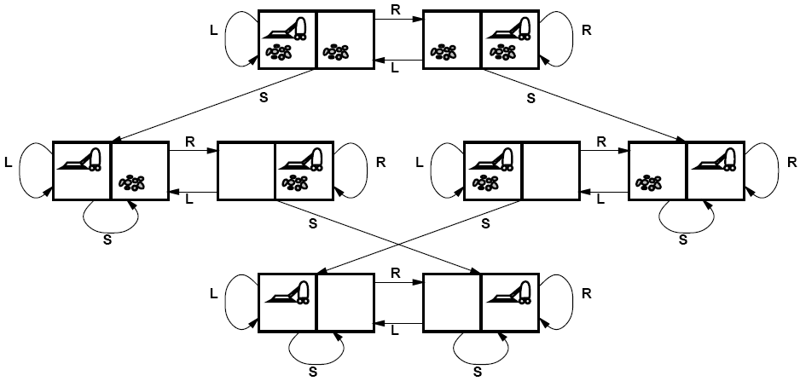
Vacuum world state space graph

Slide 10
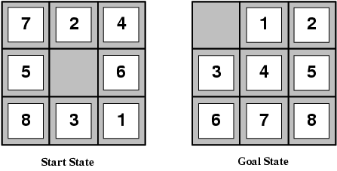
Example: The 8-puzzle
States
Locations of tiles
8-puzzle: 181,440 states (9!/2)
15-puzzle: ~10 trillion states
24-puzzle: ~10²⁵ states
Actions
Move blank left, right, up, down
Path cost
1 per move
Finding the optimal solution of n-Puzzle is NP-hard

Slide 11
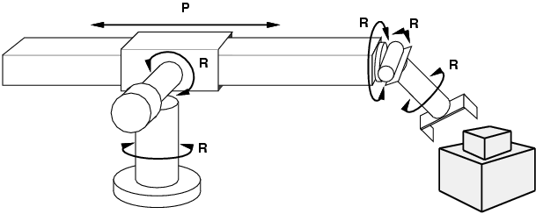
Example: Robot motion planning
States
Real-valued joint parameters (angles, displacements)
Actions
Continuous motions of robot joints
Goal state
Configuration in which object is grasped
Path cost
Time to execute, smoothness of path, etc.

Slide 12
Search
Given:
Initial state
Actions
Transition model
Goal state
Path cost
How do we find the optimal solution?
How about building the state space and then using Dijkstra’s shortest path algorithm?
Complexity of Dijkstra’s is O(E + V log V), where V is the size of the state space
The state space may be huge!
Basic problem: Dijkstra starts by enumerating all possible states.

Slide 13
Search: Basic idea
Let’s begin at the start state and expand it by making a list of all possible successor states
Maintain a frontier or a list of unexpanded states
At each step, pick a state from the frontier to expand
Keep going until you reach a goal state
Try to expand as few states as possible

Slide 14
Search tree
“What if” tree of sequences of actions and outcomes
The root node corresponds to the starting state
The children of a node correspond to the successor states of that node’s state
A path through the tree corresponds to a sequence of actions
A solution is a path ending in the goal state
Nodes vs. states
A state is a representation of the world, while a node is a data structure that is part of the search tree
Node has to keep pointer to parent, path cost, possibly other info
Starting state
Action
Successor state
…
…
…
…
Goal state

Slide 15
Tree Search Algorithm Outline
Initialize the frontier using the starting state
While the frontier is not empty
Choose a frontier node according to search strategy and take it off the frontier
If the node contains the goal state, return solution
Else expand the node and add its children to the frontier

Slide 16
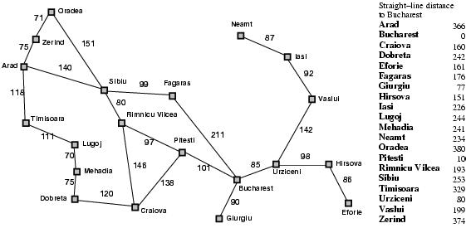
Tree search example
Start: Arad
Goal: Bucharest

Slide 17
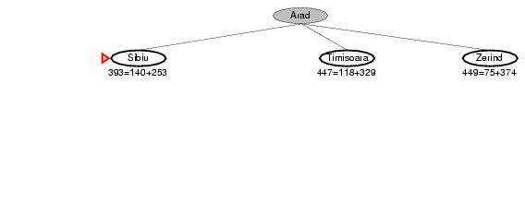
Tree search example
Start: Arad
Goal: Bucharest

Slide 18
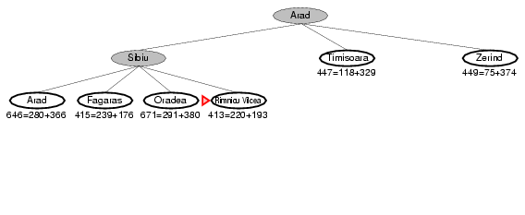
Tree search example
Start: Arad
Goal: Bucharest

Slide 19
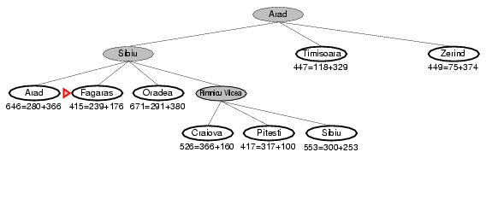
Tree search example
Start: Arad
Goal: Bucharest

Slide 20
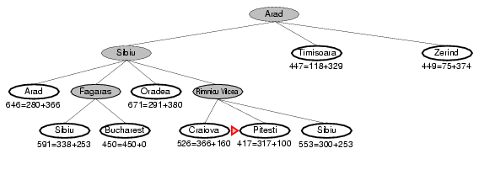
Tree search example
Start: Arad
Goal: Bucharest

Slide 21
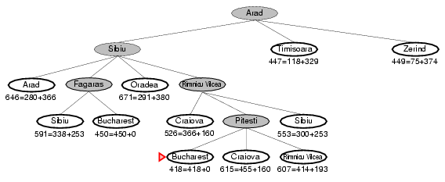
Tree search example
Start: Arad
Goal: Bucharest

Slide 22
Tree search example
Start: Arad
Goal: Bucharest
Notes:
This search tree is infinitely deep, contains redundant paths

Slide 23
Handling repeated states
Initialize the frontier using the starting state
While the frontier is not empty
Choose a frontier node according to search strategy and take it off the frontier
If the node contains the goal state, return solution
Else expand the node and add its children to the frontier
To handle repeated states:
Every time you expand a node, add that state to the explored set; do not put explored states on the frontier again
Every time you add a node to the frontier, check whether it already exists in the frontier with a higher path cost, and if yes, replace that node with the new one

Slide 24
Search without repeated states
Start: Arad
Goal: Bucharest

Slide 25
Search without repeated states
Start: Arad
Goal: Bucharest

Slide 26
Search without repeated states
Start: Arad
Goal: Bucharest

Slide 27
Search without repeated states
Start: Arad
Goal: Bucharest

Slide 28
Search without repeated states
Start: Arad
Goal: Bucharest

Slide 29
Search without repeated states
Start: Arad
Goal: Bucharest

Slide 30
Search without repeated states
Start: Arad
Goal: Bucharest

