Slide 1
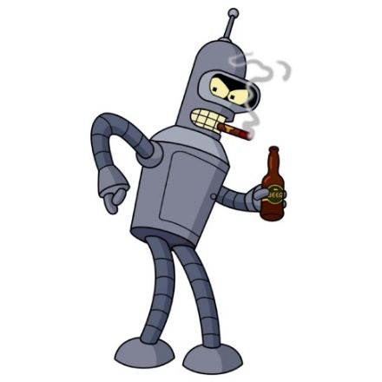
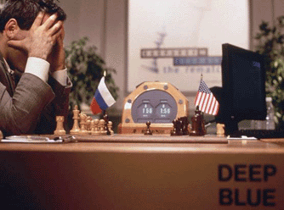
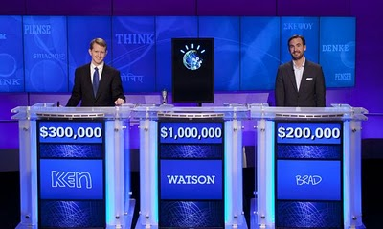
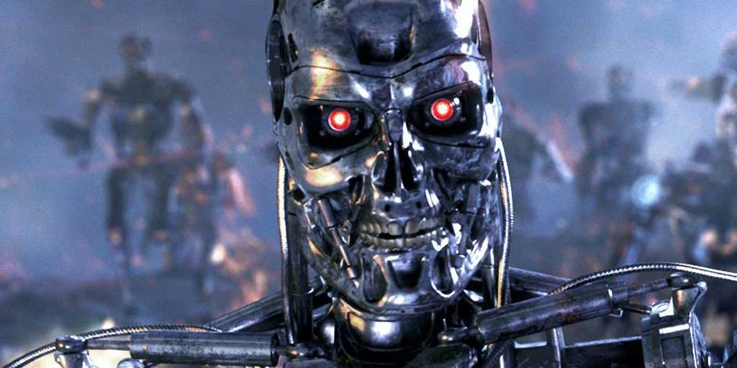
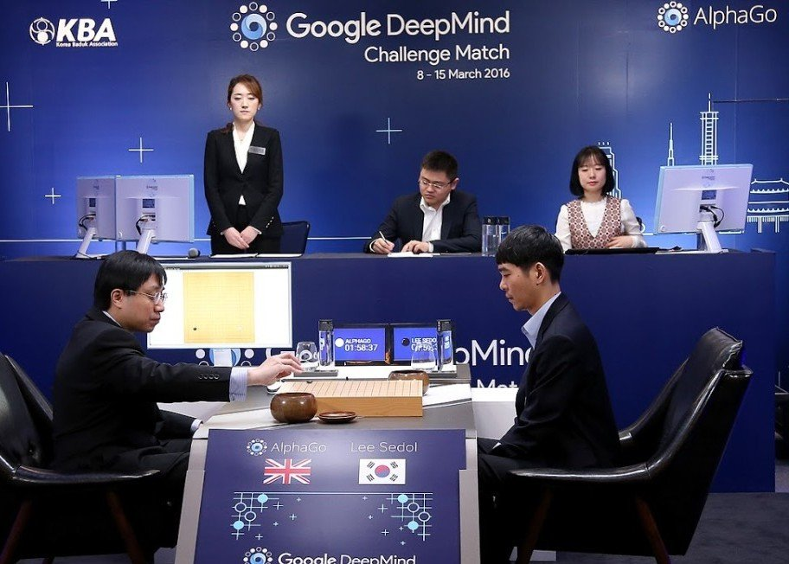
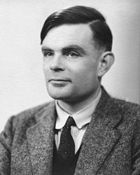
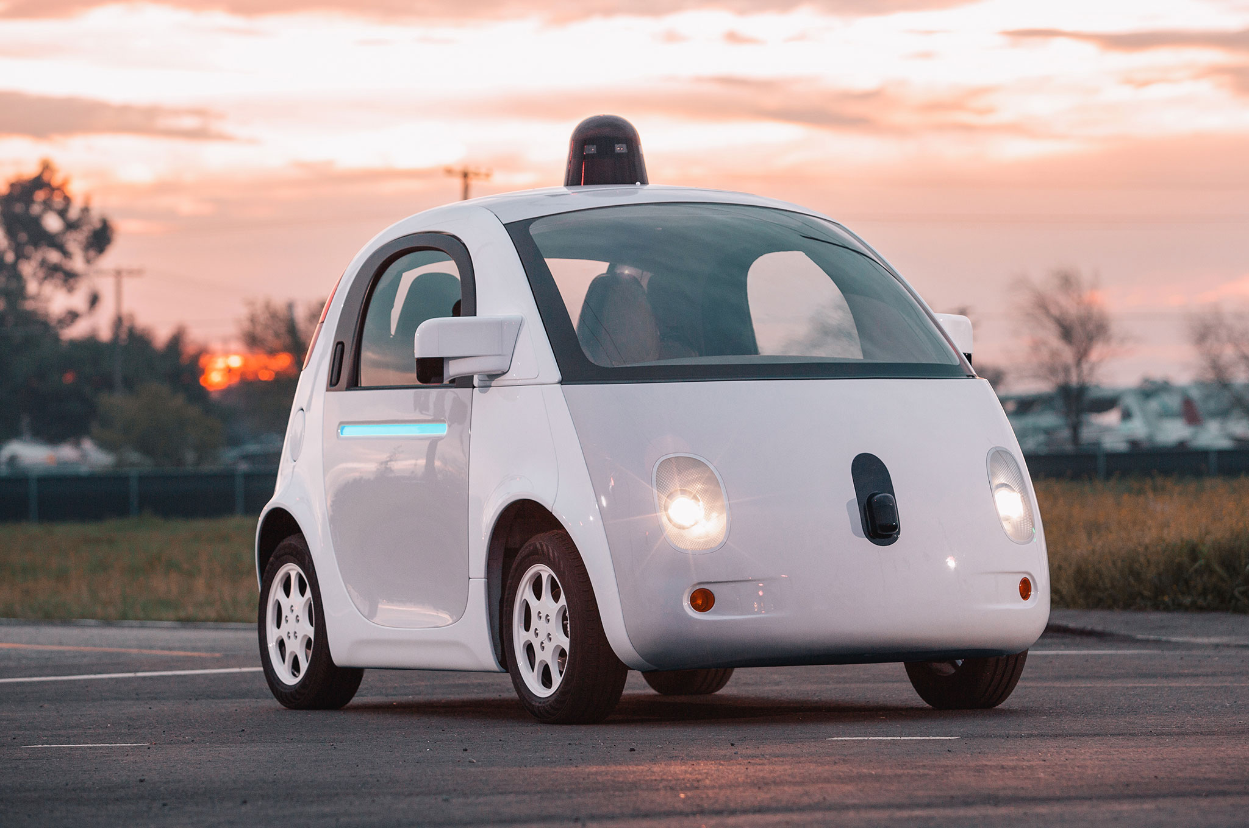
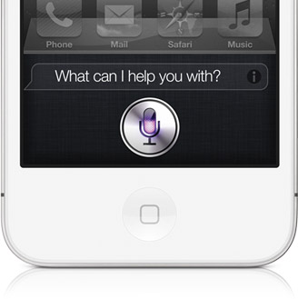
CS440/ECE448: Artificial Intelligence

Slide 2
CS440/ECE448: Artificial Intelligence
Website:
http:/courses.engr.Illinois.edu/cs440/R.html

Slide 3
What is AI?
Candidate definitions from the textbook:
1. Thinking humanly | 2. Acting humanly
3. Thinking rationally | 4. Acting rationally

Slide 4
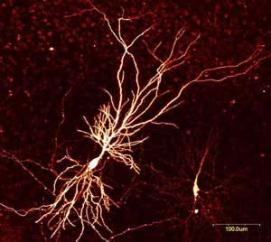
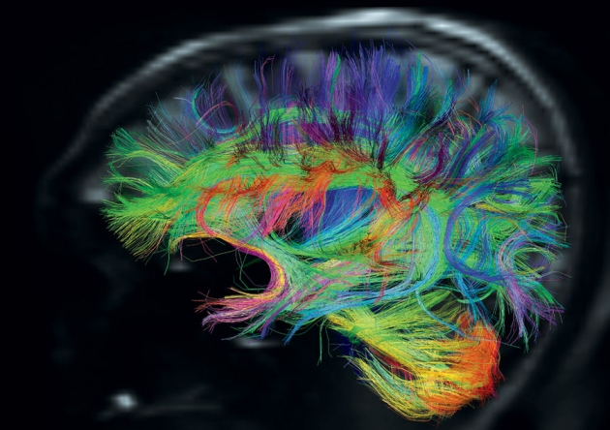
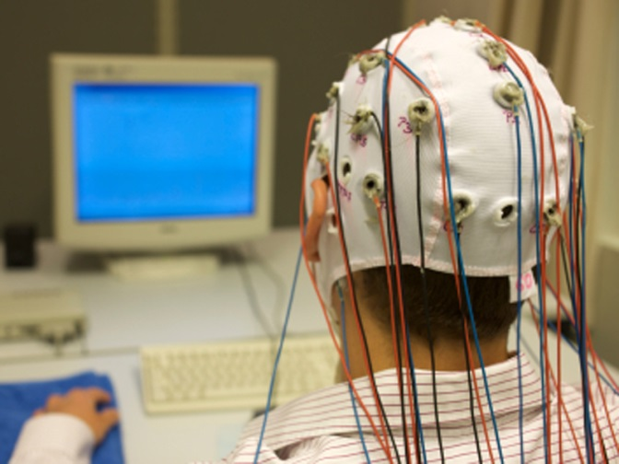
AI definition 1: Thinking humanly
Need to study the brain as an information processing machine: cognitive science and neuroscience

Slide 5
AI definition 1: Thinking humanly
Can we build a brain?
Source: L. Zettlemoyer

Slide 6
AI definition 1: Thinking humanly
Can we build a brain?
The “embodied cognition” movement exemplified:
https://www.youtube.com/watch?v=uoXAPSdXiZg
Source: L. Zettlemoyer

Slide 7
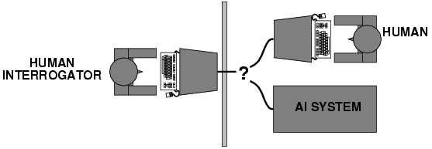
AI definition 2: Acting humanly
The Turing Test: https://www.youtube.com/watch?v=3wLqsRLvV-c
What capabilities would a computer need to have to pass the Turing Test?
Natural language processing
Knowledge representation
Automated reasoning
Machine learning
Turing predicted that by the year 2000, machines would be able to fool 30% of human judges for five minutes
A. Turing, Computing machinery and intelligence, Mind 59, pp. 433-460, 1950

Slide 8
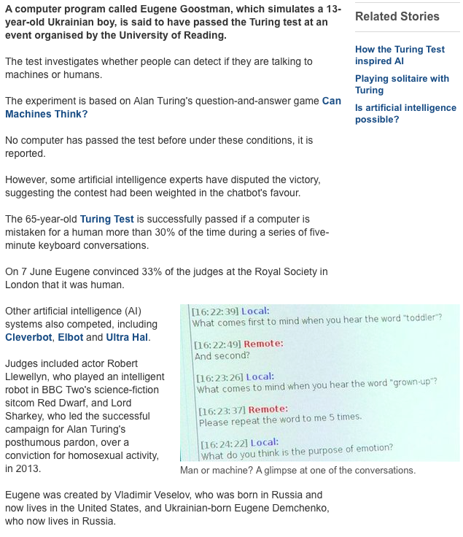
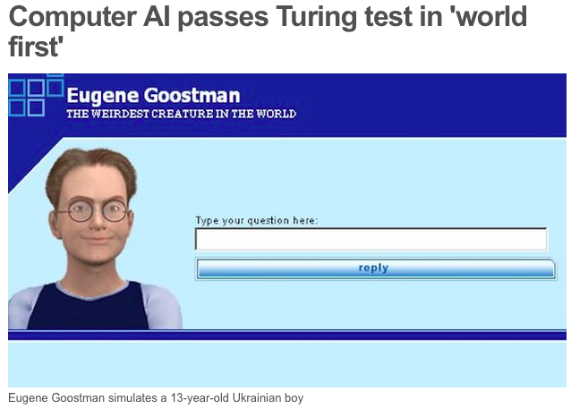
AI is solved?
http://www.bbc.com/news/technology-27762088
http://en.wikipedia.org/wiki/Eugene_Goostman
http://www.scottaaronson.com/blog/?p=1858

Slide 9
What’s wrong with the Turing test?
Variability in protocols, judges
Success depends on deception!
Chatbots can do well using “cheap tricks”
First example: ELIZA (1966)

Slide 10
A better Turing test?
Winograd schema: Multiple choice questions that can be easily answered by people but cannot be answered by computers using “cheap tricks”
The trophy would not ﬁt in the brown suitcase because it was so small. What was so small?
The trophy
The brown suitcase
H. Levesque, On our best behaviour, IJCAI 2013
http://www.newyorker.com/online/blogs/elements/2013/08/why-cant-my-computer-understand-me.html

Slide 11
A better Turing test?
Winograd schema: Multiple choice questions that can be easily answered by people but cannot be answered by computers using “cheap tricks”
The trophy would not ﬁt in the brown suitcase because it was so large. What was so large?
The trophy
The brown suitcase
H. Levesque, On our best behaviour, IJCAI 2013
http://www.newyorker.com/online/blogs/elements/2013/08/why-cant-my-computer-understand-me.html

Slide 12
Winograd schema
Advantages over standard Turing test
Test can be administered and graded by machine
Does not depend on human subjectivity
Does not require ability to generate English sentences
Questions cannot be evaded using verbal dodges
Questions can be made “Google-proof” (at least for now…)
Winograd schema challenge
Held at IJCAI conference in July 2016
Six entries, best system got 58% of 60 questions correct (humans get 90% correct)

Slide 13
AI definition 3: Thinking rationally
Idealized or “right” way of thinking
Logic: patterns of argument that always yield correct conclusions when supplied with correct premises
“Socrates is a man; all men are mortal; therefore Socrates is mortal.”
Logicist approach to AI: describe problem in formal logical notation and apply general deduction procedures to solve it
Problems with the logicist approach
Computational complexity of finding the solution
Describing real-world problems and knowledge in logical notation
Dealing with uncertainty
A lot of “rational” behavior has nothing to do with logic

Slide 14
AI definition 4: Acting rationally
A rational agent acts to optimally achieve its goals
Goals are application-dependent and are expressed in terms of the utility of outcomes
Being rational means maximizing your (expected) utility
This definition of rationality only concerns the decisions/actions that are made, not the cognitive process behind them
An unexpected step: rational agent theory was originally developed in the field of economics
Norvik and Russell: “most people think Economists study money. Economists think that what they study is the behavior of rational actors seeking to maximize their own happiness.”
By standard economic definitions: a rational agent is any agent that acts rationally, e.g., human 3-year-olds:
https://www.youtube.com/watch?v=EjzadtXR-zs

Slide 15
Utility maximization formulation
Advantages
Generality: goes beyond explicit reasoning, and even human cognition altogether
Practicality: can be adapted to many real-world problems
Naturally accommodates uncertainty
Amenable to good scientific and engineering methodology
Avoids philosophy and psychology
Disadvantages
Practical disadvantage: In practice, utility optimization is subject to the agent’s computational constraints (bounded rationality or bounded optimality)
Theoretical disadvantage: does being human involve anything other than rationality? Are the other aspects of being human important? Would it be useful if a machine had them, whatever they are?
Notes:
Disadvantages: it may be hard to formulate utility functions, especially for complex open-ended tasks. Has limited applicability to humans.

