Slide 1
CS440/ECE448 Midterm Review Fall 2016

Slide 2
Things to know
Review of topics
Review exam

Slide 3
Topics
Intro to AI
Search
Constraint Satisfaction Problems
Games
Game Theory
Planning

Slide 4
1. Intro to AI
AI = human thought, human action, rational thought, rational action?
Turing test: pros and cons, alternatives
Rationality
Utility, expected utility
Agent = PEAS (performance, environment, actions, sensors)
Environment characteristics: fully vs. partially observable, deterministic vs. stochastic, episodic vs. sequential, static vs. dynamic, discrete vs. continuous, single-agent vs. multi-agent, known vs. unknown

Slide 5
2. Search
Search problem formulation: initial state, actions, transition model, goal state, path cost, state space
Tree search algorithm: frontier, search strategy, repeated state detection
Evaluation of search strategies: completeness, optimality, time complexity, space complexity
Uninformed search: BFS, UCS, DFS, IDS (breadth-first search, uniform cost search, depth-first search, iterative deepening search)
Informed search: greedy best-first, A*, weighted A*
Heuristics: admissibility, consistency, dominance
Optimality of A*

Slide 6
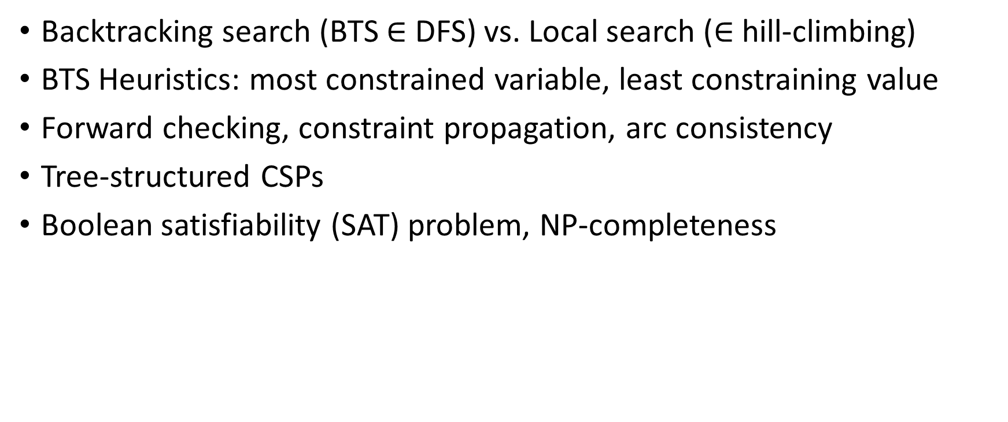
3. Constraint Satisfaction Problems
Backtracking search (BTS $∈$ DFS) vs. Local search ($∈$hill-climbing)
BTS Heuristics: most constrained variable, least constraining value
Forward checking, constraint propagation, arc consistency
Tree-structured CSPs
Boolean satisfiability (SAT) problem, NP-completeness

Slide 7
4. Games
Zero-sum games
Game tree
Minimax strategy, minimax search
Alpha-beta pruning
Evaluation functions
Quiescence search, horizon effect
Monte Carlo tree search, AlphaGo
Stochastic games, expectiminimax
Partially observable games

Slide 8
5. Game Theory
Normal form representation
Dominant strategy
Nash equilibrium (pure and mixed strategy)
Pareto optimality
Examples of games: Prisoner’s Dilemma, Stag Hunt, Game of Chicken
Mechanism design: auctions, regulation

Slide 9
6. Planning
Situation space vs. plan space planners
Interleaved vs. non-interleaved planners
Partial order plan
Complexity of planning

Slide 10
Review Exam Questions
Environment
State
Tree Search
BFS vs. DFS
Greedy vs. A*
CSP heuristics
CSP local vs. backtracking
Maze basics
BFS vs DFS vs UCS vs A*
Tree-structured CSP
Complexity
Randomness vs. Imperfect information
Nash equilibrium vs. Minimax
Expectiminimax
Game theory

Slide 11
1. Environment, 2. State, 3. Tree Search
Can an environment be both known and unobservable? Give an example.
What is the distinction between a world state and a search tree node?
In tree search, why do we restrict costs to be non-negative?

Slide 12
4. Mazes
Each of the following sub-problems describes a type of maze. For each type of maze, specify whether breadth-first-search (BFS) or depth-first-search (DFS) will more efficiently find a solution, and say why.
The Albuquerque maze has 3 possible directions that you can take at each intersection. No path is longer than 25 steps. There is only one correct solution.
The Belmont maze has 3 possible directions that you can take at each intersection. No path is longer than 25 steps. About half of all available paths are considered correct solutions to the maze.
The Crazytown maze has 3 possible directions that you can take at each intersection. The maze is infinite in size, so some paths have infinite length. There is only one correct solution, which is known to require only 25 steps.

Slide 13
5, 6, 7: Heuristics
Suppose you are given a “perfect” heuristic function that gives the correct optimal distance from each node to the goal. Is greedy best-first search with this heuristic optimal? If not, give a counterexample.
Explain why it is a good heuristic to choose the variable that is most constrained but the value that is least constraining in a CSP search.
What is local search for CSPs? For which kinds of CSPs might local search be better than backtracking search? What about the other way around?

Slide 14
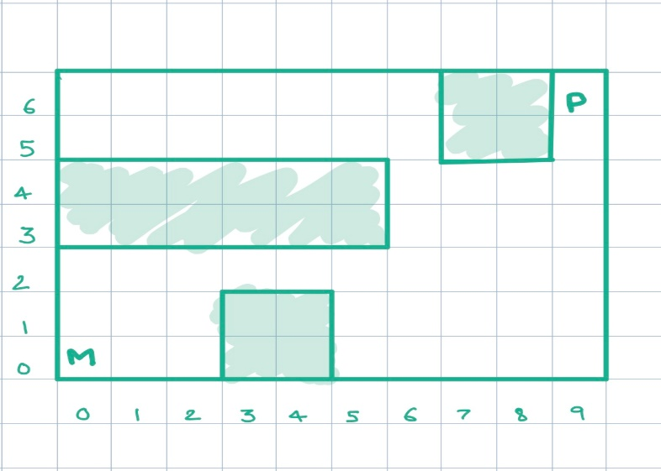
8. Maze complexity
‘M’ represents Mario, ‘P’ represents Peach, and the goal of the game is to get Mario and Peach to find each other. In each move, both Mario and Peach take turns.
a. Describe state and action representations for this problem.
b. What is the branching factor of the search tree?
c. What is the size of the state space?
d. Describe an admissible heuristic for this problem.

Slide 15
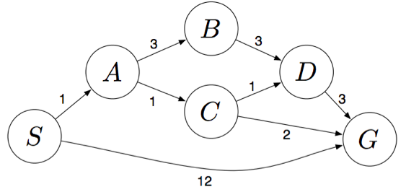
9. BFS vs DFS vs UCS vs A*
S denotes the start state, G denotes the goal state, and step costs are written next to each arc. Assume that ties are broken alphabetically (i.e., if there are two states with equal priority on the frontier, the state that comes first alphabetically should be visited first).
What path would BFS return for this problem?
What path would DFS return for this problem?
What path would UCS return for this problem?

Slide 16
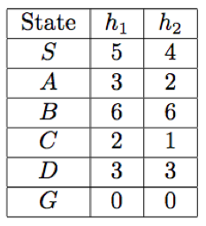
9. BFS vs DFS vs UCS vs A*
Consider the heuristics for this problem shown in the table below. Is h₁ admissible? Is it consistent? Is h₂ admissible? Is it consistent?

Slide 17
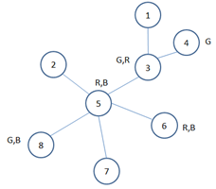
10. Tree-structured CSP
We assume there are three available colors (R,G,B) and some nodes are constrained to use only a subset of these colors, as indicated above. Show all the steps for applying the tree-structured CSP algorithm for finding a solution to this problem.

Slide 18
11. Complexity
For each of the following problems, determine whether an algorithm to optimally solve the problem requires computation time that is polynomial or exponential in the parameters d and m.
a. A map has d regions. Colors have been applied to all d regions, drawing from a set of m possible colors. Your algorithm needs to decide whether or not any two adjacent regions have the same color.
b. A map has d regions. Your algorithm needs to assign colors to all d regions, drawing colors from a set of m possible colors, in order to guarantee that no two adjacent regions have the same color.
c. Your algorithm needs to find its way out of a maze drawn on a d-by-d grid.
d. Your algorithm needs to find the shortest path in a d-by-d maze while hitting m waypoints (equivalent to dots in MP1 part 1.2).
e. Your algorithm needs to find the best strategy for a zero-sum game. There are two players. At each turn, each of the players chooses from among m possible moves. After d rounds of game play, the game ends.

Slide 19
12, 13. Randomness, Information, Nash Equilibrium, Minimax
How can randomness be incorporated into a game tree? How about partial observability (imperfect information)?
In the lectures, we covered Nash equilibrium strategies for simultaneous move games. We can also consider minimax strategies for such games, defined in the same way as for alternating games. What would be the minimax strategies in the Prisoner’s Dilemma, Stag Hunt, and Game of Chicken? Do they differ from Nash equilibrium strategies? When/why would one prefer to choose a minimax strategy rather than a Nash equilibrium strategy?

Slide 20
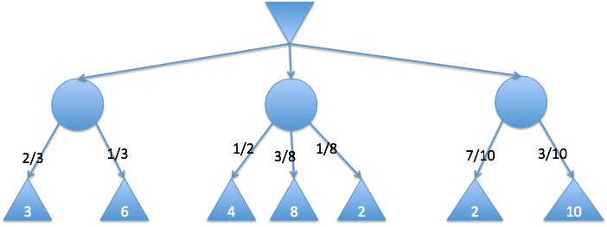
14. Expectiminimax
For each circle, calculate the node values, as per expectiminimax definition.
Which action should the min player take?

Slide 21
15. Game Theory
Suppose that both Alice and Bob want to go from one place to another. There are two routes R1 and R2. The utility of a route is inversely proportional to the number of cars on the road. For instance, if both Alice and Bob choose route R1, the utility of R1 for each of them is 1/2.
Write down the payoff matrix.
Is this a zero-sum game?
Find dominant strategies (if any).
Find pure strategy equilibria (if any).
Find the mixed strategy equilibrium.

Slide 22
15. Game Theory
 | Alice
Bob |  | R1 | R2
 | R1 | (1/2, 1/2) | (1, 1)
 | R2 | (1, 1) | (1/2, 1/2)

