Slide 1
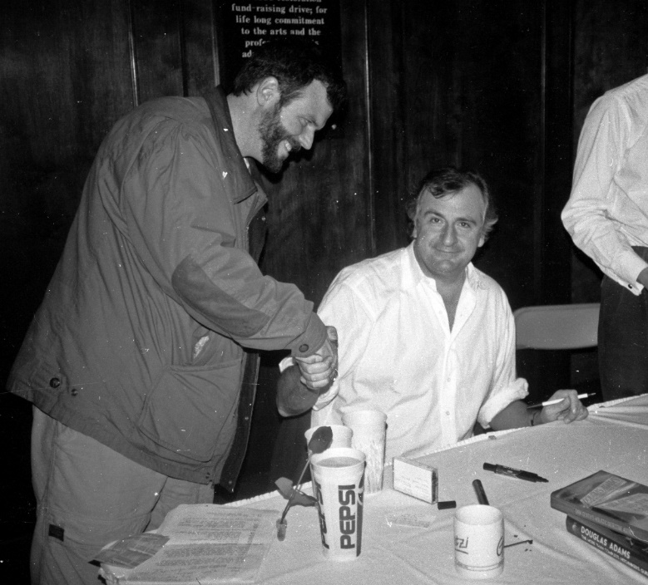
A Hitchhiker's Guide to Azure Mobile Apps

Slide 2
David Giard
Microsoft Technical Evangelist
@DavidGiard
DavidGiard.com
TechnologyAndFriends
dGiard@microsoft.com

Slide 3
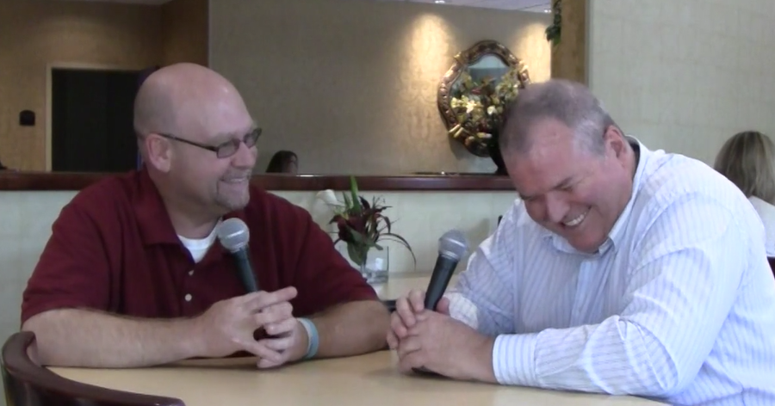
This presentation is dedicated to Bill Fink

Slide 4
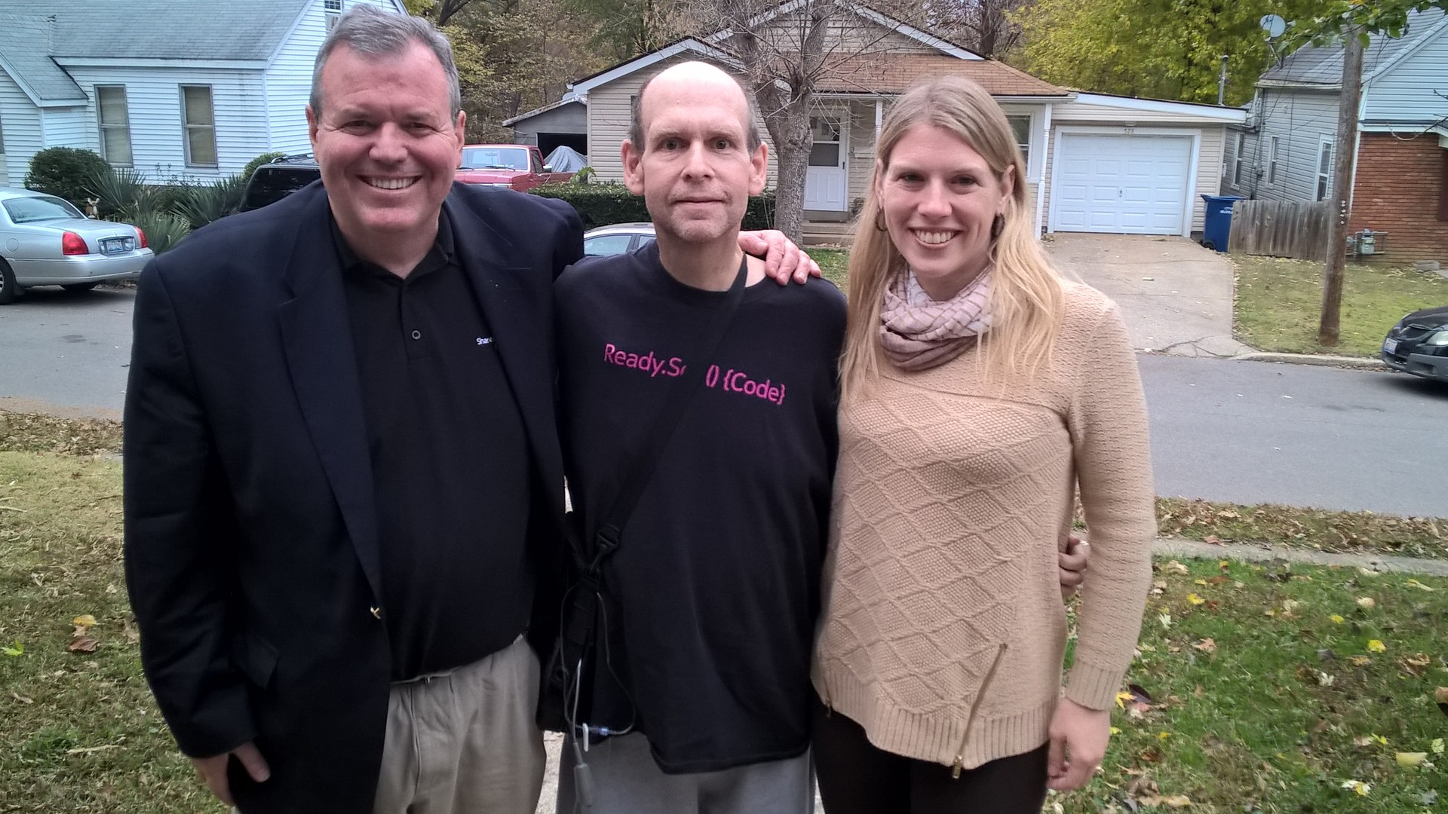
This presentation is dedicated to Bill Fink

Slide 5
Agenda
Why Azure Mobile Apps?
Mobile Architecture
Common Data Access
Customization
Dynamic Data
Client Code
Identity and Permissions
Scaling
API Scripts
Notifications

Slide 6
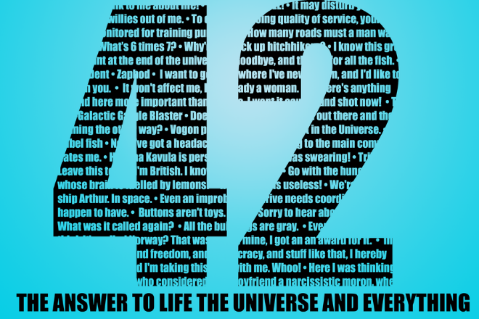
Why Azure Mobile Apps?
Integrate with
Web Apps
Logic Apps
API Apps
All features of Web Apps

Slide 7
Why Azure Mobile Services?
Frees you from plumbing code
Handles API Changes
Cross-Platform solution
Choose JavaScript or .NET

Slide 8
Mobile Architecture
Phone
REST
API
Data
Phone
Tablet or PC
iPad
JavaScript
iPhone
Android

Slide 9
Pieces of Azure Mobile Apps
Permissions
Client Code
READ
Identity
SQL Server table
INSERT
UPDATE
DELETE

Slide 10
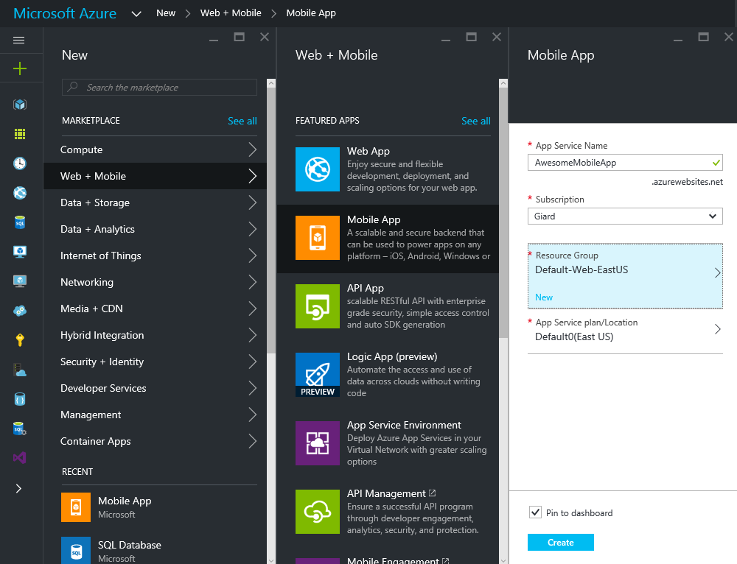
Creating a Mobile App

Slide 11
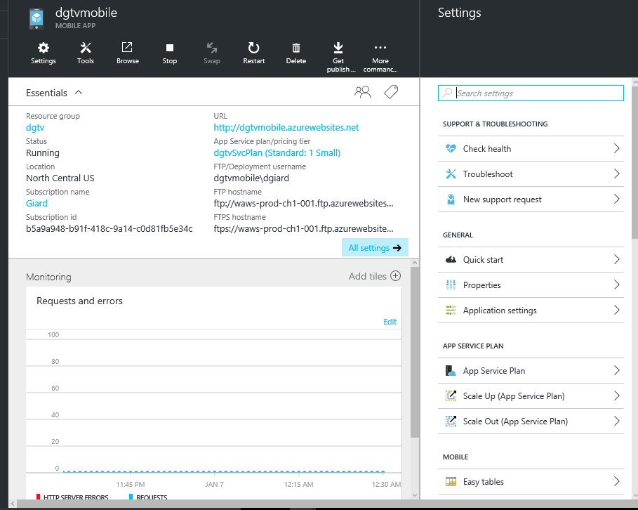
Creating a Mobile App

Slide 12
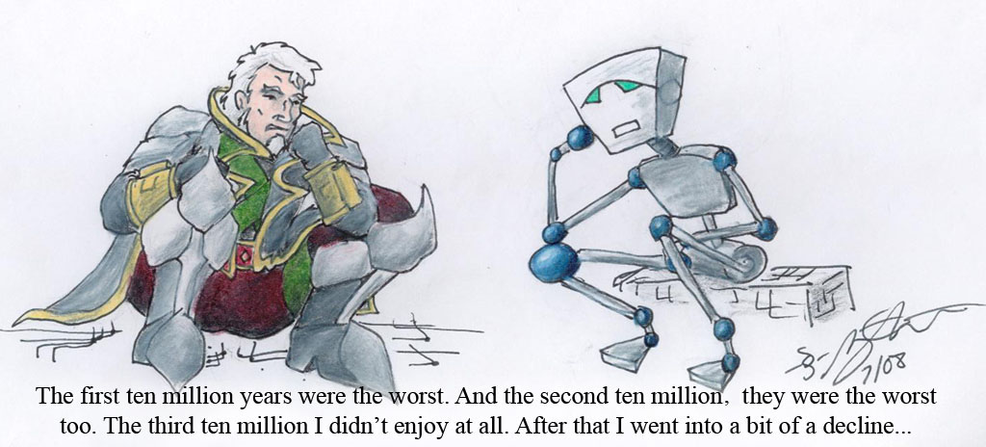
REST
https://Giard.azurewebsites.net/Tables/Table1
https://mymobileapp-code.azurewebsites.net/Tables/Table1
GET, PUT, POST, DELETE, PATCH
Extend GET with oData Query syntax

Slide 13
REST
HTTP Verb | Action | SQL
GET | Read Data | SELECT…
POST | Create Data | INSERT…
DELETE | Delete Data | DELETE…
PUT or PATCH | Update Data | UPDATE…

Slide 14
REST
Client
VERB
(POST)
Endpoint
Request
Data
(JSON)
Response

Slide 15
REST
Client
VERB
(GET)
Endpoint
Request
Response
Data
(JSON)

Slide 16
oData Query Syntax
Extension | Description
$filter | WHERE clause
$inlinecount | # items in table
$orderby | SORT clause
$select | Columns to return
$skip | #records to skip
$top | #records to return
../Tables/Table1?$filter=state eq IL
../Tables/Table1?$filter=state eq IL&$orderby=LastName

Slide 17
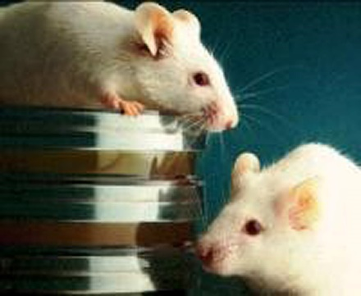
Dynamic Schema
Automatically adds columns if matching data submitted
Useful during development
Turn off during production

Slide 18
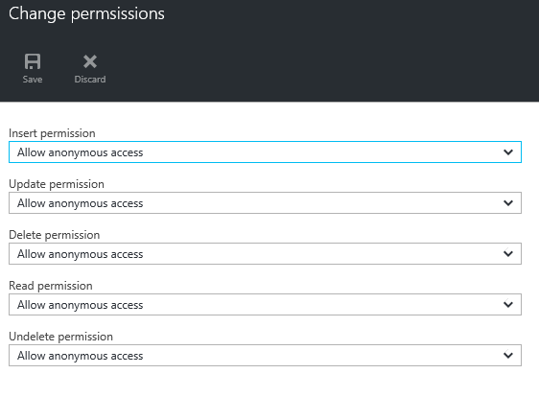
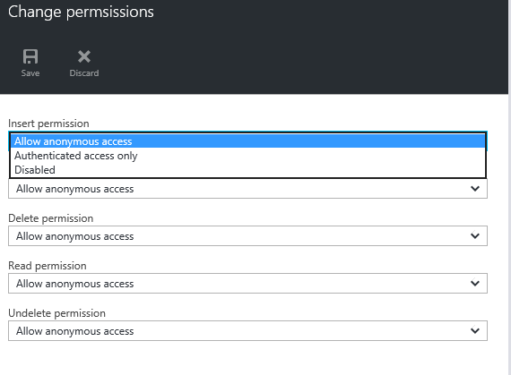
Permissions

Slide 19
Demo

Slide 20
Identity – Single Sign-On
Twitter
or Facebook
or Google
or Microsoft
Sign In
TOKEN
Client
Request
Azure Mobile App API

Slide 21
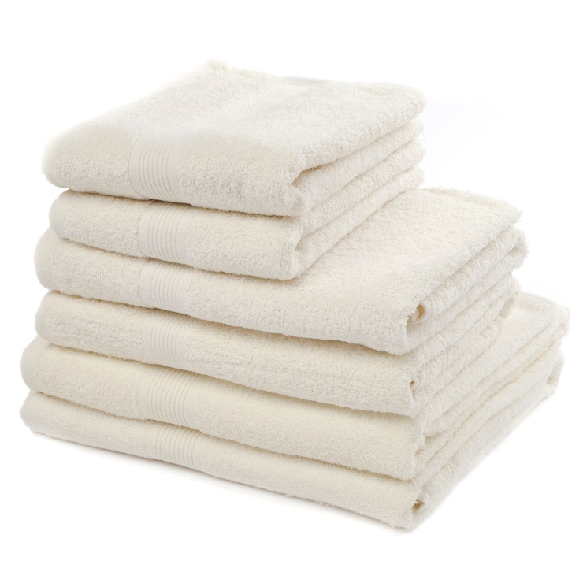
Identity

Slide 22
Identity
function insert(item, user, request) {
item.CreatedBy = user.userId;
request.execute();
}
function read(query, user, request) {
query.where ({CreatedBy:user.userId});
request.execute();
}

Slide 23
Demo

Slide 24
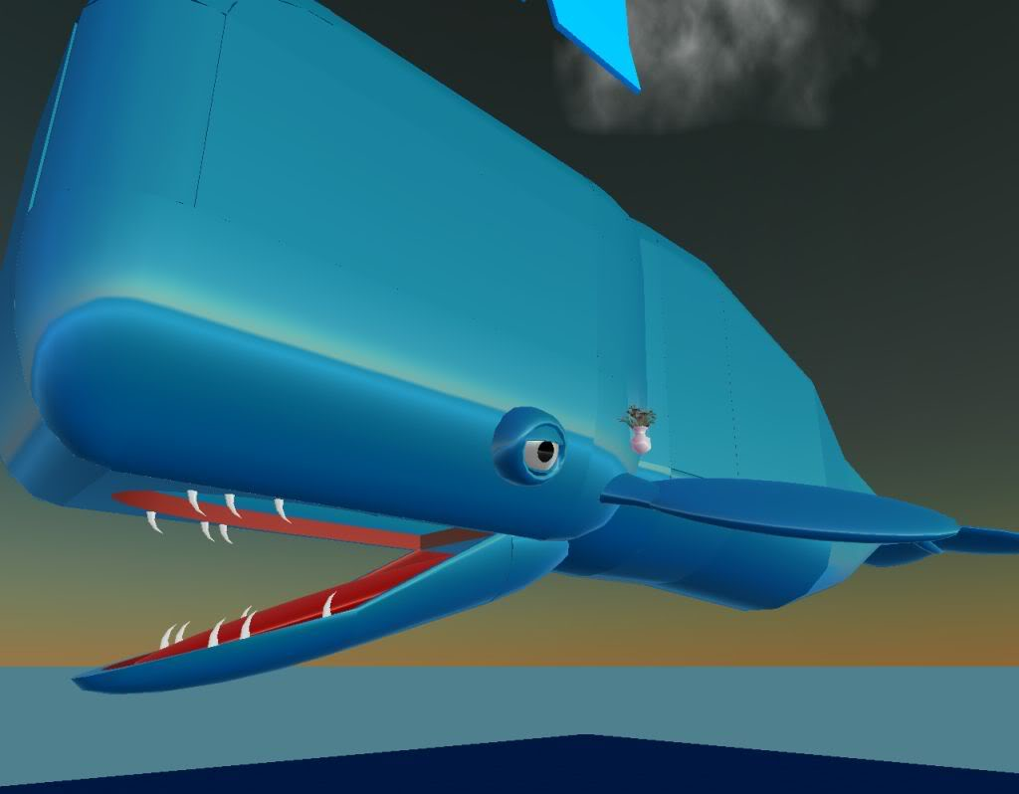
Scaling

Slide 25
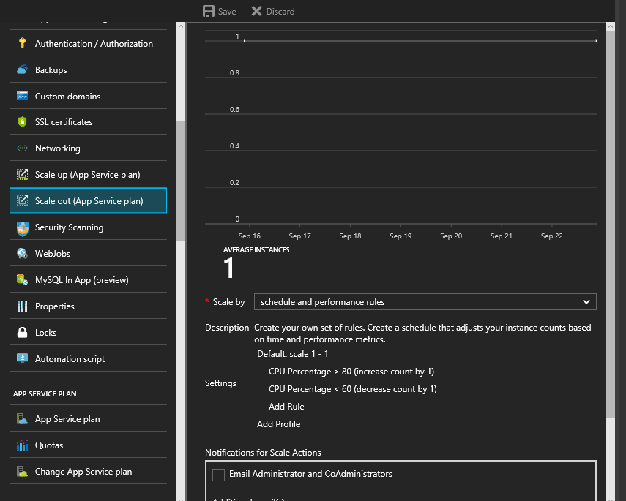
Scaling

Slide 26
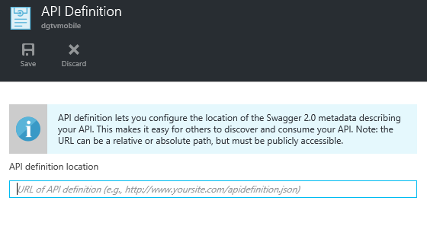
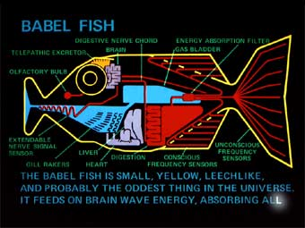
API Scripts

Slide 27
API Scripts
<Mobile Service URL>/api/<API Name>
e.g.,
https://giard.azure-mobile.net/api/MyApi
exports.post = function(request, response) {
// Use "request.service" to access features of your mobile service, e.g.:
// var tables = request.service.tables;
// var push = request.service.push;
response.send(statusCodes.OK, { message : 'Hello World!' });
};
exports.get = function(request, response) {
response.send(statusCodes.OK, { message : 'Hello World!' });
};

Slide 28
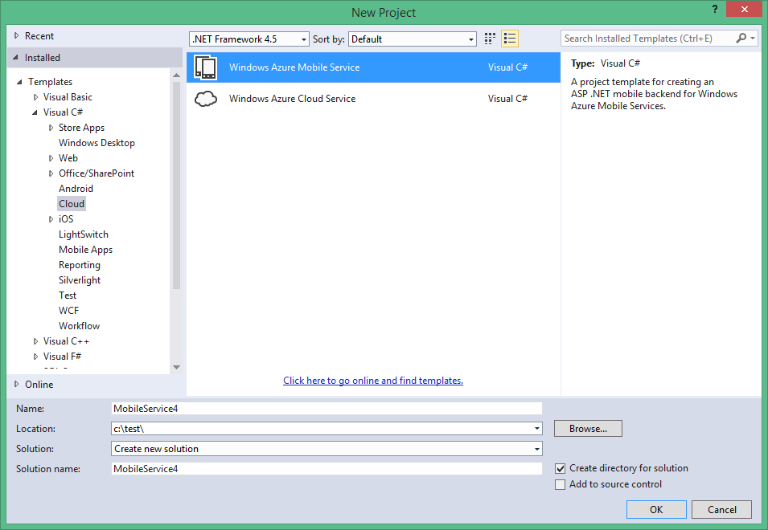
Mobile Apps in .NET

Slide 29
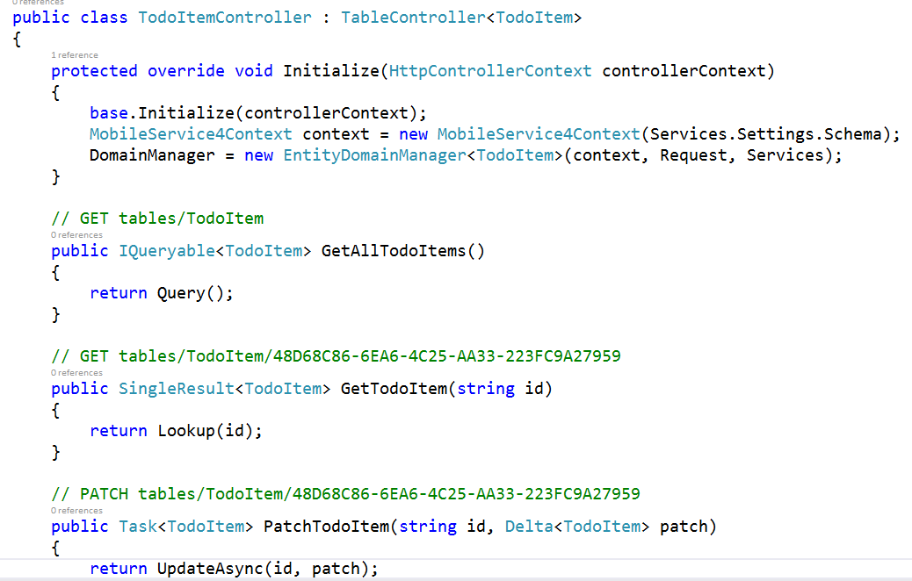
Mobile Apps in .NET

Slide 30
Demo

Slide 31
Push Notifications

Slide 32
Push Notifications
App
Azure Mobile Services
var payload = '<?xml version="1.0" encoding="utf-8"?><toast><visual><binding template="ToastText01">' +
'<text id="1">Sample Toast</text></binding></visual></toast>';
var push = request.service.push;
push.wns.send(null,
payload,
'wns/toast', {
success: function (pushResponse) {
console.log("Sent push:", pushResponse);
}
});
}
Push Service
APN (Apple)
GCM (Google)
WNS (Windows 8)
MPNS (Windows Phone)
Notes:
Microsoft Push Notification Service (MPNS)
Windows Push Notification Services (WNS)

Slide 33
Push Notifications
Azure Mobile Services
Notification
Hub
Push Service
APN (Apple)
GCM (Google)
WNS (Windows 8)
MPNS (Windows Phone)
subscribe
tinyurl.com/PushNoti
Notes:
Microsoft Push Notification Service (MPNS)
Windows Push Notification Services (WNS)

Slide 34
Push Notification on Windows 8 & WP8
Create Mobile Service
Write Client App
Associate app with store
Get Package SID and Client ID from Live Services. Copy to Mobile Service.
Register notifications channel in OnLaunched (App.xaml.cs)
Enable Toast notifications (Package.appxmanifest)
Update service to send Push Notification
tinyurl.com/Win8Push

Slide 35
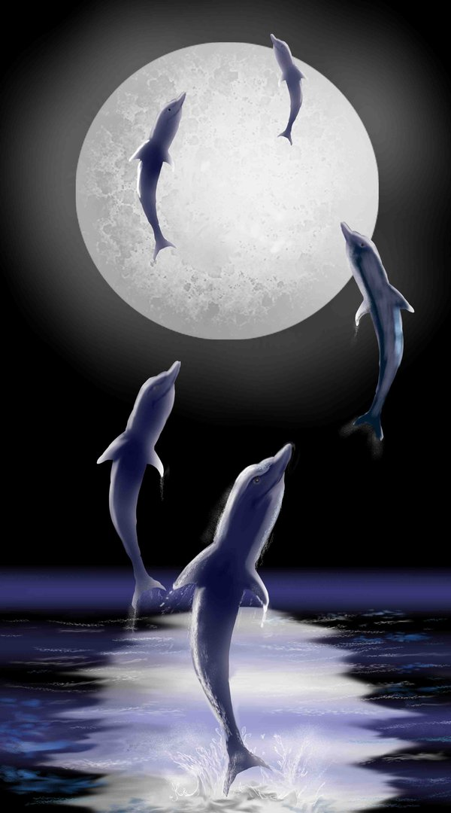
So Long and Thanks!
David Giard
@DavidGiard
DavidGiard.com
TechnologyAndFriends.com
channel9.msdn.com/niners/dgiard

