Slide 1
CS 425 / ECE 428
Distributed Systems
Fall 2015
Indranil Gupta (Indy)
Nov 5, 2015
Lecture 22: Stream Processing, Graph Processing
All slides © IG

Slide 2
Stream Processing: What We’ll Cover
Why Stream Processing
Storm

Slide 3
Stream Processing Challenge
Large amounts of data => Need for real-time views of data
Social network trends, e.g., Twitter real-time search
Website statistics, e.g., Google Analytics
Intrusion detection systems, e.g., in most datacenters
Process large amounts of data
With latencies of few seconds
With high throughput

Slide 4
MapReduce?
Batch Processing => Need to wait for entire computation on large dataset to complete
Not intended for long-running stream-processing

Slide 5
Enter Storm
Apache Project
http://storm.apache.org/
Highly active JVM project
Multiple languages supported via API
Python, Ruby, etc.
Used by over 30 companies including
Twitter: For personalization, search
Flipboard: For generating custom feeds
Weather Channel, WebMD, etc.

Slide 6
Storm Components
Tuples
Streams
Spouts
Bolts
Topologies

Slide 7
Tuple
An ordered list of elements
E.g., <tweeter, tweet>
E.g., <“Miley Cyrus”, “Hey! Here’s my new song!”>
E.g., <“Justin Bieber”, “Hey! Here’s MY new song!”>
E.g., <URL, clicker-IP, date, time>
E.g., <coursera.org, 101.102.103.104, 4/4/2014, 10:35:40>
E.g., <coursera.org, 101.102.103.105, 4/4/2014, 10:35:42>
Tuple

Slide 8
Stream
Sequence of tuples
Potentially unbounded in number of tuples
Social network example:
<“Miley Cyrus”, “Hey! Here’s my new song!”>,
<“Justin Bieber”, “Hey! Here’s MY new song!”>,
<“Rolling Stones”, “Hey! Here’s my old song that’s still a super-hit!”>, …
Website example:
<coursera.org, 101.102.103.104, 4/4/2014, 10:35:40>, <coursera.org, 101.102.103.105, 4/4/2014, 10:35:42>, …
Tuple
Tuple
Tuple

Slide 9
Spout
A Storm entity (process) that is a source of streams
Often reads from a crawler or DB
Tuple
Tuple
Tuple
Tuple
Tuple
Tuple

Slide 10
Bolt
A Storm entity (process) that
Processes input streams
Outputs more streams for other bolts

Slide 11
Topology
A directed graph of spouts and bolts (and output bolts)
Corresponds to a Storm “application”

Slide 12
Topology
Can have cycles if the application
requires it

Slide 13
Bolts come in many Flavors
Operations that can be performed
Filter: forward only tuples which satisfy a condition
Joins: When receiving two streams A and B, output all pairs (A,B) which satisfy a condition
Apply/transform: Modify each tuple according to a function
And many others
But bolts need to process a lot of data
Need to make them fast

Slide 14
Parallelizing Bolts
Have multiple processes (“tasks”) constitute a bolt
Incoming streams split among the tasks
Typically each incoming tuple goes to one task in the bolt
Decided by “Grouping strategy”
Three types of grouping are popular

Slide 15
Grouping
Shuffle Grouping
Streams are distributed evenly among the bolt’s tasks
Round-robin fashion
Fields Grouping
Group a stream by a subset of its fields
E.g., All tweets where twitter username starts with [A-M,a-m,0-4] goes to task 1, and all tweets starting with [N-Z,n-z,5-9] go to task 2
All Grouping
All tasks of bolt receive all input tuples
Useful for joins

Slide 16
Storm Cluster
Master node
Runs a daemon called Nimbus
Responsible for
Distributing code around cluster
Assigning tasks to machines
Monitoring for failures of machines
Worker node
Runs on a machine (server)
Runs a daemon called Supervisor
Listens for work assigned to its machines
Runs “Executors”(which contain groups of tasks)
Zookeeper
Coordinates Nimbus and Supervisors communication
All state of Supervisor and Nimbus is kept here

Slide 17
Failures
A tuple is considered failed when its topology (graph) of resulting tuples fails to be fully processed within a specified timeout
Anchoring: Anchor an output to one or more input tuples
Failure of one tuple causes one or more tuples to replayed

Slide 18
API For Fault-Tolerance (OutputCollector)
Emit(tuple, output)
Emits an output tuple, perhaps anchored on an input tuple (first argument)
Ack(tuple)
Acknowledge that you (bolt) finished processing a tuple
Fail(tuple)
Immediately fail the spout tuple at the root of tuple topology if there is an exception from the database, etc.
Must remember to ack/fail each tuple
Each tuple consumes memory. Failure to do so results in memory leaks.

Slide 19
Twitter’s Heron System
Fixes the inefficiencies of Storm’s acking mechanism (among other things)
Uses backpressure: a congested downstream tuple will ask upstream tuples to slow or stop sending tuples
1. TCP Backpressure: uses TCP windowing mechanism to propagate backpressure
2. Spout Backpressure: node stops reading from its upstream spouts
3. Stage by Stage Backpressure: think of the topology as stage-based, and propagate back via stages
Use:
Spout+TCP, or
Stage by Stage + TCP
Beats Storm throughput handily (see Heron paper)

Slide 20
Summary: Stream Processing
Processing data in real-time a big requirement today
Storm
And other sister systems, e.g., Spark Streaming, Heron
Parallelism
Application topologies
Fault-tolerance

Slide 21
Graph Processing: What We’ll Cover
Distributed Graph Processing
Google’s Pregel system
Inspiration for many newer graph processing systems: Piccolo, Giraph, GraphLab, PowerGraph, LFGraph, X-Stream, etc.

Slide 22
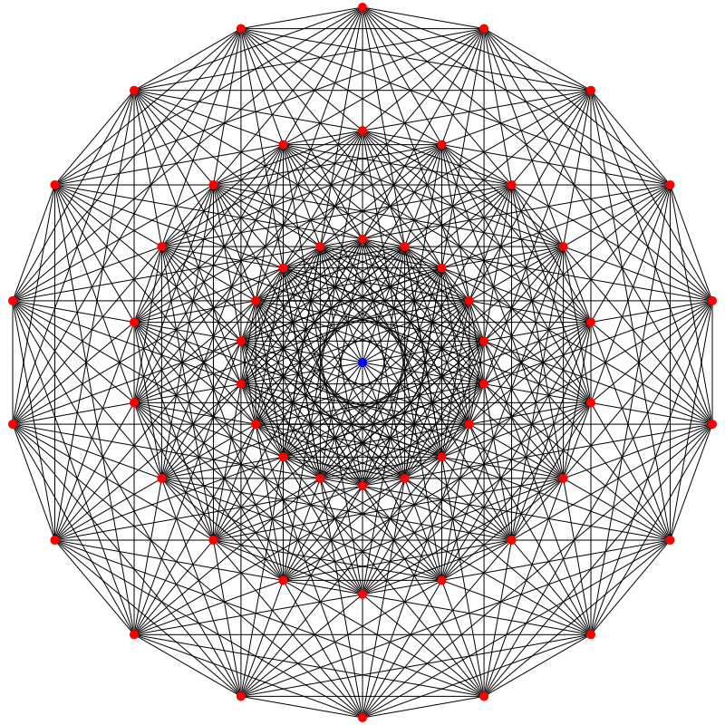
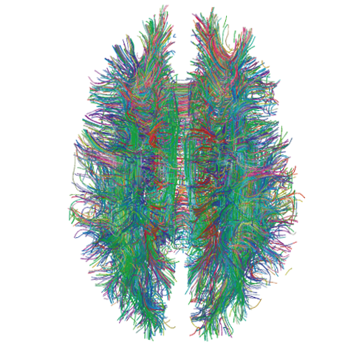
Lots of Graphs
Large graphs are all around us
Internet Graph: vertices are routers/switches and edges are links
World Wide Web: vertices are webpages, and edges are URL links on a webpage pointing to another webpage
Called “Directed” graph as edges are uni-directional
Social graphs: Facebook, Twitter, LinkedIn
Biological graphs: Brain neurons, DNA interaction graphs, ecosystem graphs, etc.
Source: Wikimedia Commons, Wikipedia

Slide 23
Graph Processing Operations
Need to derive properties from these graphs
Need to summarize these graphs into statistics
E.g., find shortest paths between pairs of vertices
Internet (for routing)
LinkedIn (degrees of separation)
E.g., do matching
Dating graphs in match.com (for better dates)
PageRank
Web Graphs
Google search, Bing search, Yahoo search: all rely on this
And many (many) other examples!

Slide 24
Why Hard?
Because these graphs are large!
Human social network has 100s Millions of vertices and Billions of edges
WWW has Millions of vertices and edges
Hard to store the entire graph on one server and process it
On one beefy server: may be slow, or may be very expensive (performance to cost ratio very low)
Use distributed cluster/cloud!

Slide 25
Typical Graph Processing Application
Works in iterations
Each vertex assigned a value
In each iteration, each vertex:
Gather: Gathers values from its immediate neighbors (vertices who join it directly with an edge). E.g., @A: B→A, C→A, D→A,…
Apply: Does some computation using its own value and its neighbors values.
Scatter: Updates its new value and sends it out to its neighboring vertices. E.g., A→B, C, D, E
Graph processing terminates after: i) fixed iterations, or ii) vertices stop changing values
C
B
A
D
E

Slide 26
Hadoop/MapReduce to the Rescue?
Multi-stage Hadoop
Each stage == 1 graph iteration
Assign vertex ids as keys in the reduce phase
Well-known
At the end of every stage, transfer all vertices over network (to neighbor vertices)
All vertex values written to HDFS (file system)
Very slow!

Slide 27
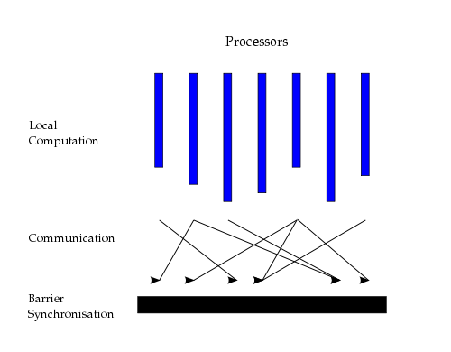
Bulk Synchronous Parallel Model
“Think like a vertex”
Originally by Valiant (1990)
Source: http://en.wikipedia.org/wiki/Bulk_synchronous_parallel

Slide 28
Basic Distributed Graph Processing
“Think like a vertex”
Assign each vertex to one server
Each server thus gets a subset of vertices
In each iteration, each server performs Gather-Apply-Scatter for all its assigned vertices
Gather: get all neighboring vertices’ values
Apply: compute own new value from own old value and gathered neighbors’ values
Scatter: send own new value to neighboring vertices

Slide 29
Assigning Vertices
How to decide which server a given vertex is assigned to?
Different options
Hash-based: Hash(vertex id) modulo number of servers
Remember consistent hashing from P2P systems?!
Locality-based: Assign vertices with more neighbors to the same server as its neighbors
Reduces server to server communication volume after each iteration
Need to be careful: some “intelligent” locality-based schemes may take up a lot of upfront time and may not give sufficient benefits!

Slide 30
Pregel System By Google
Pregel uses the master/worker model
Master (one server)
Maintains list of worker servers
Monitors workers; restarts them on failure
Provides Web-UI monitoring tool of job progress
Worker (rest of the servers)
Processes its vertices
Communicates with the other workers
Persistent data is stored as files on a distributed storage system (such as GFS or BigTable)
Temporary data is stored on local disk

Slide 31
Pregel Execution
Many copies of the program begin executing on a cluster
The master assigns a partition of input (vertices) to each worker
Each worker loads the vertices and marks them as active
The master instructs each worker to perform a iteration
Each worker loops through its active vertices & computes for each vertex
Messages can be sent whenever, but need to be delivered before the end of the iteration (i.e., the barrier)
When all workers reach iteration barrier, master starts next iteration
Computation halts when, in some iteration: no vertices are active and when no messages are in transit
Master instructs each worker to save its portion of the graph

Slide 32
Fault-Tolerance in Pregel
Checkpointing
Periodically, master instructs the workers to save state of their partitions to persistent storage
e.g., Vertex values, edge values, incoming messages
Failure detection
Using periodic “ping” messages from master → worker
Recovery
The master reassigns graph partitions to the currently available workers
The workers all reload their partition state from most recent available checkpoint

Slide 33
How Fast Is It?
Shortest paths from one vertex to all vertices
SSSP: “Single Source Shortest Path”
On 1 Billion vertex graph (tree), with 300 workers (800 cores)
50 workers: 180 seconds
800 workers: 20 seconds
50 B vertices on 800 workers: 700 seconds (~12 minutes)
Pretty Fast!

Slide 34
Summary: Graph Processing
Lots of (large) graphs around us
Need to process these
MapReduce not a good match
Distributed Graph Processing systems: Pregel by Google
Many follow-up systems
Piccolo, Giraph: Pregel-like
GraphLab, PowerGraph, LFGraph, X-Stream: more advanced

Slide 35
Announcements
MP3 Demos Next Monday
Signup sheet on Piazza

