Slide 1
Distributed Graph Processing
Abhishek Verma
CS425

Slide 2
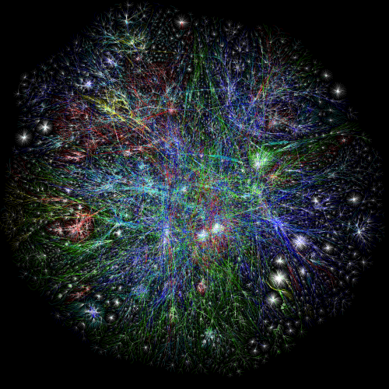
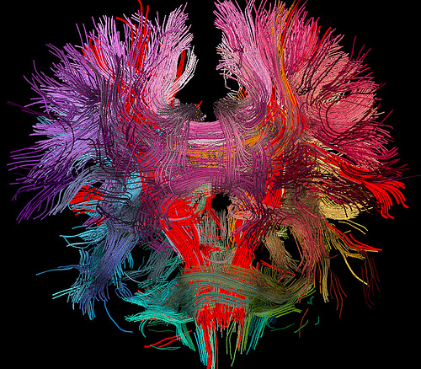
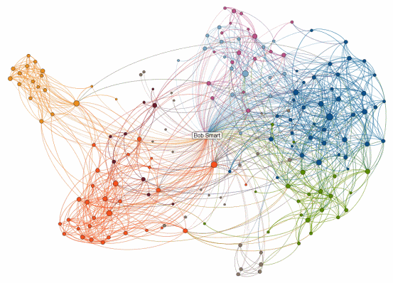
Guess the Graph?
Notes:
Guess the graph

Slide 3
Guess the Graph?
The Internet
Human Brain
LinkedIn Social Network
Notes:
Guess the graph

Slide 4
Graph Problems
Finding shortest paths
  Routing Internet traffic and UPS trucks
Finding minimum spanning trees
  Google Fiber
Finding Max Flow
  Scheduling
Bipartite matching
  Dating websites
Identify special nodes and communities
  Spread of diseases, terrorists
Notes:
Routing internet traffic, UPS trucks
Google Fiber
Scheduling
Spread of disease, influencers
Dating website

Slide 5
Outline
Single Source Shortest Path (SSSP)
SSSP MapReduce Implementation
Pregel
  Computation Model
  SSSP Example
  Writing a Pregel program
  System Design
MapReduce vs Pregel for Graph processing

Slide 6
Single Source Shortest Path (SSSP)
Problem
  Find shortest path from a source node to all target nodes
Solution for single processor machine
  Dijkstra’s algorithm

Slide 7
Example: SSSP – Dijkstra’s Algorithm
B
C
∞
∞
1
10
0
A
2
3
9
4
6
5
7
∞
∞
2
D
E

Slide 8
Example: SSSP – Dijkstra’s Algorithm
B
C
10
∞
1
10
0
A
2
3
9
4
6
5
7
5
∞
2
D
E

Slide 9
Example: SSSP – Dijkstra’s Algorithm
B
C
8
14
1
10
0
A
2
3
9
4
6
5
7
5
7
2
D
E

Slide 10
Example: SSSP – Dijkstra’s Algorithm
B
C
8
13
1
10
0
A
2
3
9
4
6
5
7
5
7
2
D
E

Slide 11
Example: SSSP – Dijkstra’s Algorithm
B
C
8
9
1
10
0
A
2
3
9
4
6
5
7
5
7
2
D
E

Slide 12
Example: SSSP – Dijkstra’s Algorithm
B
C
8
9
1
10
0
A
2
3
9
4
6
5
7
5
7
2
D
E

Slide 13
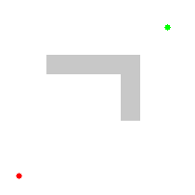

Example 2

Slide 14
Single Source Shortest Path (SSSP)
Problem
  Find shortest path from a source node to all target nodes
Solution on single processor machine
  Dijkstra’s algorithm
Distributed solution: parallel breadth-first search
  MapReduce
  Pregel

Slide 15
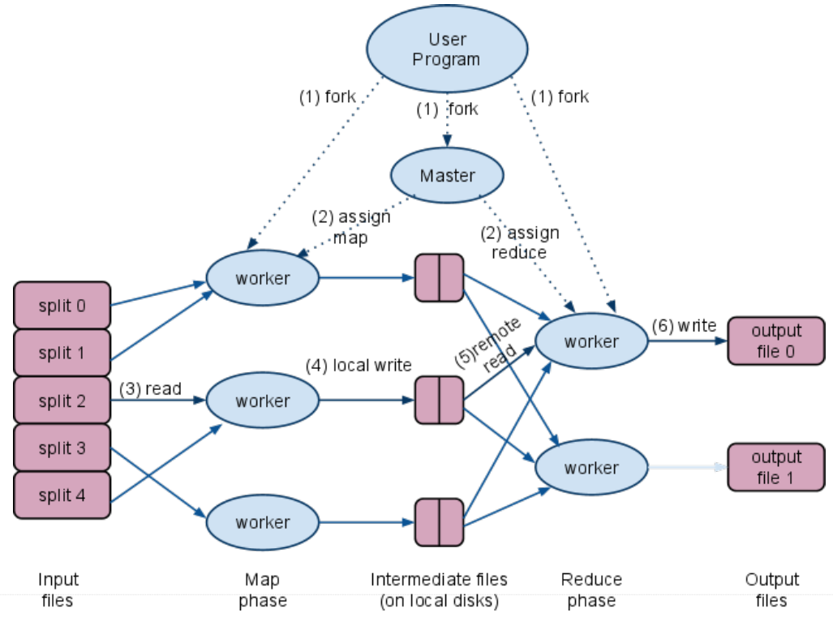
MapReduce Execution Overview

Slide 16
Example: SSSP – Parallel BFS in MapReduce
Adjacency matrix
Adjacency List
A: (B, 10), (D, 5)
B: (C, 1), (D, 2)
C: (E, 4)
D: (B, 3), (C, 9), (E, 2)
E: (A, 7), (C, 6)
B
C
 | A | B | C | D | E
A |  | 10 |  | 5
B |  |  | 1 | 2
C |  |  |  |  | 4
D |  | 3 | 9 |  | 2
E | 7 |  | 6
∞
∞
 | A | B | C | D | E
A
B
C
D
E
1
10
A
0
2
3
9
4
6
5
7
∞
∞
2
D
E

Slide 17
Example: SSSP – Parallel BFS in MapReduce
Map input: <node ID, <dist, adj list>>
<A, <0, <(B, 10), (D, 5)>>>
<B, <inf, <(C, 1), (D, 2)>>>
<C, <inf, <(E, 4)>>>
<D, <inf, <(B, 3), (C, 9), (E, 2)>>>
<E, <inf, <(A, 7), (C, 6)>>>
Map output: <dest node ID, dist>
<B, 10> <D, 5>
<C, inf> <D, inf>
<E, inf>
<B, inf> <C, inf> <E, inf>
<A, inf> <C, inf>
B
C
∞
∞
1
10
A
0
2
3
9
4
6
5
7
∞
∞
<A, <0, <(B, 10), (D, 5)>>>
<B, <inf, <(C, 1), (D, 2)>>>
<C, <inf, <(E, 4)>>>
<D, <inf, <(B, 3), (C, 9), (E, 2)>>>
<E, <inf, <(A, 7), (C, 6)>>>
2
D
E
Flushed to local disk!!

Slide 18
Example: SSSP – Parallel BFS in MapReduce
Reduce input: <node ID, dist>
<A, <0, <(B, 10), (D, 5)>>>
<A, inf>
<B, <inf, <(C, 1), (D, 2)>>>
<B, 10> <B, inf>
<C, <inf, <(E, 4)>>>
<C, inf> <C, inf> <C, inf>
<D, <inf, <(B, 3), (C, 9), (E, 2)>>>
<D, 5> <D, inf>
<E, <inf, <(A, 7), (C, 6)>>>
<E, inf> <E, inf>
B
C
∞
∞
1
10
A
0
2
3
9
4
6
5
7
∞
∞
2
D
E

Slide 19
Example: SSSP – Parallel BFS in MapReduce
Reduce input: <node ID, dist>
<A, <0, <(B, 10), (D, 5)>>>
<A, inf>
<B, <inf, <(C, 1), (D, 2)>>>
<B, 10> <B, inf>
<C, <inf, <(E, 4)>>>
<C, inf> <C, inf> <C, inf>
<D, <inf, <(B, 3), (C, 9), (E, 2)>>>
<D, 5> <D, inf>
<E, <inf, <(A, 7), (C, 6)>>>
<E, inf> <E, inf>
B
C
∞
∞
1
10
A
0
2
3
9
4
6
5
7
∞
∞
2
D
E

Slide 20
Example: SSSP – Parallel BFS in MapReduce
Reduce output: <node ID, <dist, adj list>>
= Map input for next iteration
<A, <0, <(B, 10), (D, 5)>>>
<B, <10, <(C, 1), (D, 2)>>>
<C, <inf, <(E, 4)>>>
<D, <5, <(B, 3), (C, 9), (E, 2)>>>
<E, <inf, <(A, 7), (C, 6)>>>
Map output: <dest node ID, dist>
<B, 10> <D, 5>
<C, 11> <D, 12>
<E, inf>
<B, 8> <C, 14> <E, 7>
<A, inf> <C, inf>
B
C
10
∞
1
Flushed to DFS!!
10
A
0
2
3
9
4
6
5
7
5
∞
<A, <0, <(B, 10), (D, 5)>>>
<B, <10, <(C, 1), (D, 2)>>>
<C, <inf, <(E, 4)>>>
<D, <5, <(B, 3), (C, 9), (E, 2)>>>
<E, <inf, <(A, 7), (C, 6)>>>
2
D
E
Flushed to local disk!!

Slide 21
Example: SSSP – Parallel BFS in MapReduce
Reduce input: <node ID, dist>
<A, <0, <(B, 10), (D, 5)>>>
<A, inf>
<B, <10, <(C, 1), (D, 2)>>>
<B, 10> <B, 8>
<C, <inf, <(E, 4)>>>
<C, 11> <C, 14> <C, inf>
<D, <5, <(B, 3), (C, 9), (E, 2)>>>
<D, 5> <D, 12>
<E, <inf, <(A, 7), (C, 6)>>>
<E, inf> <E, 7>
B
C
10
∞
1
10
A
0
2
3
9
4
6
5
7
5
∞
2
D
E

Slide 22
Example: SSSP – Parallel BFS in MapReduce
Reduce input: <node ID, dist>
<A, <0, <(B, 10), (D, 5)>>>
<A, inf>
<B, <10, <(C, 1), (D, 2)>>>
<B, 10> <B, 8>
<C, <inf, <(E, 4)>>>
<C, 11> <C, 14> <C, inf>
<D, <5, <(B, 3), (C, 9), (E, 2)>>>
<D, 5> <D, 12>
<E, <inf, <(A, 7), (C, 6)>>>
<E, inf> <E, 7>
B
C
10
∞
1
10
A
0
2
3
9
4
6
5
7
5
∞
2
D
E

Slide 23
Example: SSSP – Parallel BFS in MapReduce
Reduce output: <node ID, <dist, adj list>>
= Map input for next iteration
<A, <0, <(B, 10), (D, 5)>>>
<B, <8, <(C, 1), (D, 2)>>>
<C, <11, <(E, 4)>>>
<D, <5, <(B, 3), (C, 9), (E, 2)>>>
<E, <7, <(A, 7), (C, 6)>>>
… the rest omitted …
B
C
8
11
1
Flushed to DFS!!
10
A
0
2
3
9
4
6
5
7
5
7
2
D
E

Slide 24
Problems with MapReduce
Map-Reduce cannot express iterative algorithms efficiently :
Iterations
Data
Data
Data
Data
CPU 1
CPU 1
CPU 1
Data
Data
Data
Data
Data
Data
Data
Data
Slow
Processor
CPU 2
CPU 2
CPU 2
Data
Data
Data
Data
Data
Data
Data
Data
CPU 3
CPU 3
CPU 3
Data
Data
Data
Data
Data
Data
Data
Data
Barrier
Barrier
Barrier

Slide 25
MapAbuse: Iterative MapReduce
Only a subset of data needs computation:
Iterations
Data
Data
Data
Data
CPU 1
CPU 1
CPU 1
Data
Data
Data
Data
Data
Data
Data
Data
CPU 2
CPU 2
CPU 2
Data
Data
Data
Data
Data
Data
Data
Data
CPU 3
CPU 3
CPU 3
Data
Data
Data
Data
Data
Data
Data
Data
Barrier
Barrier
Barrier

Slide 26
MapAbuse: Iterative MapReduce
System is not optimized for iteration:
Iterations
Data
Data
Data
Data
CPU 1
CPU 1
CPU 1
Data
Data
Data
Data
Data
Data
Data
Data
CPU 2
CPU 2
CPU 2
StartupPenalty
Disk Penalty
Startup Penalty
Disk Penalty
Startup Penalty
Data
Data
Disk Penalty
Data
Data
Data
Data
Data
Data
CPU 3
CPU 3
CPU 3
Data
Data
Data
Data
Data
Data
Data
Data

Slide 27
Pregel Model
Bulk Synchronous Parallel Model:
Compute
Communicate
Barrier

Slide 28
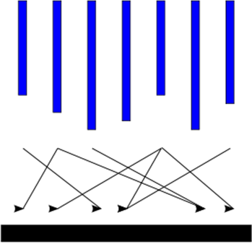
Computation Model
Input
Supersteps
(a sequence of iterations)
Output

Slide 29
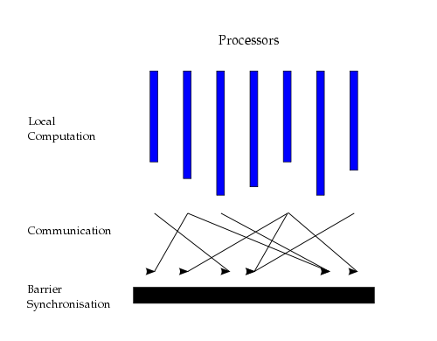
Computation Model
“Think like a vertex”
Inspired by Valiant’s Bulk Synchronous Parallel model (1990)
Source: http://en.wikipedia.org/wiki/Bulk_synchronous_parallel

Slide 30
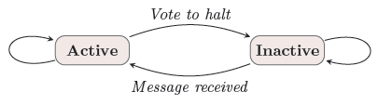
Computation Model
Superstep: the vertices compute in parallel
  Each vertex
    Receives messages sent in the previous superstep
    Executes the same user-defined function
    Modifies its value or that of its outgoing edges
    Sends messages to other vertices (to be received in the next superstep)
    Mutates the topology of the graph
    Votes to halt if it has no further work to do
  Termination condition
    All vertices are simultaneously inactive
    There are no messages in transit

Slide 31
Intermission

Slide 32
Example: SSSP – Parallel BFS in Pregel
∞
∞
1
10
0
2
3
9
4
6
5
7
∞
∞
2

Slide 33
Example: SSSP – Parallel BFS in Pregel
∞
∞
∞
1
10
10
∞
∞
∞
0
∞
2
3
9
4
6
5
∞
7
∞
5
∞
∞
2
∞

Slide 34
Example: SSSP – Parallel BFS in Pregel
10
∞
1
10
0
2
3
9
4
6
5
7
5
∞
2

Slide 35
Example: SSSP – Parallel BFS in Pregel
10
11
∞
1
14
10
8
0
2
3
9
4
6
5
12
7
5
∞
2
7

Slide 36
Example: SSSP – Parallel BFS in Pregel
8
11
1
10
0
2
3
9
4
6
5
7
5
7
2

Slide 37
Example: SSSP – Parallel BFS in Pregel
8
9
11
1
10
13
0
14
2
3
9
4
6
5
7
15
5
7
2

Slide 38
Example: SSSP – Parallel BFS in Pregel
8
9
1
10
0
2
3
9
4
6
5
7
5
7
2

Slide 39
Example: SSSP – Parallel BFS in Pregel
8
9
1
10
0
2
3
9
4
6
5
7
13
5
7
2

Slide 40
Example: SSSP – Parallel BFS in Pregel
8
9
1
10
0
2
3
9
4
6
5
7
5
7
2

Slide 41
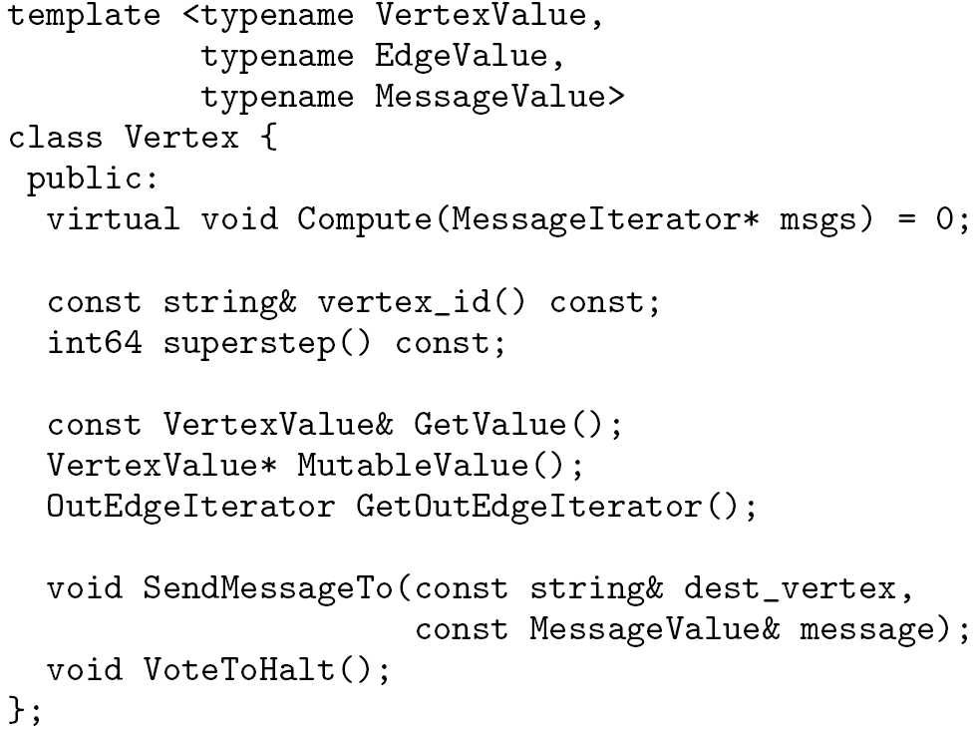
C++ API
Writing a Pregel program
  Subclassing the predefined Vertex class
Override this!
in msgs
out msg

Slide 42
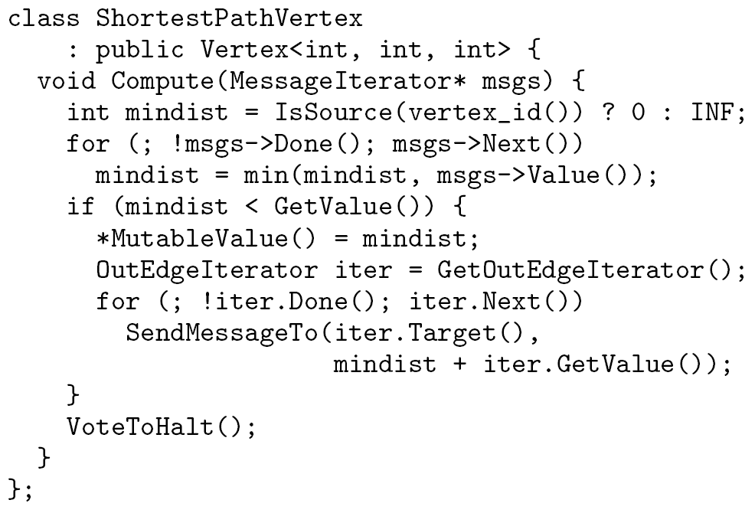
Example: Vertex Class for SSSP

Slide 43
System Design
Pregel system also uses the master/worker model
  Master
    Maintains worker
    Recovers faults of workers
    Provides Web-UI monitoring tool of job progress
  Worker
    Processes its task
    Communicates with the other workers
Persistent data is stored as files on a distributed storage system (such as GFS or BigTable)
Temporary data is stored on local disk

Slide 44
Execution of a Pregel Program
Many copies of the program begin executing on a cluster
The master assigns a partition of input to each worker
  Each worker loads the vertices and marks them as active
The master instructs each worker to perform a superstep
  Each worker loops through its active vertices & computes for each vertex
  Messages are sent asynchronously, but are delivered before the end of the superstep
  This step is repeated as long as any vertices are active, or any messages are in transit
After the computation halts, the master may instruct each worker to save its portion of the graph

Slide 45
Fault Tolerance
Checkpointing
  The master periodically instructs the workers to save the state of their partitions to persistent storage
    e.g., Vertex values, edge values, incoming messages
Failure detection
  Using regular “ping” messages
Recovery
  The master reassigns graph partitions to the currently available workers
  The workers all reload their partition state from most recent available checkpoint

Slide 46
Experiments
Environment
  H/W: A cluster of 300 multicore commodity PCs
  Data: binary trees, log-normal random graphs (general graphs)
Naïve SSSP implementation
  The weight of all edges = 1
  No checkpointing

Slide 47
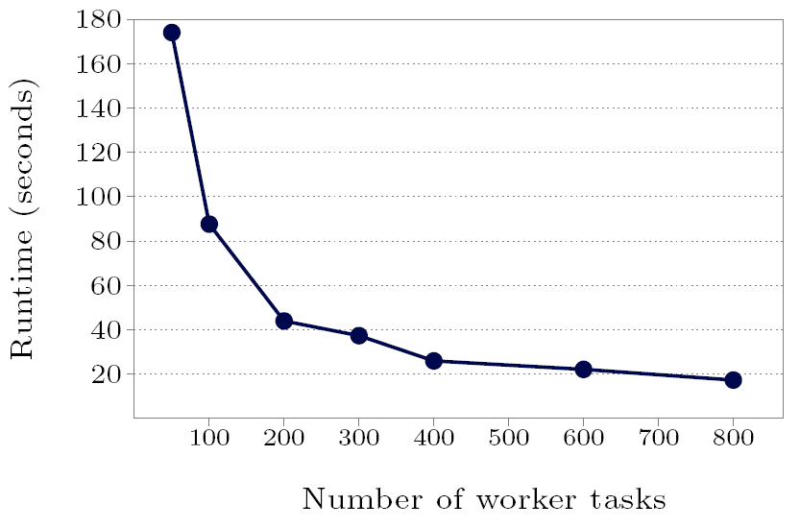
Experiments
SSSP – 1 billion vertex binary tree: varying # of worker tasks

Slide 48
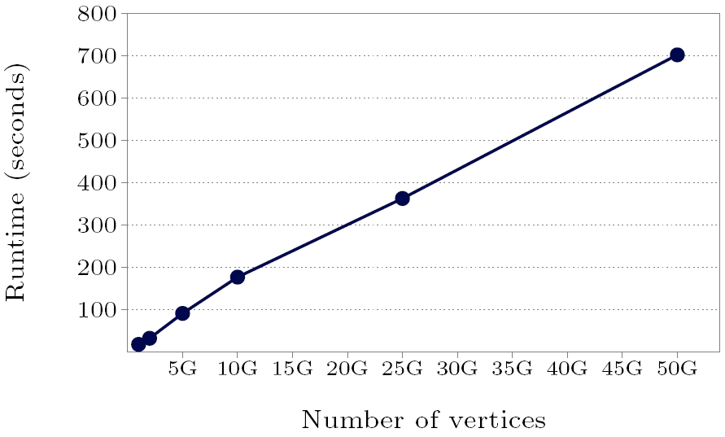
Experiments
SSSP – binary trees: varying graph sizes on 800 worker tasks

Slide 49
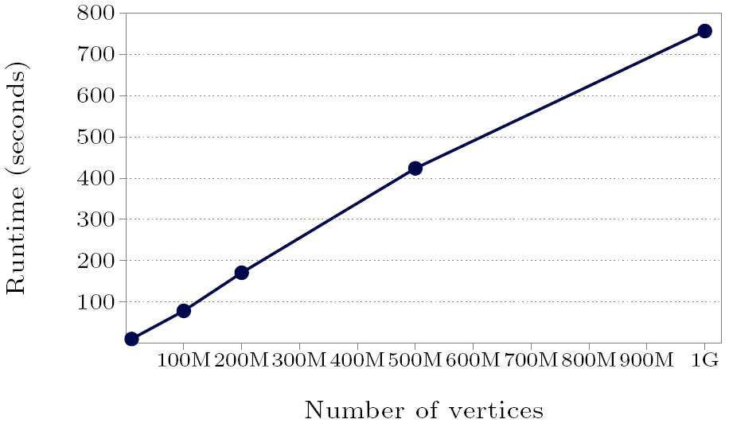
Experiments
SSSP – Random graphs: varying graph sizes on 800 worker tasks

Slide 50
Differences from MapReduce
Graph algorithms can be written as a series of chained MapReduce invocation
Pregel
  Keeps vertices & edges on the machine that performs computation
  Uses network transfers only for messages
MapReduce
  Passes the entire state of the graph from one stage to the next
  Needs to coordinate the steps of a chained MapReduce

Slide 51
MapReduce vs Graph Processing
When to use MapReduce vs Graph Processing Frameworks?
  Two models can be reduced to each other
  MR on Pregel: Every vertex to every other vertex
  Pregel on MR: Similar to PageRank on MR
Use graph fw for sparse graphs and matrixes
  Comm. limited to small neighborhood (partitioning)
  Faster than the shuffle/sort/reduce of MR
  Local state kept between iterations (side-effects)

Slide 52
MapReduce vs Graph Processing (2)
Use MR for all-to-all problems
  Distributed joins
  When little or no state between tasks (otherwise have to written to disk)
Graph processing is middleground between message passing (MPI) and data-intensive computing

Slide 53
Backup Slides

Slide 54
Pregel vs GraphLab
Distributed system models
  Asynchronous model and Synchronous model
  Well known tradeoff between two models
    Synchronous: concurrency-control/failures easy, poor perf.
    Asynchronous: concurrency-control/failures hard, good perf.
Pregel is a synchronous system
  No concurrency control, no worry of consistency
  Fault-tolerance, check point at each barrier
GraphLab is asynchronous system
  Consistency of updates harder (sequential, vertex)
  Fault-tolerance harder (need a snapshot with consistency)

Slide 55
Pregel vs GraphLab (2)
Synchronous model requires waiting for every node
  Good for problems that require it
  Bad when waiting for stragglers or load-imbalance
Asynchronous model can make faster progress
  Some problems work in presence of drift
  Fast, but harder to reason about computation
  Can load balance in scheduling to deal with load skew

