Slide 1
Diamond Square
Apollo Ellis

Slide 2
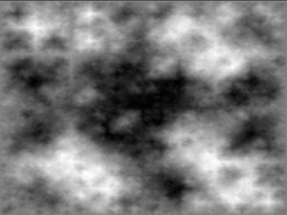
Idea
Generate height field by subdividing quads while assigning random values to the quad corners.
Output is a 2D noise function
Values vary largely at first
Generating “Features”
Values vary less when closer together
Features are defined by smaller features
Can be thought of as recursion

Slide 3
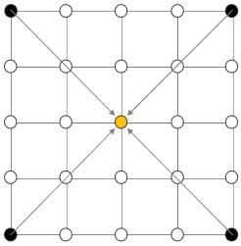
Depth first recursive approach
Initialize corners to random values
Two steps to each recursive layer
First, Diamond step
Propagate values diagonally
Average corners into the center
Add a perturbation discussed next

Slide 4
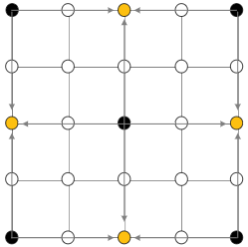
Depth first recursive approach
Two steps to each recursive layer
Second, Square Step
Propagate values horizontal and vertically
Fill in the midpoint of the quad edges
Use the 4 adjacent values
Note with depth first it will be 3 values

Slide 5
Perturbation
At each recursive step we must add a random perturbation to the computed averages. This gives us some variance
Perturbation is random within some “range”
Range gets smaller with each recursive step
I.E. Things vary less as they get closer together
Example using a smoothness value
RangeNext = RangeCurrent * 2^(-smoothness);

Slide 6
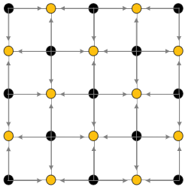
Depth first recursion caveats
As mentioned every point generated in square step uses only 3 surrounding values
Other values aren’t available yet
If we recurse depth first on the upper left
These points don’t exist yet

Slide 7
Depth first recursion caveats
What happens when we recurse upper right?
This point already has a value
It was already used by upper left recursively

Slide 8
Breadth first recursive approach
Loop over all quads at each level setting diamond values
Loop over all quads at each level setting square values
Recurse on the next level
Caveat, a little trickier to implement

Slide 9
Code for diamond step
diamondSquare(min,max,length){
for(int i = min; i < max ; i+= length)
for(int j = min; j < max ; j+=length){
float ll = height[i][j] //lower left
float lr = height[i][j+length] //lower right
float ur = height[i+length][j+length] //upper right
float ul = height[[i+length][j] //upper left
height[i+length/2][j+length/2] = (ll +lr +ur + ul) / 4 + perturb
//Square step is trickier
//Recurse
}

