Slide 1
CS 418 Practice Exam 2
Slides by Sidney Oderberg

Slide 2
Question 1

Slide 3
Answer
The image to the left shows how to get (s,t) from (u,v) for Nearest Neighbor Filtering.
0.25 x 64 – 0.5 = 15.5 -> 16
0.75 x 64 – 0.5 = 47.5 -> 48

Slide 4
Question 2

Slide 5
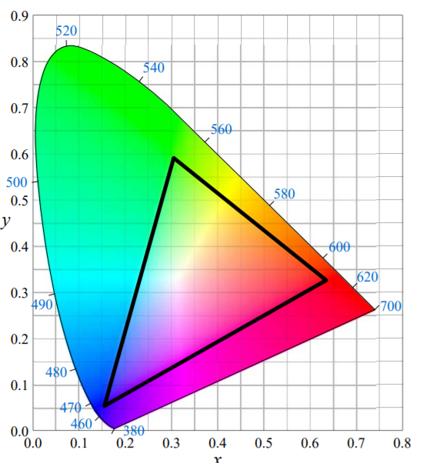
Answer
The HSV color space is another way to represent the RGB color space. The RGB color space doesn’t include all the colors we can see because it is created linearly combining three colors from the horseshoe shape shown at the left. There are clearly colors outside of the triangle that represents all the colors of RGB, so HSV is also limited to those colors.

Slide 6
Question 3

Slide 7
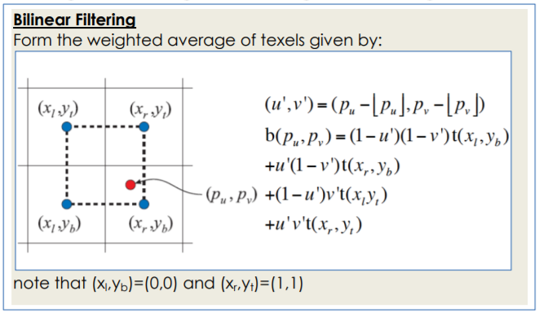
Answer
Bilinear filtering finds the closest four texels to get an average.

Slide 8
Question 4

Slide 9
Answer
To make the object appear shinier, the specular component of the Phong model needs to be increased. Decreasing the alpha exponent (answer (a)) will cause the specular highlight to be bigger but this is not the same as making the object shinier. Answers (c) and (e) only affect the diffuse component, so they don’t make the object shinier. Answer (d) will have the opposite effect, so answer (b) is the most direct way to increase the shininess.

Slide 10
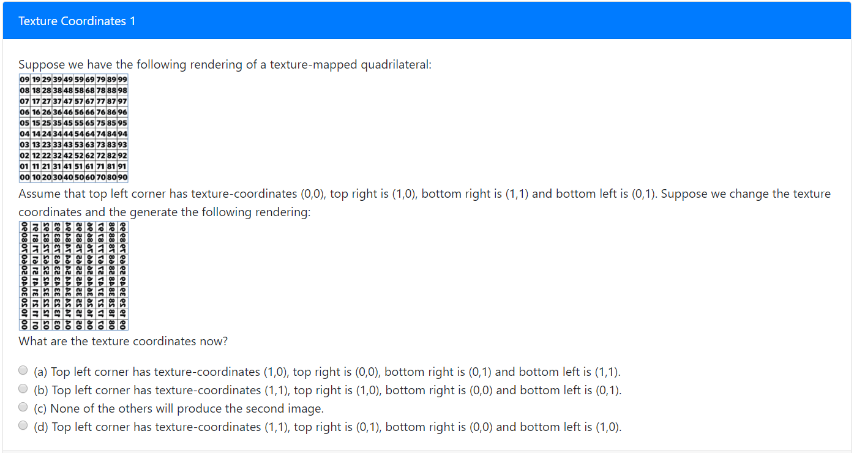
Question 5

Slide 11
Answer
To go from the first image to the second image, the first image is mirrored along a diagonal going from the bottom left to the top right. This means the texture coordinates in the top left and bottom right switch, while those in the bottom left and top right stay the same.

