Slide 1
Lab 9
CS 418: Interactive Computer Graphics
UNIVERSITY OF ILLINOIS AT URBANA-CHAMPAIGN
Eric Shaffer

Slide 3
Goals
Things you will need to do include:
Learn how to asynchronously fetch an image.
Learn how to create a Texture Cube.
Learn how to easily apply the Texture to a Sphere.
All of this code will be useful for MP3.

Slide 4
Async Image File Loading.
No Different from getting a Text File
No need for parsing too!
We need to get a Texture for each face of the Cube.
How? What is the order of the requests?

Slide 5
function handleTextureLoaded(image, face)
Called each time a texture has loaded.
Have to assign each texture to the appropriate face.
Start by binding the Texture Cube.
Then, bind each face.

Slide 6
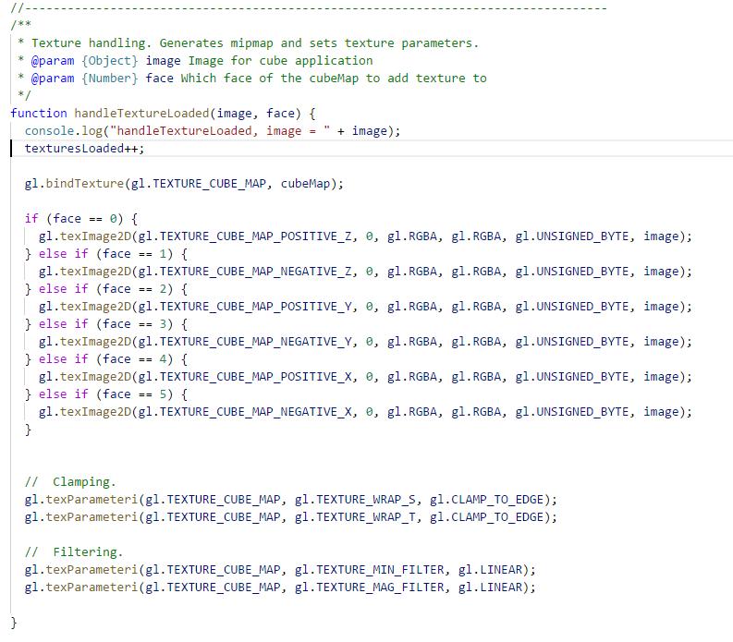
Every time a texture is loaded, increment the textures count.
Bind the CubeMap.
Check which face we have to fill.
Set up the clamping and filtering.

Slide 7
function setupSphereBuffers
What do we have to setup to render a sphere?
Look in simpleModelling.js – which function gives you a sphere?
What arrays do you need for just the sphere?
For lighting?

Slide 8
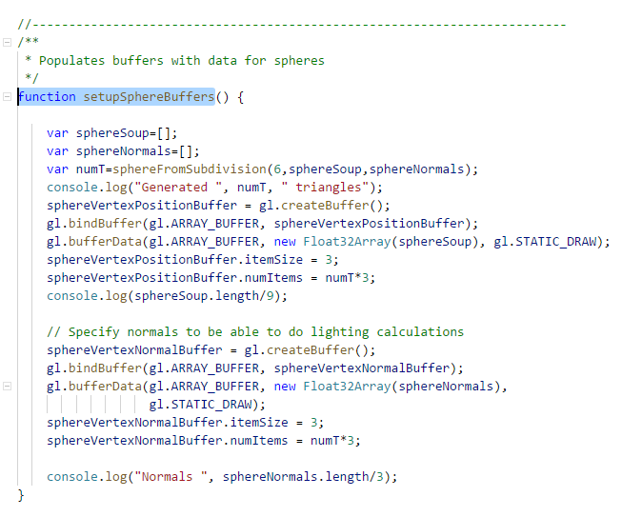
Get the Sphere from Subdivision.
Create a buffer for vertices.
Populate the buffer.
Set the itemSize and numItems.
Create a buffer for the normals.
Populate the buffer.
Set the itemSize and numItems.

Slide 9
function drawSphere
We have the vertices and normals.
What do we have to do to render a sphere?
How do we apply a texture?

Slide 10
Bind the Vertex Array to the Vertex Position Attribute.
Bind the Normal Array to the Normal Position Attribute.
Set the Texture to be used.

Slide 11
Vertex Shader Time.
What do we have to do in the Vertex Shader?

Slide 12
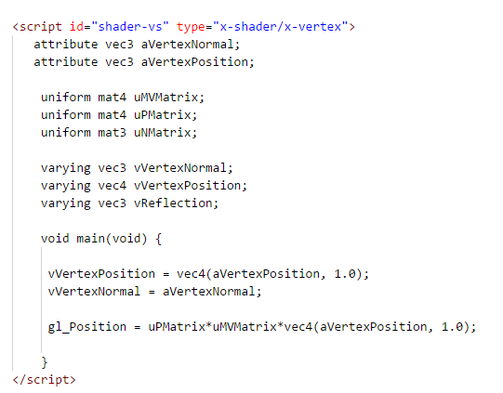
Set the gl_Position.
Also, send the vertexPosition and vertexNormal to the fragment shader.

Slide 13
Fragment Shader Time
How do you sample a Texture Cube? Any ideas?

Slide 14
Sample the Cube using the normalized vertex position to map the Cube to the Sphere!

Slide 15
