Slide 1

Lab 6
CS 418: Interactive Computer Graphics
UNIVERSITY OF ILLINOIS AT URBANA-CHAMPAIGN
Eric Shaffer

Slide 2
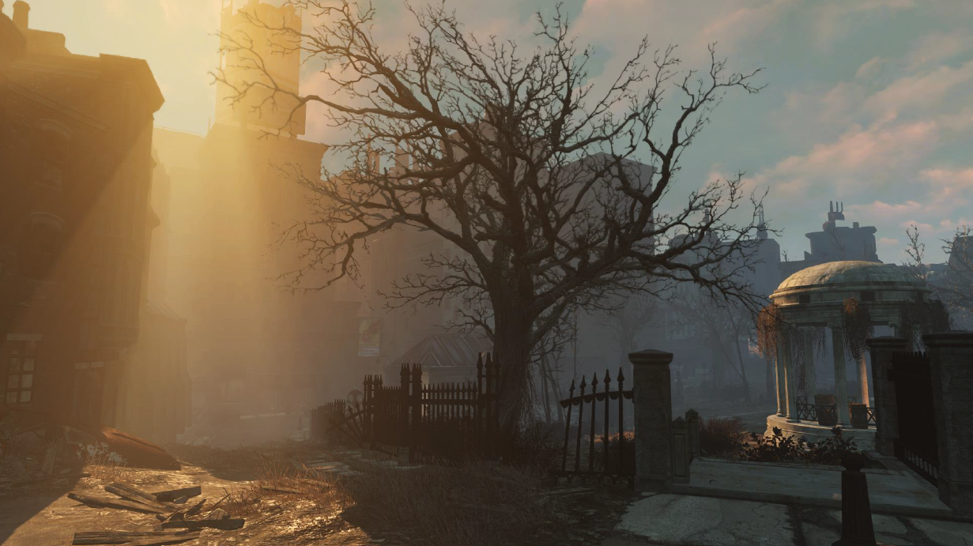
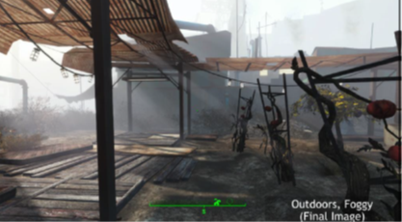
Fog
Fog is an example of participating media
These are typically some sort of particulate
Scatters and otherwise changes light
There are a number of sophisticated ways to render such phenomena
…we’ll use a simple one
For something complex, check out
http://www.gdcvault.com/play/1023519/Fast-Flexible-Physically-Based-Volumetric

Slide 3
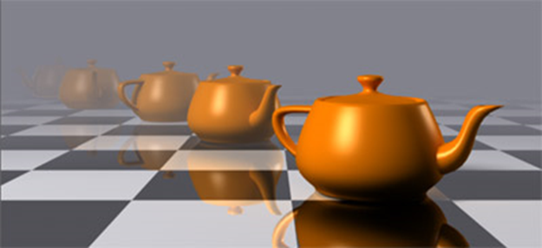
Distance Fog
Just mix a fragment color with a fog color
The farther the fragment from the viewer, more fog color
…and less original color

Slide 4
Fog in WebGL and GLSL
We implement fog in the fragment shader
Compute the distance from fragment to camera
And define a fog color
  White is a good choice…especially with a white background
float fogCoord = (gl_FragCoord.z/gl_FragCoord.w);
vec4 fogColor = vec4(1.0, 1.0, 1.0, 1.0);

Slide 5
Mixing in Fog
Use linear interpolation to mix fog with the fragment color
fragColor is the color computed by your shading equation
  Probably Blinn-Phong
The mix function is built-in GLSL function that performs lerp
But what is fogFactor?
gl_FragColor = mix(fogColor, fragColor, fogFactor );

Slide 6
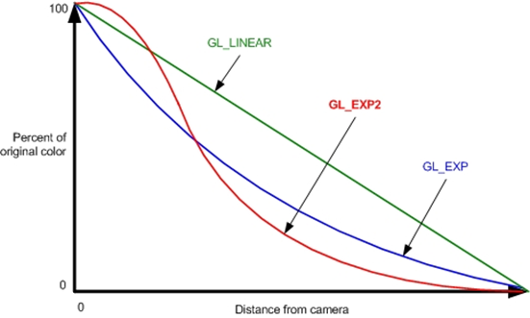
Fog Factor
const float LOG2 = 1.442695;
float fogDensity = 0.0005
float fogFactor = exp2( -fogDensity * fogDensity * fogCoord * fogCoord * LOG2 );
fogFactor = clamp(fogFactor, 0.0, 1.0);
Fog factor determines how much of the color is fog
  A value of 1 means all fog in this case…a value of 0 means no fog
You can see the curve below…we’re computing GL_EXP2

Slide 7
Fog Factor Debugging
In case you have trouble,
try just implementing the linear curve for the fogFactor…see if that works.
Can also render your fogCoord values
  Compute z=fogCoord/farClipDistance;
  Set gl_FragColor to (z,z,z, 1.0)
  See if the image makes sense

Slide 8
Representing Orientations
Rotating a vector around itself does not change it
Rotating an object around its principal direction changes its orientation
Orientations require more information to represent than a vector

Slide 9
Representing Orientations
No simple means of representing a 3D orientation
Unlike position and Cartesian coordinates
There are several popular options:
Euler angles
Rotation vectors (axis/angle)
3x3 matrices
Quaternions

Slide 10
Euler Angles
Airplane orientation
  Roll
    rotation about x
    Turn wheel
  Pitch
    rotation about y
    Push/pull wheel
  Yaw
    rotation about z
    Rudder (foot pedals)
Airplane orientation
  Rx(roll) Ry(pitch) Rz(yaw)
z
y
x

Slide 11
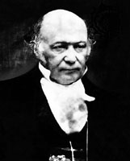
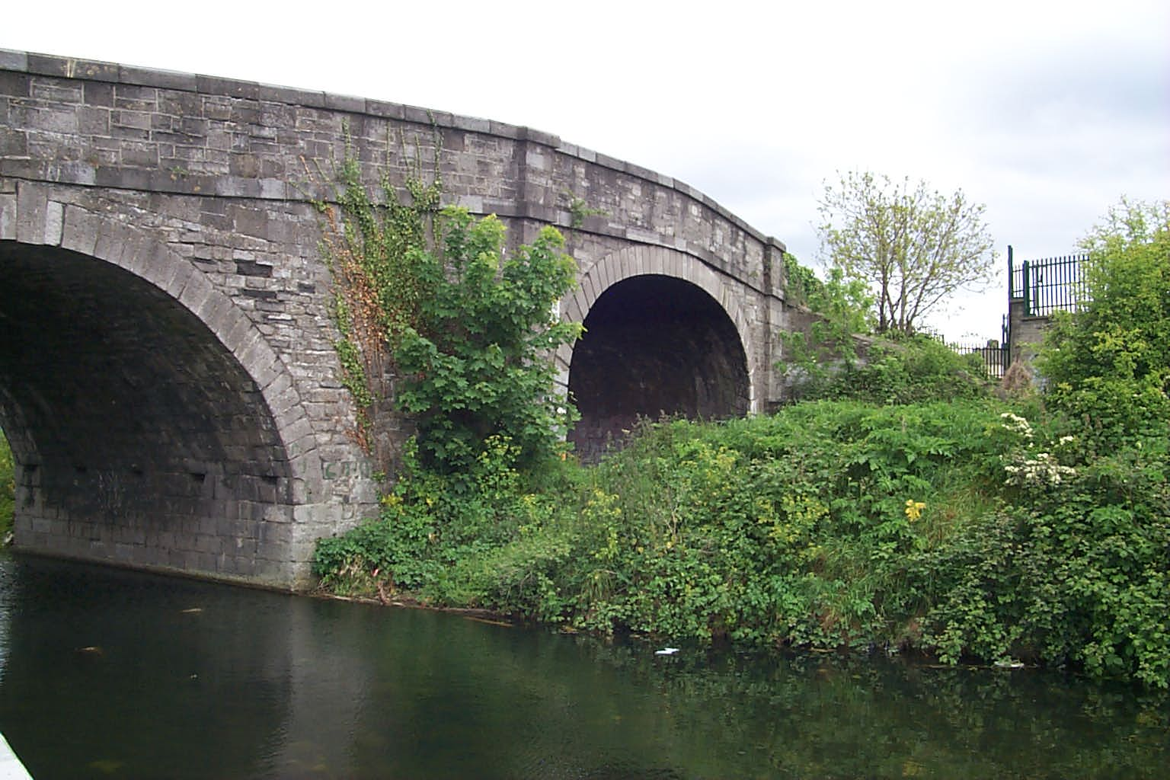
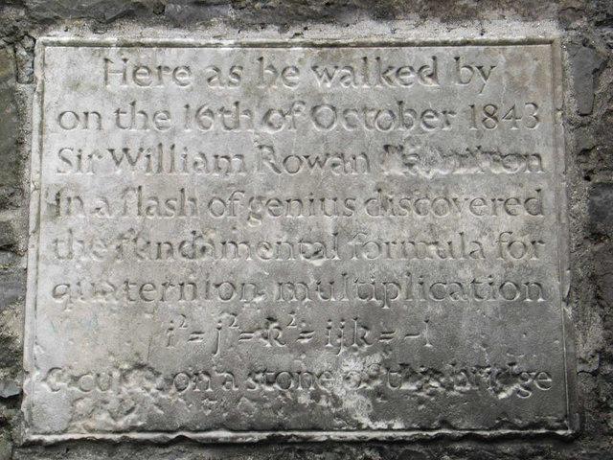
Quaternions
Developed by Sir William Rowan Hamilton [1843]
Quaternions are 4-D numbers
With one real axis
And three imaginary axes: i,j,k
Imaginary-style multiplication rules
Hamilton Math Inst.,
Trinity College

Slide 12
Quaternions
Introduced to Computer Graphics by Shoemake [1985]
Given an angle and axis, easy to convert to and from quaternion
  Euler angle conversion to and from arbitrary axis and angle difficult
Quaternions allow stable and constant interpolation of orientations
  Cannot be done easily with Euler angles

Slide 13
Unit Quaternions
For convenience, we will use only unit length quaternions
These correspond to the set of 4D vectors
They form the ‘surface’ of a 4D hypersphere of radius 1

Slide 14
Quaternions as Rotations
A quaternion can represent a rotation by angle θ around a unit vector a:
If a is unit length, then q will be also

Slide 15
Rotation using Quaternions
Let q = cos(θ/2) + sin(θ/2) u be a unit quaternion: |q| = |u| = 1
Let point p = (x,y,z) = x i + y j + z k
Then the product q p q⁻¹ rotates the point p about axis u by angle θ
Inverse of a unit quaternion is its conjugate
(negate the imaginary part)
q⁻¹ = (cos(θ/2) + sin(θ/2) u)⁻¹
= cos(-θ/2) + sin(-θ/2) u
= cos(θ/2) – sin(θ/2) u
Composition of rotations q₁₂ = q₁ q₂ ≠ q₂ q₁
We haven’t talked about how to multiply quaternions yet, but don’t worry about that for now…
θ
u
p
q p q⁻¹

Slide 16
Quaternion to Matrix
Again, why do we want to be able to do this?
To convert a quaternion to a rotation matrix:

Slide 17
Quaternion Multiplication
We can perform multiplication on quaternions
  we expand them into their complex number form
If q represents a rotation and q’ represents a rotation, qq’ represents q rotated by q’
This follows very similar rules as matrix multiplication (I.e., non-commutative)

Slide 18
Quaternion Multiplication
Two unit quaternions multiplied together results in another unit quaternion
This corresponds to the same property of complex numbers
Remember(?) multiplication by complex numbers is like a rotation in the complex plane
Quaternions extend the planar rotations of complex numbers to 3D rotations in space

Slide 19
Flight: Orientation
Lots of ways to implement flight…
MP requires the use of quaternions
One option to change orientation:
  Set up an initial view using mat4.lookat
  Keep a quaternion that records current orientation
  Each frame:
    Capture key presses as Euler angles
    Construct a temporary quaternion based on the Euler angles.
      quat.fromEuler in glMatrix library…get current release!
    Update the orientation quaternion using the temp
      How?
    Update the view matrix using the orientation quaternion
      How?

Slide 20
Flight: Moving Forward
Keep a user set speed factor
  User can adjust
Move in the direction of the current orientation
  By speedFactor*directionVector
  You’ll need to experiment to find appropriate speedFactor
What’s the current directionVector?
  Think about how you could compute it….

