Slide 1
Lab 10
CS 418: Interactive Computer Graphics
UNIVERSITY OF ILLINOIS AT URBANA-CHAMPAIGN

Slide 2
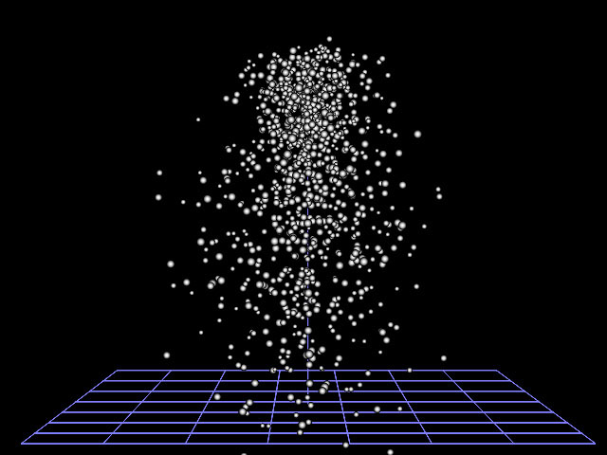
MP 4
Goal: Write a simple particle system using WebGL.
Particle systems are typically used to model fine-grained physical effects like fire, smoke, and water. ​We will do something simpler and just render a system of bouncing spheres

Slide 3
Implementing Particles
Consider using a JS class to represent a sphere.
https://developer.mozilla.org/en-US/docs/Web/JavaScript/Reference/Classes
Each sphere object should have
Position
Velocity
Acceleration
Color
Radius
…anything else you want to add…
Keep a JS array for sphere objects
Iterate over the array every frame and draw each sphere

Slide 4
Implementing Particles
You should shade using Phong or Blinn-Phong reflectance
You can pass the sphere color as a uniform for spheres with a single color
You need only generate the triangles for a sphere once
See the code in simpleModeling.js
Just a keep one buffer of sphere geometry!
Use transformations to position and scale the sphere
All sphere objects use the same triangle buffer to render

Slide 5
Implementing Physics
You will implement two forces:
Gravity
Friction
Each frame you will, for each sphere:
Draw
Use the forces to update the acceleration
Use the acceleration to update the velocity
Use the velocity to update the position
Use real time! Or a scaled version of real time

Slide 6
Implementing Collision Detection
Spheres bounce around a box
You need to implement sphere-plane collision detection
Can be very simple with axis-aligned walls!
Do not need to implement sphere-sphere
But you can…
Why is this harder?
When a collision is detected need to
Find point of impact
Compute new velocity vector for sphere
Basically just need to use fact that angle of reflection will be angle between velocity vector and wall normal
Reflect vector around normal…

